Slide 1
VOCL-FT: Introducing Techniques for Efficient Soft Error Coprocessor Recovery
Antonio J. Peña, Wesley Bland, Pavan Balaji

Slide 2
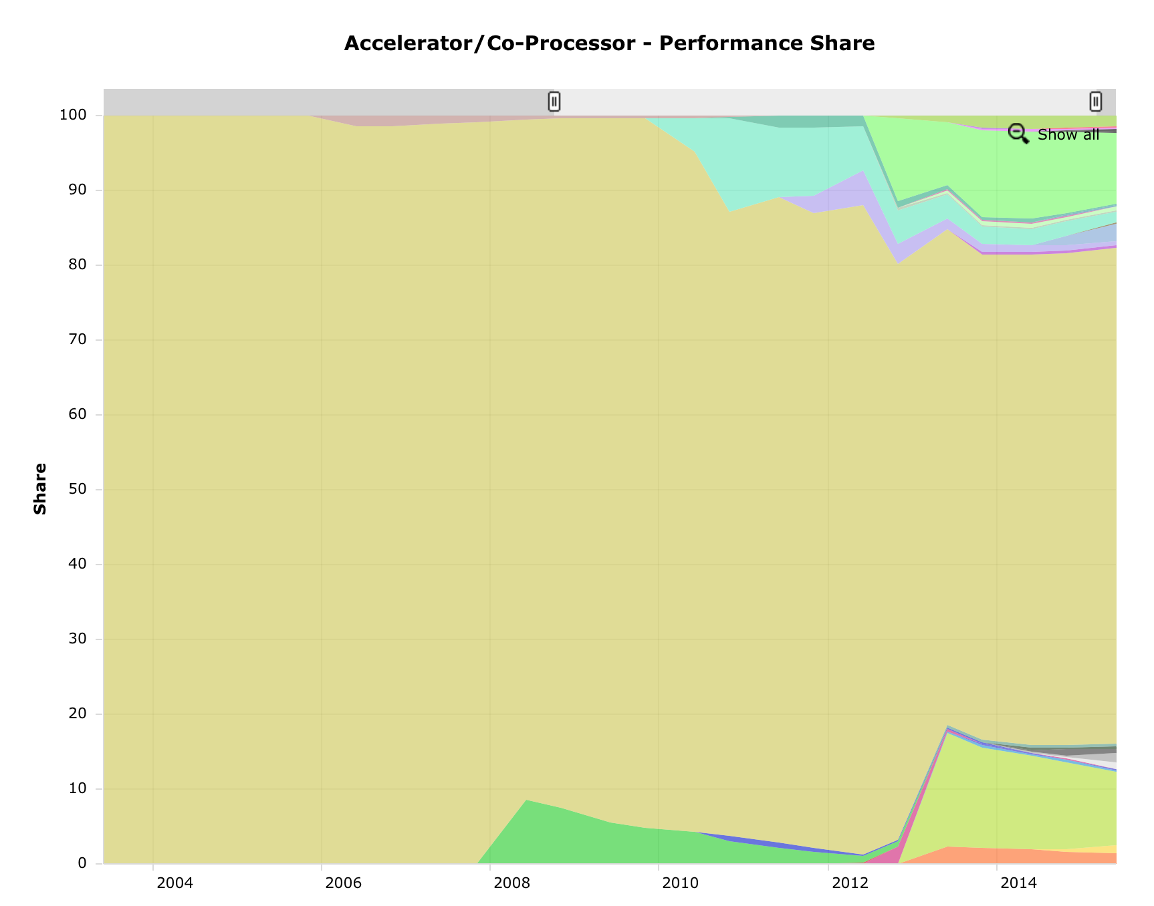
Background
We can see that coprocessors are a clear trend in HPC
About 34% of the performance on the November Top500 list (18% of the systems)
We generally accept that fault tolerance is becoming a growing issue
No Accelerator
All Others
Image Courtesy of top500.org/statistics/overtime/

Slide 3
Fault Tolerance Research Areas
Hard Errors
Soft Errors
Focus on full-system restart/recovery
“Upgrades” errors to be fail-stop
Often uses checkpoint/restart to roll-back to last good state
Detects errors in CPU memory
Possibly corrects errors via redundancy/ABFT methods
Sometimes looks at I/O errors
Little focus on coprocessors

Slide 4
Fault Tolerance on Coprocessors
5% of errors on Tsubame 2.5 are double-bit ECC errors in GPU memory
Average of one every 2 weeks
Other machines see rates as high as .8 per day
These rates will probably continue to rise
Some resilience work has started in this area:
DS-CUDA performs redundant computation.
Hauberk inserts SDC detectors into code via source-to-source translation and uses checkpoint/restart.
Snapify provides checkpoint/restart with migration on Intel® Xeon Phi™,
CheCUDA and CheCL use checkpoint/restart to handle full-system failures.
None focus on automatic, in-place recovery for coprocessors.

Slide 5
What we propose
Generic techniques to provide efficient error recovery from offload-like APIs
Automatic fault detection and recovery for soft errors
Automatic checkpointing in synchronization points
Start with something that looks like checkpoint/restart
Take advantage of optimizations to avoid unnecessary checkpoints and minimize the footprint
As an example, we extend the existing VOCL library to support fault tolerance (VOCL-FT) based on uncorrected ECC error detection

Slide 6
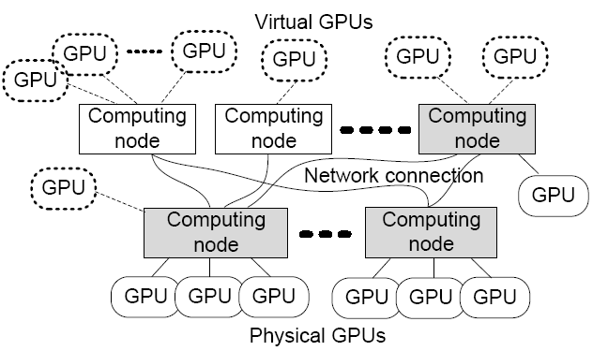
What is VOCL?
Compute Node
Compute Node
Application
VOCL Proxy
Virtual OpenCL
Transparent utilization of remote GPUs
Efficient GPU resource management:
Migration (GPU / server)
Power Management: pVOCL
OpenCL API
OpenCL API
Native OpenCL Library
Native OpenCL Library
Physical GPU
Physical GPU
Traditional Model
Compute Node
Compute Node
Application
VOCL Proxy
OpenCL API
OpenCL API
VOCL Library
Native OpenCL Library
Virtual GPU
Virtual GPU
Physical GPU
VOCL Model

Slide 7
The Basic Idea
Host2Dev
Check for ECC errors once the code reaches a synchronization point
If an uncorrected error occurs, replay the commands since the last sync. point again
Specifically for accelerator memory
Host memory can be protected by other, existing tools
Epoch
Kernel
Replay
Dev2Host
Sync. point
Error?
Yes
No
Notes:
The concept of epochs and sync. points is important - data consistency

Slide 8
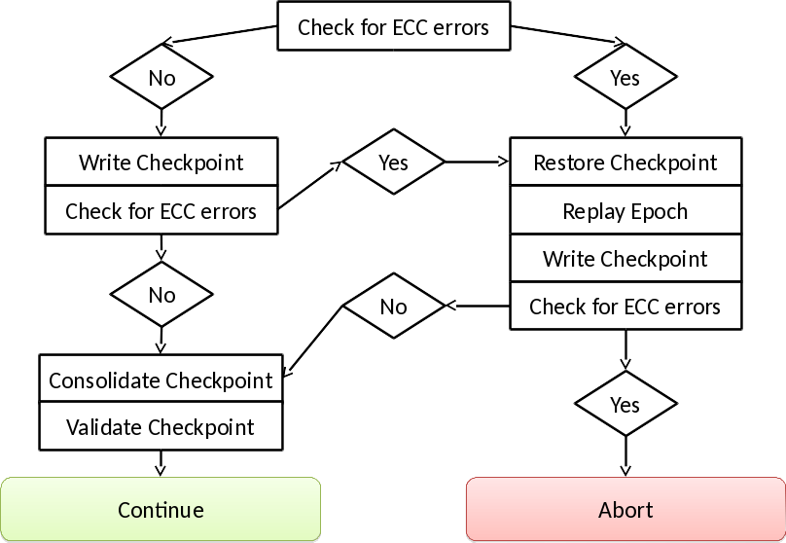
A More Complete Picture
Notes:
You could mention here that this is not so easy, explain the double-checkpoint files (consolidate & validate checkpoint), etc.

Slide 9
Execution Logging
Transferred data and commands logged to temporary storage
Uses asynchronous transfers and pinned host buffers to reduce performance impact
Only backup data that can’t be restored from user memory
Data is logged as it is written
Not only at synchronization points
Prevents in/out buffers from being corrupted
Saves an extra copy to and from the backups
writeToDevice(&a);
kernel();
readFromDevice(&a);
checkForECCErrors(); createCheckpoint(a);
ECC Error
a is already corrupted

Slide 10
Failure Detection / Recovery
Use ECC memory protection to detect errors
Use NVIDIA® Management Library (NVML) to query for memory errors
Provides counter of total ECC errors (no locality information)
Recovery happens by replaying logs

Slide 11
That’s the easy part…
The interesting work comes in the optimizations

Slide 12
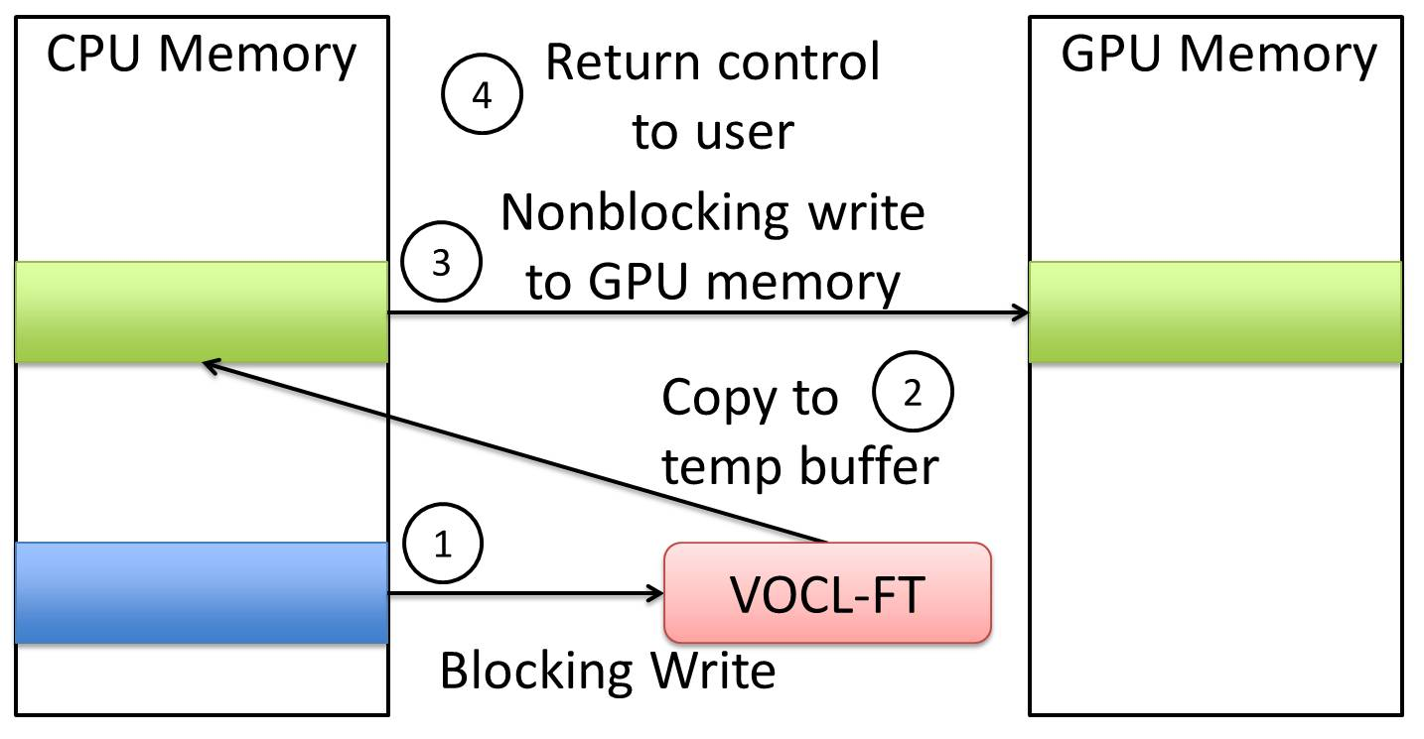
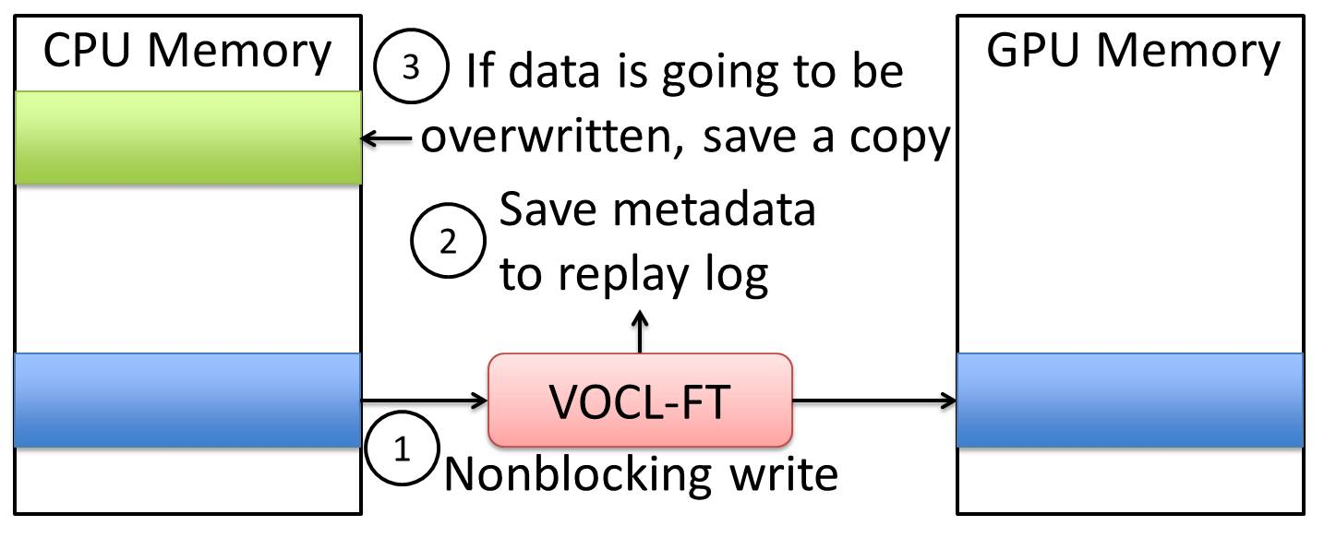
Don’t Make Extra Checkpoints
Only checkpoint data that’s actually changed
If data hasn’t changed, don’t checkpoint it (MOD)
If data is read-only, don’t checkpoint it (RO)
Transform blocking writes into non-blocking writes and use temp buffer (MOD)
Use temp files for non-blocking writes (MOD)
Delay copying data for non-blocking writes until host data is overwritten with device data (HB)

Slide 13
Get More Information from the User
Read-Only Buffers (EAPI)
Scratch Buffers (SB)
Allow the user to specify buffers as read-only per epoch.
More fine-grained than specifying read-only for the lifetime of the object.
Only make logs, but not full checkpoints.
Don’t keep checkpoint after epoch.
If we replay, use the same buffer without reloading
Notes:
RO comes from the OpenCL API, a standard flag in the alloc. call
EAPI for per-epoch RO is unfortunate, since SB comes from an extended API as well
Note that these are the only two opts. that require API extension

Slide 14
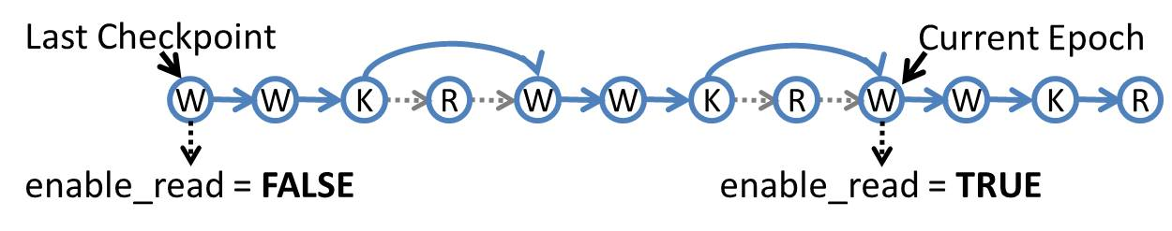
Reduce Synchronization
Host Dirty (HD)
Checkpoint Skip (CS)
Only write a checkpoint when host memory has been overwritten.
Reduces synchronization for unnecessary checkpoints.
Skip reading data from the device when a checkpoint is loaded.
Don’t write a checkpoint for every epoch.

Slide 15
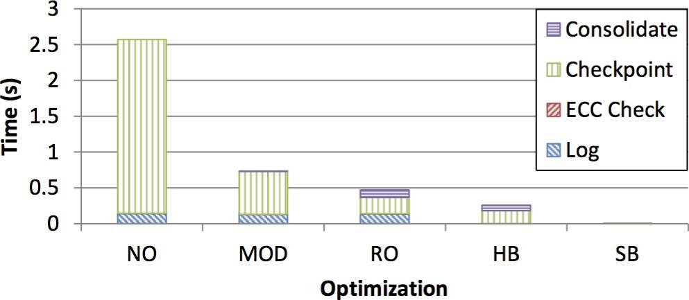
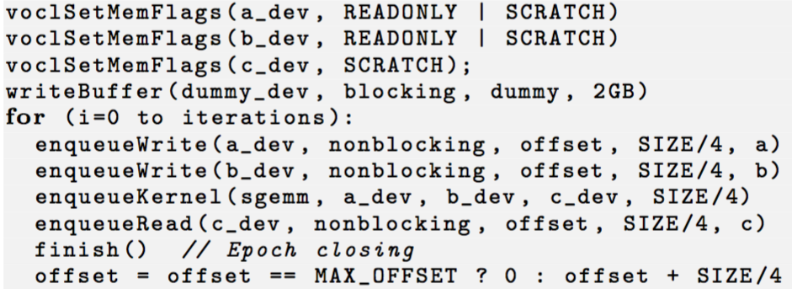
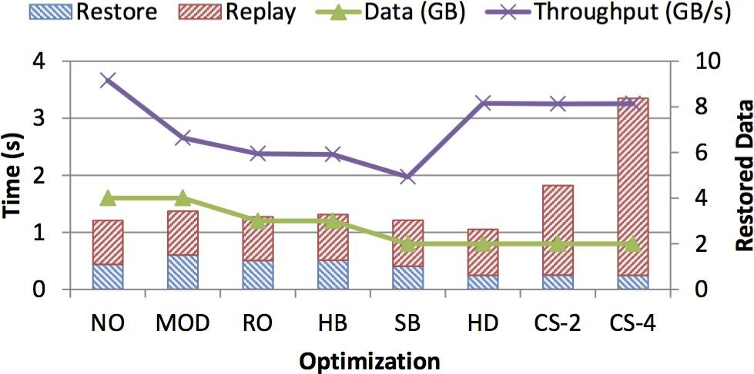
Single Node Evaluations
Failure-free Test
Simple microbenchmark test
Repeated matrix multiplication
Single Failure Recovery Time
NO = No Optimization, MOD = Unmodified Buffers, RO = Read-only Buffers, HB = Host Buffers, SB = Scratch Buffers, HD = Host Dirty, CS = Checkpoint Skip
Notes:
I/O write speeds are much better than advertised for small buffers (closer to 3.5 GB/s instead of 300 MB/s) because…
Note that we have a much more extensive performance evaluation in the paper

Slide 16
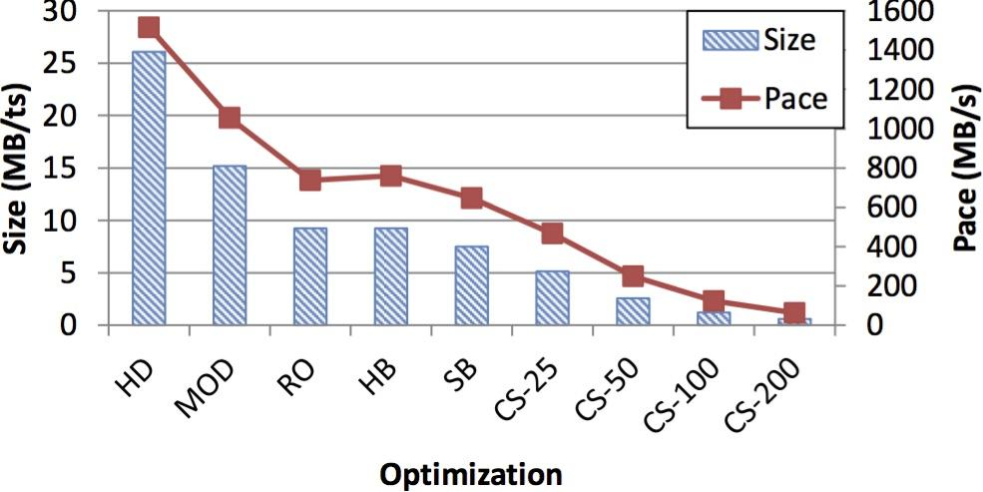
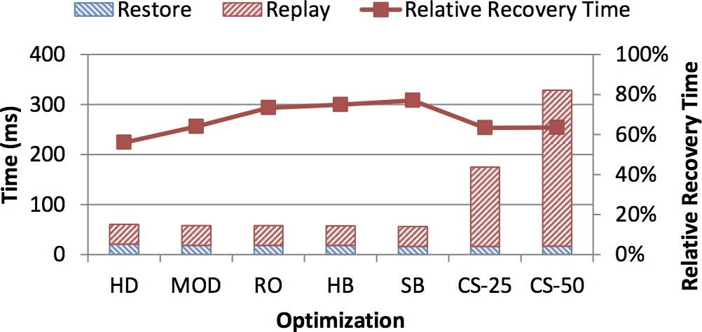
Single Node Evaluations
Checkpoint Size and Pace
MiniMD
Checkpoint sizes decrease dramatically with optimizations
Relative recovery time is roughly static
Execution overhead is under 10% with full optimizations
Other apps see overheads as low as 1% (Hydro)
Tradeoff between error rate and check period (CS-X)
Recovery Time
HD = Host Dirty, MOD = Unmodified Buffers, RO = Read-only Buffers, HB = Host-only Buffers, SB = Scratch Buffers, CS = Checkpoint Skip

Slide 17
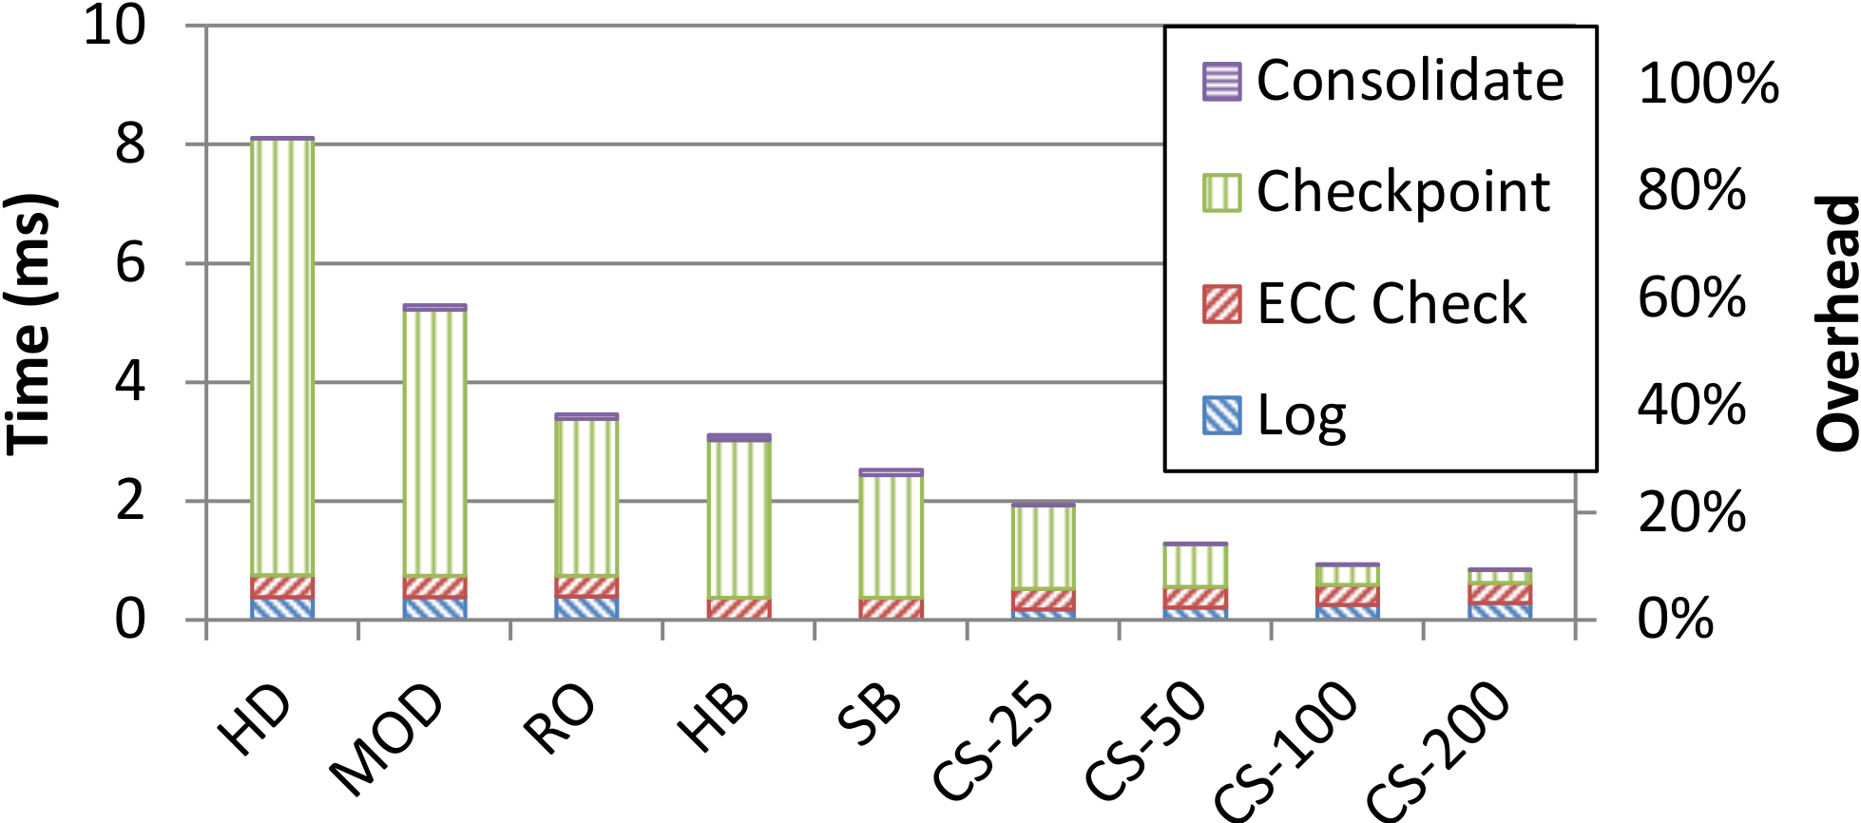
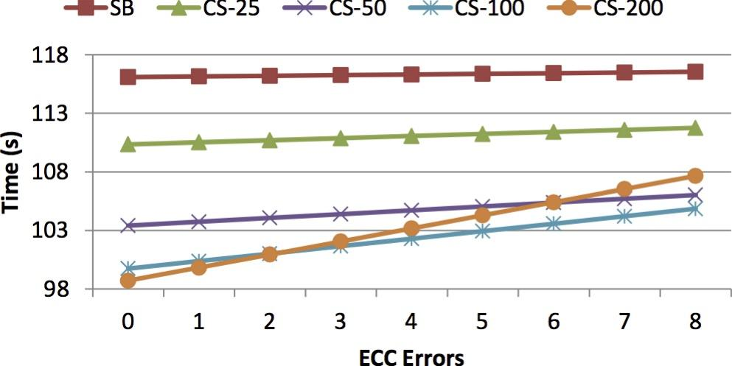
Single Node Evaluations
Error-Free Timestep Execution Time
MiniMD
Checkpoint sizes decrease dramatically with optimizations
Relative recovery time is roughly static
Execution overhead is under 10% with full optimizations
Other apps see overheads as low as 1% (Hydro)
Tradeoff between error rate and check period (CS-X)
Recovery for Multiple Faults (10K Timesteps)
HD = Host Dirty, MOD = Unmodified Buffers, RO = Read-only Buffers, HB = Host-only Buffers, SB = Scratch Buffers, CS = Checkpoint Skip

Slide 18
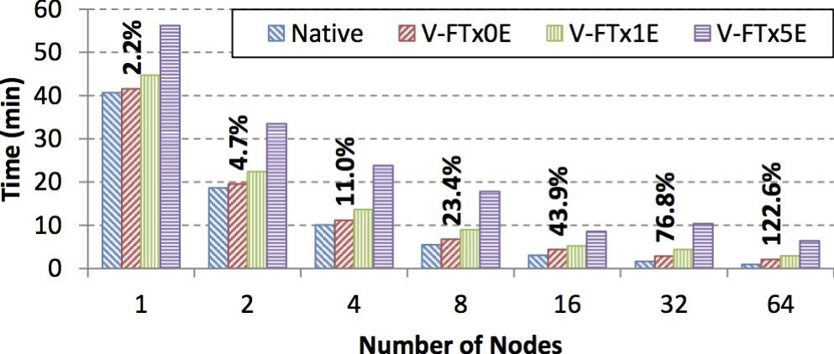
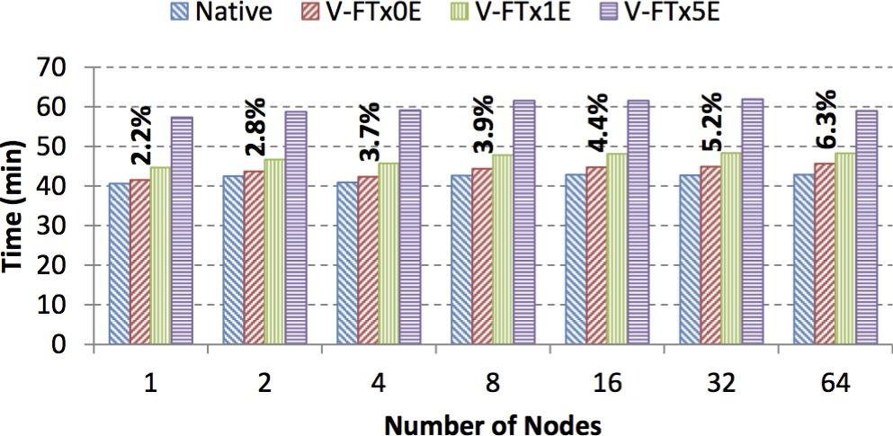
Multi Node Evaluations
Strong Scaling
Hydro
Native vs. full optimization without (x0E) and with (x1E & x5E) errors
Strong scaling get much worse because of lower CPU involvement
Weak scaling gets slightly worse because more communication creates more synchronization points
Weak Scaling

Slide 19
Conclusion
We created an efficient, automatic protection scheme for GPU memory.
Generic techniques that can be adopted by other similar offloading APIs (e.g. CUDA) and error detectors (ECC is just an example)
With minimal input from the user, performance impact can be very low.
With no impact to the user, performance can still be good.
Recovery times can also be relatively low depending on the trade-off for number of iterations between checkpoints.

Slide 20
Test Systems
Single Node
Multi Node
SuperMicro® SuperServer© 7047GR-TPRF
Intel® E5-2687W v2 octocore
3.4 GHz
64GB DDR3 RAM
NVIDIA® Tesla© K40m
Intel® S3700 SSD disks
HokieSpeed @ Virginia Tech
InfiniBand® QDR fabric
2x hexa-core Intel® Xeon© E5645
24GB RAM
2x NVIDIA® Tesla© M250
Intel® MPI 4.1

Slide 21
Questions?
antonio.pena@bsc.es
wesley.bland@intel.com
balaji@anl.gov

