Slide 1
Compiler-Assisted Overlapping of Communication and Computation in MPI Applications
Jichi Guo, Qing Yi (University of Colorado, Colorado Springs)
Jiayuan Meng (Google Inc)
Junchao Zhang, Pavan Balaji (Argonne National Laboratory)

Slide 2
Need for Asynchrony
Largest supercomputers in the world host millions of cores
The Sunway Taihulight machine has 10 million cores
Large variation in communication time between different nodes/cores
Several orders of magnitude in some cases
Physical distances are one reason for it
Network sharing and dynamism in communication routing is another reason
To synchronize or not to synchronize
In many applications, synchronization cannot be avoided: you cannot escape physical causality
But you can, sometimes, overlap such synchronization with other work

Slide 3
What are we trying to do?
Compiler assistance to handle MPI optimizations
Computation/communication overlap is the example considered in this paper
User assistance to help identify aspects that the compiler cannot automatically identify (e.g., buffer aliasing)
Goal:
User annotates the code with hints/guarantees
Compiler (which is tightly coupled with the MPI implementation) generates code that overlaps computation and communication that is suitable for that MPI implementation
Automatically adds autotuning hooks to improve performance
Alternative approach to high-level programming frameworks

Slide 4
Overlapping computation and communication
Goal: enhance performance portability of MPI applications
Network communication latency unpredictable a priori
No longer true --- equal work means equal time
Approach: overlap computation and communication from different loop iterations
Overlap Alltoall2 with Before3 and After1
Before1
Ialltoall1
Wait1
After1
Iteration 1
Before2
Ialltoall2
Wait2
Iteration 2
Before3
Ialltoall3
Iteration 3

Slide 5
Gotchas with Comm/Comp Overlap
Portability
Nonblocking variants of operations keep appearing in newer MPI standards
Nonblocking collectives are only 4 years old at this point
Nonblocking I/O routines are only an year old
New nonblocking operations are expected to appear in MPI-4
Performance tuning
Nonblocking operations do not always make automatic progress
Might need to poke the MPI implementation “once in a while”
How much to overlap?
More overlap means more resources (e.g., buffers)

Slide 6
Compiler Optimization challenges
Profitability --- where to optimize?
Where are the expensive communications?
Need to take sufficiently long to be overlapped
Is overlapping necessary?
Blocking communication is faster on fast network connections
Safety: are there computations to overlap?
Cannot violate dependence constraints
Need inter-procedural analysis
Need to consider runtime code path and data access patterns
How to perform the optimization?
May require replication of communication buffers
Need to insert MPI_Test at the right frequency to avoid slowdowns

Slide 7
Outline
Optimization workflow
Core Design
Hot path extraction and profitability analysis
Safety analysis with annotation
Tuning progress
Experiment results
Related work

Slide 8
Optimization Workflow
Input program
Input data and
number of processes
Analytical
performance modeling
(Using Roofline and LogGP models)
Bayesian execution tree
CCO analysis
(Profitability analysis & Safety analysis
with procedural annotation & inlining)
Optimization configuration
CCO optimization and tuning MPI_Test
Optimized code

Slide 9
Analytical Performance Modeling
main()
Find global communication hot spots
Through extensions to the Skope framework by Guo and Meng et. al
For each communication hot spot
Find its enclosing loops
Find local computation in the loops
NAS FT (1D layout)
54s
loop x6
1.6s
0.02s
evolve(x1)
fft(x1, x2)
checksum(x2)
branch 0D
0%
branch 1D
100%
branch 2D
0%
5.4s
4.2s
39s
4.5s
cffts1(x1)
cffts2(x1)
transpose(x1, x2)
cffts1(x1)
1.7s
37s
0.01s
transpose_local(x1)
MPI_Alltoall(x1, x2)
transpose_finish(x2)

Slide 10
Example Hot Communication path
Communication hot spots
MPI blocking communication
Point-to-point
Collective
Computation hot spots
Loops of CPU or memory intensive arithmetic computation
Clear separation of computation and communication
Comp => Comm => Comp => …
Reuse buffers across iterations
NAS FT (1D layout)
In
Loop
Computation
Before (I)
MPI_Alltoall (I)
Loop
(I = 1 … N)
Loop
Computation
After (I)
Out

Slide 11
Overlap computation and communication in the loop
Replace blocking MPI_Alltoall by MPI_Ialltoall and MPI_Wait
Reorder Before/After/MPI_Ialltoall/MPI_Wait if dependence allowed
Overlap Alltoal2 with Before3 and After1
Before1
Ialltoall1
Wait1
After1
Iteration 1
Before2
Ialltoall2
Wait2
Iteration 2
Before3
Ialltoall3
Iteration 3

Slide 12
Optimized NAS FT
…
Reorder computation and communication
Need dependence analysis
Before(I) => MPI_Wait(I-?)
Before(I) => After(I-?)
Challenges
Cross procedure boundaries
Dynamic control and data flow
Loop
Before (I)
Computation
MPI_Wait (I-1)
Loop
(I = 2 … N)
MPI_Ialltoall (I)
Loop
Computation
After (I-1)
…

Slide 13
Safety analysis
Inline procedure calls inside the optimization target loop
Use operational developer annotations to enhance accuracy of dependence analysis
Select branches taken at runtime
NAS FT: 0D, 1D, or 2D layout is runtime-dependent
Express memory side effects for MPI API through array accesses
MPICH source code is encapsulated and hidden from compiler
Normalize array dimensions
Arrays used by computation and communication could have different dimensions

Slide 14
Program transformation
Outline and specialize function calls based on the location of the communication (Before(I), After(I), Comm(I))
Reorder communication and computation
…
I = 2 … N
I = 1 … N
In
In
I = 1 … N
Before (I)
In
Before (I)
Before (I)
Wait (I-1)
Icomm (I)
Comm (I)
Icomm (I)
Wait(I)
After (I)
After (I-1)
After (I)
Out
Out
Out
…

Slide 15
Insert MPI_Test into computation hot spots
…
Loop
Insert MPI_Test into computation loops with tunable Freq
MPI_Test
Before (I)
Computation
MPI_Wait (I-1)
Loop
(I = 2 … N)
Loop I = 1 … N
If I % Freq == 0
MPI_Test
Computation
MPI_Ialltoall (I)
Loop
MPI_Test
After (I-1)
Computation
…

Slide 16
Empirical Tuning of MPI_Test frequency
Insertion of MPI_Test
Evenly distribute MPI_Test in the computation
Communication operation is divided into network requests with roughly the same length
Making progress is needed by each request
Prune search space using modeled runtime
Constraints between different frequencies
Tune frequency with binary search
Runtime will monotonic increasing when the frequency is increasing/decreasing from the optimal value
Use MPI internal information for deciding when to increase/decrease progress frequency
…
MPI_Ialltoall
Loop I = 1 … L₁
If I % Freq₁ == 0
MPI_Test
Computation1
Loop I = 1 … L₂
If I % Freq₂ == 0
MPI_Test
Computation₂
…
Loop I = 1 … L_{N}
If I % Freq_{N} == 0
MPI_Test
Computation_{N}
MPI_Wait
…

Slide 17
Experimental design
Clusters and compilers
Intel Xeon x86 cluster, InfiniBand, 2.6GHz (hyper threading disabled), 64GB RAM, ICC/IFort 13.1
Intel Xeon x64 cluster, 1 Gbps Ethernet, 3.2GHz, 16GB RAM, GCC/Gfortran 4.4.7
MPICH 3.1.1
Nodes: 2 ~ 9, 1 process per node
NAS Parallel Benchmark (NPB) 3.3.1, excluding DT and EP
Profilers: Tau and Instrumented timers

Slide 18
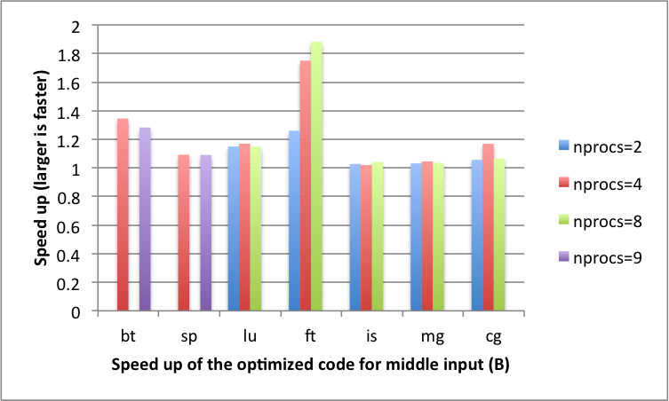
Optimization speedup
Relative execution time for NPB 3.1.1 (excluding DT and EP)
Intel Xeon x86 cluster (InfiniBand): up to 1.84x faster

Slide 19
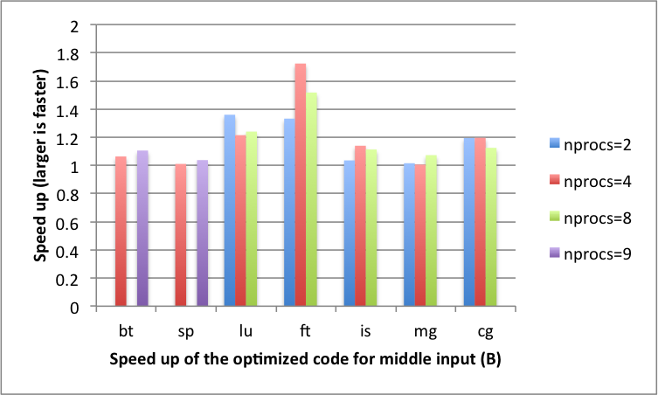
Optimization speedup
Relative execution time for NPB 3.1.1 (excluding DT and EP)
Intel Xeon x64 cluster (1 Gbps Ethernet): Up to 1.79x faster

Slide 20
Concluding Remarks
Machines are getting complex
Hand-tuning MPI codes is quickly getting impractical
Heavy imbalance in communication costs
Feature availability is not uniform across MPI implementations/supercomputers
Tuning the frequency of poking the progress engine is black magic
Automatic frameworks are becoming important
Our approach extends the state of art by using the application’s natural programming model + annotations to help the compiler

Slide 21
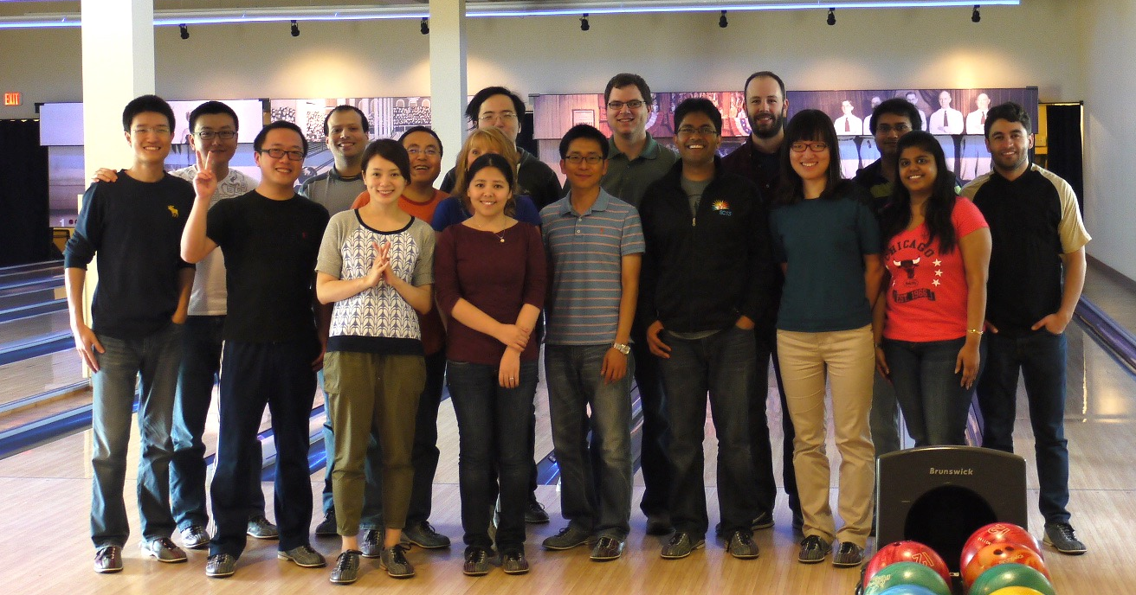

Web: http://www.mcs.anl.gov/~balaji Email: balaji@anl.gov
Group website: http://www.mcs.anl.gov/group/pmrs/

Slide 22

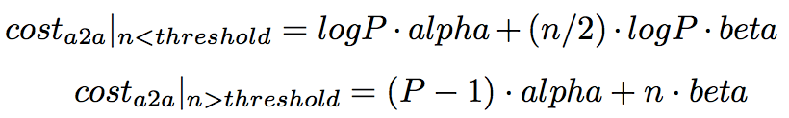

Modeling Communication Cost
Point-to-point
alpha: startup cost per message
beta: reciprocal of bandwidth, i.e. cost per byte for long messages
All2all
In general
Communication cost does not include wait time between unbalanced processes

Slide 23
Future work
Automate the program transformation
Support more CCO patterns
Model multiple cores on single node and the unbalanced communication time

Slide 24
Backup slides

Slide 25
Related work
MPI-aware compiler optimization
Transformations to Parallel Codes for Communication-Computation Overlap, SC’05,
Exact Dependence Analysis for Increased Communication Overlap, EuroMPI’12
Model-based approaches
Automatic Transformation for Overlapping Communication and Computation, NPC’08
Overlapping with threads
Overlapping Communication and Computation with OpenMP and MPI, SP’01
Overlapping for one-sided communication
Optimizing Bandwidth Limited Problems Using One-sided Communication and Overlap, IPDPS’06

