Slide 1
One-Sided Interface for Matrix Operations using MPI-3 RMA: A Case Study with Elemental
Sayan Ghosh¹, Jeff R. Hammond², Antonio J. Peña³, Pavan Balaji⁴, Assefaw H. Gebremedhin¹ and Barbara Chapman⁵
School of EECS, Washington State University¹
Intel Corporation²
Barcelona Supercomputing Center³
MCS, Argonne National Laboratory⁴
IACS, Stony Brook University⁵

Slide 2
Parallel scientific application requirements
Often applications are a mixture of regular and irregular computations
Global view programming model is useful for irregular computations
Frequent one-sided accesses to distributed arrays – basic need of quantum chemistry apps
Optimal data distribution for load balance
High performance dense linear algebra
High performance libraries exist which either target communication (e.g., MPI, ARMCI, SHMEM) or linear algebra (PLAPACK, PLASMA) – rarely both are combined

Slide 3
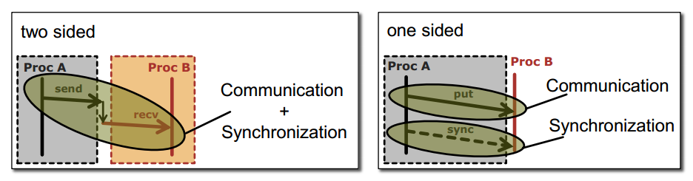
One-sided communication
Communication is one-sided (no involvement of destination or remote process)
Decouples communication and synchronization
All major network interconnects support RDMA
Figure courtesy: https://htor.inf.ethz.ch/publications/img/fompi-slides.pdf

Slide 4
Our work
Devised an easy to use interface for one-sided operations on distributed matrices (RMAInterface)
Combined one-sided programming (using MPI-3 RMA) with a high quality software interface for linear algebra (Elemental)
RMAInterface is built on top of Elemental’s DistMatrix interface
DistMatrix is the matrix distributed across processes in a cell-cyclic fashion (it’s a core data structure in Elemental)
Any program using DistMatrix could use RMAInterface
RMAInterface provides essential one-sided primitives – Put, Get, Accumulate (communication) and Flush (local and remote synchronization)
Possible to build high-level interfaces on top of RMAInterface – prototyped Global Arrays like interface

Slide 5
Upcoming slides
Elemental
Introduction
Data distribution
Elemental AXPYInterface and need for RMAInterface
Elemental RMAInterface design
Implementation schematic of RMAInterface one-sided operations
Use case – NWChem TCE proxy
Microbenchmark evaluation
Distributed Arrays interface (EL::DA) on top of RMAInterface
Compare performance of EL::DA with GA (Distributed GEMM)
Application evaluation - GTFock
Concluding remarks

Slide 6
About Elemental
C++11 library for distributed-memory algorithms for dense/sparse linear algebra and interior-point methods for convex optimization
Designed around the idea of building different matrix distributions, and provide an API to move matrix between different distributions throughout computation
Poulson, Jack, et al. "Elemental: A new framework for distributed memory dense
matrix computations. " ACM Transactions on Mathematical Software (TOMS) 39.2 (2013): 13.

Slide 7
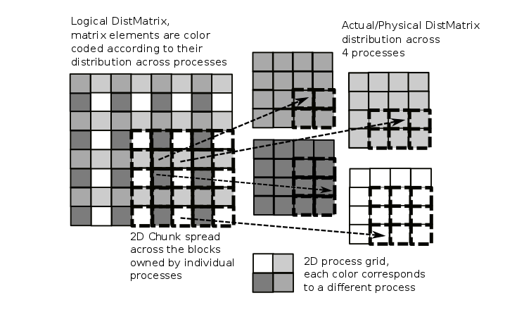
Data distribution
Unlike libraries which distribute contiguous chunks, Elemental spreads the matrix in an element-wise fashion

Slide 8
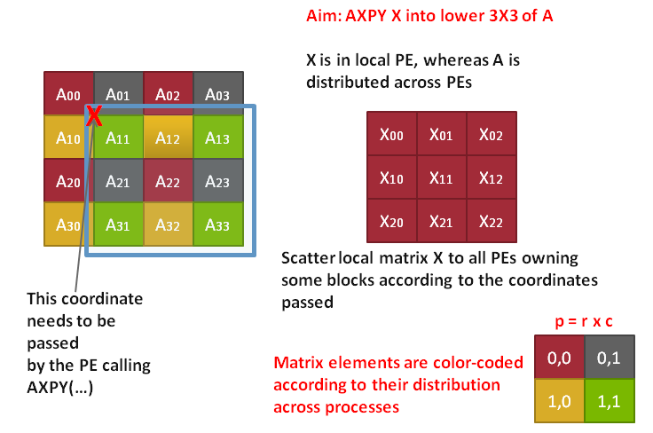
Elemental AxpyInterface - Basic idea
Analogous to BLAS axpy operation for vector-vector operations, i.e., y := a*x + y (a is scalar, x and y are vectors)
* A (= Y) is a distributed matrix, and
X is a local matrix in this case
* AXPY is similar to ARMCI scaled
accumulate dst += scale*src

Slide 9
Elemental AxpyInterface design
AxpyInterface has 3 routines – Attach, AXPY and Detach
Attach (collective): Buffer allocation/resizing
AXPY (p2p): Sends or receives data to/from (depending on a direction parameter) the globally distributed matrix
Detach (collective): Finishes all outstanding communication and tracks progress
A DistMatrix, or the local matrix cannot be updated between Attach and a Detach
Every process is free to AXPY as many local matrices to DistMatrix as desired (but, see above)
AXPY is analogous to ARMCI scaled accumulate – dst += scale*src – could be implemented directly using one-sided semantics

Slide 10
AxpyInterface – Issues and expectations
Asynchrony – Interface does not allow overlapping of operations, when Detach returns, all communication to/from global matrix will end (a la bulk synchronous)
Over-allocation – Although one could issue as many Axpy calls within an Attach-Detach epoch, but one must allocate a new local matrix every time [as completion not guaranteed until Detach]
Restrictive synchronization – in Detach, every PE must exchange EOM packets to mark communication end; also Attach-Detach called per access epoch
90% of Detach is taken up by HandleEoms()
Becomes a great issue when there are a large number of tasks!
Expression - Put/Get/Acc are all expressed via a single function, Axpy, where one must pass alpha and direction to select operation
To rectify the above issues, one would need to:
Re-design the interface
Attach-Detach once per DistMatrix
Introduce Put/Get/Acc functions
Flush – Local and remote completion
Implement the new APIs with MPI-3 RMA
Our direction

Slide 11
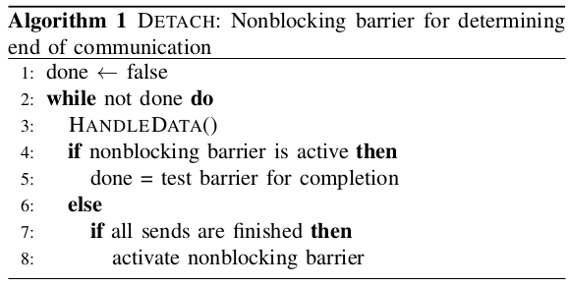
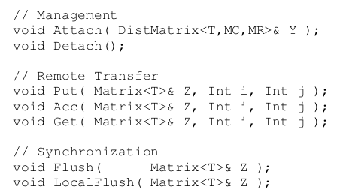
Optimizations to AxpyInterface and beyond
Original API (Attach-Axpy-Detach)
Remove EOM matching criteria from AxpyInterface
Use Non-blocking consensus* instead (referred to as ORIG-NBX)
RMAInterface (new API) (Attach-Put/Acc/Get-Flush-Detach)
Expose one-sided semantics, re-design the interface completely
Implement this using MPI-3 passive RMA (referred to as RMA)
New API
*Hoefler, Torsten, Christian Siebert, and Andrew Lumsdaine. "Scalable communication protocols for dynamic sparse data exchange." ACM Sigplan Notices 45.5 (2010): 159-168.

Slide 12
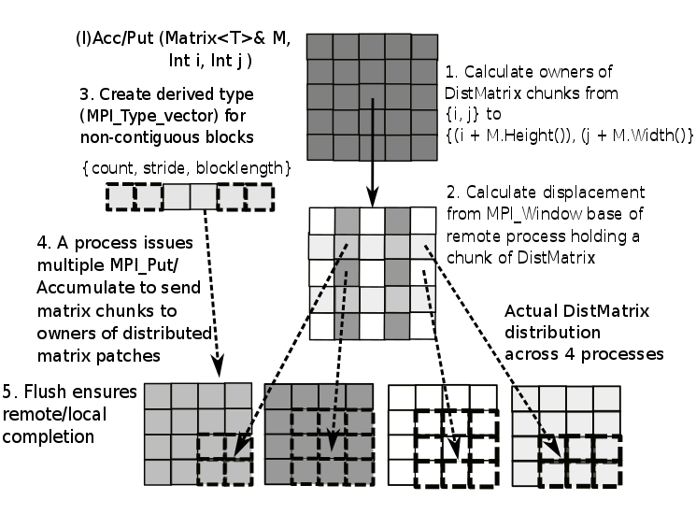
RMAInterface one-sided operation steps

Slide 13
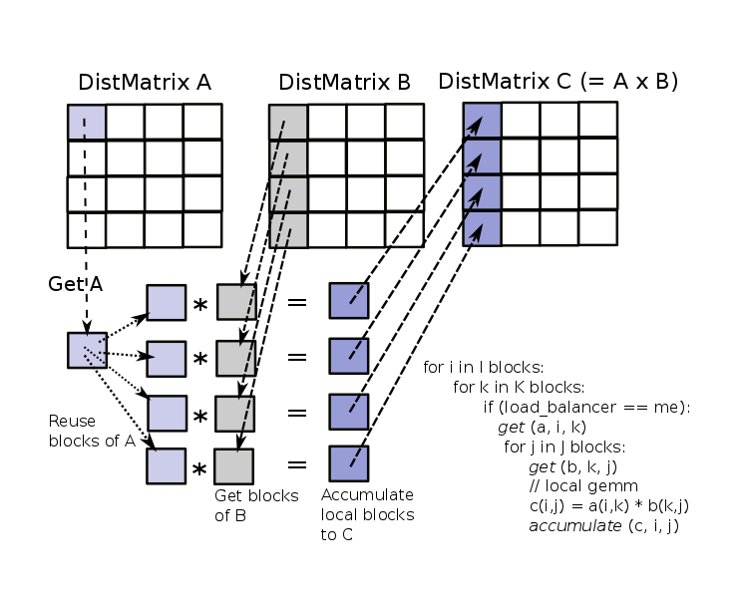
Use case – NWChem TCE proxy (I)

Slide 14
Use case – NWChem TCE proxy (II)
AxpyInterface
RMAInterface
for i in I blocks:
for k in K blocks:
if (load_balancer == me):
ai.Attach (A)
ai.Axpy (a, i, k)
ai.Detach ()
for j in J blocks:
bi.Attach (B)
bi.Axpy (b, k, j)
bi.Detach ()
// gemm
c(i,j) = a(i,k) * b(k,j)
ci.Attach (C)
ci.Axpy (c, i, j)
ci.Detach ()
ai.Attach (A) bi.Attach (B)
ci.Attach (C)
for i in I blocks:
for k in K blocks:
if (load_balancer == me):
ai.Get (a, i, k)
for j in J blocks:
bi.Get (b, k, j)
// flush outstanding acc
ci.Flush (c)
// gemm
c(i,j) = a(i,k) * b(k,j)
ci.Acc (c, i ,j)
ai.Detach () bi.Detach ()
ci.Detach ()

Slide 15
Use case – NWChem TCE proxy (II)
AxpyInterface
RMAInterface
for i in I blocks:
for k in K blocks:
if (load_balancer == me):
ai.Attach (A)
ai.Axpy (a, i, k)
ai.Detach ()
for j in J blocks:
bi.Attach (B)
bi.Axpy (b, k, j)
bi.Detach ()
// gemm
c(i,j) = a(i,k) * b(k,j)
ci.Attach (C)
ci.Axpy (c, i, j)
ci.Detach ()
ai.Attach (A) bi.Attach (B)
ci.Attach (C)
for i in I blocks:
for k in K blocks:
if (load_balancer == me):
ai.Get (a, i, k)
for j in J blocks:
bi.Get (b, k, j)
// flush outstanding acc
ci.Flush (c)
// gemm
c(i,j) = a(i,k) * b(k,j)
ci.Acc (c, i ,j)
ai.Detach () bi.Detach ()
ci.Detach ()
But this is wrong! Attach/Detach are collective, and the innermost loop may be executed by a subset of processes in comm

Slide 16
Platform
Argonne LCRC Blues – 310-node cluster with dual-socket Intel Xeon E5-2670 processors per node (~2.6 GhZ) and a QLogic InfiniBand QDR interconnect
MVAPICH2 2.2.1
NERSC Cori (Phase 1) – 1,630-node Cray XC40 machine with dual-socket Intel Xeon E5-2698v3 CPUs per node and the Cray XC series interconnect (Aries).
Cray MPI 7.2.5
Global Arrays 5.4 (w ARMCI-MPI)
We also use Casper*, a new process-based progress engine for MPI one-sided operations (2-4 ghost processes used per node)
*Si, Min, et al. "Casper: An asynchronous progress model for MPI RMA on
many-core architectures." Parallel and Distributed Processing Symposium (IPDPS),
2015 IEEE International. IEEE, 2015.

Slide 17
Hartree-Fock proxy microbenchmark (on ANL LCRC Blues)
ORIG: Original Elemental
AxpyInterface
ORIG-NBX: Elemental
AxpyInterface with NB
consensus in Detach
RMA(B): Locally (non)blocking
API of RMAInterface
RMA(B)-CSP: Locally
(non)blocking API of
RMAInterface with Casper
DistMatrix
Acc
Matrix
for (i = 0; i < DistMatrix_dim; i+=Matrix_dim) {
if (load_balancer == me) {
for (j = 0; j < DistMatrix_dim; j+= Matrix_dim)
// Acc or Get
}
Get
Performed twice,
first for Acc and
next for Get
Process grid

Slide 18
Distributed Arrays Interface (EL::DA)
EL::DA is built on top of the Elemental DistMatrix and RMAInterface interfaces – a rich set of Elemental optimization framework exposed via EL::DA
Similar to Global Arrays API – straightforward to port GA applications…supports fundamental GA operations
Both regular and irregular (GA) distributions internally map to Elemental’s cell-cyclic data layout
One-sided operations (e.g., NGA_Put/Acc) uses RMAInterface, whereas for collective operations (e.g., GA_Add/Symmetrize), core Elemental API is used
NGA_Access is no longer a local operation (due to data layout), so is NGA_Release_update

Slide 19
Distributed DGEMM - EL::DA vs GA (on NERSC Cori)
GA distribution used is regular (rows x nblock), whereas Elemental uses cell-cyclic layout
It’s challenging to determine the best distribution block-size for load balancing
Elemental removes that constraint of distribution block size (nb_dist == 1)

Slide 20
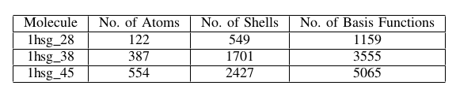
Application evaluation – GTFock (I)
HF (Hartree-Fock) or SCF (Self-Consistent Field) method is an iterative method used in approximating the energy of a quantum many-body systems in a stationary state
In each SCF iteration, the most compute intensive part is the calculation of the Fock matrix
GTFock* is a new parallel algorithm for HF calculations that uses fine-grained tasks to balance the computation
GA irregular distribution is known to be scalable for HF calculations
Native GTFock uses GA (and MPI), EL::DA port is essentially a drop-in replacement to GA functions
*Liu, Xing, Aftab Patel, and Edmond Chow. "A new scalable parallel algorithm for
Fock matrix construction." Parallel and Distributed Processing Symposium,
2014 IEEE 28th International. IEEE, 2014.

Slide 21
Application evaluation – GTFock (II) - (on NERSC Cori)
EL::DA shows consistently around 20% improvement over GA up to 128 processes
Volume of remote communication increases significantly in the Fock matrix building stage, which negatively affects the overall scalability of EL::DA
NGA_Access is not a local operation for EL::DA

Slide 22
Concluding remarks
Presented a case study in designing a one-sided interface within a high-performance linear algebra and optimization framework (Elemental)
We started with improving existing interface for distributed matrix update (AXPYInterface), and justified the need for a truly one-sided interface (RMAInterface)
Built EL::DA over Elemental DistMatrix and RMAInterface
Demonstrated efficacy of RMAInterface as an effective interface for asynchronous distributed matrix update
Integrating RMAInterface to Elemental opens up interesting possibilities in exposing algorithms required for scientific computation in a one-sided programming model
RMAInterface demonstrated competitive performance compared to GA and MPI point-to-point
Cyclic distribution is not suitable for some form of HF calculations, but RMAInterface is designed to be general purpose

Slide 23
Acknowledgements
My co-authors
Jack Poulson, Stanford University

Slide 24
Thanks!
sghosh1@eecs.wsu.edu

