Slide 1

SWAP-Assembler 2: Optimization of De Novo Genome Assembler at Extreme Scale
Jintao Meng, Sangmin Seo, Pavan Balaji, Yanjie Wei,
Bingqiang Wang, Shengzhong Feng
Joint work with
Shenzhen Institutes of Advanced Technology(SIAT), CAS, China
Argonne National Laboratory, DOE, USA
BGI, Shenzhen, China
Aug 17, 2016

Slide 2
Outline of the Talk
Overview of Genome Assembly Problem
Parallel Genome Assembly
Previous works
Contributions of SWAP-Assembler
Optimization Work on Mira for SWAP-Assembler
Optimization strategy
Input & output optimization
Kmer graph construction
Graph Simplification
Performance Comparison & Evaluation
Optimization results for each steps
Experimental results for two larger data sets
Summary
Future Work
Acknowledgements

Slide 3
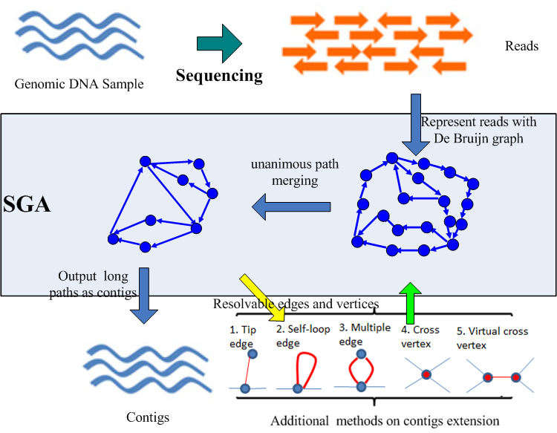
Genome assembly and DBG based strategy
Fundamental idea
Reconstruct the reference DNA by extending overlapped reads.
Three strategies
Overlap-Layout-Consensus
De Bruijn Graph
String Graph
Major steps in DBG
Kmer graph construction
Edge merging / Node merging
Generate Contigs
Scaffolding
Major steps in DBG

Slide 4
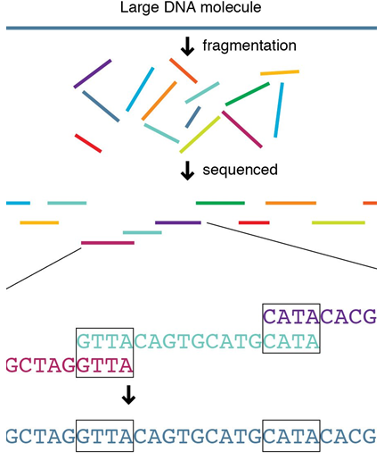

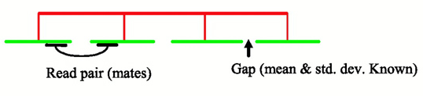
Challenges in Parallel Genome Assembly
I/O Intensive
Parallel I/O for TB data
Memory Intensive
Memory is ~50X inputs data (~PB)
Data compression (<10X)
Communication Intensive
Data distribution &exchange
Kmer spectrum analysis
Non-embarrassingly parallel
inter-communication between graph vertices
Dynamic graph topology
Access collision avoidance
Genome Assembly
Input Parallelization
Kmer Graph Analysis
Graph Construction
Edge Merging
Contig Generation
Scaffolding

Slide 5
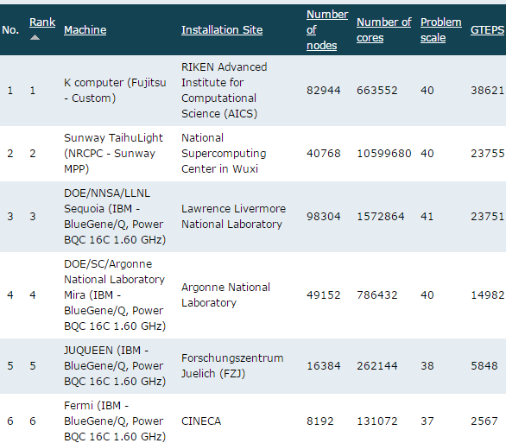
Challenges in Parallel Genome Assembly
Challenges in genome assembly:
NP-hard Problem: De Bruijn graph (DBG) strategy is a variant of traveling salesman problem, which is NP-hard problem.
Graph is huge: The number of nodes in DBG is enormous, 1000 human dataset can generate 128 trilion of k-mers (100X larger than the largest problem size of Graph500 benchmark).
Erroneous sequences: Sequencing machines are not accurate. About 50% to 80% of k-mers are erroneous.
Real world data increases complexity: Species related features, such as repeats, GC distribution, and polyploid make the genome assembly itself more complex and even harder for parallelization
Graph 500 rank list

Slide 6
Outline of the Talk
Overview of Genome Assembly Problem
Parallel Genome Assembly
Previous works
Contributions of SWAP-Assembler
Optimization Work on Mira for SWAP-Assembler
Optimization strategy
Input & output optimization
Kmer graph construction
Graph Simplification
Performance Comparison & Evaluation
Optimization results for each steps
Experimental results for two larger data sets
Summary
Future Work
Acknowledgements

Slide 7
Previous work on parallelized assembler
ABySS JT. Simpson, Genome Research/Nature Methods, 2009
Contributions：Implement the traditional DBG strategy over MPI
Ray/Ray-meta Sebastien, JCB/Genome Biology, 2012
Contributions ：Develop a general distributed engine for DBG strategy with MPI
YAGA BG. Jackson, S.aluru, ICPP /IPDPS /BMC Bioinformatics 2009
Contributions ：Bi-directed DBG graph, list ranking algorithm for path merging
BGI Hecate Project, Contrail Project (Assembly on the Cloud)
PASHA Yongchao Liu, BMC Bioinformatics, 2011
Contributions ：Multi-thread in kmer statistics & path concatenation (one thread for one path, no intra-path parallelism).
HipMer E Georganas SC 2014
Contribution：First assembler using Berkeley UPC for DBG graph construction and traversal. Other parts of HipMer is implemented with MPI.
HipMer can scale to 15K cores with its MPI&UPC implementation of DBG strategy.

Slide 8
Previous work on parallelized assembler
softwares | Mathematical Model | Algorithm Complexity | Computational Model | Scalability | Contig Quality
SOAPdenovo | DBG | Comp O(n) | PRAM | - (SMP) | 1
PASHA | DBG | Comp O(n) | PRAM | - (SMP) | -
ABySS | DBG | Comp O(n) Comm O(log(n)) | P2P | <512 | 4
Ray | DBG | - | P2P | <512 | 3
YAGA | Bi-directed DBG | Comp O(n) Comm O(log(n)) | BSP | - | -
HipMer | DBG | - | UPC | 15,000 | -
Spaler | DBG | Comp O(n) Comm O(log(n)) | Spark/GraphX | 240 | -
SWAP-Assembler | MSG | Comp O(n) Comm O(loglog(n)) | SWAP | 2048 | 2*
Quality ranking results are generated by GAGE dataset and GAGE quality analysis tools, more details in:
Jintao Meng, etc. , BMC Bioinformatics, Vol. 15 Supplement 9, 2014

Slide 9
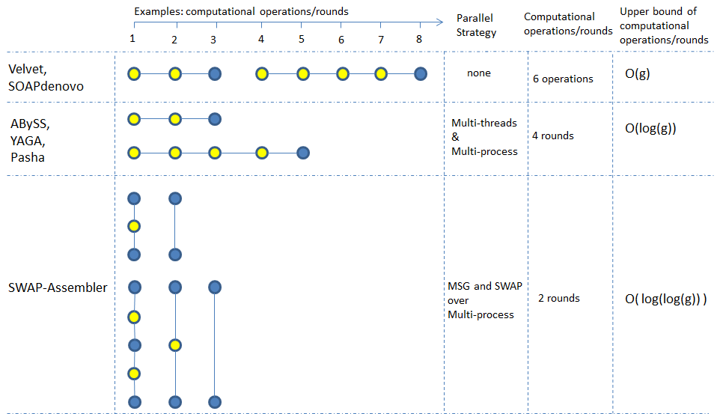

Contributions in SWAP-Assembler
Genome Assembly (GA) strategy
Multi-step Bi-directed DBG strategy
Resolve the interdependency of edge merging
Computing Model
SWAP computing model
Speedup:
Here, g is the length genome size, n the sequence data size.
b, c and r is constant numbers, q is the proportion of the repeats in the genome.
L is the communication latency , S is the startup time for each message.

Slide 10
Outline of the Talk
Overview of Genome Assembly Problem
Parallel Genome Assembly
Previous works
Contributions of SWAP-Assembler
Optimization Work on Mira for SWAP-Assembler
Optimization strategy
Input & output optimization
Kmer graph construction
Graph Simplification
Performance Comparison & Evaluation
Optimization results for each steps
Experimental results for two larger data sets
Summary
Future Work
Acknowledgements

Slide 11
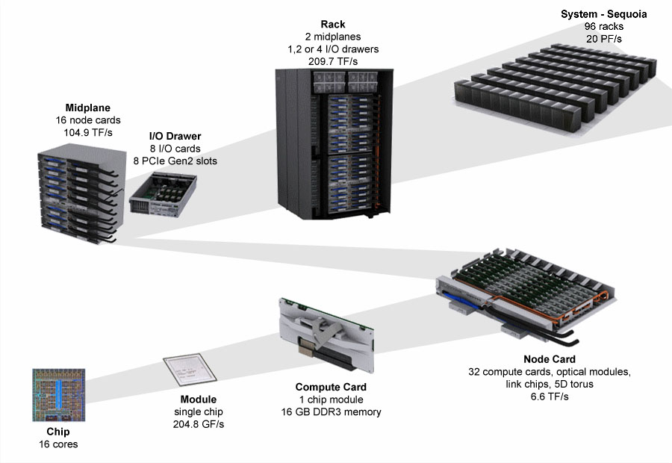
Optimization strategy for SWAP-Assembler
5D torus
(4,4,4,8,2)
5D torus
(8,16,16,16,2)
Methods
Find out the performance bottleneck
Tuning these bottleneck steps one by one
Objectives
keep the percentage of time usage in each step constant when the number of cores increases
Minimize the communication & memory usage
Scale to as many cores & as larger dataset as we can
Maximize the system efficiency
5D torus
(4,4,4,4,2)
5D torus
(2,2,2,2,2)
BG/Q Scaling Architecture

Slide 12
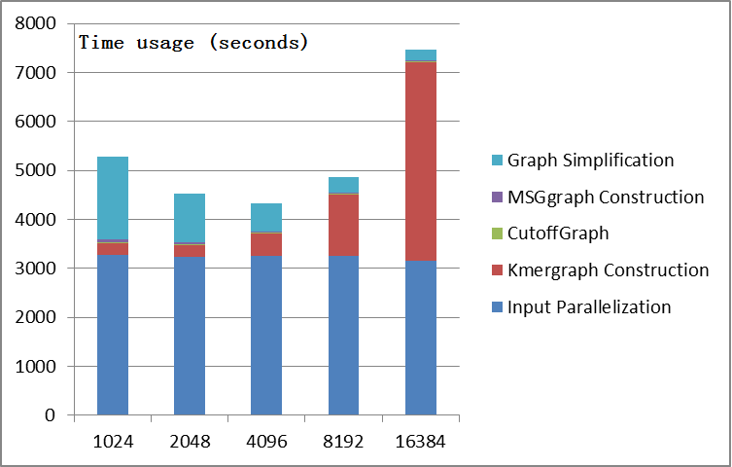
Weak scaling results of SWAP-Assembler
Weak scaling results for 1K Human data (4TB) on Mira. (~300 billion kmer-nodes)
5 steps in SWAP-Assembler
The time consuming steps are input parallelization, graph construction, graph simplification

Slide 13
Input Parallelization
In SWAP-Assembler
Data Partition: Input data is divided into p virtual data blocks.
memory usage is huge.
No tuning strategy to boost the IO performance
A0
B0
C0
P0
P1
P2
Network
Kmer
Graph
Kmer
Graph
Kmer
Graph

Slide 14
Input Parallelization
Optimization points
Fragment adjustment algorithm : Input data is divided into p virtual fragment, the begin and end position for each block is automatically separated at the beginning symbol of reads
Dynamical Self-adjustment: Each fragment is further divided into multiple pieces of fixed length (64M) data block. In each round all processes only read some pieces of data block into memory.
Benefits:
Minimize the memory usage by processing only part of data in each round.
Support data size self-adjustment in Input Parallelization step on DFS.
A0
A1
A2
A3
B0
B1
B2
B3
C0
C1
C2
C3
P0
P1
P2
Network
Kmer
Graph
Kmer
Graph
Kmer
Graph

Slide 15
Input Parallelization
Optimization points
Fragment adjustment algorithm : Input data is divided into p virtual fragment, the begin and end position for each block is automatically separated at the beginning symbol of reads
Dynamical Self-adjustment: Each fragment is further divided into multiple pieces of fixed length (64M) data block. In each round all processes only read some pieces of data block into memory.
Benefits:
Minimize the memory usage by processing only part of data in each round.
Support data size self-adjustment in Input Parallelization step on DFS.
A0
A1
A2
A3
B0
B1
B2
B3
C0
C1
C2
C3
P0
P1
P2
Network
Kmer
Graph
Kmer
Graph
Kmer
Graph
15

Slide 16
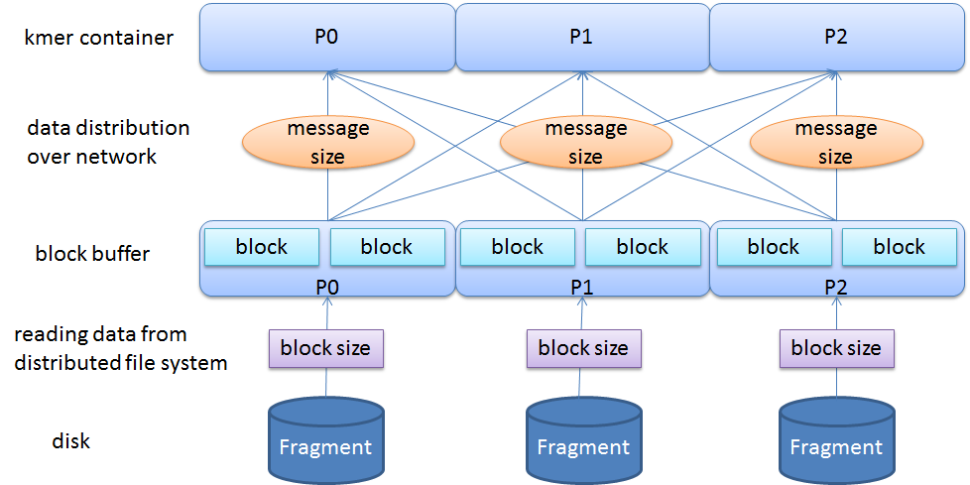
Input Parallelization & kmer graph construction
Optimization points
Data buffering technogly: boost both the communication and IO performance.
Benefits:
Isolating I/O process in the input parallelization step and the communication process in the k-mer graph construction step.
The communication phase can continuously read data from this data pool, and the data pool will be large enough to keep the message size (p2p) constant.

Slide 17
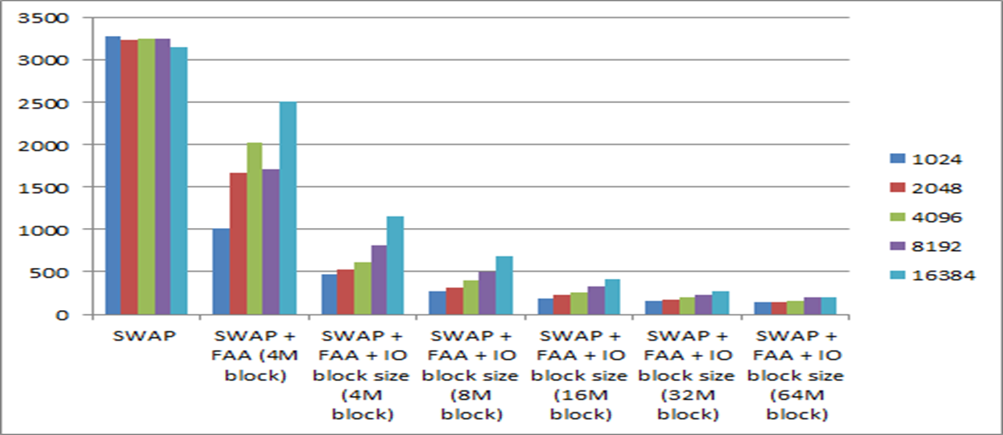
Performance improvements on I/O
The weak scaling test results of input parallelization with FAA on varying IO block size and number of cores.
With 16384 cores, 16X speedup has been achieved with the above optimization on input parallelization.

Slide 18
Kmer graph construction
In SWAP-Assembler
There is no tuning work on data size. A fixed data size is used in each round.
The message size is cut by half when increasing the number of processes.
Experience from other works
According to Dong Chen’s work in SC 2012, the bandwidth between one node to any other node in all-to-all communication is constant. Aggregated network bisection bandwidth increases proportionally with the number of cores.
We achieved 47% of communication efficiency, compared with Dong Chen’s work with 70% efficiency.
D0
P3
P2
D0
C0
C0
A0
P0
P1
B0
2D torus Network

Slide 19
Kmer graph construction
Optimization points
Keep the message size constant,
Proportionally increasing the number of data pieces with the number of cores
Improve the communication efficiency by tuning the message size.
Benefits
keep high communication efficiency
For general cluster without high performance network, there will be no harm on its performance, as the total data size communicated over the network is fixed.
D1D0
P3
P2
D0
C0
C0C1
A1A0
P0
P1
B0B1
2D torus Network

Slide 20
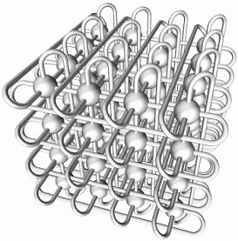
Quadrupling No. of Proc
H3H2H1H0
P7
P6
F0F1F2F3
E3E2E1E0
P4
P5
F0F1F2F3
D3D2D1D0
P3
P2
C0C1C2C3
A3A2A1A0
P0
P1
B0B1B2B3
3D torus Network

Slide 21
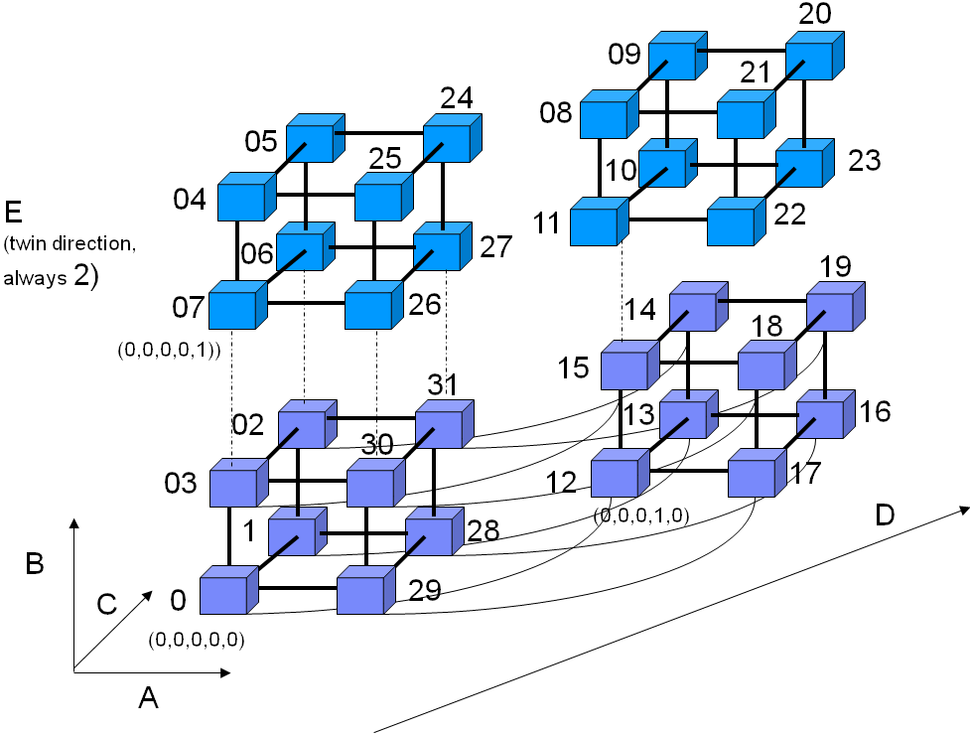
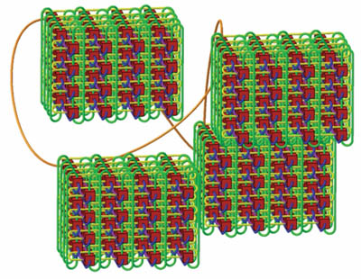
8X No. of Proc
Optimization points
Keep the message size constant by proportionally increasing the number of data pieces with the number of cores
Benefits
Fully exploit interconnection BW in 5D torus and keep communication efficiency
4D Torus Network

Slide 22
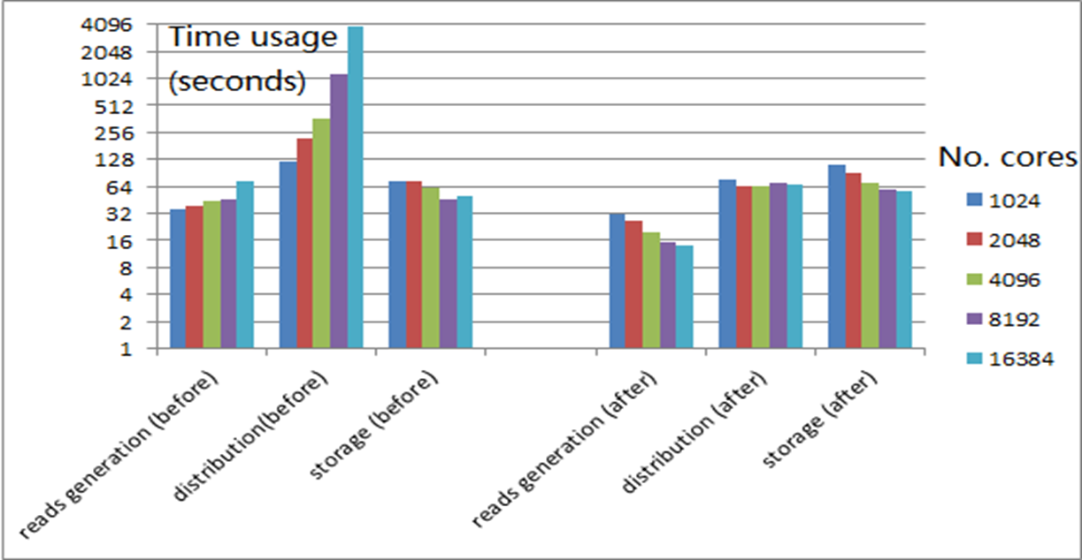
Improvements on graph construction
The weak scaling test results for three phases of kmer graph construction step before and after optimization are presented below.
The running time on reads generation decreases steadily with increasing number of cores. Communication efficiency degradation has been resolved in distribution step. With 16K cores, 64X speedup is achieved compared with our original version.

Slide 23
Graph simplification (edge merging)
Optimization points
Sending & Recving multiple messages to/from all its neighbors within one loop instead of one message to one neighbor in each loop.
Benefits
Minimize time in SWAP protocol on edge merging.
Time Line
0
Lock
Lock
1
2
Lock reply
Lock reply
0
Notify
Data
Notify
Data
1
2
Communication protocol in
SWAP on Edge merging

Slide 24
Graph simplification (edge merging)
Compute Routine
Lock Stage :
Post MPI_Isend(compReq) //Lock
Post MPI_Irecv(compReq+1) //Lock Reply
Post MPI_Isend(compReq+2)
Post MPI_Irecv(compReq+3)
Call RecvProc(4, compReq) //Wait until finish
Notify Stage :
Post MPI_Isend(compReq) //Notification &data size
Post MPI_Isend(compReq+1) //Data
Post MPI_Isend(compReq+2)
Post MPI_Isend(compReq+3)
Call RecvProc(4, compReq) //Wait until finish
Compute Routine
Lock Stage :
Post MPI_Isend(compReq) //Lock
Post MPI_Irecv(compReq+1) //Lock Reply
Call RecvProc(2, compReq) //Wait until finish
Notify Stage :
Post MPI_Isend(compReq) //Notification &data size
Post MPI_Isend(compReq+1) //Data
Call RecvProc(2, compReq) //Wait until finish
Time Line
0
Lock
Lock
1
2
Lock reply
Lock reply
RecvProc Routine (Service Routine)
While(1)
{
Post MPI_Testall(2, compReq, &flag)
if(flag) break;
Post MPI_Test(&globalReq, &flag)
if(flag==0) continue;
Doing work here…..
Post MPI_Irecv(&globalReq)
}
0
Notify
Data
Notify
Data
1
2
Note that:
Two neighbors can share the same loop in both Lock and Notify stage.
Please explain more to your audience.
Communication protocol in
SWAP on Edge merging

Slide 25
Graph simplification (edge merging)
After Message Combining, the idle time stops increasing and keeps constant.
We can’t eliminate all the idle time.
Due to the difficulty in recording the time used in sending & receiving non-blocking messages in computing routine, these time usage has been gathered into Idle time.
Percentage of time usage

Slide 26
Outline of the Talk
Overview of Genome Assembly Problem
Parallel Genome Assembly
Previous works
Contributions of SWAP-Assembler
Optimization Work on Mira for SWAP-Assembler
Optimization strategy
Input & output optimization
Kmer graph construction
Graph Simplification
Performance Comparison & Evaluation
Optimization results for each steps
Experimental results for two larger data sets
Summary
Future Work
Acknowledgements

Slide 27
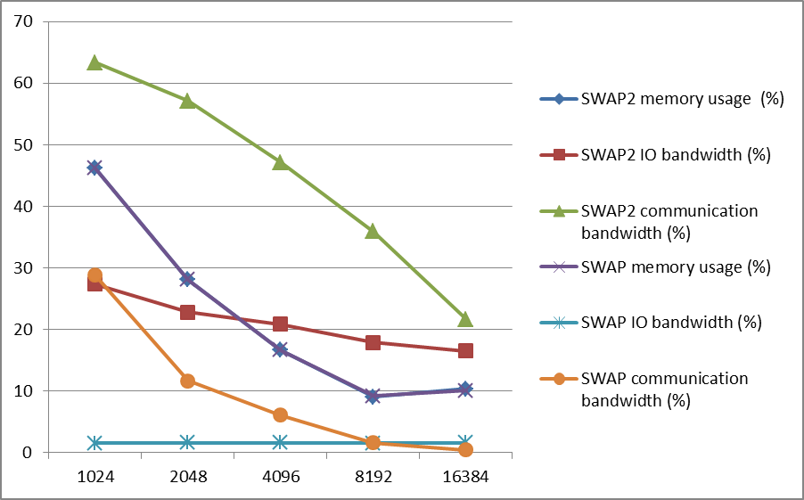
System efficiency improvement for Human data IO, communication and memory
The ratio of IO bandwidth, communication bandwidth, and memory usage with the system peak performance in theory are presented below.
IO bandwidth has been improved from 2% to 18% on 4096 cores (one rack)
Communication bandwidth has been improved from 5% to 47%
Peak memory usage does change. (1.6 TB memory is need for Human data)
The peak performance of Mira on IO bandwidth and communication bandwidth are 20GiB/rack/s and 0.9GiB/node/s respectively

Slide 28
System efficiency comparison
5D torus
(4,4,4,8,2)
5D torus
(8,16,16,16,2)
I/O optimization
0.3GiB/s/rack (SWAP, JT Meng)
4.7GiB/s/rack (SWAP2, JT Meng)
5 GiB/s/rack (SC’09, Rob Latham)
20 GiB/s/rack (IBM BGQ user guide)
Communication optimization
< 3% 5D peak performance (SWAP)
47% 5D peak performance (SWAP2)
74% 5D peak performance (SC12, Dong Chen)
0.9 GB/s/node (SC12, Dong Chen)
Memory optimization
1.6 TB for Human dataset (SWAP)
1.6 TB for Human dataset (SWAP2)
5D torus
(4,4,4,4,2)
5D torus
(2,2,2,2,2)
BG/Q Scaling Architecture
28

Slide 29
Scalability of SWAP2 on Human dataset
(MIRA)
SWAP-Assembler (Recomb-seq2014) can handle the data in 49 minutes with 1024 cores on Mira.
SWAP 2 can finish the work in 37 minutes with 1024 cores on Mira, in 2.5 minutes with 16K cores, and 1 minutes with 64K cores. (IBM BlueGeneQ – Mira, Power BQC 1.6GHz)
No. Cores | Input Parallelization | Construct k-mer Graph | Cutoff Graph | Construct MSG Graph | Graph Simplification | Total time usage(s)
1k | 117.55 | 281.44 | 19.08 | 185.05 | 1630.32 | 2266.72
2k | 59.81 | 140.56 | 9.63 | 92.56 | 838.18 | 1157.72
4k | 20.81 | 71.77 | 6.1 | 46.3 | 429.71 | 583.51
8k | 13.46 | 39.29 | 3.15 | 22.49 | 223.92 | 307.06
16k | 8.35 | 23.9 | 1.55 | 11.39 | 115.44 | 163.36
32k | 5.08 | 18.99 | 0.88 | 5.71 | 63.77 | 96.51
64k | 6.5 | 20.85 | 0.67 | 2.92 | 27.74 | 64.55

Slide 30
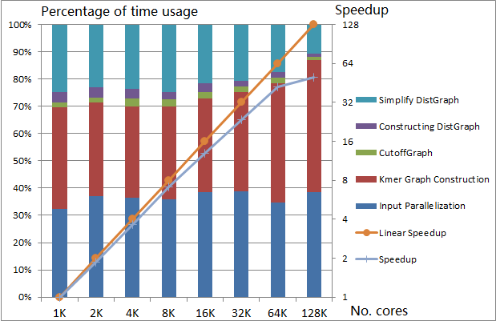
Results for 1k human project dataset (4TB, 50 billion reads, 300 billion kmers)
With parts of 1k human project dataset (4TB is used), SWAP scales to 128K cores with an efficiency of 40%.

Slide 31
Scalability results on Human dataset
(Tianhe 2)
SWAP-Assembler (Recomb-seq2014) can handle the data in 26 minutes with 1024 cores on Tianhe 2.
SWAP 2 can finished the work in 14 minutes with 1024 cores on Tianhe 2, in 1.6 minutes with 16K cores. (NUDT Tianhe 2, Xeon E5-2692v2)
No. Cores | Input Parallelization | Construct k-mer Graph | Cutoff Graph | Construct MSG Graph | Graph Simplification | Total time usage
64 | 1718.980 | 354.191 | 69.318 | 283.900 | 2724.400 | 5150.789
128 | 939.450 | 182.074 | 42.366 | 147.540 | 1480.100 | 2791.530
256 | 588.788 | 94.927 | 23.118 | 80.226 | 811.900 | 1598.959
512 | 464.540 | 50.602 | 12.318 | 41.197 | 530.659 | 1099.316
1024 | 514.250 | 26.813 | 5.934 | 20.212 | 272.750 | 839.959
2048 | 482.407 | 14.253 | 2.723 | 9.868 | 144.258 | 653.508
4096 | 199.882 | 7.093 | 1.273 | 4.889 | 91.186 | 304.322
8192 | 95.038 | 6.812 | 0.530 | 2.370 | 57.910 | 162.660
16384 | 52.864 | 20.046 | 0.340 | 1.150 | 25.040 | 99.440

Slide 32
Outline of the Talk
Overview of Genome Assembly Problem
Parallel Genome Assembly
Previous works
Contributions of SWAP-Assembler
Optimization Work on Mira for SWAP-Assembler
Optimization strategy
Input & output optimization
Kmer graph construction
Graph Simplification
Performance Comparison & Evaluation
Optimization results for each steps
Experimental results for two larger data sets
Summary
Future Work
Acknowledgements

Slide 33
Summary
SWAP-Assembler 2 contributions
First Genome assembler scale to 131,072 cores.
Parallel Genome assembler which can handle 4TB data.
Optimization on Mira
Input & output -> Data partition & dynamical balance
kmer graph construction -> Communication
graph simplification -> Message Combination
Performance Results of our work:
Ratio of time uage in each step in SWAP2 has been kept constant. Every step is scaling with the increasing number of cores.
SWAP scales to 131,072 cores with an efficiency of 40% on 4T data.

Slide 34
Future Work
Software scalability
Optimize SWAP step by step to the whole MIRA (768k cores)
Minimize the memory usage with data compressing technology.
New algorithm for edge merging
Try to use Independent Set method in edge merging (maximize the degree of parallelism in edge merging)

Slide 35




Acknowledgements
Sangmin Seo, Pavan Balaji for optimization
Yanjie Wei, BQ Wang for guidance and supports
Rob Latham, Huiwei Lv for MPICH & IO
Sheng Di, Dong Chen for 5D Torus Network
Sabestien, FangFang Xia for Genome Assembly
Jiefeng Cheng, Xinyu Que for Graph Computing
Affiliation:
Robert Latham Argonne National Lab
Huiwei Lv ICT/Argonne/Tencent
Sabestien Argonne National Lab
Jiefeng Cheng SIAT/HW Noah's Ark Lab
Dong Chen IBM TJ Watson
Xinyu Que IBM TJ Watson

