Slide 1

Scalable Assembly for Massive Genomic Graphs
Jintao Meng, Ning Guo, Jianqiu Ge, Yanjie Wei, Pavan Balaji,
Bingqiang Wang
Joint work with
Shenzhen Institutes of Advanced Technology(SIAT), CAS, China
Argonne National Laboratory, DOE, USA
National Supercomputer Center in Guangzhou, Guangzhou, China
May 15, 2017

Slide 2
Outline of the Talk
Overview of Genome Assembly
Genome assembly and its challenges
State-of-art parallelization works
Optimizations in SWAP-Assembler 2
Contributions of SWAP-Assembler
Optimizations in SWAP-Assembler 2
Performance & Evaluation
Data simulation and evaluation
Optimization results for each steps
Experimental results for two larger data sets
Summary & Acknowledgements

Slide 3
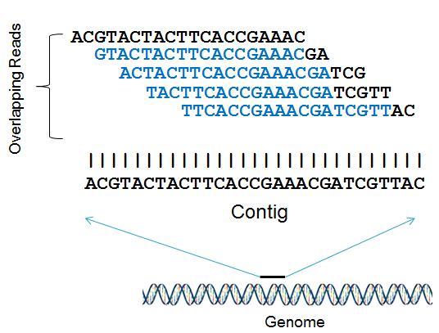
Genome assembly
Genome assembly
Reconstruct the reference DNA from the short DNA sequences (reads) generated by the sequencing machines
Three strategies
Overlap-Layout-Consensus
De Bruijn Graph (DBG)
String Graph
Genome Assembly
Notes:
Genome assembly is to reconstruct the reference DNA by extending overlapped reads, the left figure is one example of genome assembly with 5 sequencing reads, and then overlapping reads are connected to reconstruct the original contig. This figure is a simplification. The real situation is much more complicated than this.
There are three dominated strategies can be used in Genome assembly, and most parallel assembler select the De Bruijn Graph strategies.
The major step of DBG based strategy on generating contigs is plot in this figure. As we can see the major steps are kmer graph construction, edge merging, contig generation, and scaffolding. Here some additional methods on contigs extension can be used to improve the quality of results.

Slide 4
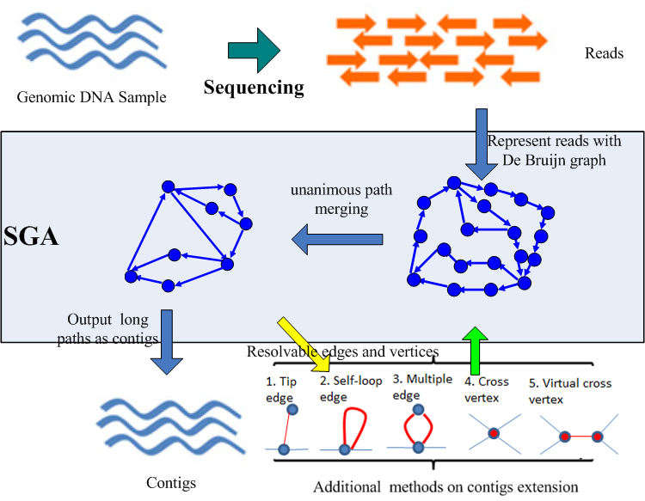
Genome assembly
DBG is popular
Kmer graph construction
Edge merging / Node merging
Contig generation
Scaffolding
TSP on massive graphs (NP-hard)
About 100 million species without reference genome
Spices | Ref size | Data size (100X) | Memory usage
Human | 3 G | 0.3~0.5 T | 0.5 ~ 2 TB
Wheat | 16 G | 2~3 T | 2.0 ~ 10 TB
Salamander | 45 G | 7~9 T | 7.5 ~ 30 TB
For metagenomes, the data size could be in TB-PB range
Scalable genome assembly is critical for reconstruct these genome.
Notes:
The is traditional travels salesman problem (TSP) on huge dynamic graphs, which is NP-hard. Irregular communication, and memory access on dynamic graphs.
So we need de novo genome assembly to reconstruct these unknown genomes.
As the genomic data is huge, scalable genome assembly is must on analysis these data.

Slide 5
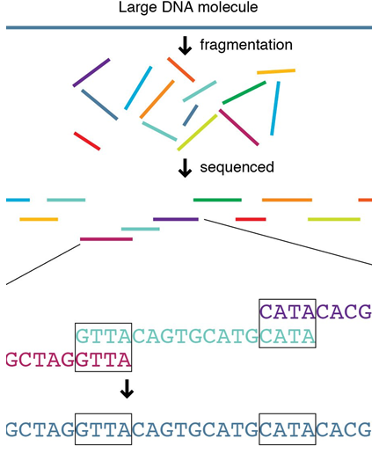

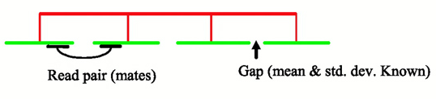
Challenges in massive gene assembly
I/O Intensive
Parallel I/O for TB data
Memory Intensive
Memory is 3X~5X of the inputs data (~PB)
Data compression (<10X)
Communication Intensive
Data distribution &exchange
Kmer spectrum analysis
Non-embarrassingly parallel
inter-communication between graph vertices
Dynamic graph topology
Access collision avoidance
Genome Assembly
Input Parallelization
Kmer Graph Analysis
Graph Construction
Edge Merging
Contig Generation
Scaffolding
Notes:
Genome assembly with massive graphs has the following four challenges, I/O intensive on huge sequencing data, memory intensive on construct and storing de bruijn graph, communication intensive on data distribution and kmer analysis, and finally this problem is also a non-embarrassingly parallel problem, and induce inter-communication between vertices on dynamic graphs.

Slide 6
Previous work on parallelized assembler
Softwares | Mathematical Model | Algorithm Complexity | Parallelization methods | Scalability | Time on human data
SOAPdenovo | DBG | Comp O(n) | Multi-threading | - (SMP) | 2 days
PASHA | DBG | Comp O(n) | Multi-threading | - (SMP) | -
ABySS | DBG | Comp O(n) Comm O(log(n)) | MPI p2p | <512 | 4
Ray | DBG | - | MPI p2p | <512 | 3
YAGA | Bi-directed DBG | Comp O(n) Comm O(log(n)) | BSP | - | -
HipMer | DBG | - | UPC | 15,000 | 8 min
Spaler | DBG | Comp O(n) Comm O(log(n)) | Spark/GraphX | 240 | -
SWAP-Assembler | MSG | Comp O(n) Comm O(loglog(n)) | SWAP | 2048 -> 262,144 | 1.5 min

Slide 7
Outline of the Talk
Overview of Genome Assembly
Genome assembly and its challenges
State-of-art parallelization works
Optimizations in SWAP-Assembler 2
Contributions of SWAP-Assembler
Optimizations in SWAP-Assembler 2
Performance & Evaluation
Data simulation and evaluation
Optimization results for each steps
Experimental results for two larger data sets
Summary & Acknowledgements

Slide 8
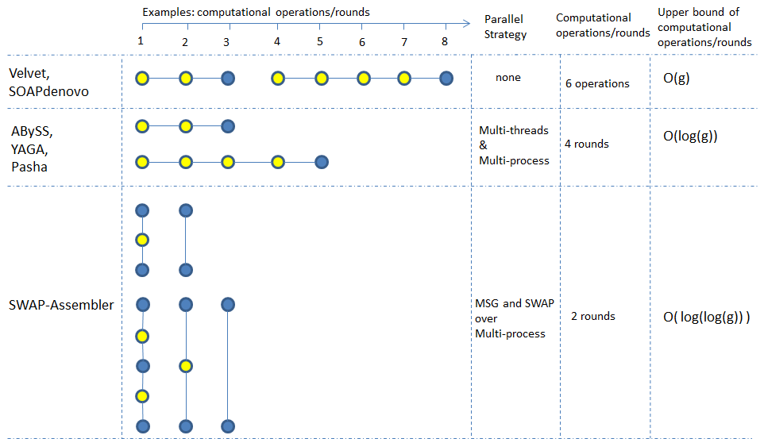

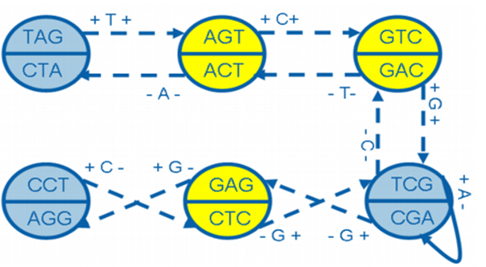

Contributions in SWAP-Assembler
Multi-step Bi-directed De Brujin Graph (MSG)
The following MSG is constructed by read “TAGTCGAGG”
SWAP asynchronous computation model for massive graphs
Lock – Compute – Unlock
Edge set with the merging operation forms a semigroup in SWAP
Near Linear Speedup
Here, g is the length genome size, p is the number of processers.
Lock
Compute
Unlock

Slide 9
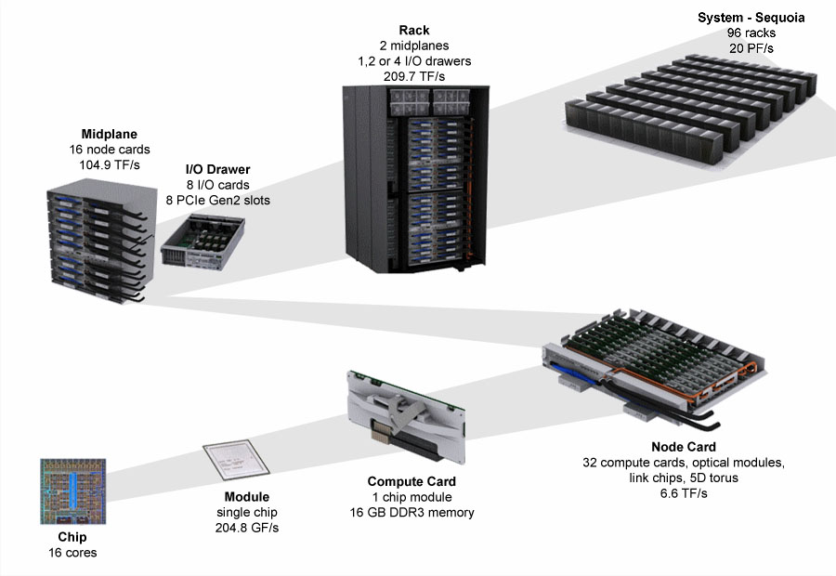
Optimization for SWAP-Assembler
5D torus
(4,4,4,8,2)
5D torus
(8,16,16,16,2)
Methods
Locate and tune the performance bottleneck
Objectives
keep the percentage of time usage in each step constant with increasing number of cores
Scale up: Minimize the communication & memory usage
Scale out: Scale to as many cores & as larger dataset as possible
Maximize the system efficiency
5D torus
(4,4,4,4,2)
5D torus
(2,2,2,2,2)
BG/Q Scaling Architecture

Slide 10
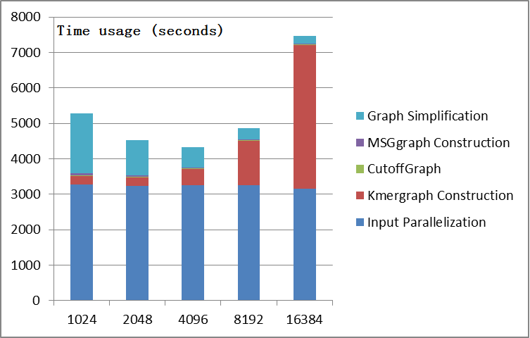
Weak scaling test of SWAP-Assembler
Weak scaling results for 1K Human data (4TB) on Mira. (~300 billion kmer-nodes)
The dominated time consuming steps are input parallelization, graph construction, graph simplification.

Slide 11
Optimization 1: Input Parallelization
In SWAP-Assembler
Data Partition: Input data is divided into p data fragment.
The last read in each fragment is broken and has to be reformed through sending the missing DNA information back by the next fragment
memory usage is huge
A0
B0
C0
P0
P1
P2
Network
Kmer
Graph
Kmer
Graph
Kmer
Graph

Slide 12
Optimization 1: Input Parallelization
Optimization points
Input data is divided to p virtual fragments; which are further divided to blocks of fixed length.
Fragment adjustment algorithm : The missing information in the last read in each virtual fragment is prefetched from the last data block. Data blocks in virtual fragment are read into memory one-by-one. For the first block of each virtual fragment, the information before the ‘>’ are discarded.
Benefits:
Minimize the memory usage by processing only part of data in each round.
Support different data size in Input Parallelization step.
A0
A1
A2
A3
B0
B1
B2
B3
C0
C1
C2
C3
P0
P1
P2
Network
Kmer
Graph
Kmer
Graph
Kmer
Graph

Slide 13
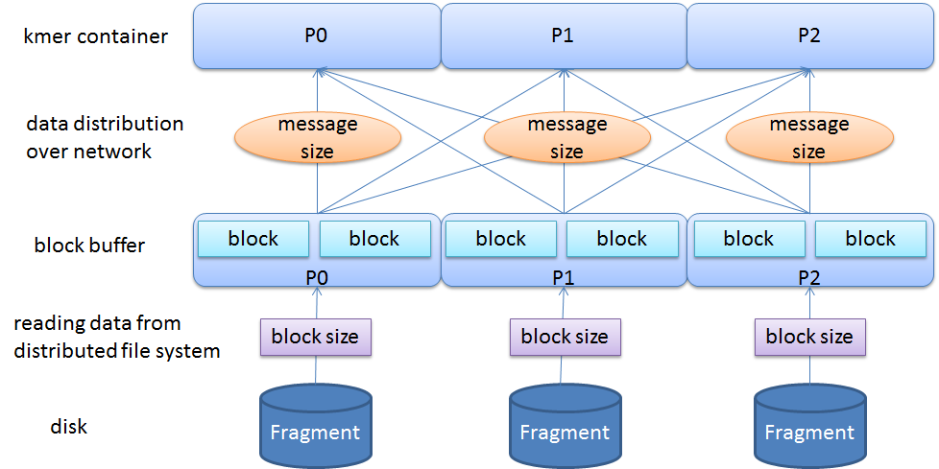
Optimization 1: Input Parallelization
Optimization points
Data buffering technology: Overlapping communication time with IO time for boosting the communication and IO performance.
Benefits of using data buffer:
Isolating I/O and communication
Tuning I/O and communication independently

Slide 14
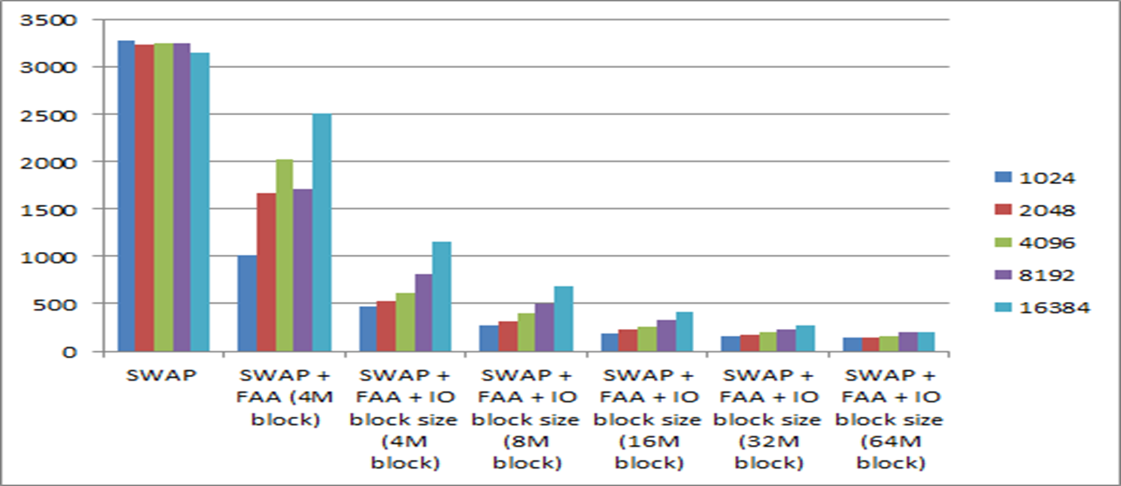
Performance improvements on I/O
The weak scaling test results of input parallelization with FAA on varying IO block size and number of cores.
With 16384 cores, 16X speedup has been achieved with the above optimization on input parallelization.

Slide 15
Optimization 2: Kmer graph construction
In SWAP-Assembler
Data used for graph construction (communication) has fixed size regardless of the No. of used cores
The message size is cut by half when increasing the number of processes.
Experience from other works
In Dong Chen’s work in SC 2012, the bandwidth between one node to any other node in all-to-all communication is constant. Aggregated network bisection bandwidth increases proportionally with the number of cores.
1
1
P3
P2
2
2
4
3
3
P0
P1
4
2D torus Network

Slide 16
Optimization 2: Kmer graph construction
Optimization points
keep the message size constant by proportionally increasing the number of data pieces with the number of used cores.
Improve the communication efficiency by tuning the message size.
Benefits
High communication efficiency
No harm on performance with some general cluster without high performance network,as the total data size communicated over the network doesn't change.
D1D0
P3
P2
D0
C0
C0C1
A1A0
P0
P1
B0B1
2D torus Network

Slide 17
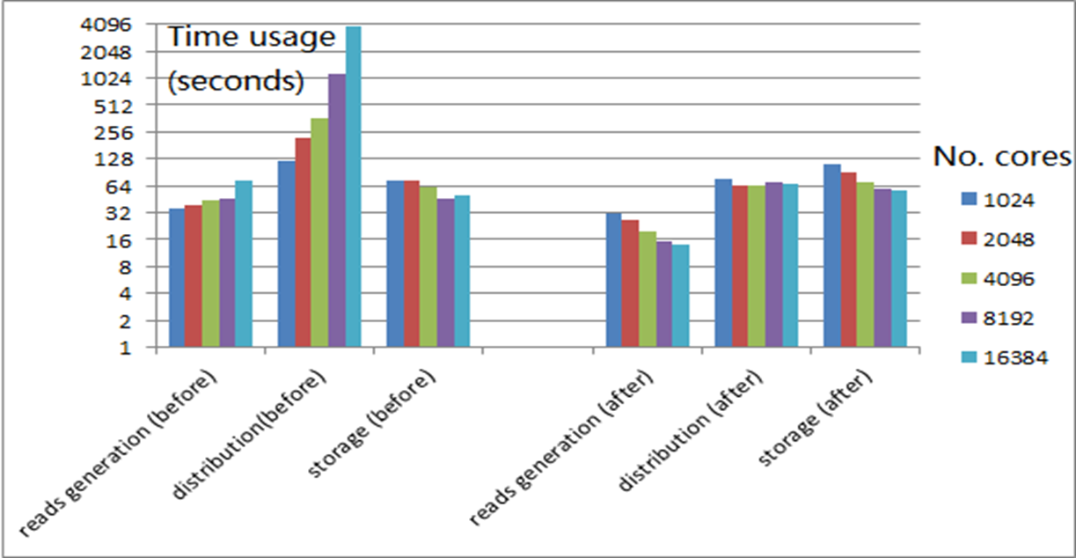
Improvements on graph construction
The weak scaling test results for three phases of kmer graph construction step before and after optimization are presented below; 4T genetic data is used.
The running time on reads generation decreases steadily with increasing number of cores. Communication efficiency degradation has been resolved in distribution step. With 16K cores, 64X speedup is achieved compared with our original version.

Slide 18
Optimization 3: Graph simplification (edge merging)
Optimization points
Reduce the no. of loops used for sending & Receiving messages to/from all its neighbors
Benefits
Minimize waiting time in SWAP protocol on edge merging.
Time Line
0
Lock
Lock
1
2
Lock reply
Lock reply
0
Notify
Data
Notify
Data
1
2
Communication protocol in
SWAP on Edge merging

Slide 19
Optimization 3: Graph simplification (edge merging)
Compute Routine
Lock Stage :
Post MPI_Isend(compReq) //Lock
Post MPI_Irecv(compReq+1) //Lock Reply
Post MPI_Isend(compReq+2)
Post MPI_Irecv(compReq+3)
Call RecvProc(4, compReq) //Wait until finish
Notify Stage :
Post MPI_Isend(compReq) //Notification &data size
Post MPI_Isend(compReq+1) //Data
Post MPI_Isend(compReq+2)
Post MPI_Isend(compReq+3)
Call RecvProc(4, compReq) //Wait until finish
Compute Routine
Lock Stage :
Post MPI_Isend(compReq) //Lock
Post MPI_Irecv(compReq+1) //Lock Reply
Call RecvProc(2, compReq) //Wait until finish
Notify Stage :
Post MPI_Isend(compReq) //Notification &data size
Post MPI_Isend(compReq+1) //Data
Call RecvProc(2, compReq) //Wait until finish
Time Line
0
Lock
Lock
1
2
Lock reply
Lock reply
RecvProc Routine (Service Routine)
While(1)
{
Post MPI_Testall(2, compReq, &flag)
if(flag) break;
Post MPI_Test(&globalReq, &flag)
if(flag==0) continue;
Doing work here…..
Post MPI_Irecv(&globalReq)
}
0
Notify
Data
Notify
Data
1
2
Note that:
Two neighbors can share the same loop in both Lock and Notify stage.
Communication protocol in
SWAP on Edge merging

Slide 20
Optimization 3: Graph simplification (edge merging)
After Message Combining, the idle stays almost the same.
Percentage of time usage

Slide 21
Outline of the Talk
Overview of Genome Assembly
Genome assembly and its challenges
State-of-art parallelization works
Optimizations in SWAP-Assembler 2
Contributions of SWAP-Assembler
Optimizations in SWAP-Assembler 2
Performance Evaluation
Data simulation and evaluation
Optimization results for each steps
Experimental results for two larger data sets
Summary & Acknowledgements

Slide 22
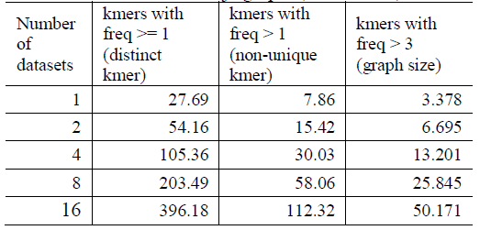
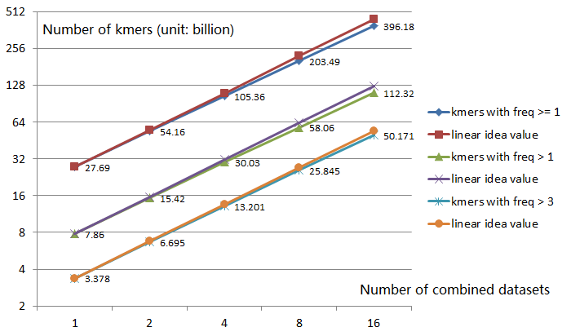
Simulated data and Graph size
16 Simulated datasets (4TB) are used to generate datasets for weak scaling test
Each dataset is generated from a human reference by randomly generating sequencing errors with a coverage of about 50X.

Slide 23
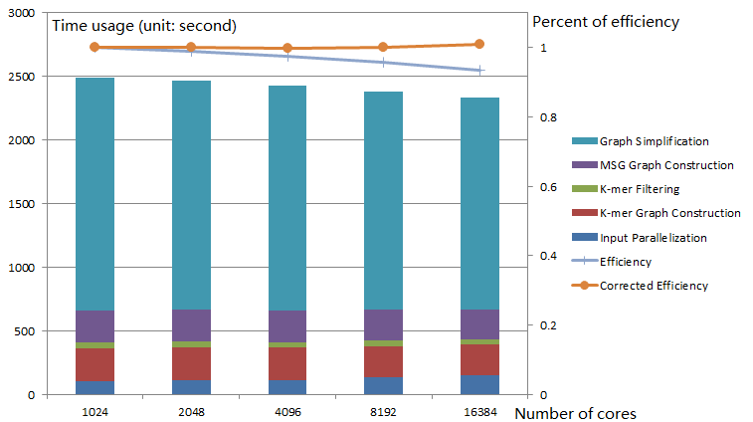
Weak scaling test on Mira
16 Simulated dataset (4TB) is used to generate datasets for weak scaling test.
The percentage of time usage for all five steps of SWAP2 is very close.
The result shows graph simplification occupied almost 75% of the total time.

Slide 24
Strong Scaling using 1K human project data on Mira
With parts of 1k human project dataset (4TB) SWAP scales to 256k cores with an efficiency of 27.5%.

Slide 25
Outline of the Talk
Overview of Genome Assembly
Genome assembly and its challenges
State-of-art parallelization works
Optimizations in SWAP-Assembler 2
Contributions of SWAP-Assembler
Optimizations in SWAP-Assembler 2
Performance & Evaluation
Data simulation and evaluation
Optimization results for each steps
Experimental results for two larger data sets
Summary & Acknowledgements

Slide 26
Summary
SWAP-Assembler 2 contributions
Optimization these major time consuming steps
Input penalization -> Data partition and blocking
kmer graph construction -> Communication
graph simplification -> Message Combination
Performance Results of our work:
Ratio of time usage in major steps in SWAP2 has been kept constant.
First Genome assembler scales to 262,144 cores with a parallel efficiency of 27% on 4T data. (HiperMer scales to 15k cores)

Slide 27




Acknowledgements
Thanks to all the authors:
Ning Guo, Jianqiu Ge, Yanjie Wei, Pavan Balaji, Bingqiang Wang
Other Contributors:
Rob Latham, Huiwei Lv for MPICH & IO
Sheng Di, Dong Chen for 5D Torus Network
Sabestien, FangFang Xia for Genome Assembly

Slide 28
Strong Scaling using Yanhuang on Mira
SWAP-Assembler (Recomb-seq2014) can handle the data in 49 minutes with 1024 cores on Mira for Yanhuang dataset (300G).
SWAP 2 can finish the work in 37 minutes with 1024 cores on Mira, in 2.5 minutes with 16K cores, and 1 minutes with 64K cores. (IBM BlueGeneQ – Mira, Power BQC 1.6GHz)
No. Cores | Input Parallelization | Construct k-mer Graph | Cutoff Graph | Construct MSG Graph | Graph Simplification | Total time usage(s)
1k | 117.55 | 281.44 | 19.08 | 185.05 | 1630.32 | 2266.72
2k | 59.81 | 140.56 | 9.63 | 92.56 | 838.18 | 1157.72
4k | 20.81 | 71.77 | 6.1 | 46.3 | 429.71 | 583.51
8k | 13.46 | 39.29 | 3.15 | 22.49 | 223.92 | 307.06
16k | 8.35 | 23.9 | 1.55 | 11.39 | 115.44 | 163.36
32k | 5.08 | 18.99 | 0.88 | 5.71 | 63.77 | 96.51
64k | 6.5 | 20.85 | 0.67 | 2.92 | 27.74 | 64.55

Slide 29
Scalability Test on Tianhe-2 with Yanhuang
SWAP 2 can finished the work in 14 minutes with 1024 cores on Tianhe 2, in 1.6 minutes with 16K cores. (NUDT Tianhe 2, Xeon E5-2692v2)
No. Cores | Input Parallelization | Construct k-mer Graph | Cutoff Graph | Construct MSG Graph | Graph Simplification | Total time usage
64 | 1718.980 | 354.191 | 69.318 | 283.900 | 2724.400 | 5150.789
128 | 939.450 | 182.074 | 42.366 | 147.540 | 1480.100 | 2791.530
256 | 588.788 | 94.927 | 23.118 | 80.226 | 811.900 | 1598.959
512 | 464.540 | 50.602 | 12.318 | 41.197 | 530.659 | 1099.316
1024 | 514.250 | 26.813 | 5.934 | 20.212 | 272.750 | 839.959
2048 | 482.407 | 14.253 | 2.723 | 9.868 | 144.258 | 653.508
4096 | 199.882 | 7.093 | 1.273 | 4.889 | 91.186 | 304.322
8192 | 95.038 | 6.812 | 0.530 | 2.370 | 57.910 | 162.660
16384 | 52.864 | 20.046 | 0.340 | 1.150 | 25.040 | 99.440

Slide 30
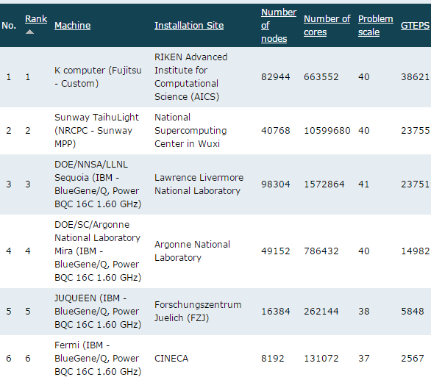
Challenges in assembly on massive graphs
Challenges in genome assembly:
NP-hard Problem: De Bruijn graph (DBG) strategy is a variant of traveling salesman problem, which is NP-hard problem.
Graph is huge: The number of nodes in DBG is enormous, 1000 human dataset can generate 128 trilion of k-mers (100X larger than the largest problem size of Graph500 benchmark).
Erroneous sequences: Sequencing machines are not accurate. About 50% to 80% of k-mers are erroneous.
Real world data increases complexity: Species related features, such as repeats, GC distribution, and polyploid make the genome assembly itself more complex and even harder for parallelization
Graph 500 rank list

Slide 31
Previous work on parallelized assembler
ABySS JT. Simpson, Genome Research/Nature Methods, 2009
Contributions：Implement the traditional DBG strategy over MPI
Ray/Ray-meta Sebastien, JCB/Genome Biology, 2012
Contributions ：Develop a general distributed engine for DBG strategy with MPI
YAGA BG. Jackson, S.aluru, ICPP /IPDPS /BMC Bioinformatics 2009
Contributions ：Bi-directed DBG graph, list ranking algorithm for path merging
BGI Hecate Project, Contrail Project (Assembly on the Cloud)
PASHA Yongchao Liu, BMC Bioinformatics, 2011
Contributions ：Multi-thread in kmer statistics & path concatenation (one thread for one path, no intra-path parallelism).
HipMer E Georganas SC 2014
Contribution：First assembler using Berkeley UPC for DBG graph construction and traversal. Other parts of HipMer is implemented with MPI.
HipMer can scale to 15K cores with its MPI&UPC implementation of DBG strategy.
Spaler bigdata 2015
Contribution： a Spark/GraphX based de novo genome assembler using de Bruijn graph.
Spaler can scale to 256 cores, its runtime is faster than RAY, and ABySS.

Slide 32
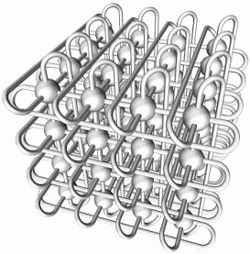
Quadrupling No. of Proc
H3H2H1H0
P7
P6
F0F1F2F3
E3E2E1E0
P4
P5
F0F1F2F3
D3D2D1D0
P3
P2
C0C1C2C3
A3A2A1A0
P0
P1
B0B1B2B3
3D torus Network

Slide 33
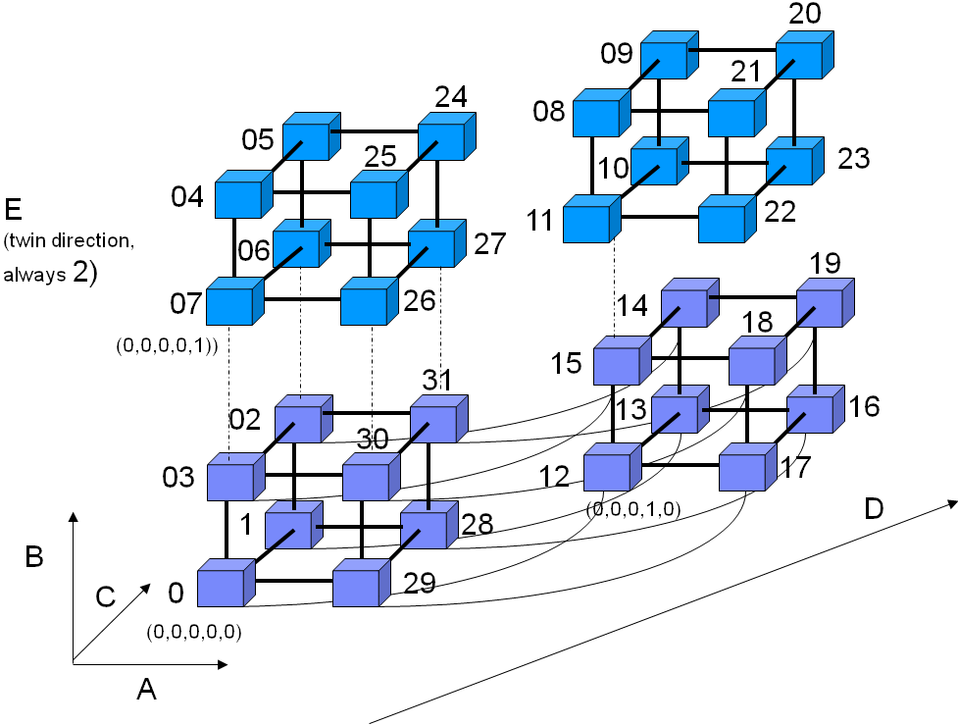
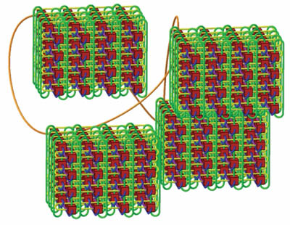
8X No. of Proc
Optimization points
Keep the message size constant by proportionally increasing the number of data pieces with the number of cores
Benefits
Fully exploit interconnection BW in 5D torus and keep communication efficiency
4D Torus Network

Slide 34
System efficiency comparison
5D torus
(4,4,4,8,2)
5D torus
(8,16,16,16,2)
I/O optimization
0.3GiB/s/rack (SWAP, JT Meng)
4.7GiB/s/rack (SWAP2, JT Meng)
5 GiB/s/rack (SC’09, Rob Latham)
20 GiB/s/rack (IBM BGQ user guide)
Communication optimization
< 3% 5D peak performance (SWAP)
47% 5D peak performance (SWAP2)
74% 5D peak performance (SC12, Dong Chen)
0.9 GB/s/node (SC12, Dong Chen)
Memory optimization
1.6 TB for Human dataset (SWAP)
1.6 TB for Human dataset (SWAP2) -> 150GB
5D torus
(4,4,4,4,2)
5D torus
(2,2,2,2,2)
BG/Q Scaling Architecture
34

Slide 35
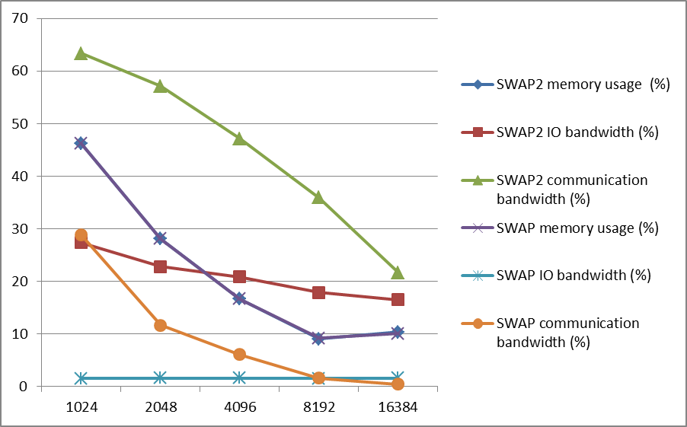
System efficiency improvement for Human data IO, communication and memory
The ratio of IO bandwidth, communication bandwidth, and memory usage with the system peak performance in theory are presented below.
IO bandwidth has been improved from 2% to 18% on 4096 cores (one rack)
Communication bandwidth has been improved from 5% to 47%
Peak memory usage doesn’t change. (1.6 TB memory is need for Human data)
The peak performance of Mira on IO bandwidth and communication bandwidth are 20GiB/rack/s and 0.9GiB/node/s respectively

Slide 36
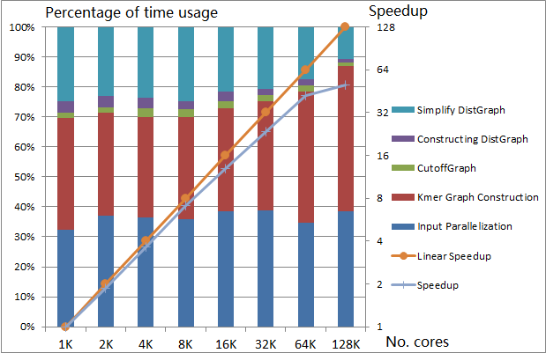
Results for 1k human project dataset on Mira (4TB, 50 billion reads)
With parts of 1k human project dataset (4TB is used), SWAP scales to 128K cores with an efficiency of 40%.

