Slide 1
S-Aligner: Ultra-scalable read-mapping on Sunway Taihu Light
Xiaohui Duan, Kai Xu, etc
High Performance Computing Research Group of Shandong University

Slide 2
Background
NGS data will continue to grow rapidly in the forseeable future.
Read mapping is a critical and compute-intensive step for a variety of NGS pipelines.
“any-best” mappers like BWA are mostly used while “all” mappers like RazerS3 can serve more kind of applications.
S-Aligner is developed in “all” mode, following the seed-and-extend strategy, fulfilling more needs of applications and making better use of Sunway Taihu Light’s compute capacity.

Slide 3
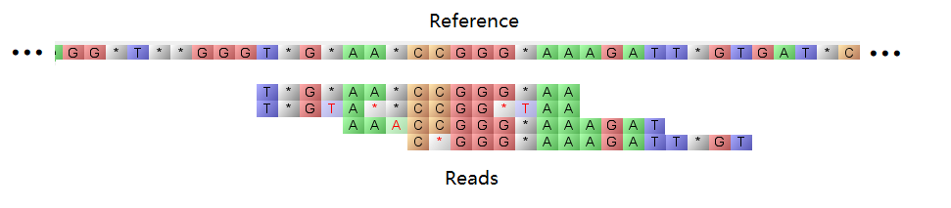
Short Read Mapping Problem
Mordern NGS instruments produces short reads with a few hundred base-pairs (bps) from genomes with billions bps.
To further analyze the short reads, they typically mapped to their originate locations on the genome (reference) by software.
Below is an example of short read mapping problem.

Slide 4
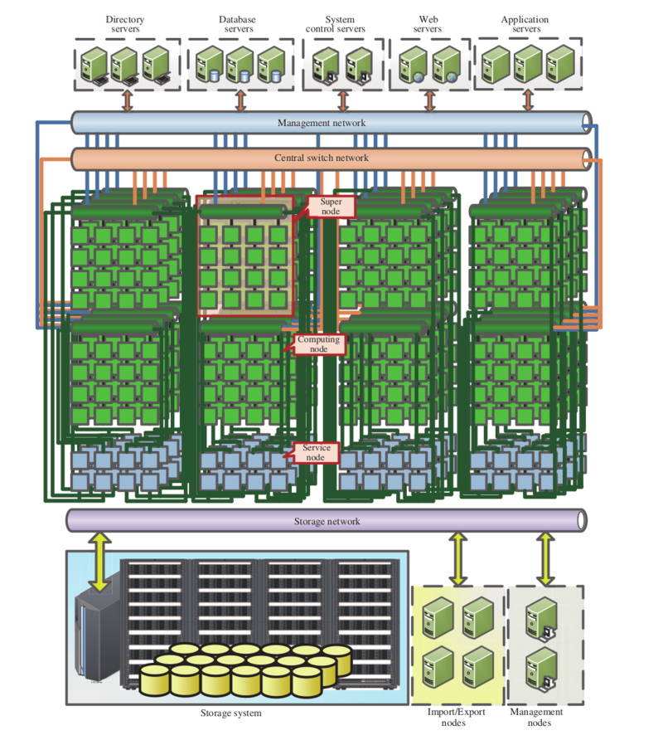
Architecture of Sunway Taihu Light
Sunway Taihu Light is composed in a structure of: CPU-Super Node-Cabinet-Machine.
Centralized storage and management.
CPU is China’s home grown SW26010 many core processor.

Slide 5
Architecture of SW26010 CPU
Each CPU has 4 Compute Group (CG)s, each CG has one master processor (MP) and 64 slave processors (SP), CGs are connected by network on chip (NoC).
MP has its own cache (256KB L2), SP has 64KB local device memory(LDM).
Using LDM needs explicit data transfer with shared memory.

Slide 6
Seed-and-Extend based mapping pipeline
The seed and extend mapping pipeline many contains 3-steps:
Seed: filter out some possible locations by using a index.
Extension: use accurate string matching algorithms to extend seeds, determining whether a location is a valid mapping location.
Alignment: generate bp-level alignment between the read and reference.

Slide 7
Contributions
An efficient implementation of Myers’ bit-parallel string matching algorithm.
A task parallel framework for solving “seed-and-extend” strategy problems efficiently on one compute group (CG) of SW26010 CPU.
A highly scalable inter compute group parallelization scheme providing up to 95% weak scaling efficiency among 53,248 compute groups.

Slide 8
Parallelization in one CG
Our basic implementation on one CG uses task parallel strategy between the MP and the 64 SPs.
SPs do the compute intensive extension and alignment work in parallel.
MP do seeding and IO work.
SPs and MP do their work in parallel asynchronously.
Load balance is done by limiting task workload and then use static balancing.

Slide 9
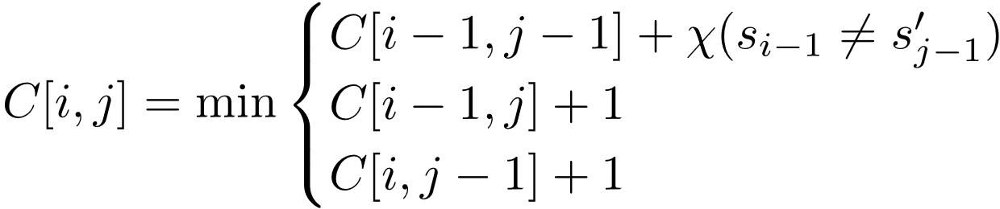
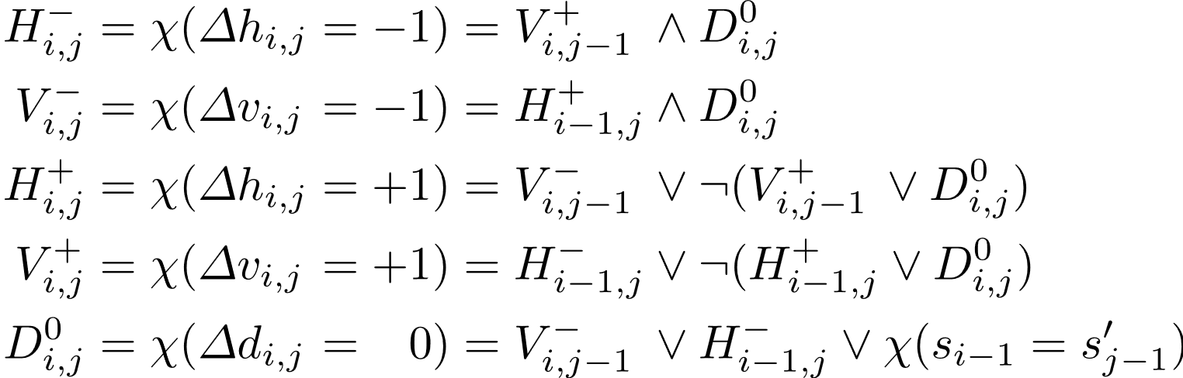
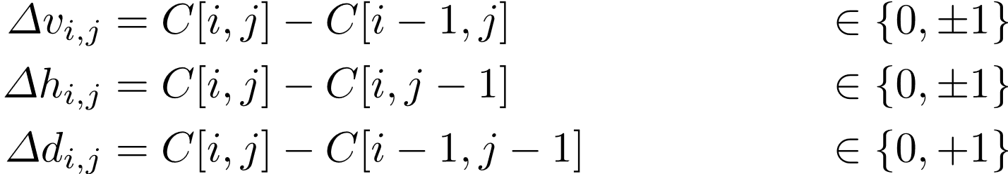
Bit-parallel string matching algorithm
The edit distance formula is as follows:
By encoding the formula as follows:
By rewriting the formula in Myers’ form (1):
The problem can be done with a set of logical operations with data dependency solved by add operation.

Slide 10
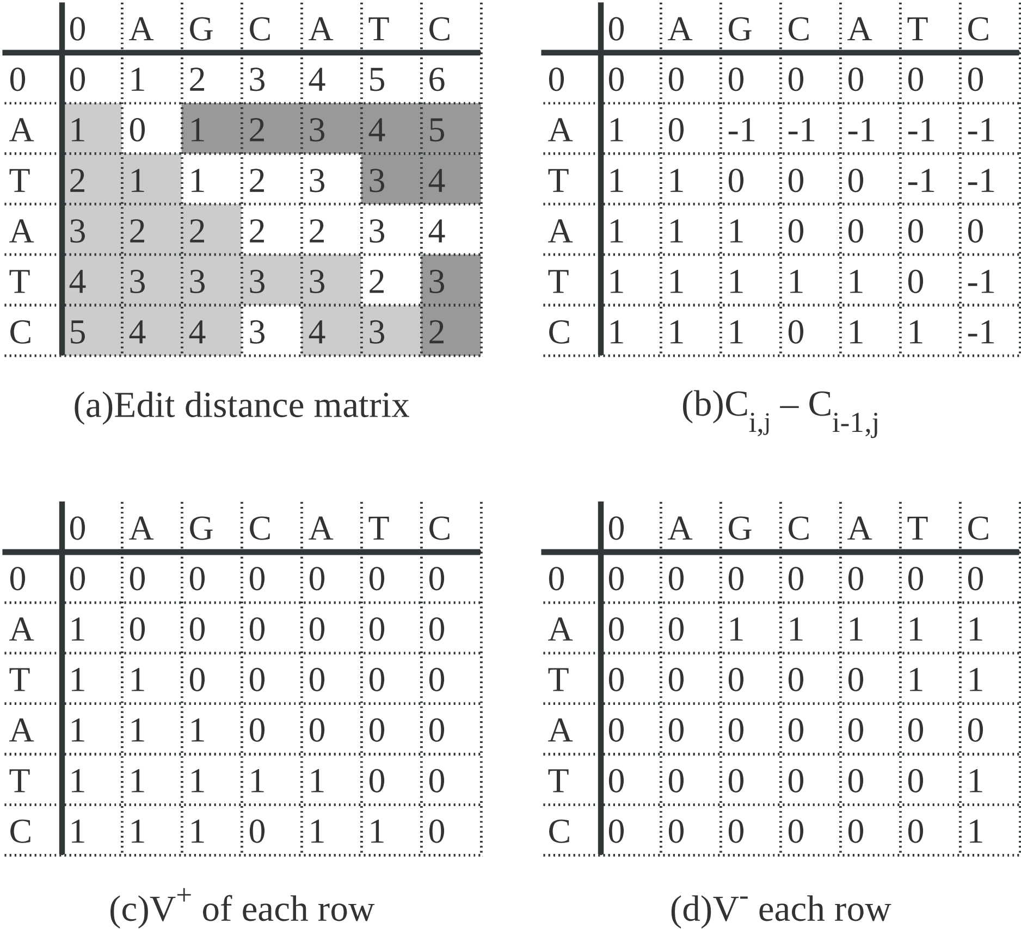
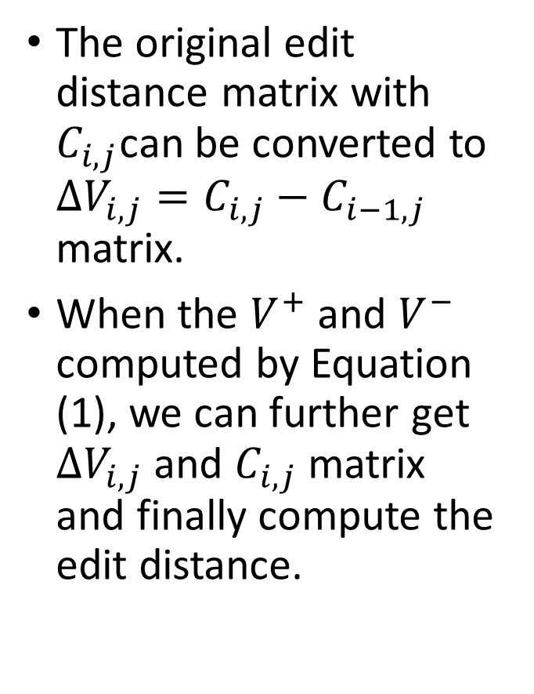
An example of Myer’ algorithm
The original edit distance matrix with $C_{i,j}$can be converted to $∆V_{i,j}=C_{i,j}−C_{i−1,j}$ matrix.
When the $V^{+}$ and $V^{−}$ computed by Equation (1), we can further get $∆V_{i,j}$ and $C_{i,j}$ matrix and finally compute the edit distance.

Slide 11
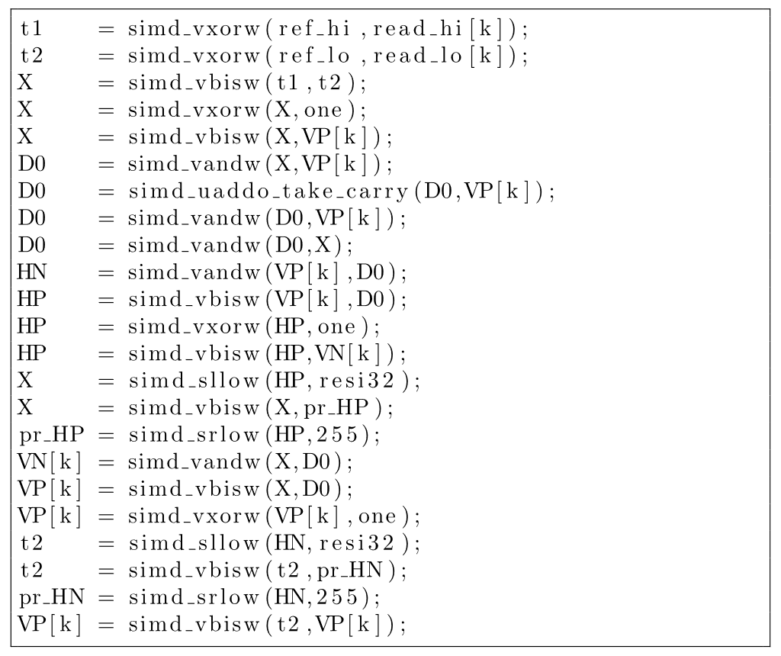
Implementing the algorithm on SPs
Using Shenwei’s High Precision Integer Extension (done by VPUs).
Supports 256bit integer add/sub with carry.
Bitwise operations is compatible with Shenwei’s SIMD Extension.
Code of implementation is shown right.

Slide 12
Inter CG parallelization
Motivations:
Needs for big data processing.
Memory of one CG is not enough for large indexes.
Challenges:
Data partition for load balance.
Parallel IO overhead.

Slide 13
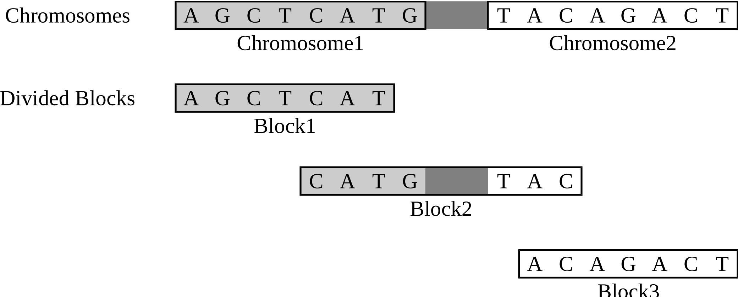
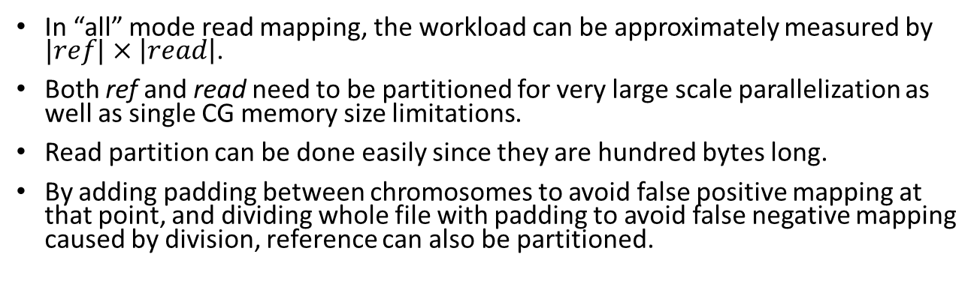
Reference partition for inter CG parallelization
In “all” mode read mapping, the workload can be approximately measured by $|ref|×\left|read\right|$.
Both ref and read need to be partitioned for very large scale parallelization as well as single CG memory size limitations.
Read partition can be done easily since they are hundred bytes long.
By adding padding between chromosomes to avoid false positive mapping at that point, and dividing whole file with padding to avoid false negative mapping caused by division, reference can also be partitioned.

Slide 14
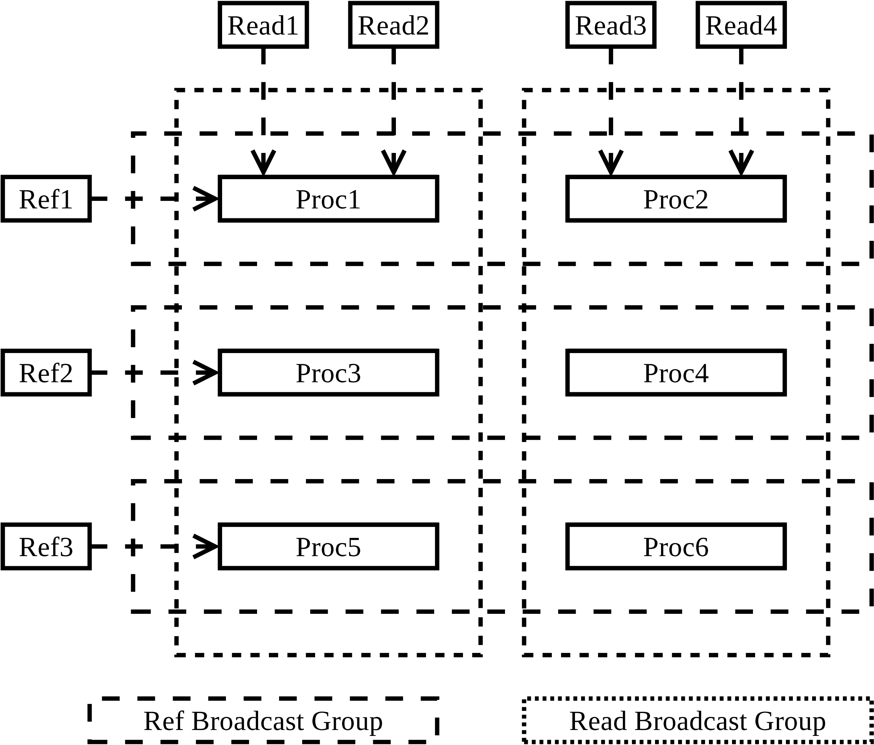
Task grid for inter CG parallelization
Both reference and read is divided to parts.
Reference index is ~12 times larger than the reference.
Each process do the mapping of one reference block and several read blocks to avoid the overhead of reloading reference index.
Broadcast strategy is used to decrease total IO amount.

Slide 15
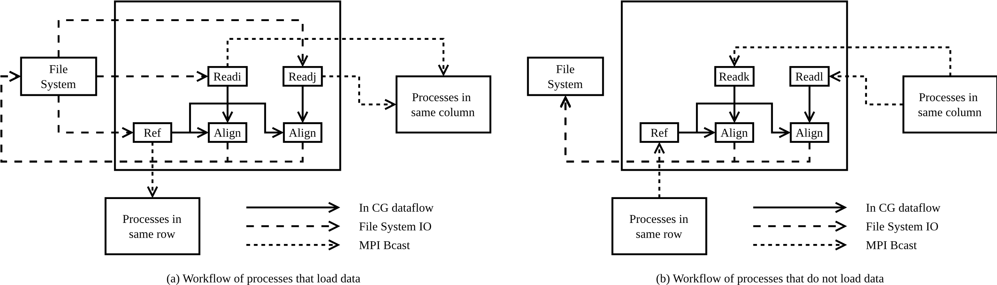
Data sharing
Build row/column broadcast groups for sharing reference/read blocks.
Only the first process in each group actually loads data from filesystem.
Those processes broadcast blocks to processes in the same row/column.

Slide 16
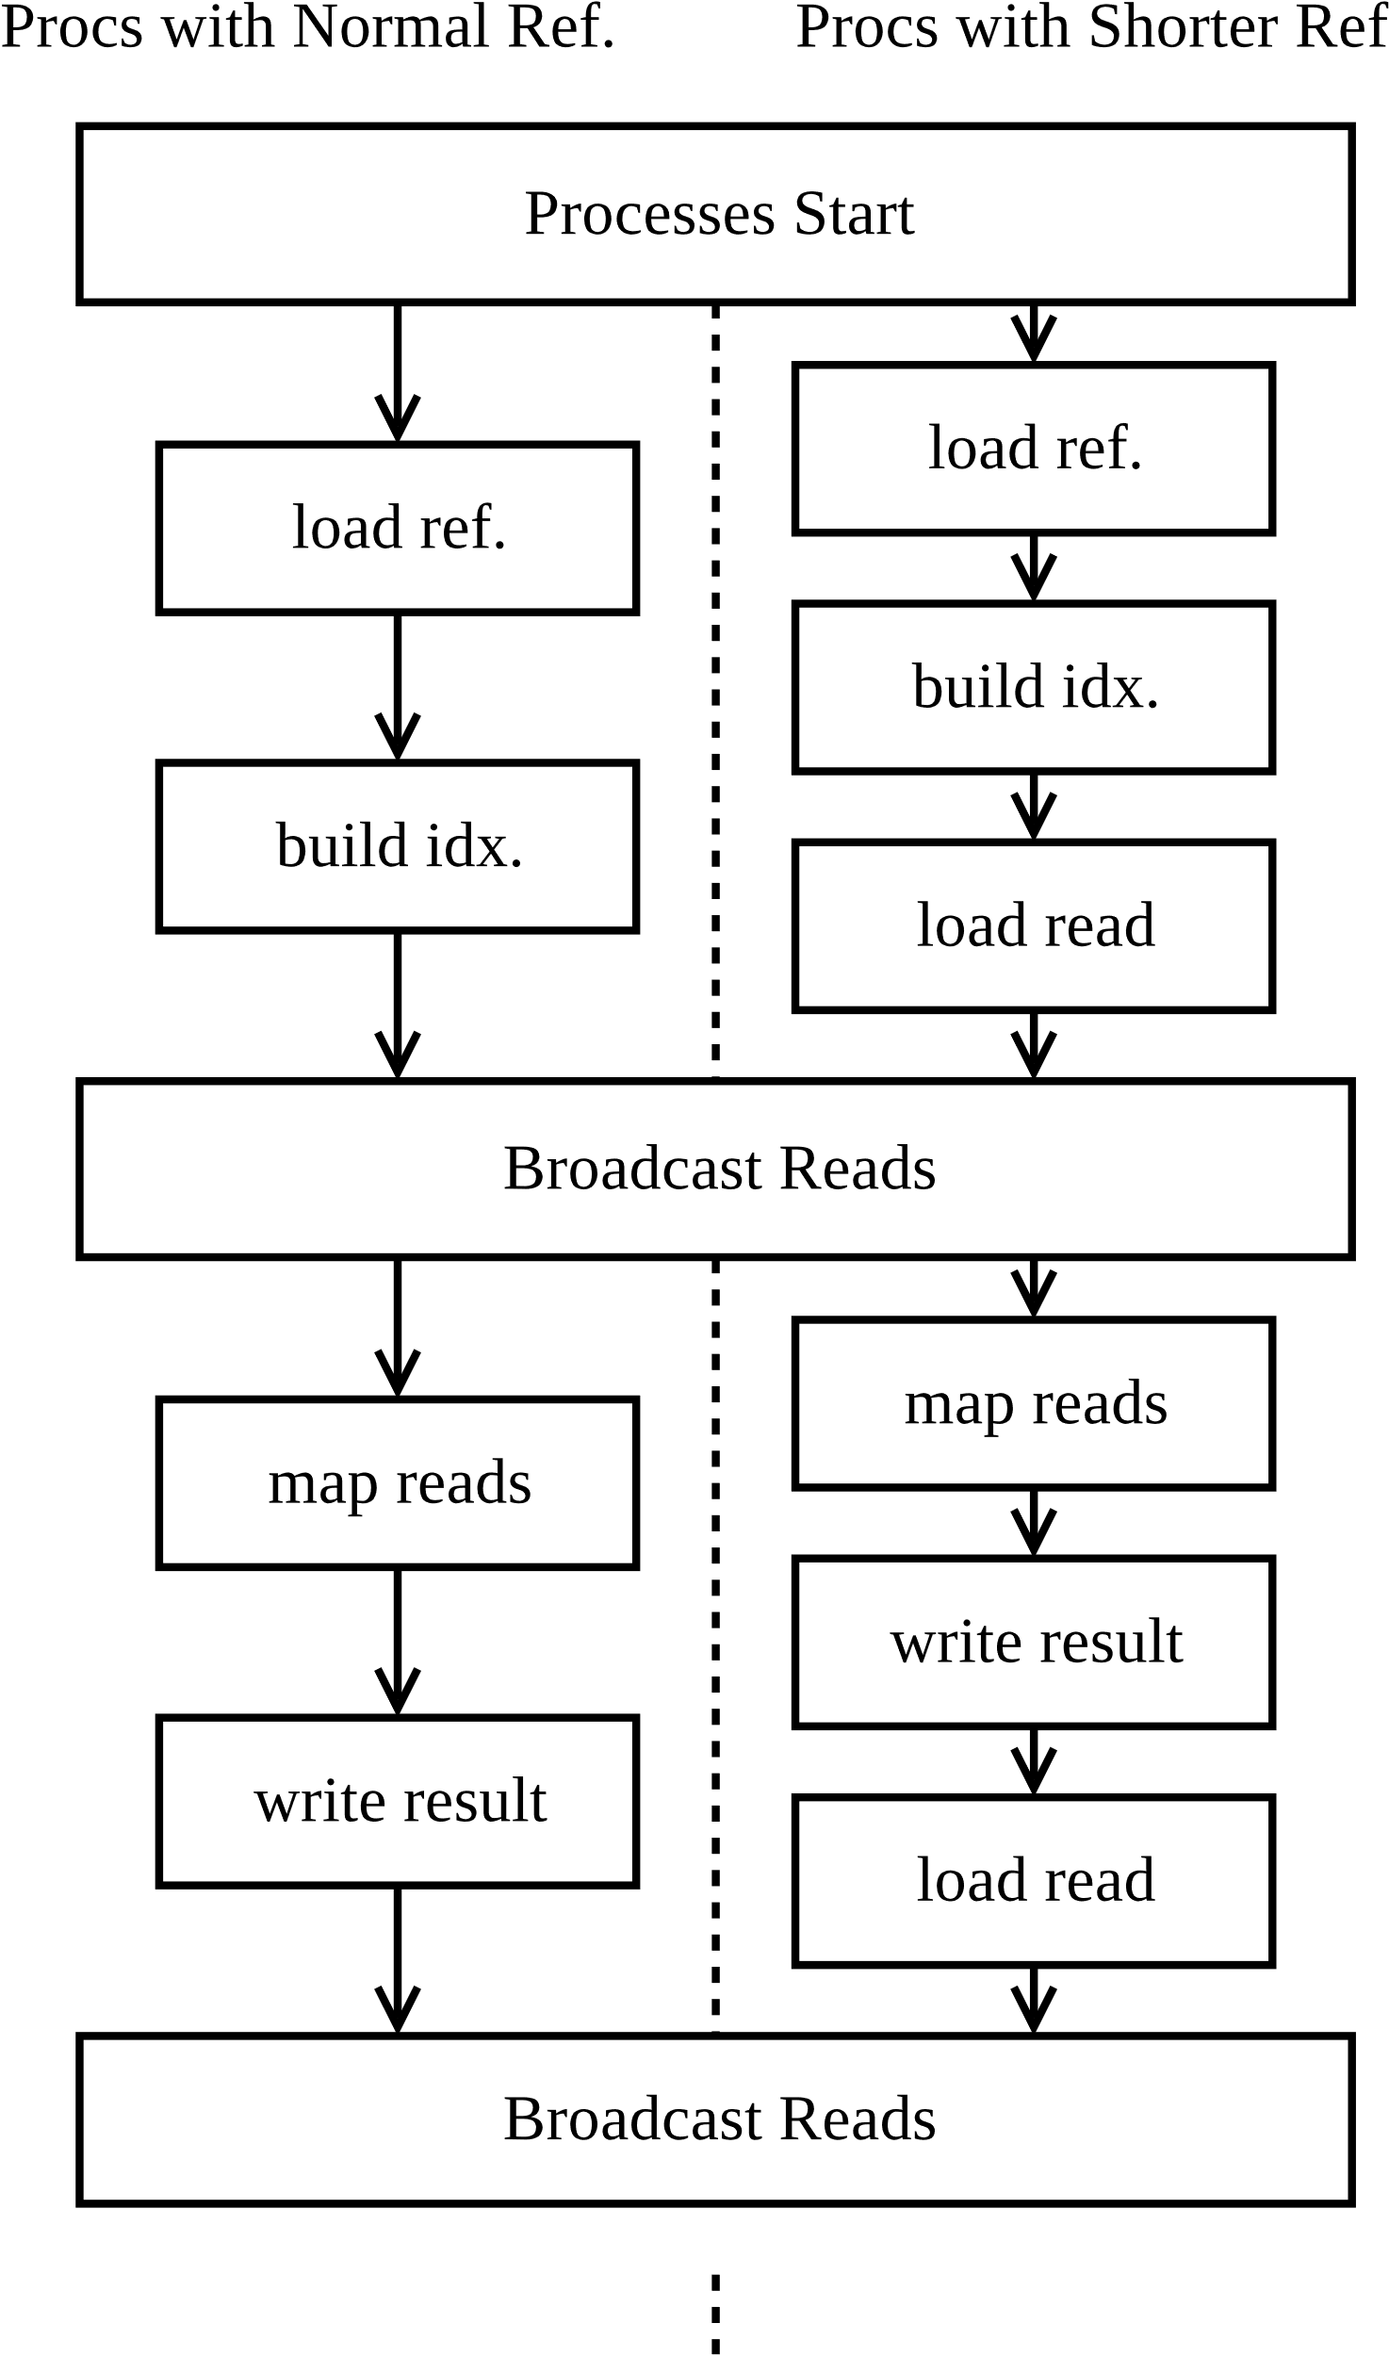
Asynchronous IO optimization
Use process level asynchronous data loading.
Processes with lighter workload (shorter reference block) process IO jobs.
Thus IO overhead can be further hidden.

Slide 17
Single node evaluation
We evaluate our work on a single Sunway node in comparison with RazerS3 on a node with eight E7-8860 v3.
Our work delivers much better performance than RazerS3 when reads are short.
The accuracy is 99.34% on real 108bp read and 99.82% on simulated read of RazerS3.
Ref | Read | Time.R | Time.S
116M | 108bp | 939 | 405
253M | 108bp | 3,044 | 892
253M | 200bp | 3,430 | 2,580
Time.R/S means Time for Razers and S-aligner. Ref is from human genome. Read contains 40,000,000 sequences.

Slide 18
Different parallelization levels
We run our program with different parallelization level on a Sunway node.
Which shows bit-parallel algorithm and use parallelization on SPs can both accelerate the read-mapping solution (tens times faster).

Slide 19
Different data transfer method
We run our program with different data transfer method on a Sunway node.
DMA is much faster than memcpy since it is pure hardware implementation.
Asynchronous DMA causes slightly performance increase.

Slide 20
Scaling evaluation
#nodes | #reads | Time | Mbpps | Para.Eff
13 | 16M | 1,315 | 2.43 | 1.000
52 | 64M | 1,321 | 9.69 | 0.996
208 | 256M | 1,321 | 38.76 | 0.995
832 | 1,024M | 1,327 | 154.33 | 0.995
3,328 | 4,096M | 1,349 | 607.26 | 0.969
13,312 | 4,096M | 344 | 2,381.40 | 0.964
Reference is Full Human genome, read is 200bp simulated data. Bpps won’t change a lot if #nodes/read length/reference don’t change.
We run our program in different scale with same reference (including input but without output).
Performance can be abstracted to bps processed per second (bpps).
It gains almost linear speedup in up to 13,312 nodes with 53,248 processes.
The largest scale, 53,238 processes achieved 2.4 Giga-bpps.

Slide 21
Thanks
For more information about our work, contact us at:
sunrise.duan@mail.sdu.edu.cn

