Slide 1



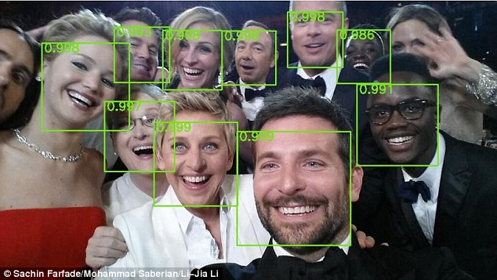
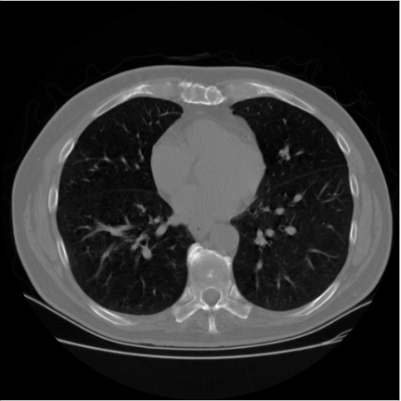


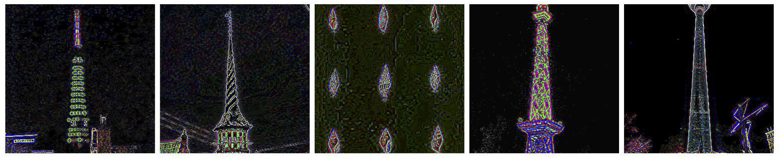


I/O Optimizations for Scalable Deep Learning
Sarunya Pumma^{1,2}, Min Si², Wu-chun Feng¹, and Pavan Balaji²
¹Virginia Tech, ²Argonne National Laboratory
Motivation
Analysis of I/O in Caffe (cont.)
Our Solution: LMDBIO (cont.)
Deep Learning & Challenges
Analysis of LMDB’s Data Access Model
LMDBIO-MPIIO: Direct I/O Optimization
Robotics
Asimo (Honda)
Compute bound
LMDB data access is sequential in nature due to the B+-tree structure
There is no way to randomly access a data record
All branch nodes associated with the previous records must be read before accessing a particular record
When multiple processes read the data, they read extra data
The worst case, a process could end up reading R x B bytes (R = a total number of readers and B = a size of an individual data portion)
Different processes do different amount of work, causing skew
B+ tree structure
Branch node
Problem : mmap fundamentally relies on dynamic I/O data fetching and does not allow for optimizations with bulk I/O
Optimization: Selectively replace mmap with MPI-IO to eliminate the contention caused by mmap for most of the I/O
High-dimensional input data
Image classification
Data Science Bowl’s tumor detection from CT scans
3 |  | 5
d_{i} = i^{th} data record
To perform direct I/O, we need to estimate the pages to be fetched
Due to the B+ tree structure, we cannot precisely estimate the pages to be read
The accuracy of estimation of LMDBIO-DM does not affect correctness but affects performance
Here, accuracy will affect correctness
Key idea:
For performance: Use direct I/O to load most pages
For correctness: Have a fallback path to load some pages that our estimation misses (we expect that the number of fallback pages is very small)
I/O Bound
1 |  | 2 |  | 3
d₁ | d₂ |  | d₃
4 |  | 5
d₄ | d₅
6 |  | 7
d₆ | d₇
Our buffers
Facial Recognition
Deep Dense Face Detector (Yahoo Labs)
High volume data
Sentiment analysis
Twitter analysis
Yelp’s review fraud detection
Image classification
ImageNet’s image classification
Leaf node l₁
Leaf node l₂
Leaf node l₃
Main buffer – for primary access of the database
It is a write-mmap buffer that maps to a virtual file (in memory). We use mmap because LMDB is optimized for 4 KB page accesses
We mainly use direct I/O to write to this buffer
Fallback buffer – for correction for estimation error
It is a read-mmap buffer that maps to a database file in the file system
We use OS’s page fault handler to load pages to memory
We expect to access this buffer infrequently
Batch Size
(# samples)
Database
LMDB redundant data movement
Offline & Online Data Analytics
Real Time News Feed (Facebook)
Tumor detection from CT scans
D0 | D1 | D2 | D3
Communication bound
P0 reads
In the past decade …
10 – 20x improvement in processor speed
10 – 20x improvement in network speed
Only 1.5x improvement in I/O performance
I/O will eventually become a bottleneck for most computations
Networks with large number of parameters
Unsupervised image feature extraction
LLNL’s network with 15 billion parameters
P1 seeks
P2 seeks
P1 reads
P2 reads
P3 seeks
P3 reads
Speculative Direct I/O
Network Size
(width and depth)
Our Solution: LMDBIO
Each reader estimate pages to be read using the same method as LMDBIO-DM
Then each reader performs data reading via direct I/O
To avoid the out of memory problem (as we write to the virtual file), we unmap and remap the virtual file in every iteration
1. Read using direct I/O
Main buffer (mmap to a virtual file in memory)
Image feature extraction
LMDBIO-LMM: Intranode Optimization
2. Write
Problem 1: mmap relies on the CFS scheduler and the underlying bottom-half handler to wake up processes that perform I/O
Process 0
Process 1
Process 2
Shared file system (physical file)
Virtual file (write buffer)
Access
Speculative data reading via direct I/O
Deep Learning Scaling
mmap buffer
(Process 0)
Copy
Access
Access
Fallback I/O
Optimization: Take into account data access pattern of deep learning and Linux’s I/O scheduling to reduce mmap’s contentions
Shared Memory
We use a memory protection mechanism along with the signal handler to implement a page fault handler in user space
When a reader tries to access a page that is not yet loaded to memory (via direct I/O), our page fault handler copies the missing page from the fallback buffer to the main buffer
The access to the fall back buffer will invoke the OS’s fault handler to read a page from file system to memory
We do not use direct I/O in our fault handler as it is signal handler unsafe
2. Page fault handler tries to copy the page from the fallback buffer
Overall Training Time (CIFAR10-AlexNet, 1024 iterations)
Training Time Breakdown (CIFAR10-AlexNet, 1024 iterations)
Map
Fallback buffer (mmap database)
4. Copy
1. Access
Localized mmap
Only one process does mmap on each node
Using MPI shared-memory (MPI-3) to share data
Even LMDBIO has extra copy (from mmap to shared memory), Caffe still gains benefit from LMDBIO
Page cache
Main buffer
Shared file system
(shared between nodes)
Read
3. Read by OS’s fault handler
4. Write
Localized mmap
Shared file system
Virtual file
LMDBIO-DM: Internode Optimization
Fallback I/O
Read Bandwidth
Problem 2: LMDB data access is sequential in nature due to the B+-tree structure. There is no way to randomly access a data record without reading all the previous records
Optimization: coordinate between reader processes to improve parallelism
Experiments and Results
Caffe is 20x worse than ideal for 512 processes
Read time takes up 80% of the total training time for 512 processes
I/O performance (bandwidth) is much worse than ideal
Inefficient utilization of I/O bandwidth (96% loss of efficiency for 512 processes)
POSIX Read
Database
Part I: Sequential I/O and cursor handoff
Overall Training Time
LMDBIO-MPIIO’s Training Time Breakdown
Part I: Serializing I/O
Serialize data reading and coordinate between processes
Each process reads its data and sends the higher rank process the location to start fetching its data from
This allows NO extra data reading: number of bytes read is EXACT… but I/O is done sequentially
D0 | D1 | D2 | D3
Sequential
P0 reads
P0 sends cursor to P1
P1 sends cursor to P2
P1 reads
P2 reads
P2 sends cursor to P3
Portable Cursor Representation
P3 reads
…
Analysis of I/O in Caffe
LMDB calls the position indicator for a record within B+ tree a “cursor”
Not a simple offset from the start of file
It contains the complete path of the record’s parent branch nodes (multiple pointers), a pointer to the page header, and access flags
It is not trivial to port pointers across processes as virtual address spaces are different
Our solution: symmetric address space
Every process memory-maps the database file to the same memory location
Allowing the pointers within the B+ tree to be portable across processes
Database
Part II: Parallel I/O and in-memory sequential seek
Caffe’s I/O Subsystem: LMDB
D0 | D1 | D2 | D3
Context Switches
Platform: Argonne’s Blues Dataset: CIFAR10-Large
InfiniBand Qlogic QDR Network: AlexNet
110 TB GPFS storage MPI: MVAPICH-2.2
Each node
2 Sandy Bridge 2.6 GHz Pentium Xeon (16 cores, hyperthreading disabled)
64 GB memory
15 GB RAM disk
Uses Lightning Memory-mapped database (LMDB) for accessing the dataset
B+-tree representation of the data
Database is mapped to memory using mmap and accessed through direct buffer arithmetic
Virtual memory allocated for the size of the full file
Specific physical pages dynamically loaded by the OS on-demand
Pros: makes it easy to manipulate complex Cons: OS has very little knowledge of the data structures (e.g., B+ trees) since LMDB access model and parallelism making it hard can think of it as fully in-memory to optimize
Concurrent
P0 reads
P1 reads
P2 reads
P0 seeks
P0 sends cursor to P1
P3 reads
Sequential
(in-memory)
P0 accesses
P1 seeks
P1 sends cursor to P2
P2 sends cursor to P3
P1 accesses
P2 seeks
P3 seeks
…
P2 accesses
P3 accesses
Analysis of mmap
Part II: Speculative Parallel I/O
Estimation of Speculative I/O (cont.)
Conclusion
Underlying I/O in mmap relies on the CFS scheduler to wake up processes after I/O has been completed
Processes are put to sleep while waiting for I/O to complete
I/O completion interrupt is a bottom-half interrupt
The handler does not have knowledge about the specific process that triggered the I/O operation
Every process that is waiting for I/O is marked as runnable
Every reader is woken up each time an I/O interrupt comes in
This causes a large number of unnecessary context switches
Context Switches
Read Time Breakdown
Each process estimates pages that it will need and speculatively fetches pages to memory in parallel
Then each process sequentially seeks the location for another processes and sends the cursor to the next higher rank process
The expectation is that the seek can be done entirely in memory
Once the sequential seek is done, each reader can perform actual data access
This adds a small amount of extra data reading, but allows parallel I/O
The estimation of number of pages to fetch is based on the first record’s data size
I.e., CIFAR10-Large record’s size is 3 KB, which is ~1 page. To read n records, it needs to fetch n pages
The estimation of the read offset is performed in the same fashion
Estimation of the “approximate” start and end location for each process is important
If the estimate is completely wrong, we will end up reading up to 2x the dataset size (still better than the LMDB)
We use a history-based training for our estimation
We correct our estimate in each iteration depending on the actual data read in all of the previous iterations
The general ideal of out correction is that we attempt to expand the speculative boundaries to reduce the number of missed pages
Initial iterations might be slightly inaccurate, but we converge fairly quickly (1-2 iterations)
I/O is a significant problem in deep Learning, particularly for simple networks
Improved hardware trends making communication and computation faster, making I/O an even bigger problem
We proposed LMDBIO: an optimized I/O framework specially designed for deep-learning applications
Intranode optimization: localizing mmap
Internode optimization: coordinating between processes
Direct I/O optimization: replace mmap with direct I/O
Caffe gains a 11-fold improvement in the overall performance with LMDBIO in some cases
Estimation of Speculative I/O
Our Publications
Sarunya Pumma, Min Si, Wu-Chun Feng and Pavan Balaji. Towards Scalable Deep Learning via I/O Analysis and Optimization. IEEE International Conference on High Performance Computing and Communications (HPCC). Dec. 18-20, 2017, Bangkok, Thailand.
Sarunya Pumma, Min Si, Wu-Chun Feng and Pavan Balaji. Parallel I/O Optimizations for Scalable Deep Learning. IEEE International Conference on Parallel and Distributed Systems (ICPADS). Dec. 15-17, 2017, Shenzhen, China.

