Slide 1
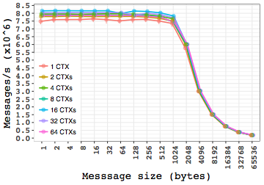
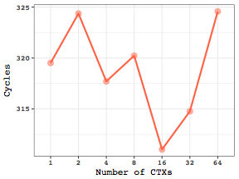
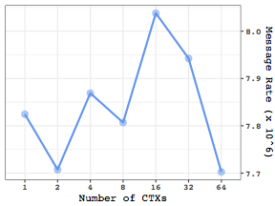
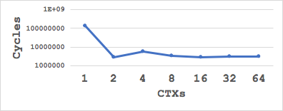
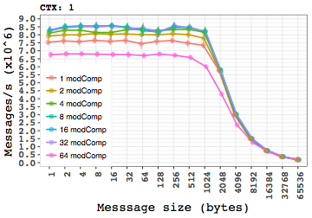
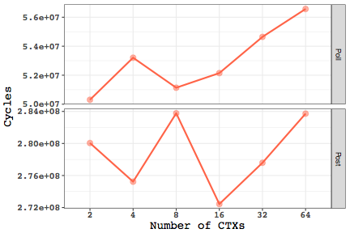
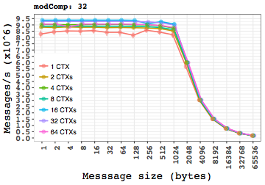


Network hardware today
Feature multiple communication contexts.
Continuing to move in this direction by featuring multiple NICs on a node.
Expose parallelism at the network hardware level.
MPI today
Each process uses only one communication context.
Multiple communication contexts used only if multiple ranks exist on a node.
Even in hybrid environments, all threads use the context available to one rank.
Underutilized resources
When number of ranks on a node is smaller than the number of contexts.
MPI rank could acquire the remaining resources and tap the network parallelism.
Scenario to study
A single process sending messages using multiple network resources.
Evaluation over InfiniBand.
Using libibverbs.
A sender-receiver pair on the JLSE Cluster
64-core Intel Xeon E7-8867 CPU @ 2.5 GHz; RHEL 7.4
Mellanox OFED 4.1-1.0.2.0
Completions every issue
Explaining observed Message Rates
Contingent on rate of issuing ibv_post_sends.
ibv_post_send called every 296.18 cycles in the post-loop
But ibv_post_send of next post-loop is called only after 3838.88 cycles
Hence, bottlenecked by completion-check of issued sends
A completed send
A send that involves a ibv_post_send and a successful ibv_poll_cq
Issue-rate of completed sends
Completed-send cycles
Calculated MRs
Batch completions
Network processing saturates with increase in number of CTXs
Sender
int posts_per_qp = messages / num_ctxs; MPI_Barrier(MPI_COMM_WORLD); /* Sender loop */ while (tot_post_count<messages || tot_comp_count<messages) { for (i=0; i<num_ctxs; i++) { /* Post */ posts = min(posts_per_qp - post_count[i], qp_depth - (post_count[i]-comp_count[i])); for (k=0; k<posts; k++) { ibv_post_send(qp[i], &send_wqe[i], &bad_send_wqe); } post_count[i] += posts; tot_post_count += posts; /*Poll*/ if (comp_count[i]<posts_per_qp) { cqe_count = ibv_poll_cq(cq[i], num_comps, WC); comp_count[i] += cqe_count; tot_comp_count += cqe_count; } } }
While the aggregate number of posting and polling cycles remain the same with the same number of CTXs, the slow down fro 16 CTXs to 64 CTXs is due to the increase in number of polls
Receiver
int posts_per_qp = messages / num_ctxs; MPI_Barrier(MPI_COMM_WORLD); /* Receiver loop */ while (tot_comp_count<messages) { for (i=0; i<num_ctxs; i++) { cqe_count = ibv_poll_cq(cq[i], num_comps, WC); if (cqe_count>0) { for(j=0; j<cqe_count; j++) { if (post_count[i]<posts_per_qp) { ibv_post_recv(qp[i], &recv_wqe[i], &bad_recv_wqe); } ++post_count[i]; } } } }
Network hardware parallelism (multiple contexts) can help improve performance to some extent.
but should be used judiciously.
Next steps
Evaluate on different high-performance interconnects and study similarities and differences of behavior with libibverbs
Evaluate with virtual topologies and hybrid environments

