Slide 1

Exploiting Common Neighborhoods to Optimize MPI Neighborhood Collectives
Seyed H. Mirsadeghi¹, Jesper L. Trӓff, Pavan Balaji, and Ahmad Afsahi
Parallel Processing Research Laboratory, Queen’s University, Canada
Vienna University of Technology (TU Wien), Research Group Parallel Computing
Mathematics and Computer Science Division, Argonne National Laboratory
24th International Conference on High Performance Computing,
Data, and Analytics (HiPC 2017)
December 21, 2017
1. Currently at AdGear Technologies

Slide 2
Outline
Introduction
MPI
Topology awareness
Neighborhood collectives
Optimizing neighborhood collectives
Experimental results
Conclusion and future work

Slide 3
Introduction
Message Passing Interface (MPI)
De facto standard for parallel programming in HPC
A mature parallel programming system
Distributed memory
Shared memory
PGAS
Provides (mainly) communication APIs
Point-to-point
Collective (broadcast, all-to-all, etc.)
RMA
Notes:
Promising performance improvements reported

Slide 4
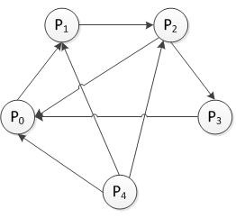
Introduction (cont.)
Topology awareness
Physical topology
Virtual topology (communication pattern)
Topology-aware process-to-core mapping
MPI process topology interface
Cartesian
Distributed graph

Slide 5
Neighborhood Collectives
Relatively new communication type
Add communication semantics to process topologies
Pattern is defined by the process topology graph
Only send/receive to/from neighbors
Sparse collective communications
Benefits:
User-defined collectives
Support for widely used patterns
Better scalability
Can we design non-trivial schedules to
optimize neighborhood collectives?
Neighborhood Allgather

Slide 6
Optimizing Neighborhood Collectives: Objectives
Small-message communications
Startup latency
Decrease the number of communication stages
Large-message communications
Serialization latency
Decrease congestion

Slide 7
Optimizing Neighborhood Collectives
Offload from large-outdegree nodes to those with a lower outdegree
Tree Balancing algorithm by Torsten Hoefler¹
Ensure balanced communication across all nodes
x
x
Beneficial only for unbalanced topology graphs
Many applications have a balanced topology graph
[1] T. Hoefler and T. Schneider, "Optimization principles for collective neighborhood communications," SC, 2012, pp. 1-10.

Slide 8
Our Contribution
Exploit common neighborhoods for message combining
K common neighbors between $p1$ and $p2$
Reduce number of communication stages from K to $\frac{K}{2}+1$

Slide 9
Our Contribution: Highlights
Fully distributed algorithm
Using no prior knowledge about the topology
Targeting MPI distributed graph topology
Focus on small messages
Two phases
Pattern design from the topology
Schedule design from the pattern

Slide 10
Pattern Design
Extract common neighborhoods
Find friend processes
Two processes that have more than θ neighbors in common
Pair with a friend
Build friendship graph
Weighted graph matching in friendship graph
Divide common neighbors between friends
Update neighborhood information
Once per topology

Slide 11
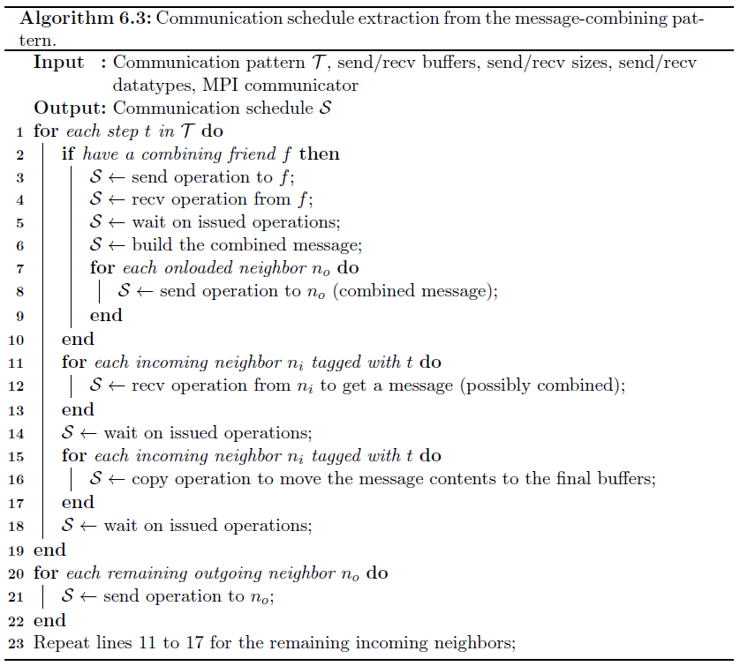
Schedule design
Precisely specifies send, receive, and memory-copy operations
Contains specific buffer addresses
For each step t in the pattern
Send/receive messages to/from the paired friend
Build the combined message
Send the combined message to the onloaded neighbors
Receive message from incoming neighbors tagged with t
Copy data to the final buffers
Send/receive to/from any remaining neighbors
Once per specific collective function

Slide 12
Experimental Setup
Microbenchmark to measure neighborhood collective latencies
Two class of topologies:
Random sparse graph
Moore neighborhoods
Two design flavors:
Non-persistent collective
Persistent collective
Moore neighborhood with D = 2, R = 2

Slide 13
Experimental Setup (cont.)
GPC cluster at SciNet (Compute Canada)
3780 nodes
2 quad-core Intel Xeon 2.53 GHz
QDR InfiniBand, 3-level fat-tree topology
Mellanox ConnectX HCAs

Slide 14
Latency Results: Random Sparse Graph
MPI neighbor allgather, 4,096 processes
4-byte message size

Slide 15
Latency Results: Random Sparse Graph
Edge density = 0.05
Edge density = 0.2
MPI neighbor allgather, 4,096 processes
Different message sizes

Slide 16
Latency Results: Moore Neighborhood
D = 2, 168 × 64 processes
D = 3, 32 × 16 × 16 processes
MPI neighbor allgather, 8,192 processes
4-bytemessage size

Slide 17
Latency Results: Moore Neighborhood
D = 2, R = 2, 168 × 64 processes
D = 3, R = 2, 32 × 16 × 16 processes
MPI neighbor allgather, 8,192 processes
Different message sizes

Slide 18
Overheads: Phase 1 & Phase 2
Random sparse graph, 4K processes
Moore neighborhood, 8K processes
Main overhead is in Phase 1
Once per topology
Much lower overhead with Moore neighborhood

Slide 19

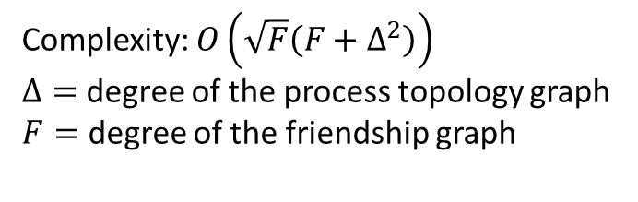
Overheads: Phase 1 Scale Trend (cont.)
Random Sparse Graph
Increase in time
Increase in number of friends per process
Complexity: $O\left(\sqrt{F}\left(F+Δ^{2}\right)\right)$
$Δ=$ degree of the process topology graph
$F=$ degree of the friendship graph
$$O(p^{1.5})$$

Slide 20

Overheads: Phase 1 Scale Trend (cont.)
Moore Neighborhood
Increase in time
Increase in number of friends
Complexity: $O\left(\sqrt{F}\left(F+Δ^{2}\right)\right)$
$Δ=$ degree of the process topology graph
$F=$ degree of the friendship graph
Independent of $p$

Slide 21
Conclusion
There is potential for optimizing Neighborhood collectives
Useful information can be extracted from process topology graphs
Common neighborhoods can be extracted and used for message combining

Slide 22
Future Work
Finding the best value of friendship threshold Ө
Using other algorithms to solve matching problem in friendship graph
Considering more than two processes at each friend-matching step (small cliques of friends)
Integrating other metrics into the friendship relationship
Friend affinity?
Using one-sided communications and datatypes to decrease communication and data copying overheads

Slide 23




Acknowledgments

Slide 24
?
Thanks for your attention!

Slide 25
Backup Slides

Slide 26
Pick a candidate
Check validity

