Slide 1
Portable topology aware MPI-io
erhtjhtyhy
Rob Latham
Pavan Balaji
Leonardo Bautista Gomez
Math and Computer Science Division
Argonne National Laboratory
Math and Computer Science Division
Argonne National Laboratory
Barcelona Supercomputing Center
16 December 2017
ICPADS

Slide 2
motivation
Classic tale of CPU-storage gap:
Storage hierarchy growing more complex in response
Traditionally, one globally accessible parallel file system
“Burst buffers” – SSD, NVRAM – appearing now
Requires site-specific knowledge to use

Slide 3
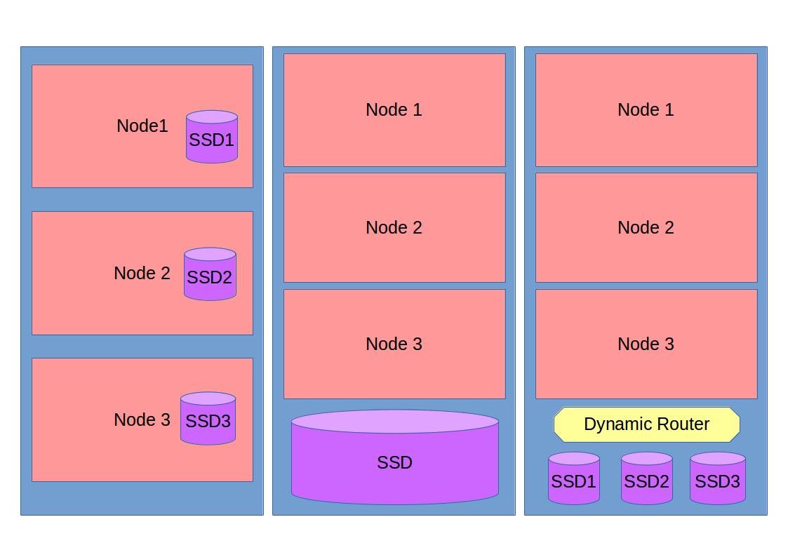
NO standard solution yet
Platform | Hierarchy
BlueGene/Q (e.g. ANL Mira) | Ramdisk on I/O nodes
Node-local NVRAM (e.g. ANL Theta) | Local SSD
Cray DataWarp (e.g. NERSC Cori) | Depends on directives used
Node-local
Rack-local
Distributed

Slide 4
Some MPI context
MPI: specification and implementation for portable message passing
Concept of “Communicator”: collection of processes and context for messaging
Everyone starts in MPI_COMM_WORLD
MPI_COMM_SPLIT:
Algorithmically create new sub-communicators based on “color”
“I want half my processes doing X and half doing Y”
MPI_COMM_SPLIT_TYPE
Create new sub-communicators based on machine-specific factors
“I want all processes in a communicator to have access to shared memory”

Slide 5
Extending MPI standard
int MPI_Comm_split_type(MPI_Comm comm, int split_type, int key, MPI_Info info, MPI_Comm *newcomm)
Introduced in MPI-3
Standard defines one “split_type”: MPI_COMM_TYPE_SHARED: processes share memory
Proposed/implemented new split_type flag: “MPIX_COMM_TYPE_NEIGHBORHOOD”
What kind of neighborhood? Info key directs
Key: “nbhd_common_dirname”; value: some path shared among processes

Slide 6
Approach
Exhaustive
Every process creates one candidate file
Works well if storage not globally shared
Completely useless on global storage
Heuristic
Less accurate but only requires two storage calls
If e.g. NVRAM installed at rack-level, heuristic will inaccurately detect node-local storage

Slide 7
Results
Application Kernel
Scenario: simulation code periodically writes checkpoints
What if we checkpoint to local storage?
Drawback: scatters files across nodes.
Benefit: much faster checkpoints
Maybe checkpoints are written more often than read?
Maybe we can collect one set of staged checkpoints (at exit? At synchronization points?) fast enough to still come out ahead

Slide 8
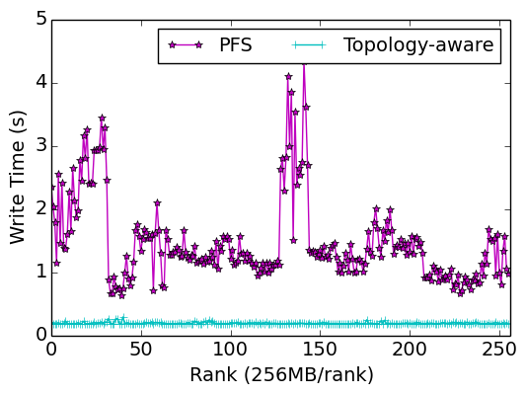
Results
Intermediate storage
Workflow simulations need some way to get products between stages of workflow pipeline
Saving intermediate steps to parallel file system adequate, but poor fit for parallel file system designs
“Write visibility”: needed at task level, not process level
Use burst buffer to hold intermediate products
Avoid contention on parallel file system
Better semantic fit

Slide 9
Next Steps
Split communicator based on NUMA domains
OpenMPI approach, but with hints
Use generated communicator in I/O logging
Collective I/O for log replay across nodes sharing NVRAM
Improved heuristics

Slide 10
Conclusion
We can extend well-established APIs to help programs cope with storage hierarchy changes/complexity
Could be used directly by application, though also could be a building block for system libraries
Download latest MPICH and give it a try!

