Slide 1
Memory Compression Techniques for Network Address Management in MPI
Yanfei Guo¹, Charles Archer², Michael Blocksome², Scott Parker³, Wesley Bland², Ken Raffenetti¹ and Pavan Balaji¹
1. Mathematics and Computer Science Division (MCS), Argonne National Laboratory
2. Intel Corporation
3. Argonne Leadership Computing Facility (ALCF), Argonne National Laboratory

Slide 2
Acknowledgement and Disclaimer
This work is supported by the U.S. Department of Energy, Office of Science, under contract number DE-AC02-06CH11357. This research used Blues, a high-performance computing cluster operated by the Laboratory Computing Resource Center at Argonne National Laboratory. This research used resources of the Argonne Leadership Computing Facility, which is a DOE Office of Science User Facility.
Disclaimer: Optimization Notice: Intel’s compilers may or may not optimize to the same degree for non-Intel microprocessors for optimizations that are not unique to Intel microprocessors. These optimizations include SSE2, SSE3, and SSSE3 instruction sets and other optimizations. Intel does not guarantee the availability, functionality, or effectiveness of any optimization on microprocessors not manufactured by Intel. Microprocessor-dependent optimizations in this product are intended for use with Intel microprocessors. Certain optimizations not specific to Intel microarchitecture are reserved for Intel microprocessors. Please refer to the applicable product User and Reference Guides for more information regarding the specific instruction sets covered by this notice. Software and workloads used in performance tests may have been optimized for performance only on Intel microprocessors. Performance tests, such as SYSmark and MobileMark, are measured using specific computer systems, components, software, operations and functions. Any change to any of those factors may cause the results to vary. You should consult other information and performance tests to assist you in fully evaluating your contemplated purchases, including the performance of that product when combined with other products. For more complete information visit www.intel.com/benchmarks. Notice Revision #20110804

Slide 3
MPI Library Could Use Up All of Your Memory
MPI runtime libraries are highly optimized for communication performance
MPI runtime can use a lot memory for internal data structures
Network Address Management
Poor memory scalability
Future HPC systems: Intel Xeon Phi (72 cores, 32GB MCDRAM)
out of memory at 768K procs, 100 COMMs
On Mira 16 core/node, 16 GB/node
1 GB mem for 1 proc

Slide 4
Network Address Management
Communicators and Ranks
MPI libraries must translate ranks to network addresses
Virtual Connection (VC): a bundle of communication related data structures
Network address, transport function, connection state, process group, …
Global data structure in each MPI process
480B per VC (peer process) => 480MB per process for a 1M procs job
MPI_Send(buf, 1, MPI_BYTE, 1, 0, MPI_COMM_WORLD)
Target rank Communicator
Virtual Connections
1
Addr
…
Process 0
MPI_COMM_WORLD
Addr
…
Process 1
Addr
…
O(P) Memory, P processes
Addr
…
…
…

Slide 5
Communicators
Communicator contains a group of processes
Virtual Connection Reference Table (VCRT) for rank translation
Built-in communicators and internal communicators
MPI_COMM_WORLD, MPI_COMM_SELF (created at initialization)
Node_local_comm, node_roots_comm (created for each communicator)
User-created communicators
Communication for subgroups, different contexts
Selecting processes from a parent communicator
Reordering
0
1
2
0
1
2
3
0
1
2
3
Dup
Split+reorder
4
5
6
7
4
5
6
7
Split
8
9
10
11
8
9
10
11
0
1
2
3
12
13
14
15
12
13
14
15
4
5
6
7

Slide 6
VC-VCRT Scheme for Network Address Management
Address = VC[comm.VCRT[rank]].addr;
Pros
Support any group with arbitrary rank order
Cons
Fat VC = Uses more memory
Simple rank-address = Less overhead on performance critical path (constant cost for lookup)
Fat VC = Less memory dereference
O(P) memory for VCs (for P processes)
O(nP) memory for VCRTs (for n communicators)
Memory cost model is uniform to all applications
The same scheme is used in MPICH, OpenMPI, and all other MPI libraries that derived from them. (vendor MPI libraries)

Slide 7
Related Works
Machine specific optimization => loss of generalization
Compressing the VCRTs
[Chaarawi-ICCS’08] O(Log(P)) lookup time
[Träff-EuroMPI’10] Traverse overhead
[Kumar-EuroMPI’16] Topology-specific
Great reduction on memory usage
High/non-constant translation cost, communication overhead
The hard part is to compress the memory usage without hurting the communication performance.

Slide 8
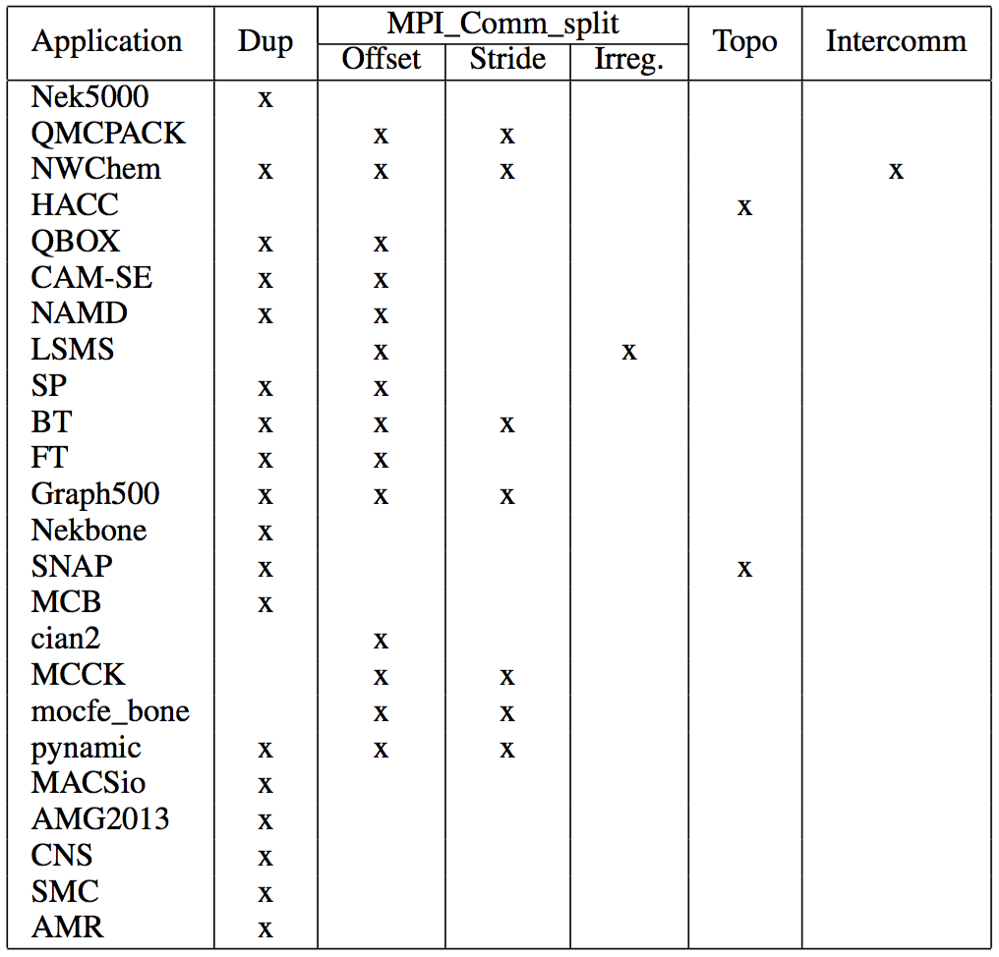
Communicators in MPI Applications
62 applications (NAS, CORAL Benchmarks, DOE codesign)
Common use cases of communicator creations
Most applications duplicates communicators
Topology communicators are created without reordering (equals to dup)
No one use dynamic process (no true intercomm)
Split has regular pattern and no reordering

Slide 9
Regular Patterns in Split Communicators
Offset and Stride patterns
Processes in 2-D grids, row comm and column comm
No reordering
Simple mapping between ranks to processes
Internal communicators (node_local_comm, node_roots_comm)
0
1
2
3
0
0
0
0
0
1
2
3
1
1
1
1
4
5
6
7
0
1
2
3
2
2
2
2
8
9
10
11
3
3
3
3
0
1
2
3
12
13
14
15
0
1
2
3

Slide 10
AV-Rankmap Overview
Prioritizing common use cases
Reduce memory usage for common cases without adding overheads to performance critical path
Uncommon cases are paying the same or more
Do not compromise on functionality
Two-part solution
Address Vector (AV): Stripped-down VC
Still O(P) memory, but with smaller element
Rankmap: Explioting regular mapping patterns
Constant memory for each communicators with common use cases
COMM1
COMM2
COMM3
DIRECT
COMM
OFFSET
COMM
STRIDE
COMM
LUT
COMM
MLUT
COMM
VCRT
0
1
2
3
VCRT
0
1
VCRT
0
1
R=0
R=0
R=0
R=0
R=1
Offset
Stride
5
4
0:5
1:1
VC 0
VC 1
VC 2
VC 3
…
VC n
VC n+1
AV tables
0
1
2
3
4
5
0
1

Slide 11
Deprioritizing the Support of Multi-Transport and Dynamic Process in Address Vector
Multiple transport – Reduce redundancy
Multiple function pointers in VC, allowing each peer process to have different transport
Usually, there are only two transports: shared memory and network.
Store function pointers separately, use 1 bit to select between shared memory and network
Function pointer array is small and frequently referenced
Dynamic process
Connection information, process group ID, etc.
Use dynamic allocated connection table
Save process group ID to communicator
Address Vector (AV) contains only the core network access information.
Each address vector element (AVE) is only 12 bytes
Low-level network libraries can embed the address in AVE or use AVE as a pointer to the address structure
AVE can be as low as 8B if the 1 bit for transport selection can be embedded into address

Slide 12
Rank-Address Translation through Regular Patterns
A rankmap holds the maps ranks to the indices of AVEs
Two rankmaps per comm (remote/local group)
Predefined regular patterns
Direct
Offset (offset)
Stride (stride, offset)
Strideblock (stride, offset, blocksize)
Fallback to lookup tables
LUT (indices)
MLUT (AVTid, indices)
DIRECT
COMM
OFFSET
COMM
STRIDE
COMM
LUT
COMM
MLUT
COMM
R=0
R=0
R=0
R=0
R=1
Offset
Stride
5
4
0:5
1:1
AV tables
0
1
2
3
4
5
0
1

Slide 13
Communicator Creation in AV-Rankmap
Comm Creation
Parent Comm (base rankmap)
Indirect Mapping (rank selection)
Detecting pattern of the indirect mapping
Direct => Offset => Stride => Irregular
Determine child comm’s rankmap
Select type and calculate parameters
Irregular pattern optimizations
Deduplication
Mixed mode (regular mapping to a lookup table)
MPI_COMM_WORLD
+
2
3
4
5
=
Child Comm (offset = 2)
 | direct | offset | stride | irregular
direct | direct | offset | stride | lut
offset | offset | offset | stride | lut
stride | stride | lut | lut | lut
lut | lut* | lut* | lut | lut
mlut | mlut* | mlut* | mlut | mlut

Slide 14
Memory Saving of AV-Rankmap
Loop-split, MPI_Comm_split(), 10 comms and 100 comms, ppn=16, Mira
AV-Rankmap effectively reduced the memory usage
VC-VCRT run out of memory at 768K procs, 100 COMMs
AV-Rankmap uses 6MB for at 100 COMMS

Slide 15
Understanding the Impact to the Performance Critical Path
avtid, index = Rankmap_translation(comm.rankmap, rank);
Address = AV[avtid][index];
Rank-address translation
Check rankmap type (direct, offset, etc.)
Calculate AVE index (no-op for direct)
Access AVE by avtid and index
Implementation details (using Intel SDE)
Switch vs. if-switch hybrid
Special case for avtid=0
VC-VCRT
mov rax, qword ptr [rbp+0x60]
mov rdx, qword ptr [rip+0x43566d]
mov rax, qword ptr [rax+0x188]
mov eax, dword ptr [rax+r12*4+0xc]
shr eax, 0x1
cdqe
mov rax, qword ptr [rdx+rax*8+0x8]
Load the COMM address
Load the base address of VC table
Load the base address of VCRT
Access VCRT
Calculate the address of rank in VC table
(extending 32-bit to 64-bit)
Access VC
Switch
cmp dword ptr [rdi+0x1a8], 0xa
jnbe 0x435039
mov eax, dword ptr [rdi+0x1a8]
jmp qword ptr [rax*8+0x5cfcc8]
movsxd rax, esi
add rax, 0x1
shl rax, 0x4
add rax, qword ptr [rip+0x4682c6]
mov rax, qword ptr [rax]
Switch statement for mapping model
Jump to default case (not taken)
Load mapping model
Jump to corresponding case
Load rank
Calculate the address of rank in AV table
Add the base address of AV table
Access AV for the rank

Slide 16
Switch vs If-Switch Hybrid
Prioritizing direct type with if statement
Less instruction (single cmp + branch)
Penalty on other types
Switch
cmp dword ptr [rdi+0x1a8], 0xa
jnbe 0x435039
mov eax, dword ptr [rdi+0x1a8]
jmp qword ptr [rax*8+0x5cfcc8]
movsxd rax, esi
add rax, 0x1
shl rax, 0x4
add rax, qword ptr [rip+0x4682c6]
mov rax, qword ptr [rax]
Switch statement for mapping model
Jump to default case (not taken)
Load mapping model
Jump to corresponding case
Load rank
Calculate the address of rank in AV table
Add the base address of AV table
Access AV for the rank
Hybrid
mov edx, dword ptr [rdi+0x1a8]
cmp edx, 0x1
jnz 0x435370
movsxd rax, esi
add rax, 0x1
shl rax, 0x4
add rax, qword ptr [rip+0x467e8b]
mov rax, qword ptr [rax]
If (mapping model == DIRECT_INTRA)
Jump to else(not taken)
Load rank
Calculate the address of rank in AV table
Add the base address of AV table
Access AV for the rank

Slide 17
Instruction Count for Rank-Address Translation
Switch-based Implementation
All model has the same priority
Hybrid of If and Switch
Prioritizing DIRECT_INTRA, OFFSET_INTRA, and STRIDE_INTRA
Even higher instruction counts for other models
Baseline: Rank-Address Translation in CH3 is 7 instructions
 | IC of Switch Impl | IC of Hybrid Impl
DIRECT_INTRA | 9 | 8
DIRECT | 11 | 10
OFFSET_INTRA | 11 | 12
OFFSET | 13 | 14
STRIDE_INTRA | 13 | 16
STRIDE | 15 | 17
STRIDE_BLOCK_INTRA | 20 | 23
STRIDE_BLOCK | 22 | 25
LUT_INTRA | 11 | 18
LUT | 13 | 20
MLUT | 15 | 22

Slide 18
Detail Performance Analysis: Improvement on Issuing Rate
Issuing MPI_Put in loop without actual sending data (bypassing network)
Theoretical maximum performance
On LCRC Blues, CPU frequency is 2.6 GHz, processes are bind to cores

Slide 19
L1D Cache Misses
Compressing VC structure reduces the cache misses during communication
Deduction in L1D cache misses compensated the overhead of additional instructions
Measured with PAPI on LRCR Blues

Slide 20
MPI_Put Issuing Rate on Real Network
Issuing MPI_Put in loop
On LCRC Blues, CPU frequency is 2.6 GHz, processes are bind to cores, Qlogic Infiniband QDR 40Gbps

Slide 21
Nek5000
Medium and Large test case for Nek5000
On Mira with 512K procs

Slide 22
Conclusion
AV-Rankmap reduces memory usage without adding performance overhead to the communication path
Effective for most common use cases
Available in MPICH v3.3a2
https://www.mpich.org/downloads

Slide 23
Q & A

