Slide 1

Process-in-Process: Techniques for Practical Address-Space Sharing
HPDC’18, Tempe Arizona
June 14, Arizona
Atsushi Hori (Riken) and Min Si (ANL)
B. Gerofi, M. Takagi, Y. Ishikawa (Riken),
J. Dayal (Intel), P. Balaji (ANL)

Slide 2
Motivation
Conventional In-node Parallel Execution Models
Multi-Process: MPI
Multi-Thread: OpenMP
Pros
Multi-Process: Privatized variables
Multi-Thread: Easy to exchange info.
Cons
Multi-Process: Hard to exchange data
Multi-Thread: Locks on shared variables
The rise of Many-Core
makes above cons worse

Slide 3
Conventional Parallel Execution Models
 |  | Address Space
 |  | Isolated | Shared
Variables | Privatized | Multi-Process (MPI)
 | Shared | N/A | Multi-Thread (OpenMP)
Pros
Multi-Process: Privatized variables
Multi-Thread: Easy to exchange data
Cons
Multi-Process: Hard to exchange data
Multi-Thread: Locks on shared variables

Slide 4
Take the best of two worlds
 |  | Address Space
 |  | Isolated | Shared
Variables | Privatized | Multi-Process (MPI) | 3rd Exec. Model
 | Shared | N/A | Multi-Thread (OpenMP)
Pros
Multi-Process: Privatized variables
Multi-Thread: Easy to exchange data
Cons
Multi-Process: Hard to exchange data
Multi-Thread: Locks on shared variables
3rd Model

Slide 5
Take the best of two worlds
 |  | Address Space
 |  | Isolated | Shared
Variables | Privatized | Multi-Process (MPI) | 3rd Exec. Model
 | Shared | N/A | Multi-Thread (OpenMP)
Pros
Multi-Process: Privatized variables
Multi-Thread: Easy to exchange data
Cons
Multi-Process: Hard to exchange data
Multi-Thread: Locks on shared variables
3rd Model
Variables and Data are SHARABLE

Slide 6
3rd Model Implementations
Two Approaches
Process Approach
SMARTMAP (SNL) Kitten OS
PVAS (Riken) Patched Linux
Thread Approach
MPC (CEA) Compiler
None of them is portable nor practical
Our Goal:
Can we implement it at user-level ?
more portable and practical

Slide 7
Process-in-Process (PiP)
User-Level Implementation
3 Technical Elements
dlmopen() - not dlopen()
creates a new (symbol) name space for linking
can privatize statically allocated variables
Position Independent Executable (PIE)
can load multiple programs in the same virtual address space
clone() or pthread_create()
creates kernel threads to run on the same virtual address space
PiP has only 3K LOC

Slide 8
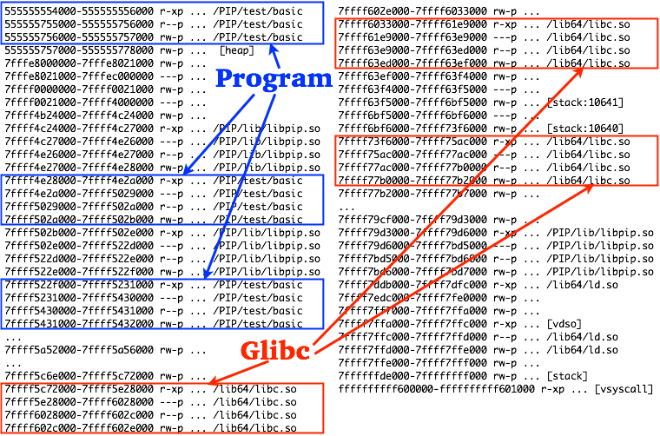
/proc/*/maps Example of PiP

Slide 9
OpenMP, MPI and PiP
OpenMP
int main() {
int tid, seed, i;
srand(1);
#pragma omp parallel …
{
seed = 1;
tid = omp_get_thread_num();
for ( i=0; i<3; i++ ) {
#pragma omp barrier
printf( "<%d> %d : %d\n", tid,
rand(), rand_r(&seed) ); }
}
return 0;
}
MPI
int main( … ) {
int i, rank, seed = 1;
MPI_Init( … );
MPI_Comm_rank( …, &rank );
srand(1);
for ( i=0; i<3; i++ ) {
MPI_Barrier( … );
printf( "<%d> %d : %d\n", rank,
rand(), rand_r(&seed) ); }
MPI_Finalize();
return 0;
}
PiP
pthread_barrier_t barrier, *barrp;
int main() {
int i, pipid, seed = 1;
pip_init( &pipid, … );
if ( pipid == 0 ) {
pthread_barrier_init( &barrier,
NULL, ntasks );
pip_export( &barrier );
barrp = &barrier;
} else {
do {
pip_import( 0, (void**) &barrp );
} while( barrp == NULL ); }
srand(1);
for ( i=0; i<3; i++ ) {
pthread_barrier_wait( barrp );
printf( "<%d> %d : %d\n", pipid,
rand(), rand_r(&seed) );
}
pip_fin();
return 0;
}

Slide 10
OpenMP, MPI and PiP
OpenMP
int main() {
int tid, seed, i;
srand(1);
#pragma omp parallel …
{
seed = 1;
tid = omp_get_thread_num();
for ( i=0; i<3; i++ ) {
#pragma omp barrier
printf( "<%d> %d : %d\n", tid,
rand(), rand_r(&seed) ); }
}
return 0;
}
MPI
int main( … ) {
int i, rank, seed = 1;
MPI_Init( … );
MPI_Comm_rank( …, &rank );
srand(1);
for ( i=0; i<3; i++ ) {
MPI_Barrier( … );
printf( "<%d> %d : %d\n", rank,
rand(), rand_r(&seed) ); }
MPI_Finalize();
return 0;
}
PiP
pthread_barrier_t barrier, *barrp;
int main() {
int i, pipid, seed = 1;
pip_init( &pipid, … );
if ( pipid == 0 ) {
pthread_barrier_init( &barrier,
NULL, ntasks );
pip_export( &barrier );
barrp = &barrier;
} else {
do {
pip_import( 0, (void**) &barrp );
} while( barrp == NULL ); }
srand(1);
for ( i=0; i<3; i++ ) {
pthread_barrier_wait( barrp );
printf( "<%d> %d : %d\n", pipid,
rand(), rand_r(&seed) );
}
pip_fin();
return 0;
}

Slide 11
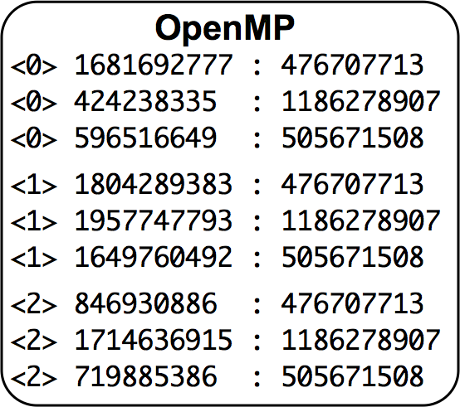
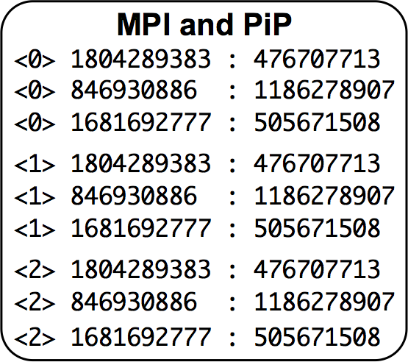
PiP Programming
PiP
pthread_barrier_t barrier, *barrp;
int main() {
int i, pipid, seed = 1;
pip_init( &pipid, … );
if ( pipid == 0 ) {
pthread_barrier_init( &barrier,
NULL, ntasks );
pip_export( &barrier );
barrp = &barrier;
} else {
do {
pip_import( 0, (void**) &barrp );
} while( barrp == NULL ); }
srand(1);
for ( i=0; i<3; i++ ) {
pthread_barrier_wait( barrp );
printf( "<%d> %d : %d\n", pipid,
rand(), rand_r(&seed) );
}
pip_fin();
return 0;
}
rand()
rand_r()
rand()
rand_r()
pthread_barrier (and pthread_mutex) works with PiP
VAS is shared
The sequence of rand() is the same with MPI
Variables are privatized
pip_import() and pip_export()

Slide 12
How PiP Works
Root Process
Spawn Tasks
PiP Task
Share the same VAS with root
PIE
PiP Execution Mode
Process mode clone()
Thread mode pthread_create()
In either mode, variables are privatized
pthread_create() is more portable than clone()
Root
Root
Task0
Root
Task0
Task1
Task2
Root
Task0
Task3
Task1
spawn
spawn
spawns

Slide 13
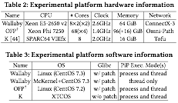
Potability
Glibc Patch: dlmopen() can create up to 16 name spaces
McKernel is a multi-kernel developed at Riken
PiP also works on Arm64/Linux

Slide 14
/proc/*/maps Example of PiP

Slide 15
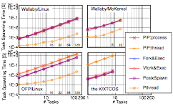
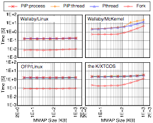
PiP Basic Performance
A larger number of memory segments MAY affect task spawning time and/or mmap() time
Spawn: Almost equal to processes
mmap(): Almost equal to pthreads
Task Spawning Time
mmap() Time (10 tasks)
Better

Slide 16
PiP-aware MPI Prototype
PiP Root: Hydra process manager
PiP Tasks: MPI Processes
PiP Mode: Process Mode
Base MPI: MPICH (v3.3a3)
PiP-aware MPI Optimizations
Pt2Pt rendezvous protocol
Before: 2 copies
After: 1 copy
MPI_Win_allocate_shared()
Before: Allocate POSIX shmem and broadcast
After: malloc() at root and broadcast
pmi-proxy
MPI Proc-0
MPI Proc-1
MPI Proc-2
MPI Proc-3
:

Slide 17
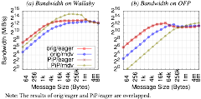
MPI Pt2Pt (Intra-Node) Performance
PiP rendezvous protocol outperform 2.8x
IMB Ping-Pong benchmark (Intra-Node)
Running on Xeon
Running on OFP (KNL)
2.8x
Better

Slide 18
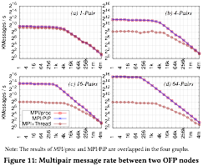
MPI Multithreaded (Inter-Node) Performance
Modified osu_mbw_mr benchmark program
to compare MPI+Thread and PiP-aware MPI
Node0 |  | Node1
task0 |  | task0
task1 |  | task1
task2 |  | task2
: |  | :
pair
pair
Better
pair
Running on
OFP (KNL)

Slide 19
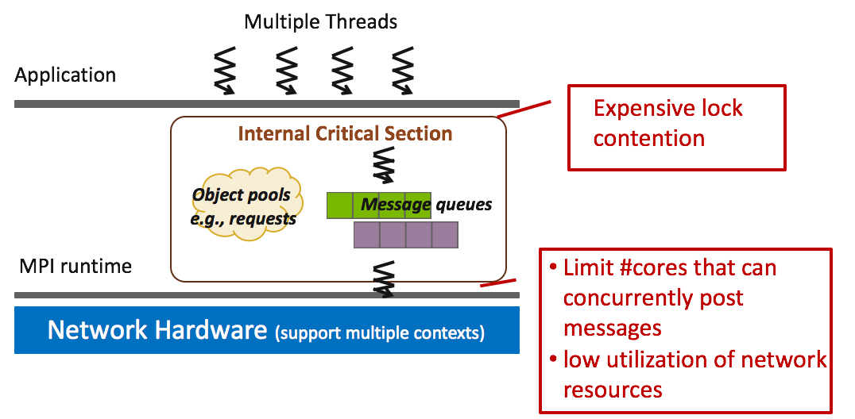
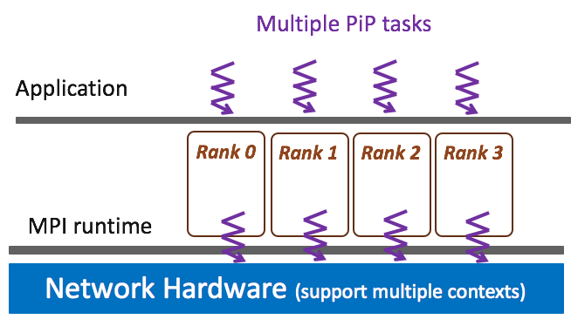
Why PiP is better ?
MPI standard does not allow threaded comm.
Each PiP task has its own MPI lib. and they can run in parallel

Slide 20

SNAP
Before: MPI + OpenMP
SNAP call MPI functions from each OpenMP thread
Only one communication takes place at a time
After: MPI + PiP
Each PiP task can perform communication in parallel
Running on OFP (KNL)
Better
3.2
Better

Slide 21
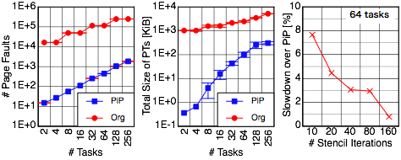
MPI_Win_allocate_shared()
not in the paper
not in the paper
Better
Org: POSIX Shmem (Memory Mapping)
PiP: VAS Sharing
5P Stencil (double, 8K x 8K), Xeon Phi (KNL)
Example program stencil_mpi_shmem.c in Advanced MPI Programming - Tutorial at SC14. http://www.mcs.anl.gov/∼thakur/sc14-mpi-tutorial

Slide 22
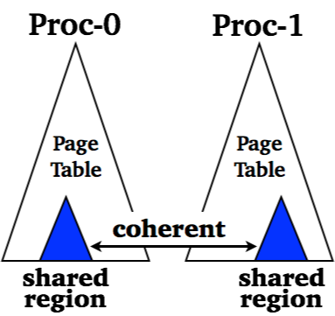
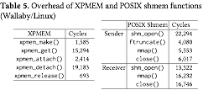
Memory Mapping vs. PiP
Memory Mapping Technique (POSIX Shmem, XPMEM, …)
OH of sub-PT creation (create, attach, etc.)
OH of maintaining coherency (page fault)
Each process must have PT entries - O(N²)
Those OH can be avoided by using PiP Because Page table is shared
(Xeon/Linux)

Slide 23

LAMMPS with In-Situ
Before: LAMMPS + In-Situ
Using POSIX shmem -> 2 Copies
After: LAMMPS + In-Situ (as a PiP task)
LAMMPS passes a pointer to In-Situ and In-Situ copies simulation data -> 1 Copy
LAMMPS (OpenMP)
In-Situ
Better

Slide 24
Summary
PiP provides the 3rd execution model at user-level
Portable (on most Linux compatible OS)
dlmopen(), PIE, and clone() or pthread_create()
Practical
Runs on big machines (K and OFP) in operation
PiP outperforms Memory Mapping Techniques
Setup cost
Page fault overhead
Page table size
PiP Showcases
PiP-aware MPI — pt2pt, MPI_Win_allocate_shared()
MPI+PiP outperforms MPI+OpenMP
More efficient In-Situ implementation

Slide 25
FAQs
It is crazy to mix programs, I cannot debug
Can’t you debug multi-thread programs ?
Do not mix independent programs. Mix communicating and/or interacting programs.
Is PiP a Programming Model ?
No, it is a execution model
If I use huge pages, PiP has no advantage
PiP can work with huge pages
Pit falls of using huge pages
Transparent Huge Pages may hinder execution
Other huge page techniques require extra programming
More memory consumption
We are already happy with MPI and OpenMP, no need of PiP
PiP is for people who are not happy with them.
PiP+OpenMP works ?
In PiP Process Mode: YES. In Thread Mode, it depends.

Slide 26

BSS and DATA

Slide 27
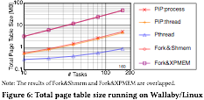

Page Table Size
Sharing 128 MiB/Task
Xeon E5-2650 v2 8×2(×2)
2.6GHz 64 GiB

Slide 28
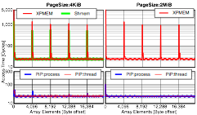
Page Fault
Sender allocates memory region and set some values
Receiver scan the data in the “shared” memory region
Measure the each access time on the reciever
Xeon E5-2650 v2 8×2(×2) 2.6GHz 64 GiB

Slide 29
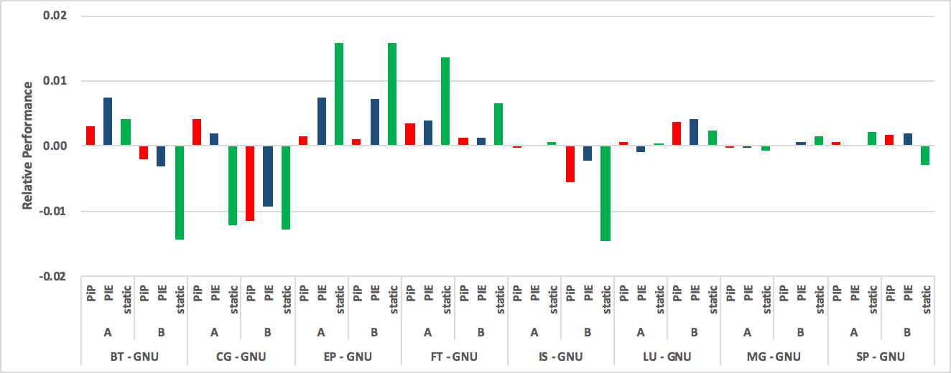
PIE and Static

