Slide 1



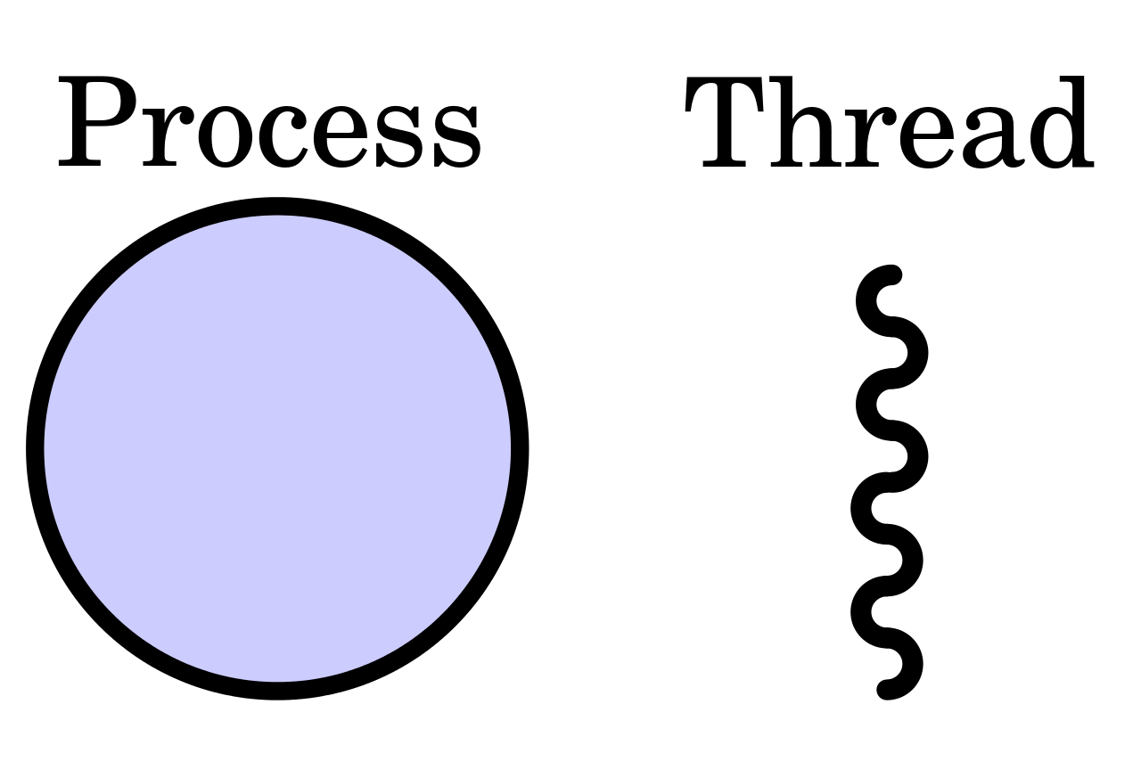
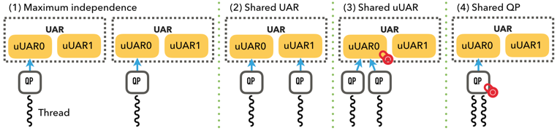
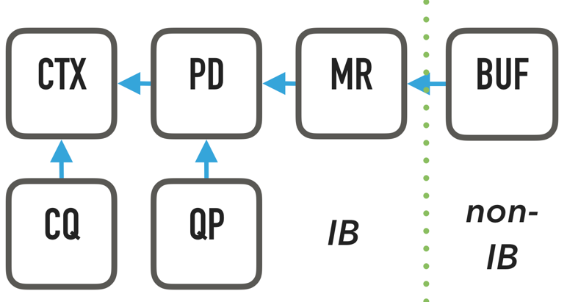
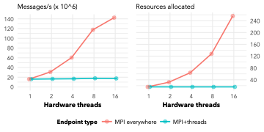
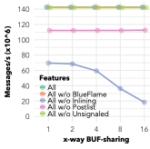
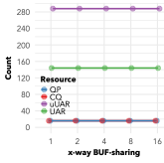
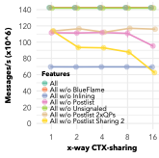
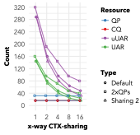
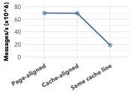
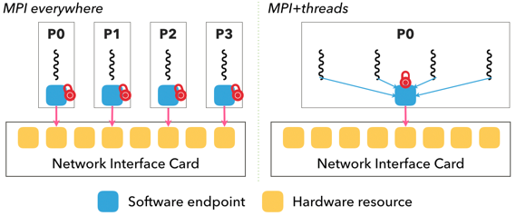
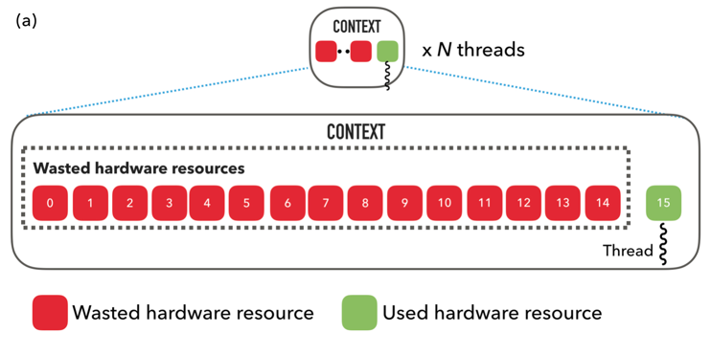
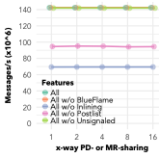
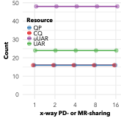
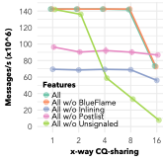
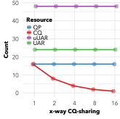
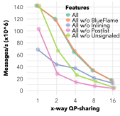
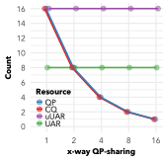



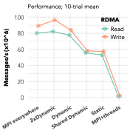
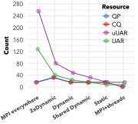
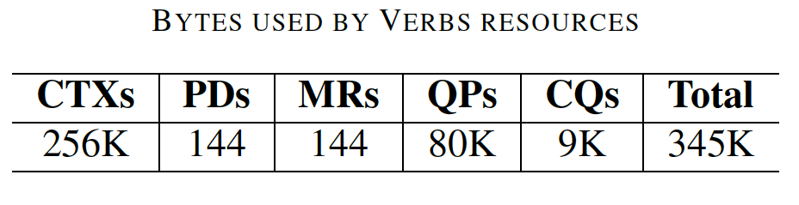

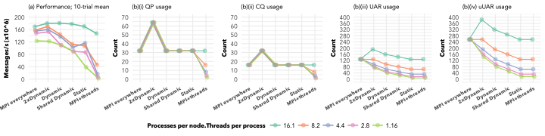
Scalable Communication Endpoints for MPI+Threads Applications
Rohit Zambre,* Aparna Chandramowlishwaran,* Pavan Balaji⌃ *University of California, Irvine | ⌃Argonne National Laboratory
Introduction
Resource Sharing Analysis
MPI everywhere
MPI+threads
MPI everywhere not scalable on modern systems
Disproportionate increase in number of cores compared to other on-node resources
Dwindling share of resources per process
MPI+Threads model addresses scalability issue
Analytically, four levels of sharing
Hierarchy of Verbs resources
Node
Core
Process
Thread
Buffer sharing
Context sharing
The tradeoff
Communication performance of MPI+Threads is 9x worse
MPI everywhere uses 16x more communication resources
Why this tradeoff?
Endpoint configuration in state-of-the-art MPI libraries:
Hash function of NIC’s parallel TLB design based on cache line
Effects most visible with Programmed I/O
Sharing the UAR hurts performance (yellow line)
Sharing the Context reduces uUAR usage
Software endpoint
Protection Domain Memory Region sharing
Completion Queue sharing
Naive solution for MPI+Threads: emulate MPI everywhere endpoints
Leads to 93.75% wastage of limited hardware resources
Need a second NIC after using only 6.25% of the resources on the first
MPI+Threads allows for arbitrary level of sharing: what level of sharing is ideal?
Depends on performance requirements and availability of resources
A tradeoff space between performance and sharing resources exists
Scalable Communication Endpoints
A resource sharing model that concretely categorizes the tradeoff space ranging from fully independent paths to fully shared paths
No impact on performance or resource usage
PD and MR are only software objects
They are not accessed on the critical path
Lock on shared CQ affects performance
Postlist/Unsignaled benefits VS. hurtful sharing
Affects only memory usage
Queue Pair sharing
Each thread must have its own cache-aligned buffer
Can use Protection Domain and Memory Region at will
Sharing the Context most critical for hardware resource usage
Only QP and CQ sharing impact memory usage
Background
Sending 1 message
(1)(i) Write a message descriptor (MD)
(1)(ii) CPU MMIO-writes to NIC
(2) NIC DMA-reads MD
(3) NIC DMA-reads payload
(4) NIC DMA-writes completion after receiving ACK from target
Write MD
CPU polls for completion
1
(i)
MEM
Write completion
Affects performance with reduced network parallelism
~27x worse performance; 16x reduced memory usage
CPU
2
Read MD
3
Read data
4
Scalable Endpoints
1
NIC
PCIe device
Features that help small messages
Postlist: Reduces (1)(ii)
Unsignaled Completions: Reduces (4)
Inlining: Removes (3)
Programmed I/O: Removes (2)
Based on analysis above, we define six categories of endpoints for N threads:
(ii)
Category | Description | Performance | Hardware resources |  | Memory resources
 |  |  | UAR | uUAR | QP | CQ
MPI everywhere | Separate Context per thread | Slightly lower than maximum | 8N | 16N | N | N
2xDynamic | Shared Context; 2N max. indep. Thread Domains | Maximum | 8 + 2N | 16 + 4N | 2N | 2N
Dynamic | N max. indep. Thread Domains | Lower than MPI everywhere | 8 + N | 16 + 2N | N | N
Shared Dynamic | N Thread Domains with Shared UAR | Lower than Dynamic | 8 +⎾N/2⏋ | 16 + N | N | N
Static | Statically allocated resources of Context | Depends on N | 8 | 16 | N | N
MPI+Threads | 1 QP | Worst | 8 | 16 | 1 | 1
DoorBell
TX
ACK
1 MMIO-write + 2 DMA-reads + 1 DMA-write
Communication Resources
Sender
Network Fabric
Switches
Routers
Receiver
Completion Q
Completion Q
Transmit Q
Transmit Q
Transmit Queue: Queue Pair (QP) in Verbs (consumes memory)
Completion Queue: Completion Queue (CQ) in Verbs (consumes memory)
Hardware resource: micro User Access Region (uUAR) within UAR pages on Mellanox InfiniBand (consumes hardware resources)
Naive solution impacts memory and hardware resource usage
Memory: Creating 16 naive endpoints will occupy 5.15 MB
Not of immediate concern; memory on supercomputers in the order of GB
Evaluation using 16 threads
Global array kernel
DGEMM
Stencil kernel
5-point stencil with 1-D partitioning
Hardware resources: much smaller limit than that of memory in general
Max of 16K uUARs on ConnectX-4 (1021 naive endpoints); max of 160 HW contexts on Omni-Path
Performance decreases with increasing resource efficiency
Evaluation Setup
2 nodes with Intel Haswell (16 cores per socket) @ 2.5 GHz + Mellanox ConnectX-4 adapter on each node
To study effect of feature f on multithreaded RDMA-write message rate: “All w/o f”
OFED stack; QP-depth: 64; Postlist: 32; Unsignaled Completions: 64

