Slide 1



Scalable Communication Endpoints for MPI+Threads Applications
Rohit Zambre,* Aparna Chandramowlishwaran,* Pavan Balaji⌃
*University of California, Irvine
⌃Argonne National Laboratory
Notes:
Good morning everyone, my name is Rohit Zambre and I am a Ph.D. candidate at UC Irvine. For the next 10 minutes I will be talking about Scalable Communication Endpoints which is a resource sharing model and it is relevant for MPI+Threaded applications since we can share communication resources only in multithreaded environments.
Let met set the scene for you by motivating the problem.

Slide 2
Interconnect
Node
Core
Process
Communication
Traditional MPI:
MPI Everywhere
Application ignores location of processes
Problem: dwindling share of resources per process
Why: cores scaling a lot faster than other on-node resources
Notes:
Traditionally, MPI users have been writing their applications by launching a bunch of processes that run in parallel across the different nodes. The user ignores the fact that some of the processes will be on the same node while some will be on different nodes. So, when a process needs to communicate with another, the MPI library takes care of using either shared memory for communication between processes running on the same node or internode communication for processes running on different nodes. But this traditional model is not scaling on modern architectures since the number of cores is increasing rapidly while the other on-node resources such TLB space, network registers, etc. are not increasing at the same rate. Hence the static split of resources between the processes leads to a smaller and smaller share of resources per process.

Slide 3
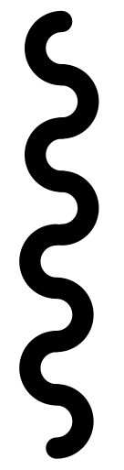
Interconnect
Node
Core
Process
Communication
Thread
Hybrid MPI:
MPI+threads
e.g. MPI+OpenMP
1 multi-threaded process per node
Like processes, each thread offers a program counter and stack
Unlike processes, each thread can access all on-node resources
Notes:
So user are moving to an hybrid approach of MPI+Threads where the user spawns a process per node and uses multiple threads within the process. Just like processes, threads give the user a separate program counter and stack. But unlike multiple processes, all the threads in the process can access all of the resources within the node. But, unfortunately, the performance of the MPI+Threads model in state-of-the-art MPI implementations takes a hit.

Slide 4
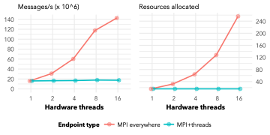
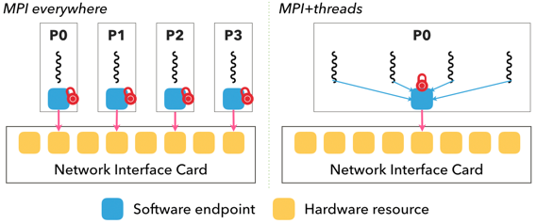
2-byte
The Problem with Today’s MPI IMplementations
The communication performance of MPI+threads is 9x worse than MPI everywhere
Why: the MPI library uses only 1 endpoint per process
Naive solution: emulate endpoint configuration of MPI everywhere
Notes:
In particular, the communication performance of MPI+Threads is 9x worse than that of MPI everywhere as we can see in the graph above. The figure below shows the main reason why this 9x difference exists. The MPI library uses 1 endpoint per process. So in the case of MPI+Threads, the network hardware parallelism is not utilized and the communication of all the threads is bottlenecked through 1 endpoint. So a naive solution would then be to emulate the MPI everywhere endpoint configuration so that there’s an endpoint per thread. Assuming we are able to achieve this, we run into another problem with respect to resource usage.

Slide 5
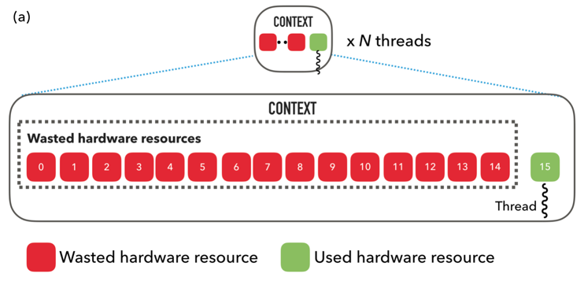
2-byte
The Problem with Today’s MPI IMplementations
MPI+threads performs up to 9x worse than MPI everywhere
MPI everywhere allocates 16x more resources than MPI+Threads and wastes 93.75% of them
Why: only 1 every 16 hardware resources used
Notes:
The new graph on the top shows that MPI everywhere allocates 16x more resources than MPI+Threads and more importantly, 93.75% of its allocated resources are wasted. The illustration at the bottom of the graph

Slide 6
MPI+Threads allows resource sharing
Scalable Communication Endpoints for MPI+Threads Applications
But what level of sharing is ideal?
Depends on performance requirements and resource availability.
There exists a tradeoff space between performance and sharing resources
Scalable Communication Endpoints: a resource sharing model that concretely categorizes the tradeoff space ranging from fully independent to fully shared paths.

Slide 7
Communication Resources in INfiniBand
Scalable Communication Endpoints for MPI+Threads Applications
We work with the InfiniBand communication stack
InfiniBand, the preferred interconnect on the TOP500 and for AI and HPC applications.
Transmit Queue: Verbs’ Queue Pair (impacts memory usage)
Completion Queue: Verbs’ Completion Queue (impacts memory usage)
Hardware resources: micro User Access Region (uUARs) within UAR pages in Mellanox InfiniBand (impacts usage of limited hardware resources)

Slide 8
Resource-sharing analysis
Scalable Communication Endpoints for MPI+Threads Applications
Analyze the impact of sharing resources on performance and resource usage
The Verbs API exposes 6 levels of sharing
Lessons learned
Each thread must have its own cache-aligned buffer
Can use Protection Domain and Memory Region at will
Sharing the Context is the most critical for hardware resource usage
Only QP- and CQ-sharing impact memory usage
Context
Protection Domain
Memory region
Buffer
Completion Queue
Queue Pair
IB
non- IB

Slide 9
MPI-everywhere
Shared Dynamic
CTX
CTX
CTX
CTX
CTX
STATIC UAR
STATIC UAR
STATIC UAR
STATIC UAR
8 Static UARs
DYNAMIC UAR
DYNAMIC UAR
uUAR
uUAR
uUAR
uUAR
uUAR
uUAR
uUAR
uUAR
uUAR
uUAR
uUAR
uUAR
QP
QP
QP
QP
TD
TD
TD
TD
Scalable Endpoints
2xDynamic
Static
CTX
CTX
DYNAMIC UAR
DYNAMIC UAR
DYNAMIC UAR
DYNAMIC UAR
DYNAMIC UAR
DYNAMIC UAR
DYNAMIC UAR
DYNAMIC UAR
STATIC UAR
STATIC UAR
uUAR
uUAR
uUAR
uUAR
uUAR
uUAR
uUAR
uUAR
uUAR
uUAR
uUAR
uUAR
uUAR
uUAR
uUAR
uUAR
uUAR
uUAR
uUAR
uUAR
Categorize the sharing space into 6 categories from maximum independence to maximum sharing
TD
TD
TD
TD
TD
TD
TD
TD
QP
QP
QP
QP
Dynamic
MPI+threads
CTX
CTX
DYNAMIC UAR
DYNAMIC UAR
DYNAMIC UAR
DYNAMIC UAR
STATIC UAR
uUAR
uUAR
uUAR
uUAR
uUAR
uUAR
uUAR
uUAR
uUAR
uUAR
TD
TD
TD
TD
QP

Slide 10
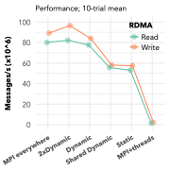
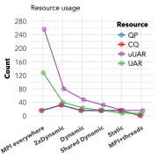
Global Array Evaluation
Scalable Communication Endpoints for MPI+Threads Applications
16 threads
 | Performance | Hardware resources | Memory resources
MPI everywhere | 100% | 100% | 100%
2xDynamic | 100% | 31.25% | 200%
Dynamic | 94% | 18.75% | 100%
Shared Dynamic | 65% | 12.5% | 100%
Static | 64% | 6.25% | 100%
MPI+Threads | 3% | 6.25% | 6.25%
Performance decreases with increasing resource efficiency
Higher is better
Lower is better
Lower is better
Notes:
Expand this into two slides: (1) design + (2) numbers

Slide 11
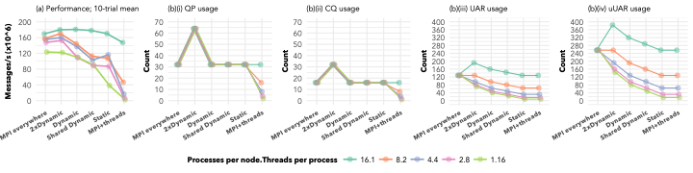
Stencil Evaluation
Scalable Communication Endpoints for MPI+Threads Applications
Similar trend of decreasing performance with increasing resource sharing
More processes means more messages, hence higher message-rate
Details in https://github.com/rzambre/research-docs/blob/master/papers/icpads_18_preprint.pdf
Notes:
Expand this into two slides: (1) design + (2) numbers

Slide 12
Conclusion
Scalable Communication Endpoints for MPI+Threads Applications
A tradeoff space between performance and communication resource usage exists.
We design scalable endpoints, a resource-sharing model that concretely categorizes the tradeoff space into 6 categories.
MPI+Threads with 2xDynamic, for example, achieves 100% of the performance of MPI everywhere while using only 31.25% as many resources.

