Slide 1



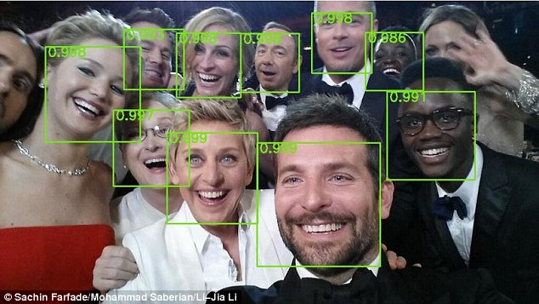
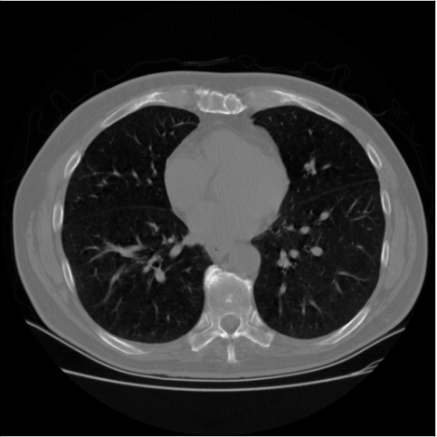


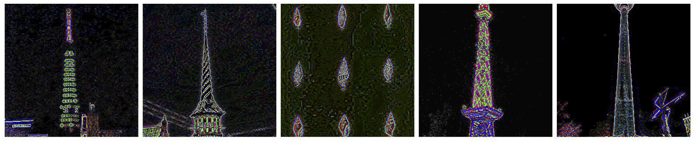


I/O Bottleneck Investigation in Deep Learning Systems
Sarunya Pumma ,^{1,2} Min Si ,² Wu-chun Feng ,¹ and Pavan Balaji²
¹Virginia Tech, ²Argonne National Laboratory
Motivation
LMDB Inefficiencies (cont.)
Our Solution: LMDBIO (cont.)
Deep Learning & Challenges
Problem 2: Sequential Data Access Restriction
LMDBIO-LMM-DM (cont.)
Robotics
Asimo (Honda)
Compute bound
LMDB data access is sequential in nature due to the B+-tree structure
There is no way to randomly access a data record
All branch nodes associated with the previous records must be read before accessing a particular record
When multiple processes read the data, they read extra data
Different processes do different amount of work, causing skew
Database
Part II: Speculative Parallel I/O
Database
Part II: Parallel I/O and in-memory sequential seek
High-dimensional input data
Image classification
Data Science Bowl’s tumor detection from CT scans
D0 | D1 | D2 | D3
Each process estimates pages that it will need and speculatively fetches pages to memory in parallel
Then each process sequentially seeks the location for another processes and sends the cursor to the next higher rank process
The expectation is that the seek can be done entirely in memory
Once the sequential seek is done, each reader can perform actual data access
This adds a small amount of extra data reading, but allows parallel I/O
The estimation of number of pages to fetch is based on the first record’s data size
I.e., CIFAR10-Large record’s size is 3 KB, which is ~1 page. To read n records, it needs to fetch n pages
The estimation of the read offset is performed in the same fashion
Estimation of the “approximate” start and end location for each process is important
If the estimate is completely wrong, we will end up reading up to 2x the dataset size (still better than the LMDB)
D0 | D1 | D2 | D3
I/O Bound
P0 reads
Facial Recognition
Deep Dense Face Detector (Yahoo Labs)
High volume data
Sentiment analysis
Twitter analysis
Yelp’s review fraud detection
Image classification
ImageNet’s image classification
P1 seeks
P2 seeks
P1 reads
P2 reads
Concurrent
P0 reads
P1 reads
Batch Size
(# samples)
P3 seeks
P3 reads
P2 reads
P3 reads
Offline & Online Data Analytics
Real Time News Feed (Facebook)
Tumor detection from CT scans
LMDB redundant data movement
P0 seeks
P0 sends cursor to P1
Communication bound
Problem 3: Mmap’s Workflow Overheads
Problem 4: I/O Block Size Management
Sequential
(in-memory)
P0 accesses
P1 seeks
P1 sends cursor to P2
Networks with large number of parameters
Unsupervised image feature extraction
LLNL’s network with 15 billion parameters
Since mmap performs implicit I/O, the user has no control over when an I/O operation is issued.
To showcase this overhead, we developed a microbenchmark to read a 256 GB file using a single reader on a single machine
Mmap benchmark uses memcpy on a mmap buffer
POSIX I/O benchmark uses pread
mmap’s read bandwidth is approximately 2.5x lower than that of POSIX I/O
P1 accesses
P2 seeks
P2 sends cursor to P3
In the past decade …
10 – 20x improvement in processor speed
10 – 20x improvement in network speed
Only 1.5x improvement in I/O performance
I/O will eventually become a bottleneck for most computations
As the number of processes increases, subbatch is smaller
POSIX I/O benefits from larger block size, while mmap does not
Migrating LMDB to use direct I/O and larger block size can give a significant performance improvement
Estimation of Speculative I/O
P2 accesses
P3 seeks
…
Estimation of Speculative I/O (cont.)
P3 accesses
Network Size
(width and depth)
We use a history-based training for our estimation
We correct our estimate in each iteration depending on the actual data read in all of the previous iterations
The general ideal of out correction is that we attempt to expand the speculative boundaries to reduce the number of missed pages
Initial iterations might be slightly inaccurate, but we converge fairly quickly (1-2 iterations)
Image feature extraction
Deep Learning Scaling
Problem 5: I/O Randomization
Overall Training Time (CIFAR10-Large-AlexNet, 512 iterations)
Training Time Breakdown (CIFAR10-Large-AlexNet, 512 iterations)
I/O requests are typically out of order in parallel I/O
A large number of processes need to divide a large file into smaller pieces and each process needs to access a part of it
Each process issues an I/O request at the same time
I/O requests do not arrive at the I/O server processes in any specific order as each process is independent
This causes the server processes to access the file in a nondeterministic fashion
Server 1
Server 2
File
1 | 3 | 5 | 7
File
2 | 4 | 6 | 8
LMDBIO-LMM-DIO
Request queue
Request queue
To use direct I/O, we need to know the position of each data record
The root process gets offsets of all data samples by seeking the database using mmap
Sequential seek is unavoidable because the offsets are not deterministic
Other reader processes receive their offsets from root and perform data reading using POSIX I/O
Readers share data using MPI shared buffer as same as LMM
5
3
7
1
2
6
8
4
Optimization: Replace mmap with POSIX I/O
660x worse than ideal
P0
seek (mmap)
Timeline
read data to shared buffer (POSIX I/O)
…
Client 1
Client 2
Client 3
Client 4
Client 5
Client 6
Client 7
Client 8
P1
wait
read data to shared buffer (POSIX I/O)
…
All requests are issued at the same time
P2
wait
scatter offsets
read data to shared buffer (POSIX I/O)
…
Our Solution: LMDBIO
LMDBIO-LMM-DIO-PROV
Experiment Information
Dataset: CIFAR10-Large
Network: AlexNet
Batch size: 18,432
Training iterations: 512
Framework: Caffe
Testbed: LCRC Bebop
(Each node: 36 cores Intel Broadwell,
128 GB memory)
Summary of LMDBIO Optimizations
Optimization: Utilize provenance information to entirely replace mmap with POSIX I/O
Important Notes
Caffe/LMDB is 660x worse than ideal for 9216 processes
Read time takes up 90% of the total training time for 9216 processes
I/O bottleneck is caused by five major problems
Interprocess contention -- results in excessive number of context switches
Implicit I/O inefficiency -- OS fully controls I/O
Sequential data access restriction -- arbitrary database access is not allowed in LMDB
Inefficient I/O block size -- I/O request size is too small to be efficient
I/O randomization -- abundant readers participating in I/O at the same time
We proposed 6 optimizations that address 5 problems in state of the art I/O subsystem of deep learning
Library | Optimization | Reducing Interprocess Contention | Explicit I/O | Eliminating Sequential Seek | Managing I/O Size | Reducing I/O Randomization
LMDB | -
LMDBIO | LMM | ✔
 | LMM-DM | ✔ |  | (partial)
 | LMM-DIO | ✔ | ✔
 | LMM-DIO-PROV | ✔ | ✔ | ✔
 | LMM-DIO-PROV-COAL | ✔ | ✔ | ✔ | ✔
 | LMM-DIO-PROV-COAL-STAG | ✔ | ✔ | ✔ | ✔ | ✔
Making a case for storing data provenance information for deep learning (how the data was created)
LMDB’s database layout can be deterministic only if the information of how it is created is provided
We can compute exactly where the data pages are located
Sequential seek can be completely eliminated
All I/O operations can be done via direct I/O (mmap is completely removed)
Provenance information is not stored in the original LMDB format
This is an extension that we are proposing
We use a separate auxiliary file to store this information
This file can be created while the database is being generated or later using a one-time read of the database
It is much smaller than the dataset itself (a few hundred bytes)
LMDBIO-LMM-DIO-PROV-COAL
LMDBIO-LMM-DIO-PROV-COAL-STAG
LMDB Inefficiencies
LMDBIO-LMM
Process 0
Process 1
Process 2
Optimization: Coalesce multiple batches of data to be read at once to allow direct I/O to benefit from large I/O size
Optimization: Adopt I/O staggering to reduce I/O randomization
Caffe’s I/O Subsystem: LMDB
Optimization: Take into account data access pattern of deep learning and Linux’s I/O scheduling to reduce mmap’s contentions
Access
We read a larger chunk of data to enlarge I/O time to eliminate the skew in I/O
A constant amount of memory is kept aside for data reading
We read multiple batches of data at once
I/O staggering technique orders the requests
Readers are divided into multiple groups with the same number of members
Only one group can perform data reading at a time
MPI_Send and MPI_Recv are used in the implementation
Uses Lightning Memory-mapped database (LMDB) for accessing the dataset
B+-tree representation of the data
Database is mapped to memory using mmap and accessed through direct buffer arithmetic
Virtual memory allocated for the size of the full file
Specific physical pages dynamically loaded by the OS on-demand
Pros: makes it easy to manipulate complex Cons: OS has very little knowledge of the data structures (e.g., B+ trees) since LMDB access model and parallelism making it hard can think of it as fully in-memory to optimize
Localized mmap
Only one process does mmap on each node
Using MPI shared-memory (MPI-3) to share data
Even LMDBIO has extra copy (from mmap to shared memory), Caffe still gains benefit from LMDBIO
mmap buffer
(Process 0)
Copy
Access
Access
Shared Memory
Page cache
Map
Shared file system
(shared between nodes)
Read
Results
Sarunya Pumma, Min Si, Wu-chun Feng and Pavan Balaji. Towards Scalable Deep Learning via I/O Analysis and Optimization. IEEE International Conference on High Performance Computing and Communications (HPCC). Dec. 18-20, 2017, Bangkok, Thailand.
Total Execution Time
LMDBIO-LMM-DM
Problem 1: Mmap’s Interprocess Contention
Optimization: coordinate between reader processes to improve parallelism
Part I: Serializing I/O
Underlying I/O in mmap relies on the CFS scheduler to wake up processes after I/O has been completed
Processes are put to sleep while waiting for I/O to complete
I/O completion interrupt is a bottom-half interrupt
The handler does not have knowledge about the specific process that triggered the I/O operation
Every process that is waiting for I/O is marked as runnable
Every reader is woken up each time an I/O interrupt comes in
This causes a large number of unnecessary context switches
Serialize data reading and coordinate between processes
Each process reads its data and sends the higher rank process the location to start fetching its data from
This allows NO extra data reading: number of bytes read is EXACT… but I/O is done sequentially
Database
Part I: Sequential I/O and cursor handoff
Context Switches
Read Time Breakdown
D0 | D1 | D2 | D3
Sequential
P0 reads
P0 sends cursor to P1
P1 sends cursor to P2
Portable Cursor Representation
P1 reads
P2 reads
P2 sends cursor to P3
Factor of Improvement over LMDB
LMDB calls the position indicator for a record within B+ tree a “cursor”
Not a simple offset from the start of file
It contains the complete path of the record’s parent branch nodes (multiple pointers), a pointer to the page header, and access flags
It is not trivial to port pointers across processes as virtual address spaces are different
Portable Cursor Representation (cont.)
P3 reads
…
Platform: Argonne’s Blues Dataset: CIFAR10-Large
InfiniBand Qlogic QDR Network: AlexNet
110 TB GPFS storage MPI: MVAPICH-2.2
Each node
2 Sandy Bridge 2.6 GHz Pentium Xeon (16 cores, hyperthreading disabled)
64 GB memory
15 GB RAM disk
Our solution: symmetric address space
Every process memory-maps the database file to the same memory location
Allowing the pointers within the B+ tree to be portable across processes
Sarunya Pumma, Min Si, Wu-chun Feng and Pavan Balaji. Parallel I/O Optimizations for Scalable Deep Learning. IEEE International Conference on Parallel and Distributed Systems (ICPADS). Dec. 15-17, 2017, Shenzhen, China.

