Slide 1


CAB-MPI: Exploring Interprocess Work Stealing towards Balanced MPI Communication
Kaiming Ouyang*^, Min Si^, Atsushi Hori†, Zizhong Chen* and Pavan Balaji^
University of California, Riverside*,
Argonne National Laboratory^,
RIKEN Center for Computational Science†

Slide 2
Is Application Really Balanced?
Application
Node 0
Node N
Computation
P₀
P₁
P₂
P_{m-2}
P_{m-1}
P_{m}
Computation Load Balance - widely studied - well optimized on application level
Communication Load Balance - not fully controlled by developers - can be well balanced like computation? - not well investigated; impact is unknown
Communication
Process Spawn
……
Inter-Process Communication (?)
Finalize

Slide 3
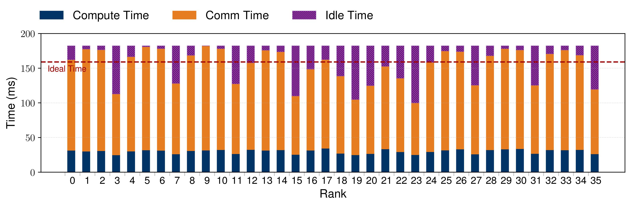
Is Communication Really Balanced?
Where is imbalance from?
MPI runtime - communication can happen among inter-node and intra-node (intra- and inter-NUMA)
Application - processes on the grid surface have less neighbors - datatype of each face is different
3D 7-point stencil process communication pattern
Communication time varies a lot (communication imbalance)
Actual runtime is around 20% larger than ideal time
process grid (4x6x6) on 4 broadwell nodes

Slide 4
Communication Rebalance Solutions
Application-level solution
MPI runtime imbalance mitigation - collect runtime information (communication time, workload, type and so on) and dynamically rebalance workload (complex & not efficient)
Application workload imbalance mitigation - cannot solve inherent communication workload imbalance
Thread-based work stealing
System-level solution
Thread-based work stealing - widely used for computation workload imbalance - incapable of optimizing interprocess communication
P0
P1
T0
T1
T2
T3
Accept
Reject
Stealing

Slide 5
Communication Rebalance Solutions
Interprocess work stealing
target interprocess communication
mitigate communication imbalance among processes
NUMA-aware stealing to maximize performance
P0
MPI_Send(P1)
src buffer (P0)
steal
copy
P2
P1
MPI_Recv(P0)
dest buffer (P1)

Slide 6
Interprocess Data Access Challenge
Forbidden data access between processes by Operating System
Need shared memory techniques
Many shared memory techniques are applicable - key factor: low data access overhead

Slide 7
Potential Shared Memory Technique
POSIX-shm
P0
(VMS*)
P1
(VMS)
MPI_Send(P1)
MPI_Recv(P0)
P0
P1
P2
Private Mem
Private Mem
allocate
allocate
allocate
src buffer (P0)
dest buffer (P1)
Shared Mem
Shared Memory
require processes to allocate shared memory collectively (high overhead)
* VMS stands for virtual memory space

Slide 8
Potential Shared Memory Technique
XPMEM
P0
(VMS)
P1
(VMS)
MPI_Send(P1)
MPI_Recv(P0)
P0
P1
Private Mem
expose
expose
src buffer (P0)
dest buffer (P1)
Exposed Mem
Attached Mem
attach
attach
P2
system call (expose and attach) and page fault overhead can offset stealing benefits (expensive)

Slide 9
Potential Shared Memory Technique
PIP^{[1]} (Process-In-Process)
VMS
P0
Private Mem
P0
P1
src buffer
dest buffer
copy
P2
P1
VMS
Private Mem
flexible data access
no system call and page fault overhead ☺
[1] Hori, Atsushi, et al. "Process-in-process: techniques for practical address-space sharing." Proceedings of the 27th International Symposium on High-Performance Parallel and Distributed Computing. 2018.

Slide 10
Definition
Worker
an idle process inside MPI
Task
copy/compute a certain amount of data from src to dest buffer
P0
P1
P0
P1
Comp
worker
MPI_Send(P2)
MPI_Irecv(P0)
P0
MPI_Send(P1)
src buffer (P0)
worker
copy
pack/unpack
copy-based task
MPI_Barrier()
MPI_Send(P1)
MPI_Wait()
P1
MPI_Recv(P0)
dest buffer (P1)
Locality
Local Stealing: task locality = worker locality
src buffer (P1)
P1
MPI_Reduce(P0)
MPI_Op
compute-based task
NUMA 0
root buffer (P0)
P0
P1
P2
P3
create
T0
T1
Locality 0

Slide 11

Work-Stealing Framework
(2) create task
Task Allocation Flow
(3) enqueue task queue
task
Task Queue (shared by all processes on the node)
(1) buffer are logically cut into chunks
Work Stealing Flow
Destination
Source
Stealing Strategy (determine stealing behaviors)
Busy Process
(4) detect idleness
Stealing Worker

Slide 12
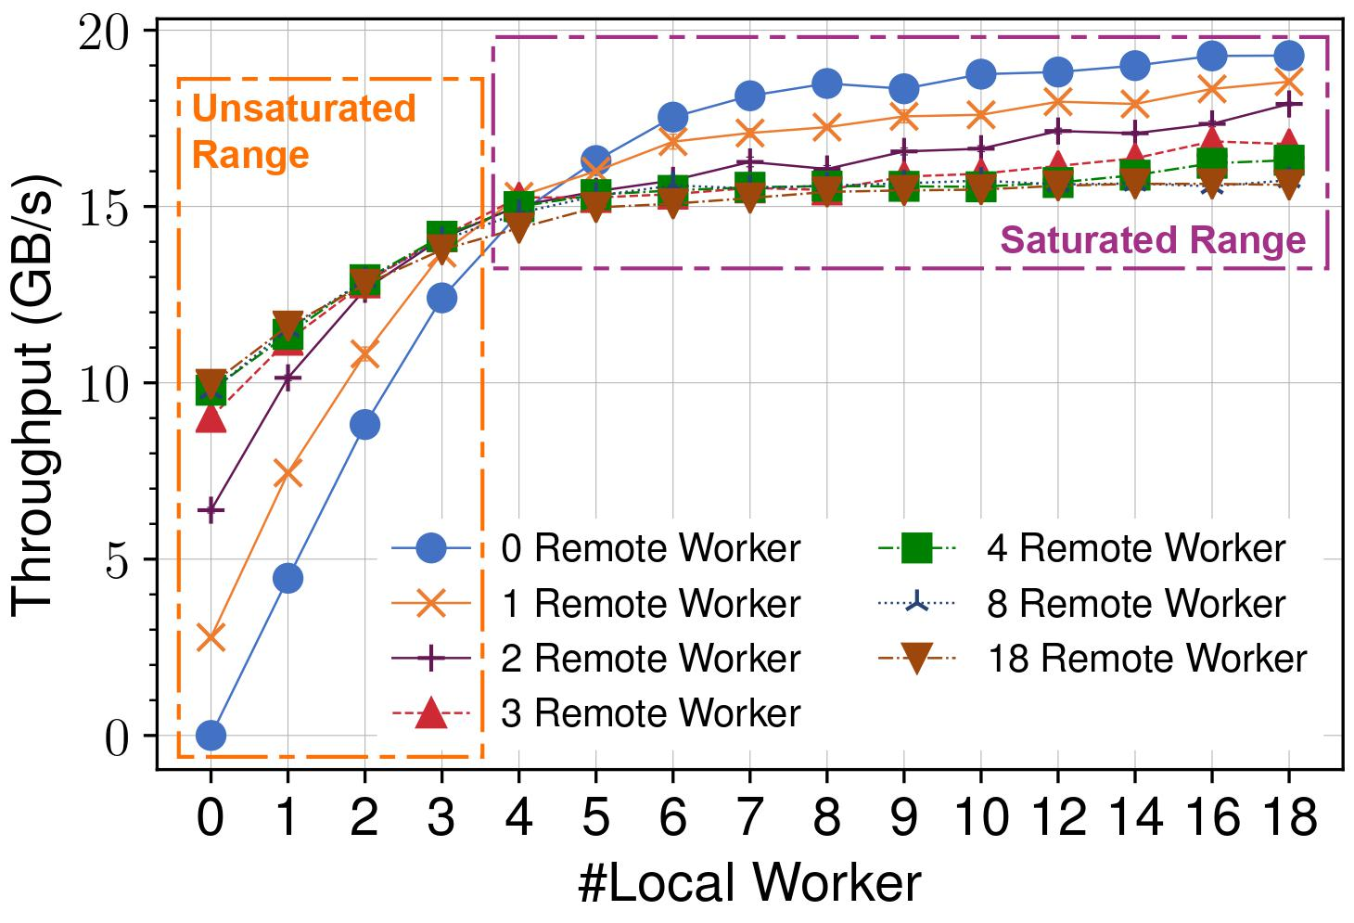

Key Factor for Stealing Performance
Task in MPI
memory-bound
memory bandwidth utilization is the key
Memcpy throughput Profiling
broadwell node 36 cores (2 sockets)
all src and dest buffer (64KB) are located at NUMA 0
More remote workers worse throughput
More remote workers better throughput

Slide 13
Work-Stealing Strategy
Localized Stealing
workers can only perform local stealing
victim is selected in a random way
achieve best throughput when local workers saturate bandwidth
lose the chances of stealing remote tasks
Mixed Stealing
to catch the remote stealing chances
workers steal local tasks in the beginning
if fails, search and steal remote tasks next time
improve performance when memory bandwidth is not saturated
may degrade performance for saturated situation
NUMA0
NUMA0
Only steal local tasks
P0
P1
(1) steal local tasks
P0
P1
NUMA0
create
NUMA0
W0
T0
T1
W0
W1
T2
T3
T2
T3
W1
No remote stealing; lose chances
create
create
(2) if (1) fails, steal remote tasks
P2
P3
P2
P3
NUMA1
NUMA1

Slide 14
Work-Stealing Strategy
Throughput-Aware Stealing
NUMA0
Quantify Bandwidth Utilization
factors: datatype, buffer location, buffer size, task type and so on
conservative method: define threshold N_{s} based on memcpy throughput profiling
(1) steal local tasks
P0
P1
P2
P3
NUMA0
Update
W0
Active Status Array (NUMA 0)
W1
(2) if (1) fails, pick remote NUMA node, check N_{active} < N_{s}
Active Status
if a process is processing a task, set active status as 1; otherwise 0
used to check whether bandwidth is saturated or not
W2
Active Status Array (NUMA 1)
W3
Update
(3) if (2) succeeds, steal remote tasks
P4
P5
P6
P7
NUMA1

Slide 15
Optimization
Reversed Task Enqueue
receiver usually access received data after communication
increase post-communication data access cache reuse
Noncontiguous Task Bundle
require tmp buffer to hold intermediate results
T0 and T1 should be stolen by the same worker to reuse tmp buffer
achieve tmp buffer cache reuse
On-demand Chunking
task chunk size should match buffer size
small chunk size increases parallelism
large chunk size reduce task creation overhead
task enqueue direction
src buffer
T0
src buffer
src
tmp
dest
T0
T1
T2
T3
dest buffer
dest buffer
T1
T0
T1
T2
T3
T4
data access direction
task enqueue direction

Slide 16
Experiment Platform
Broadwell Node
18 cores/socket, 2 sockets in total
128GB DDR4
L1 32KB, L2 256KB, L3 45MB
KNL Node
16 cores/socket, 4 sockets in total (SNC-4 cache mode)
96GB DDR4, 16GB MCDRAM
L1 32KB, L2 1MB
Hardware Platform
Network Interconnect
Intel Omni-Path (OPA)
Baseline
PIP-aware MPICH^{[1]} - single-copy communication
CAB-MPI (Communication-AutoBalance MPI)
PIP-aware MPICH + Work Stealing
Software Platform
MPICH-xpmem-coop
XPMEM-based pt2pt
sender and receiver perform (cooperative) copy
[1] Hori, Atsushi, et al. "Process-in-process: techniques for practical address-space sharing." Proceedings of the 27th International Symposium on High-Performance Parallel and Distributed Computing. 2018.

Slide 17
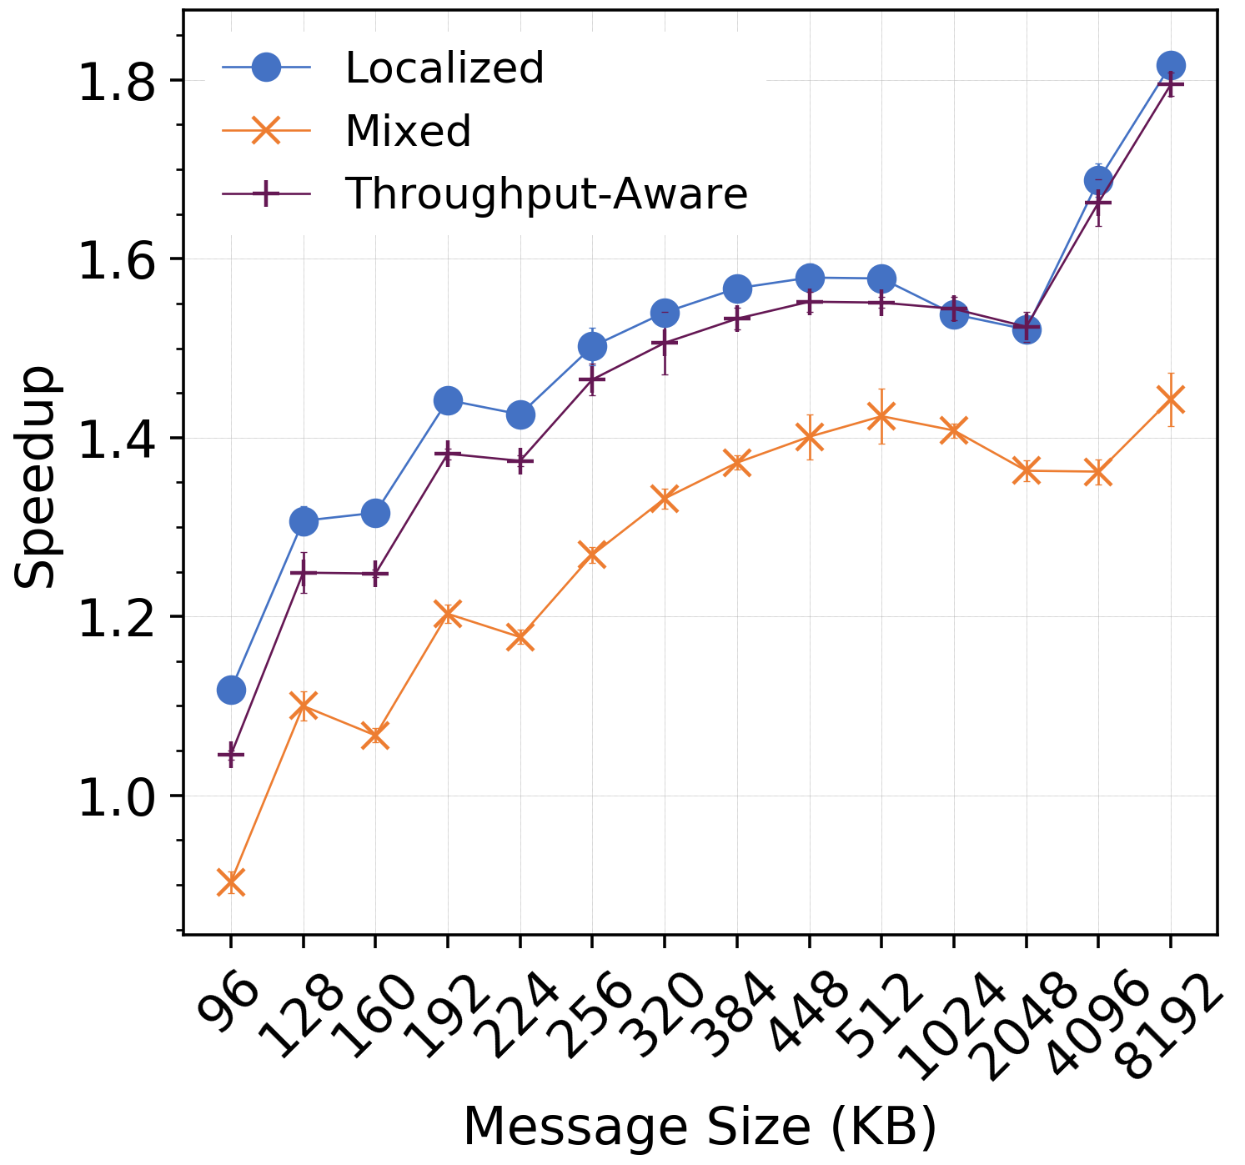
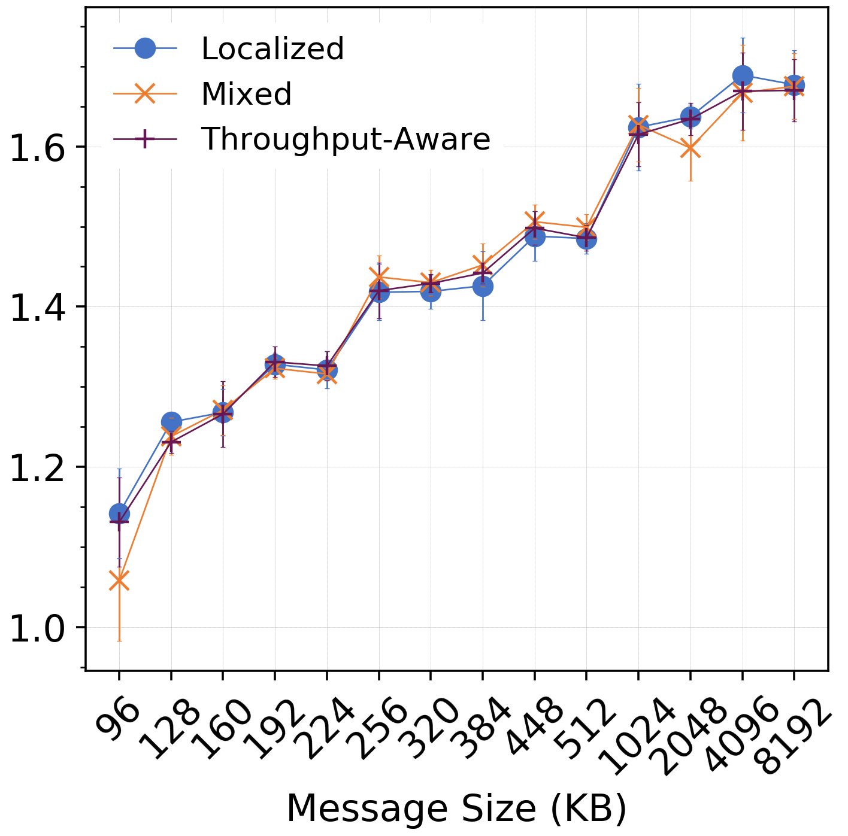
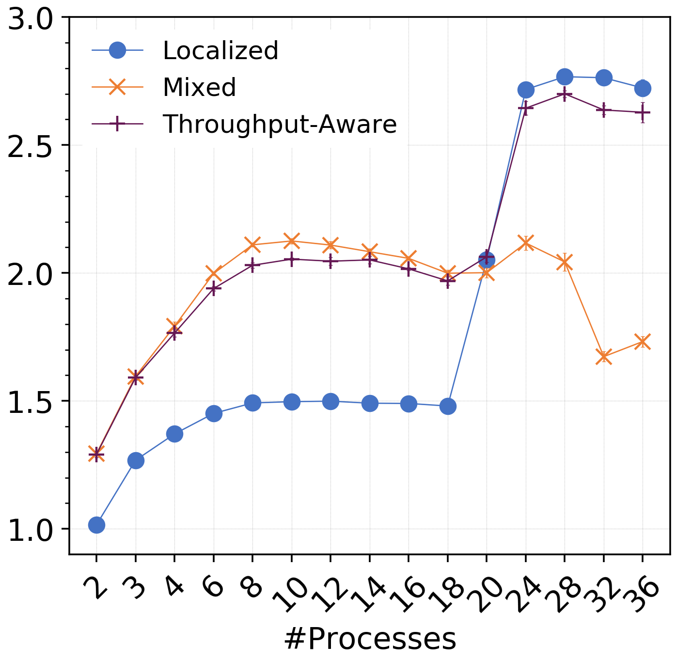
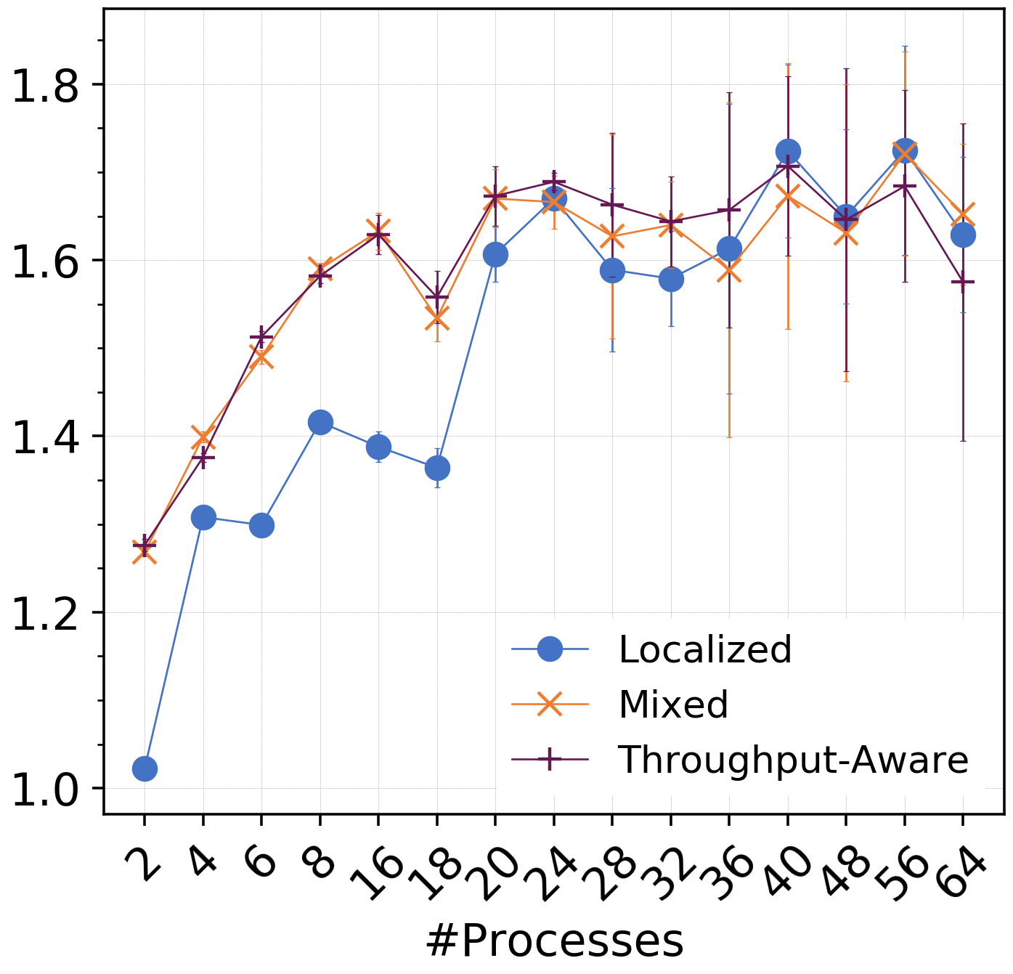
Microbenchmark – PingPong (contiguous data)
Avoid remote stealing overhead
Remote stealing on NUMA 1
High bandwidth MCDRAM; memory is not fully saturated
No stealing on NUMA 1
Broadwell intra-NUMA
(receiver creates tasks)
KNL intra-NUMA
(receiver creates tasks)
Broadwell inter-NUMA
KNL inter-NUMA
Message Size Based Test
allocate 36/64 processes on Broadwell/KNL node
rank 0 and 1 perform intra-NUMA pingpong
other processes are idle
Process Based Test
message size is fixed at 8MB
rank 0 and 1 are on NUMA 0 and 1 respectively
processes are filled from NUMA 0 to 1

Slide 18
Microbenchmark – PingPong (contiguous data)
Avoid remote stealing overhead
Remote stealing on NUMA 1
High bandwidth MCDRAM; memory is not fully saturated
No stealing on NUMA 1
Broadwell intra-NUMA
(receiver creates tasks)
KNL intra-NUMA
(receiver creates tasks)
Broadwell inter-NUMA
KNL inter-NUMA
Message Size Based Test
allocate 36/64 processes on Broadwell/KNL node
rank 0 and 1 perform intra-NUMA pingpong
other processes are idle
Process Based Test
message size is fixed at 8MB
rank 0 and 1 are on NUMA 0 and 1 respectively
processes are filled from NUMA 0 to 1
Conclusion
throughput-aware strategy is on average better than localized and mixed strategy

Slide 19
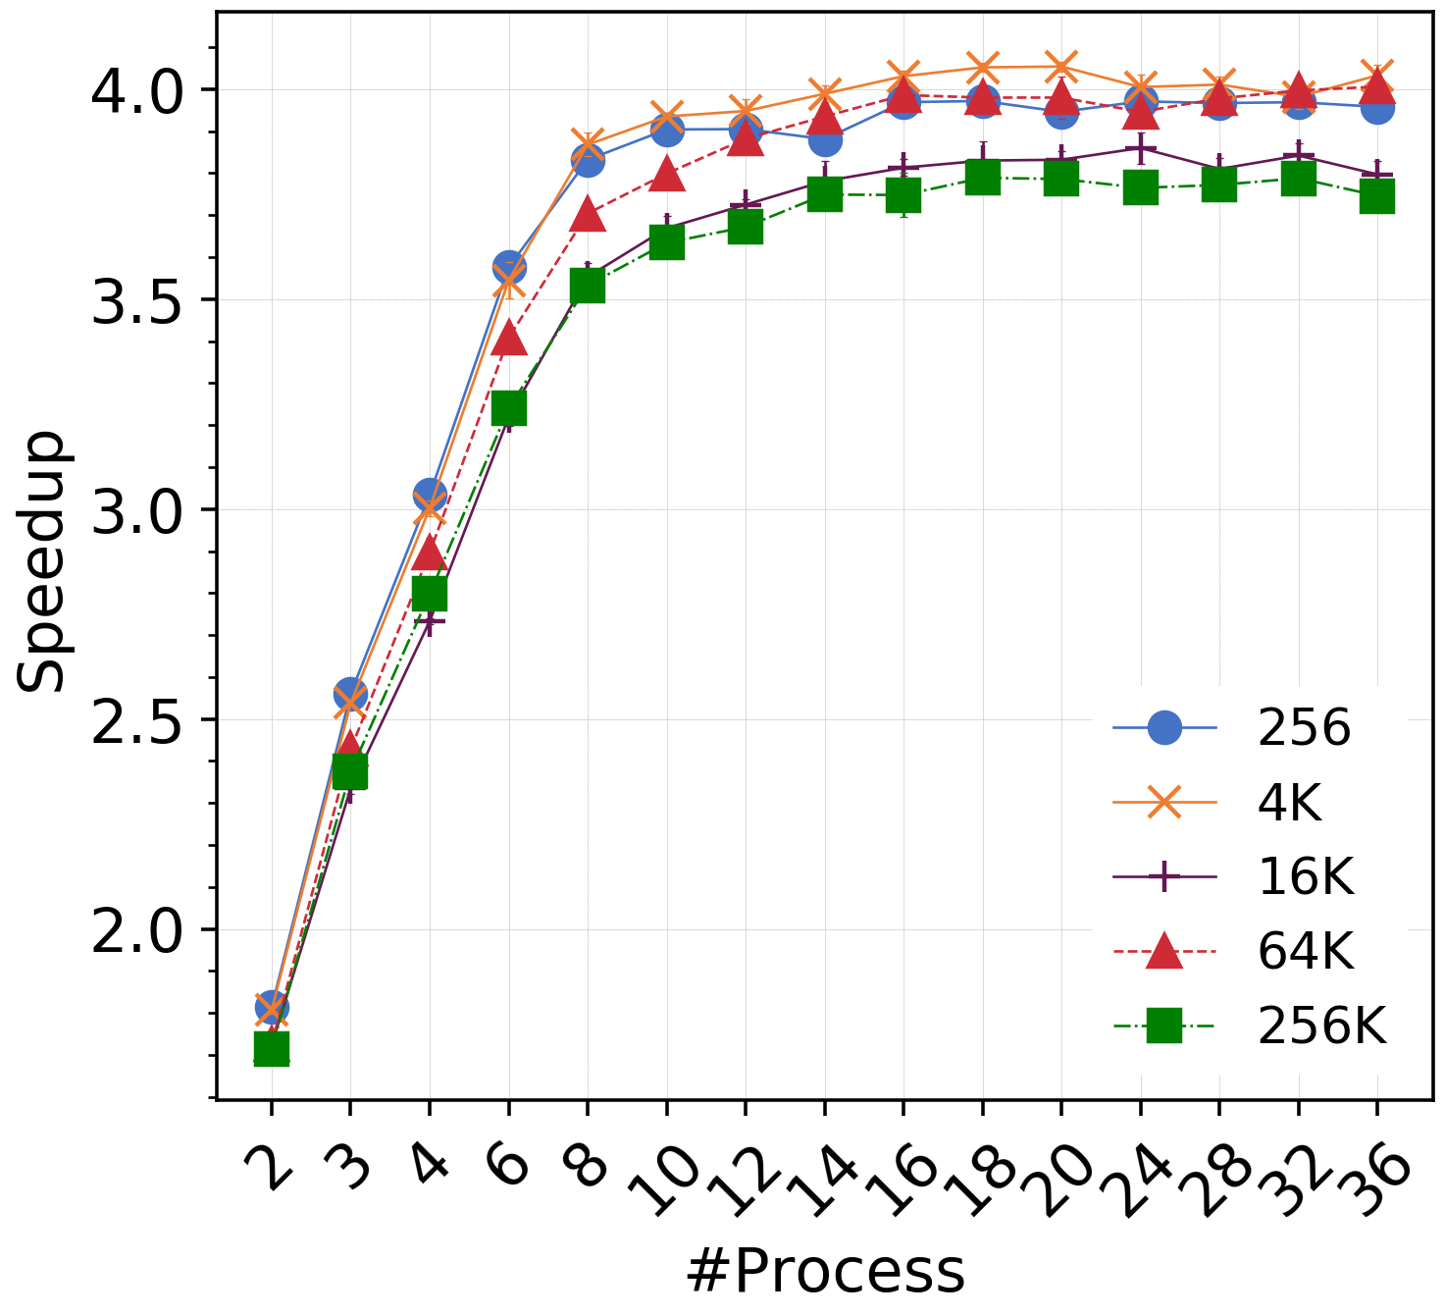
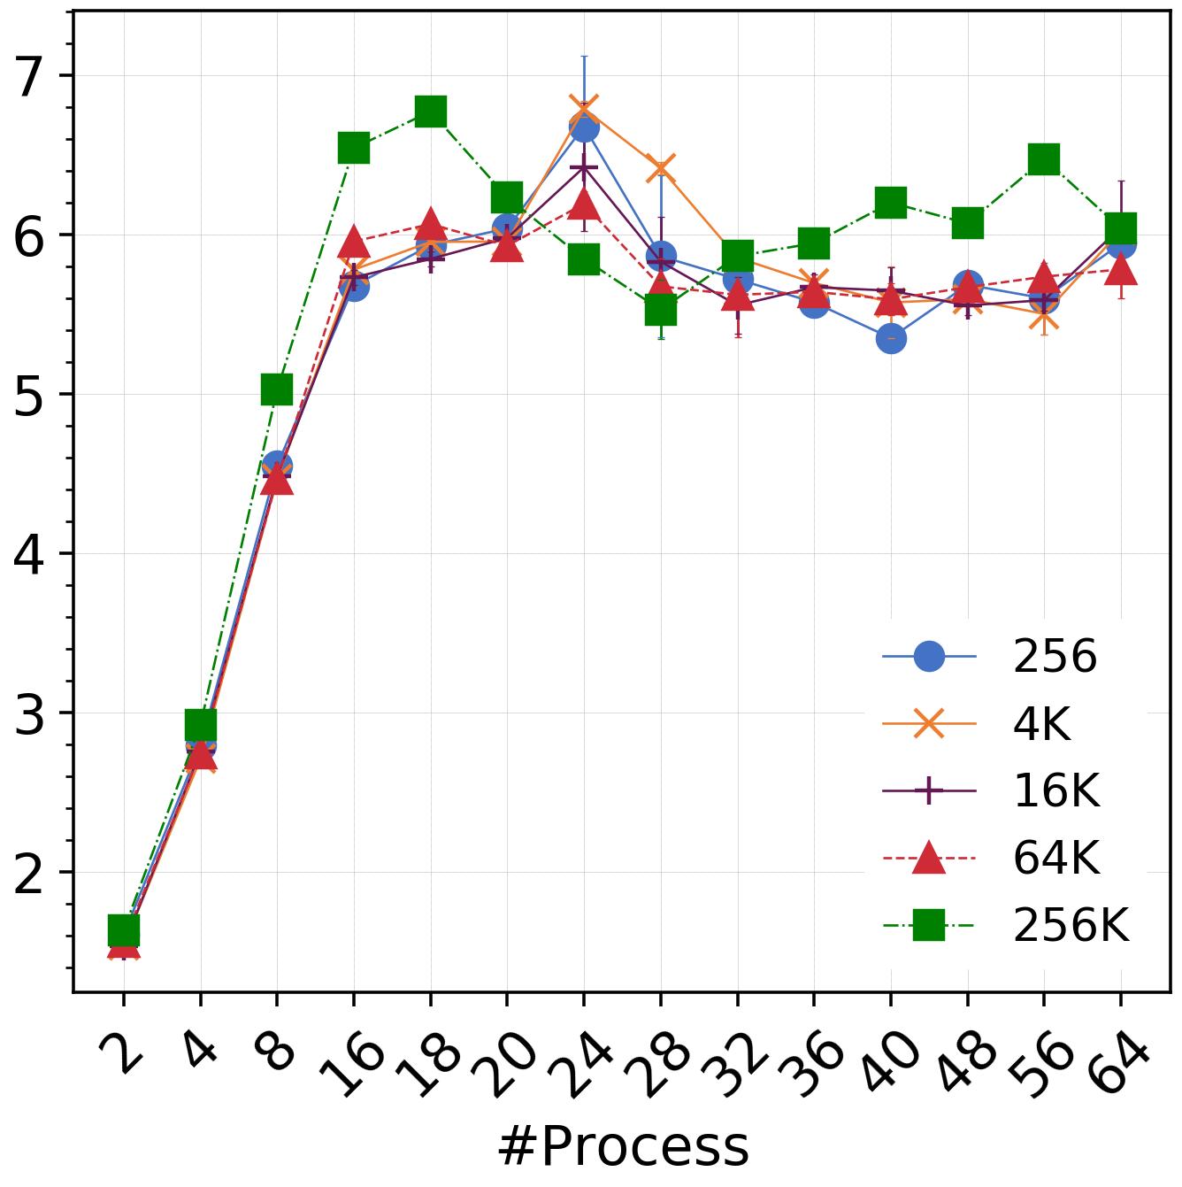
Microbenchmark – PingPong (Noncontiguous data)
Z
X
Y
3D Matrix
X as leading dimension
element type: double (8 bytes)
XZ vector datatype - block length x - stride x*y - count z
Intra-NUMA Pack on Broadwell
Intra-NUMA Pack on KNL
Pack-based PingPong
XZ face data layout defines vector datatype
matrix size x*y*z*sizeof(double)=1GB
y is fixed at 2

Slide 20
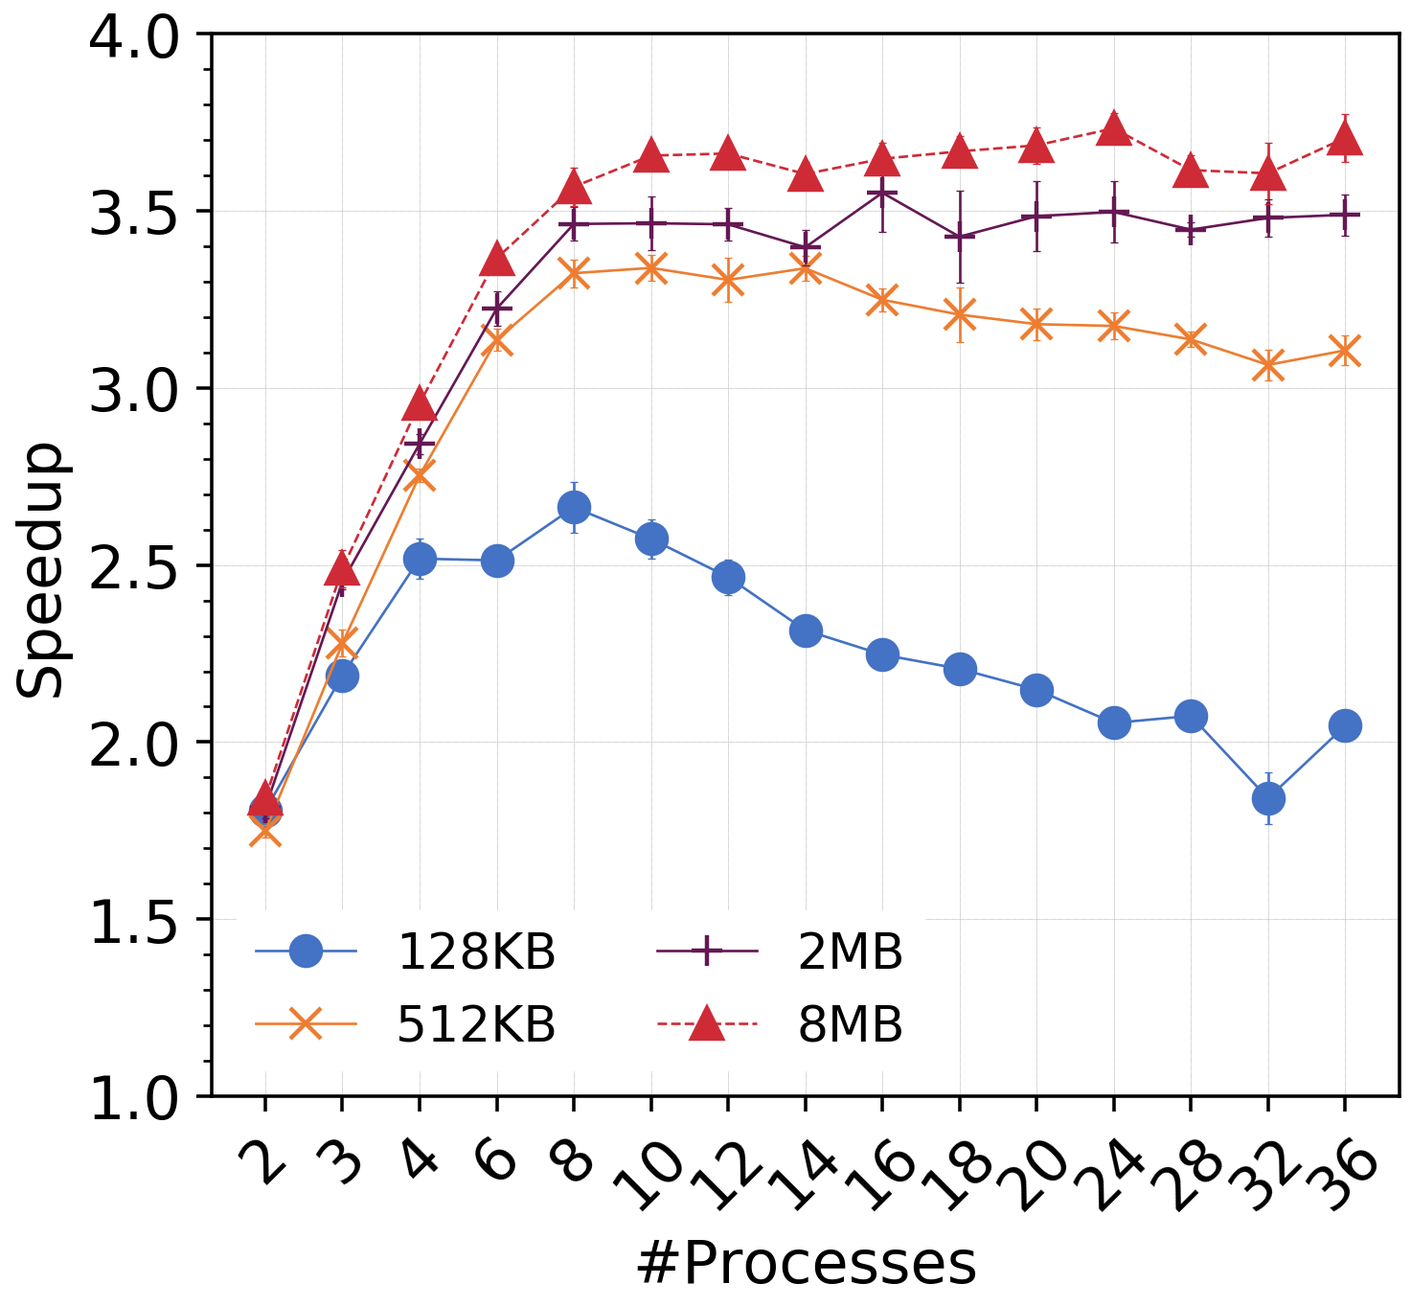
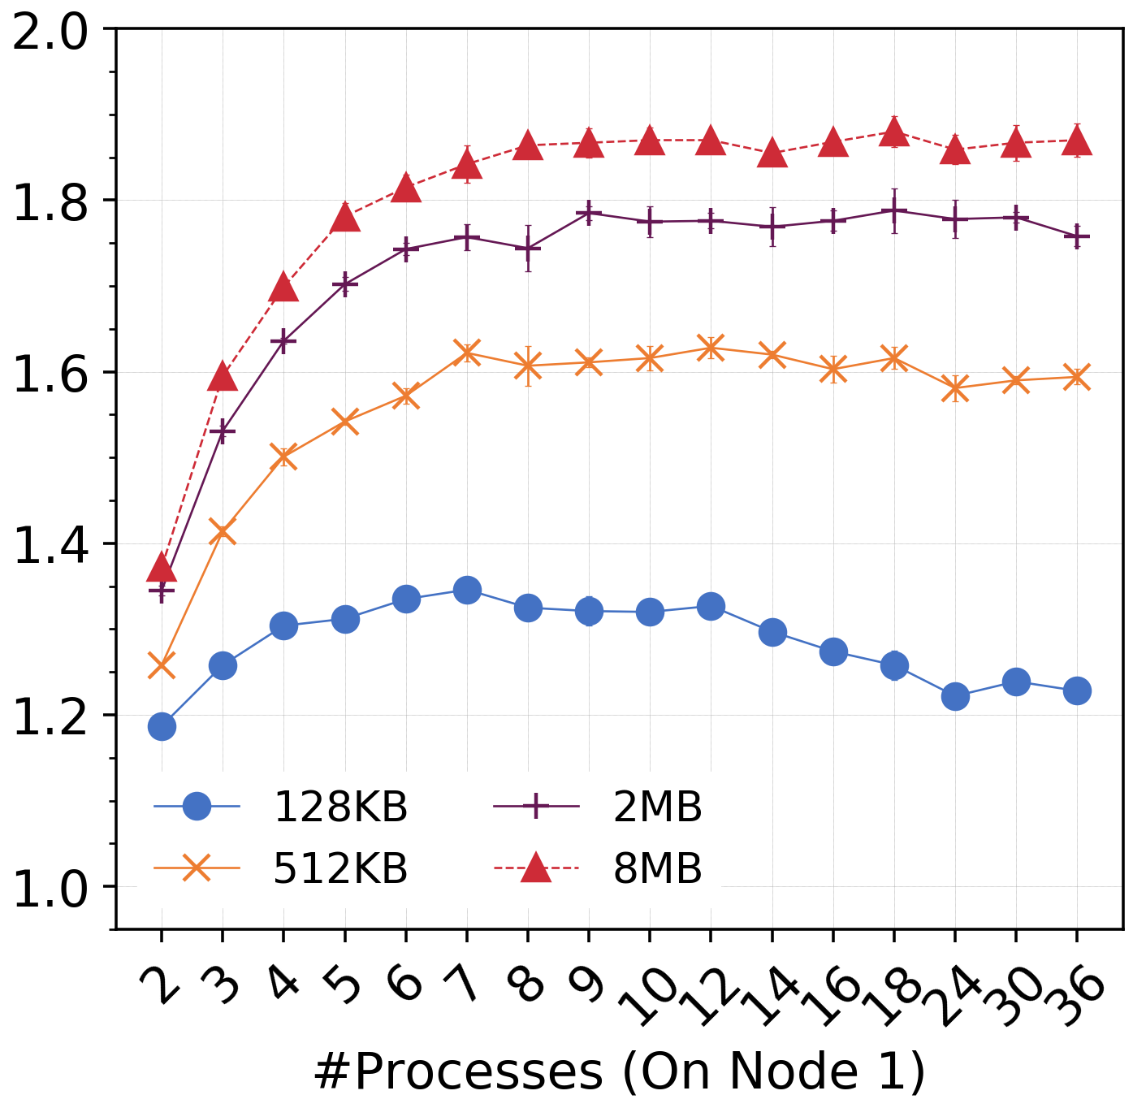
Microbenchmark – RMA Accumulate (MPI_SUM)
Active status array checking overhead
Higher memory bandwidth utilization
Intra-node Accumulate (origin process creates task)
Inter-node Accumulate (target process creates task)
origin and target are on NUMA 0
processes are filled from NUMA 0 and NUMA 1

Slide 21
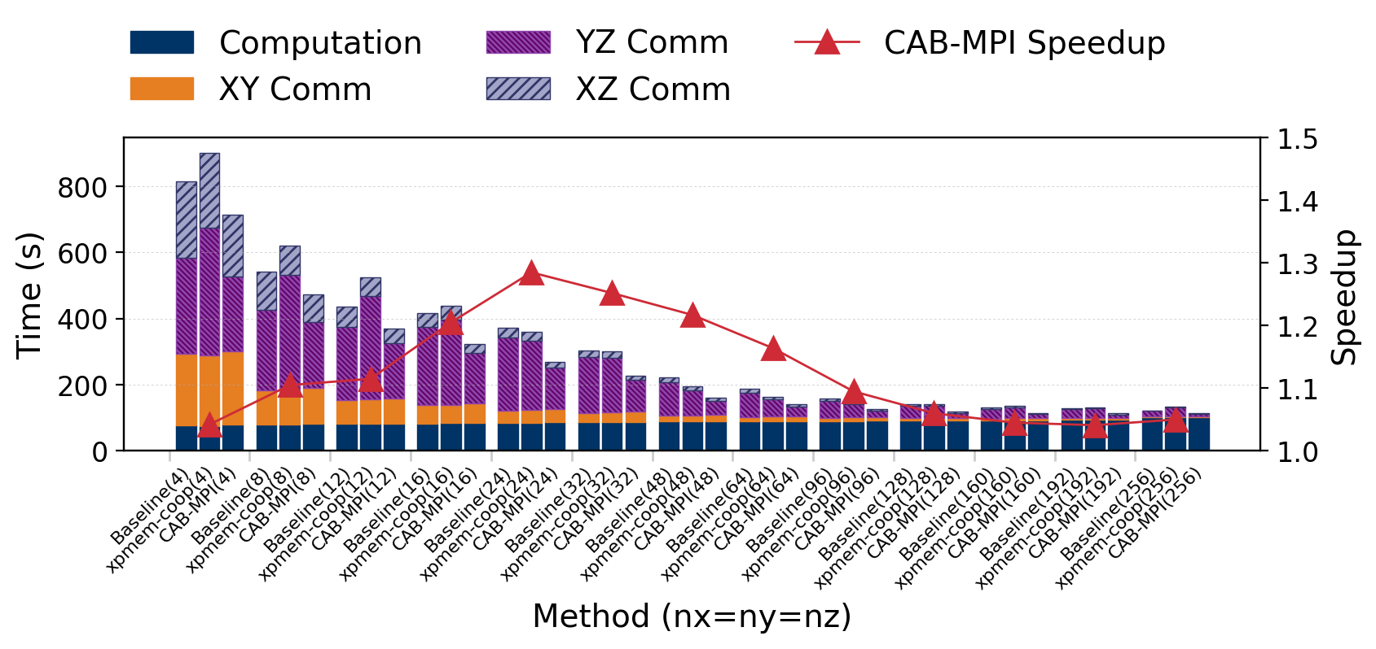
Minighost
nx*ny
...
XY Datatype –
Count N
3D 7-point stencil
each process owns N number of nx*ny*nz 3D matrix
N*nx*ny*nz*sizeof(double) = 1GB
nx*ny*nz
1
...
YZ Datatype –
Count ny*nz*N
nx
nx
...
XZ Datatype –
Count nz*N
nx*ny
N
Z
X
……
Y
YZ face stealing brings most speedup
Less tasks to steal
3D Matrix
X as leading dimension
element type: double (8 bytes)

Slide 22
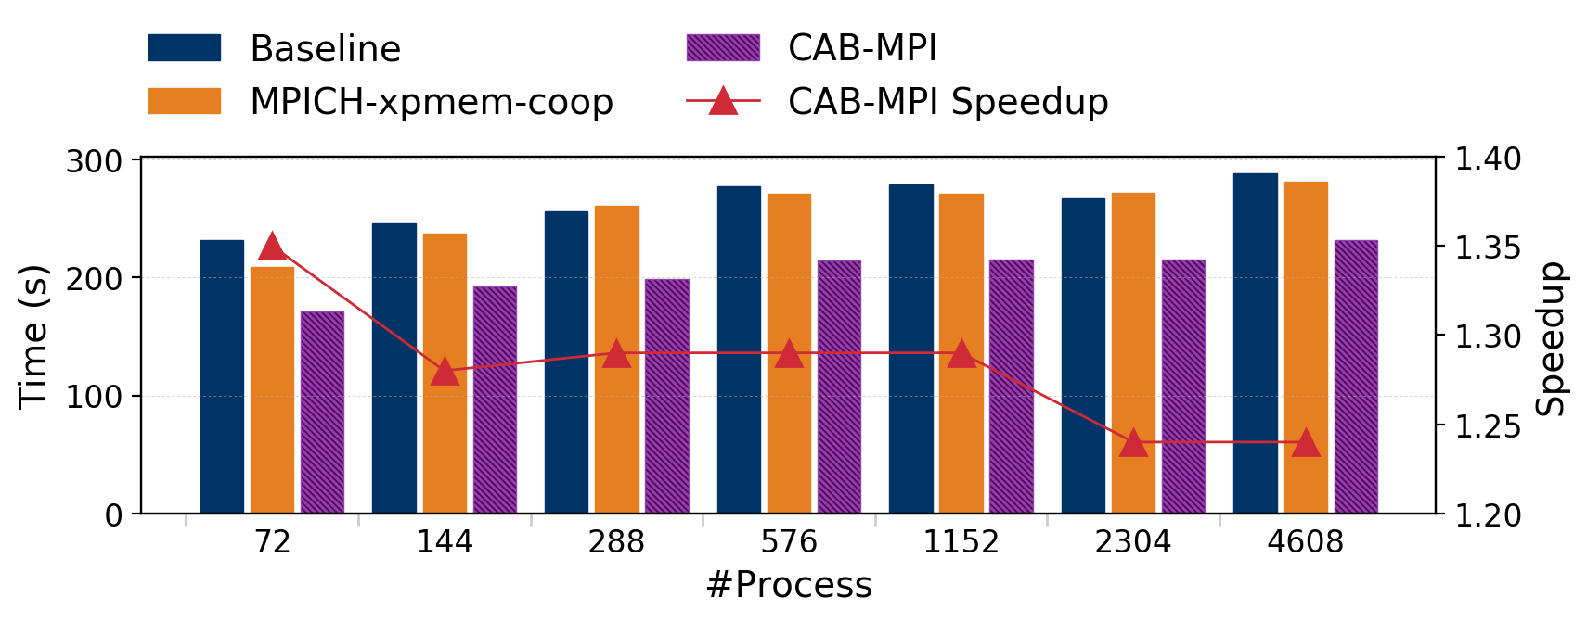
Minighost
nx*ny
...
XY Datatype –
Count N
3D 7-point stencil
each process owns N number of nx*ny*nz 3D matrix
N*nx*ny*nz*sizeof(double) = 1GB
nx*ny*nz
1
...
YZ Datatype –
Count ny*nz*N
nx
nx
...
XZ Datatype –
Count nz*N
nx*ny
N
Z
X
……
Y
3D Matrix
X as leading dimension
element type: double (8 bytes)

Slide 23
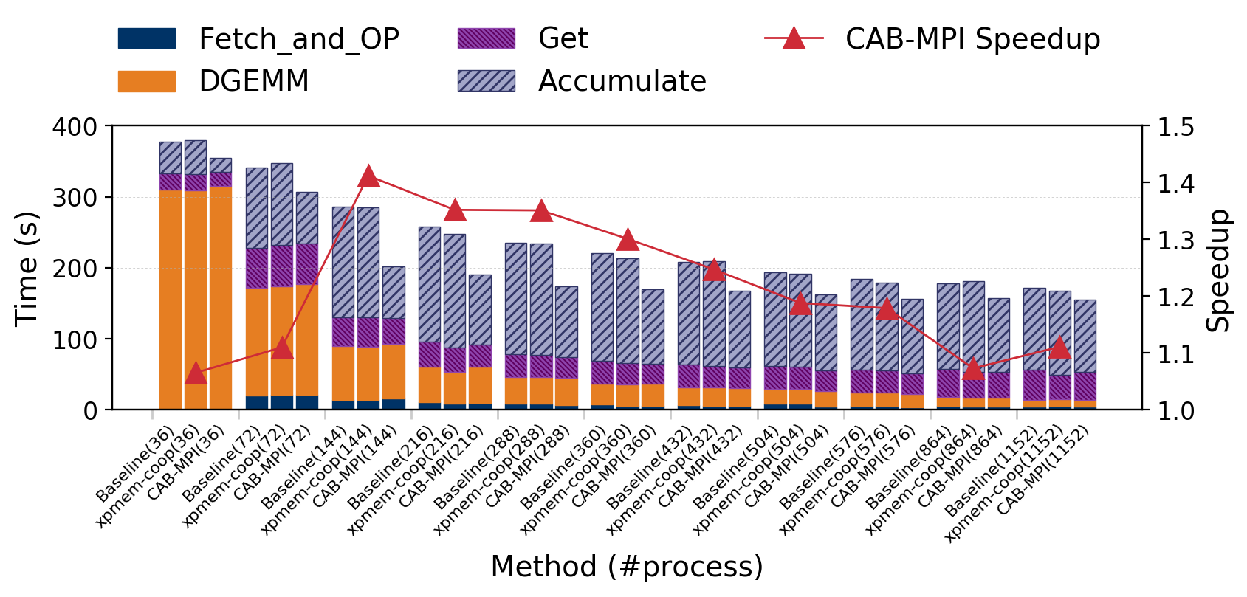
Nwchem Proxy Application
Nwchem is widely used computational chemistry application suite
Block-Sparse Matrix Multiplication (BSPMM) applies get-compute-accumulate pattern
Overall workload is fixed; submatrix blocks are equally distributed among processes
Irregular communication pattern brings more speedup
get-compute-accumulate pattern
get(A_{i}) get(B_{i})
C_{i} = dgemm(A_{i}, B_{i})
accumulate(C_{i})
More workers for stealing which increases task parallelism
Network data transfer overhead increases; proportion of stealing benefits reduces

Slide 24
Summary
Communication imbalance widely exists in HPC applications - MPI runtime • communication can happen among inter-node, intra-NUMA and inter-NUMA - application • equally distributing workload is hard or impossible in some cases - cause process idleness and performance loss
CAB-MPI: efficiently mitigate communication imbalance - PiP shared memory technique brings lightweight interprocess data access - throughput-aware strategy maximizes memory bandwidth utilization
Minighost and BSPMM results show the maximal 1.4x speedup and good scalability
Future Work - explore and optimize MPI collective communication imbalance

Slide 25
Thank You

