Slide 1



Use Case Presentation.
Use Case
17 Nov, 2019
-Pavan Balaji Nanjundappa:

Slide 2

Problem Statement
Data Background:
In India itself about eighty thousand people are killed in road crashes every year which is thirteen percent of the total fatality all over the world. Ministry of Road Transport and Highways (MoRTH) monitors and regulates the road transport efficiency system in India, releasing reports of accidents due to various conditions. Road Accident recording and reporting formats have been recently changed. There are 19 reports in all now and the data sets related to accidents with various general parameters will be provided to you. What is the interplay of different causes / factors and concomitant impact? Can we find awareness – accident connect? What correlations can be established? Is there any chance of predictions? Can the tool guide the driver in any way? Based on the data points in these reports, develop a Data Analytical Tool (Web App or Mobile) that would help reduce road accidents.

Slide 3

Data Insights
Data Set : 14 Datasets
Size: 1.78 gb
Columns Used: 31
Columns :'Accident_Classification','NoOfVehicle_Involved','HundredM','Node1','Node2', 'Road_Markings','NoOf_Animal_Injured','NoOf_Animal_Killed'
ID Columns : Unit_ID

Slide 4
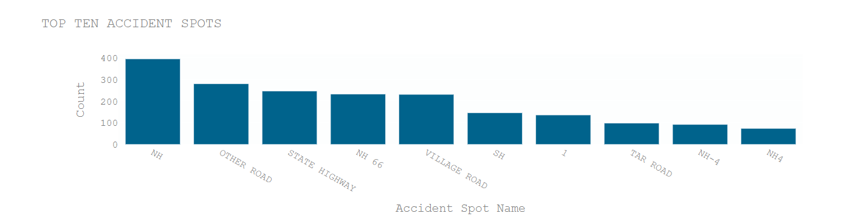
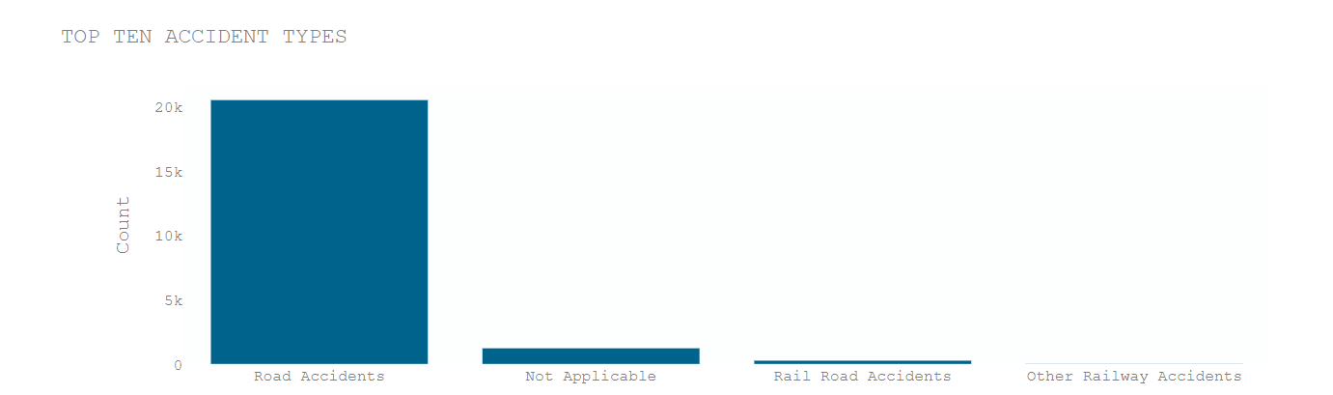
Data Insights
Distribution plots:

Slide 5
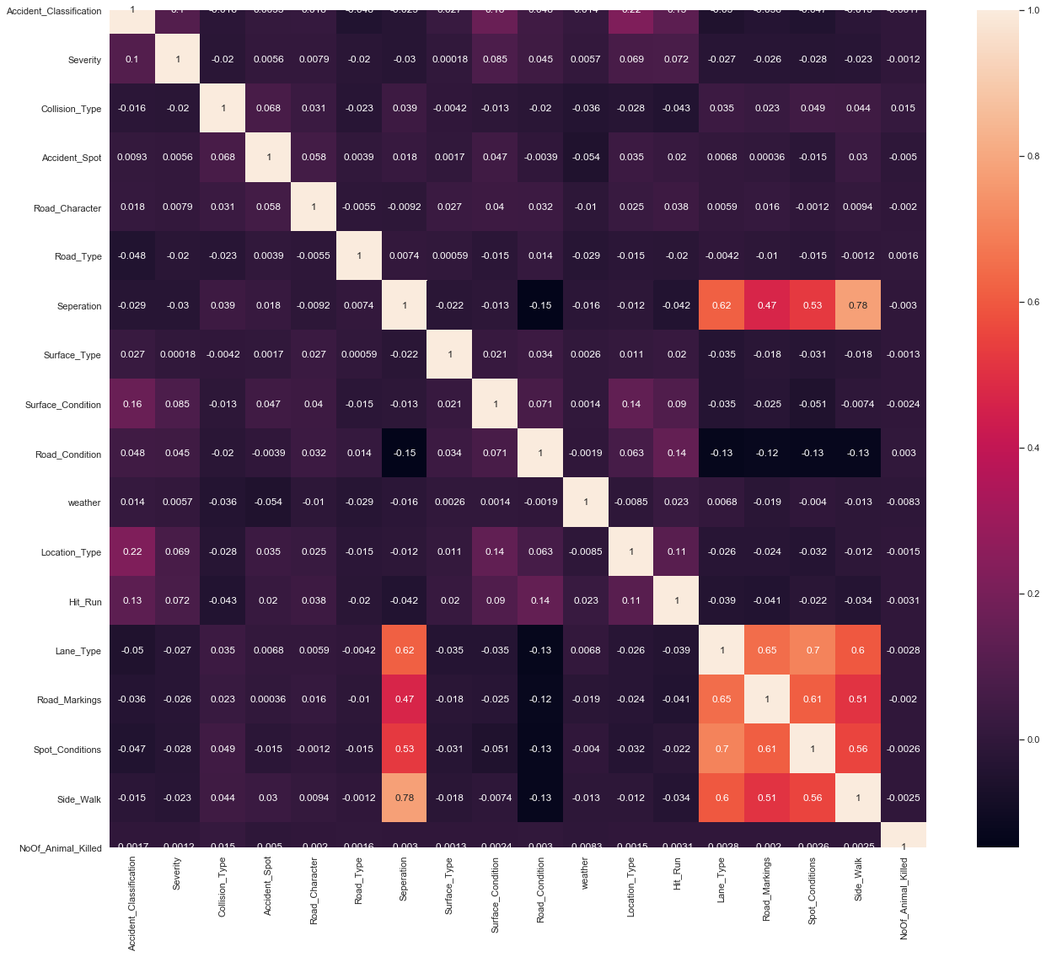
Data Insights
Correlation plots:

Slide 6
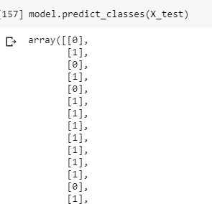
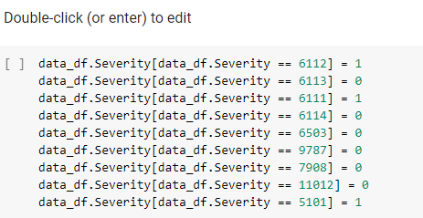
Pre-Processing
Steps:
tbl_tr_accident_report data set is used for prediction of Severity
Severity is mapped from FIR dataset
Feature selection is done based on RFE
Missing and Null values are checked
Accuracy of 66% obtained after several trails including regularization and dropouts
More data will be helpful to get more accuracy

Slide 7
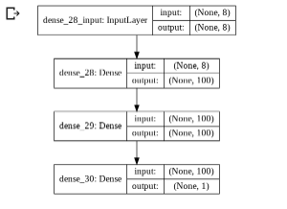
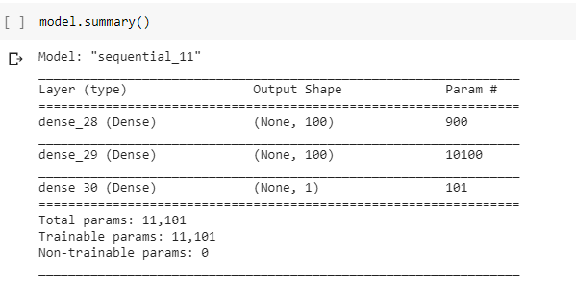
Model Details
Steps:

Slide 8
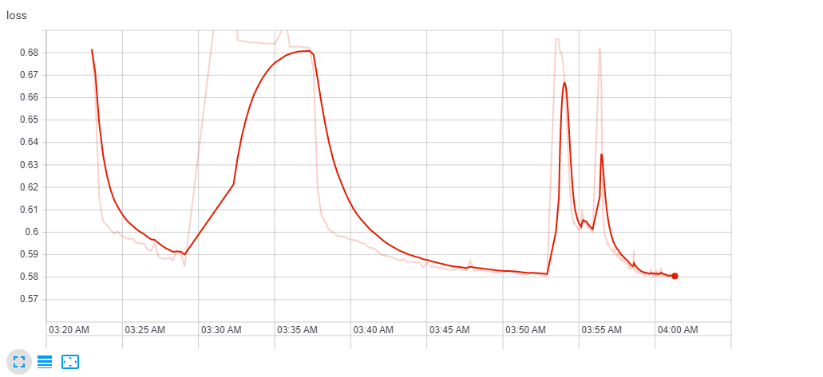
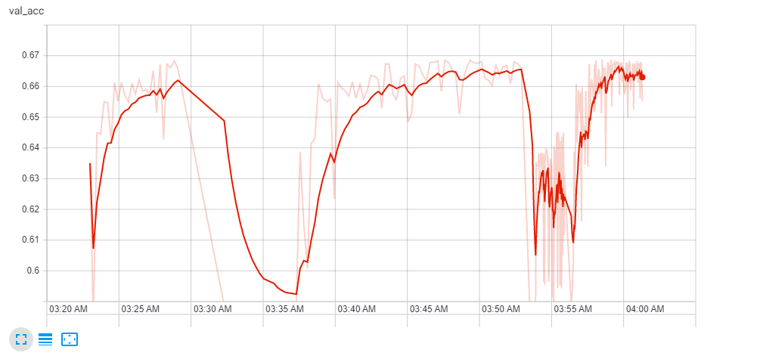
Tensor Board:

Slide 9
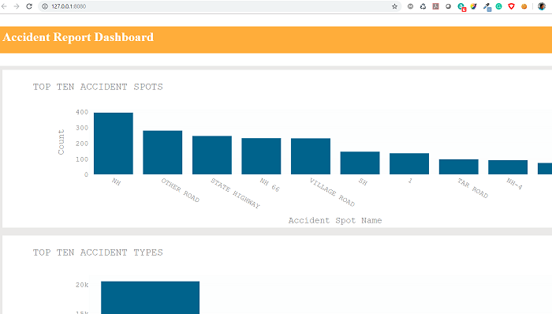
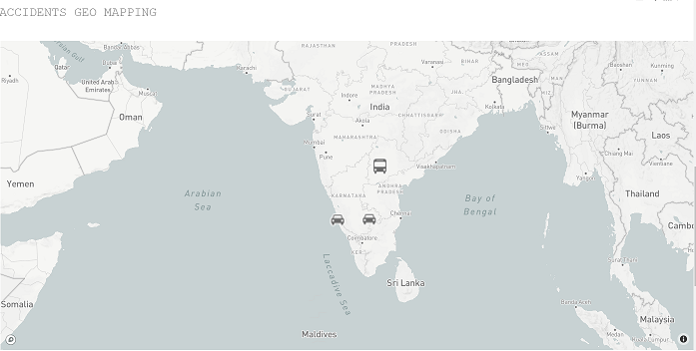
Dash Board:

Slide 10
Conclusion:
Conclusion:
With the given data, challenging part was the data volume itself
Null values and error data is rectified.
More data would be helpful to increase the accuracy.
Top Contenders for Accidents:
'NoOfVehicle_Involved','Road_Type','Seperation','Location_Type',
'Main_Cause','HundredM','Node1','Node2',
'Road_Markings','Spot_Conditions','Side_Walk',
'NoOf_Animal_Injured','NoOf_Animal_Killed'
Weather was only one record and hence is not part of top contenders

Slide 11
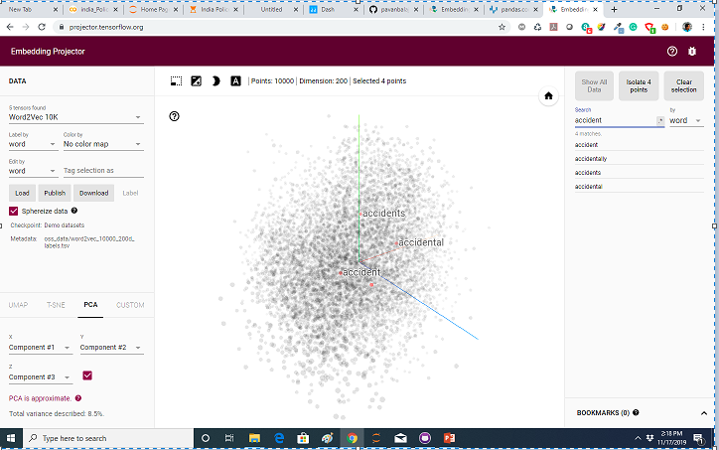
Suggestion:
Accident Embedding Dashboard Projector:
Have Tried to develop a Kannada Accident Description Word2Vec
Embedding projector, due to memory constraint and time constraint, could not achieve it
I would recommend to have a look on this feature in future
URL: https://projector.tensorflow.org/

Slide 12




Thank You

