Slide 1















EXPLORATORY DATA ANALYIS ON
AMEO DATA

Slide 2

ABOUT ME
I am Pavan Banavasi . I hold a Bachelor's degree in Computer Science and Engineering from
G Pulla Reddy Engineering college.
In today's data-driven world, I believe that mastering data science techniques will not only enhance my career prospects but also enable me to contribute meaningfully to various industries and societal challenges.

Slide 3

OBJECTIVE OF PROJECT:
Perform Exploratory Data Analysis (EDA) on the AEMO data-set . Consider Salary as a target variable
SUMMARY OF DATA :
The dataset was released by Aspiring Minds from the Aspiring Mind Employment Outcome 2015 (AMEO). The study is primarily limited only to students with engineering disciplines. The dataset contains the employment outcomes of engineering graduates as dependent variables (Salary, Job Titles, and Job Locations) along with the standardized scores from three different areas – cognitive skills, technical skills and personality skills. The dataset also contains demographic features. The dataset contains around 40 independent variables and 4000 data points. The independent variables are both continuous and categorical in nature. The dataset contains a unique identifier for each candidate. Below mentioned table contains the details for the original dataset.

Slide 4
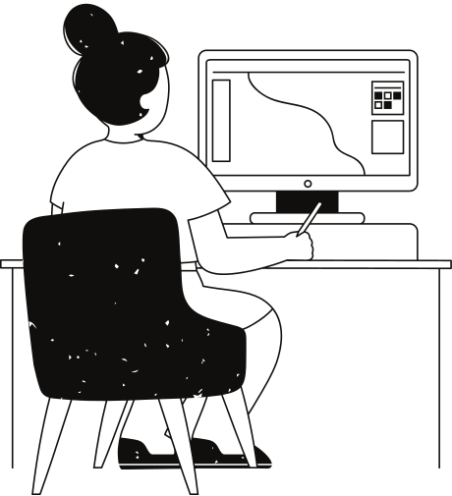
DATA :
' Unnamed: 0‘,Salary', 'DOJ', 'DOL', 'Designation', 'JobCity', 'Gender', 'DOB',
'10percentage', '10board', '12graduation', '12percentage', '12board',’CollegeID’
'CollegeTier', 'Degree', 'Specialization', 'collegeGPA',
'CollegeCityID', 'CollegeCityTier', 'CollegeState', 'GraduationYear',
'English', 'Logical', 'Quant', 'Domain', 'ComputerProgramming',
'ElectronicsAndSemicon', 'ComputerScience', 'MechanicalEngg',
'ElectricalEngg', 'TelecomEngg', 'CivilEngg', 'conscientiousness',
'agreeableness', 'extraversion', 'nueroticism', 'openess_to_experience',
DATA CLEANING:
Cleaned Job city column with fuzzyWuzzy and replaced
some uncleaned names of job city.
In 10th Board and 12 th board if all state board names
replaced with stateboard ex: Andhra State board --> state
In CollegeGPA some rows are with GPA, Which converted to
percentage.
In JobCity there is -1 where replaced with UNKNOWN
Replaced present values in DOL with 2015 dec 31 because the
data is from 2015
DATA MANIPULATION:
Created a new column period with subtraction of DOJ and DOL
Created new column ApptitudeSCore with mean of Logical,Quant,English
created new column AcademiceSCore with mean of 12percent,10thpercent,CollegeGPA

Slide 5
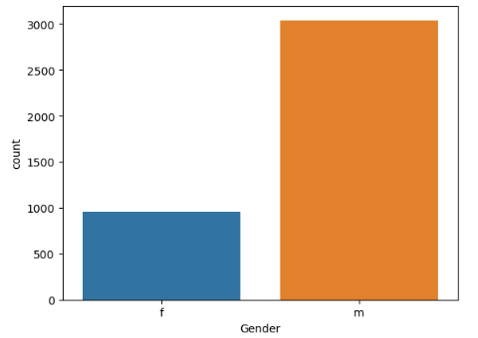
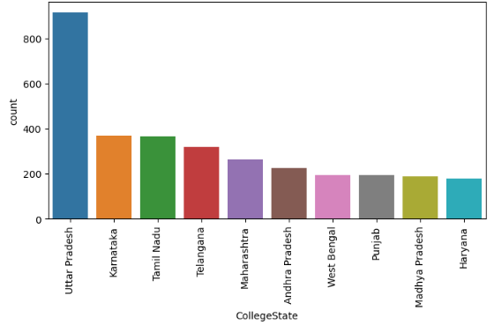
GENDER COLUMN
COLLEGESTATE COLUMN
MOST AMCAT TAKERS ARE FROM
UTTAR PRADESH COLLEGE STATE
MOST AMCAT TAKERS ARE MALE

Slide 6
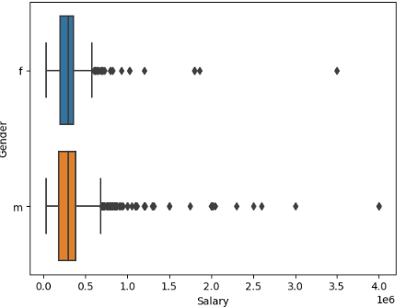
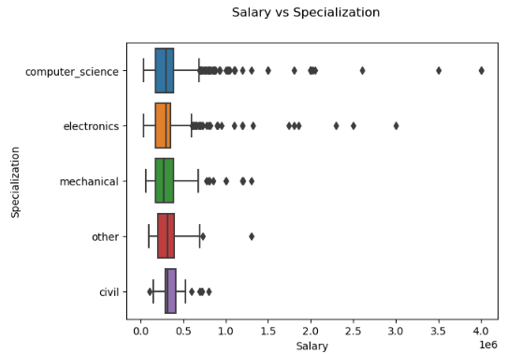
GENDER vs SALARY
SPECIALIZATION vs SALARY
Median salary of both males and females have increased
slightly with exp for first five years and Decreased suddenly
on the 6th year and then same pattern for the following years.
We can see that men and women having same experience
are paid nearly equally around 3.5-5 lakhs
Median salary of people from all
specializations are nearly similar.
We can see there are more people getting higher
pays who have specialization in
Computer_science/electronics compared to others.

Slide 7
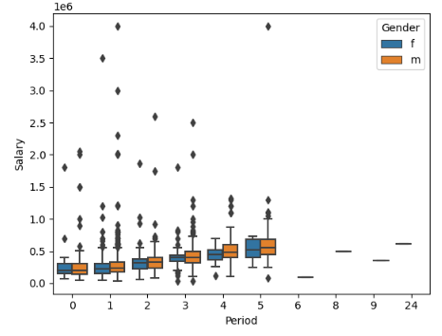
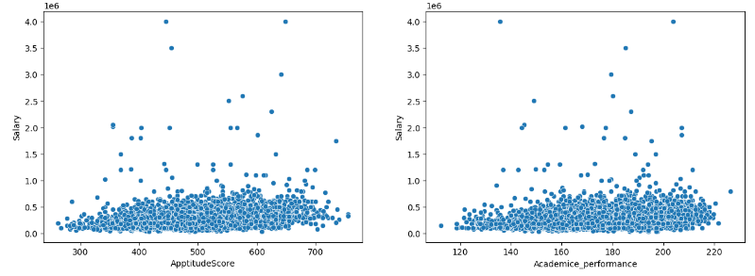
PERIOD vs SALARY
SCORES vs SALARY
We can see there is some positive correlation of
salary with both the ApptitudeScore
and Academice_performance.
It is noted that there are many outliers in the salary data
There is not much difference between median salary
for both genders.
We can also observe male have more outliers
indicating they are more people getting higher pays in
male than female category

Slide 8
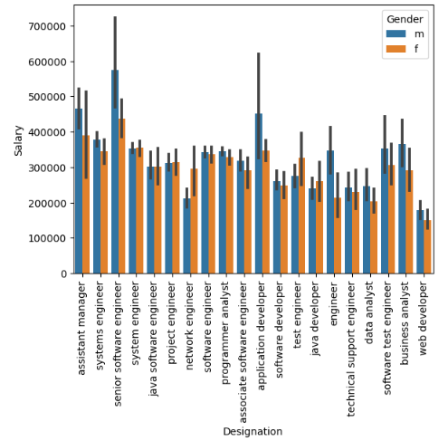
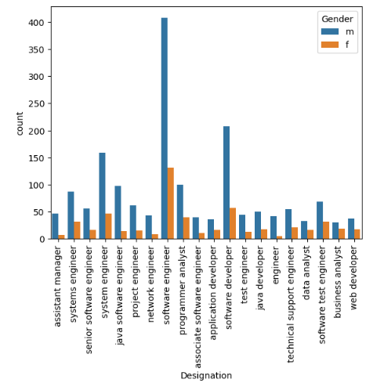
DESIGNATION vs SALARY with gender
DESIGNATION with Gender
All the general professions are more dominated by the
males as we can there is considerable difference of
frequency
Here we took the most common roles taken by the amcat
aspirants which are mostly 'IT Roles'.
mean salary of top most frequent roles is nearly
independent of gender.
there is some considerable difference in
some roles.but we cannot be sure that women is
being paid less in that role
it might be due to experience,specialization etc.

Slide 9
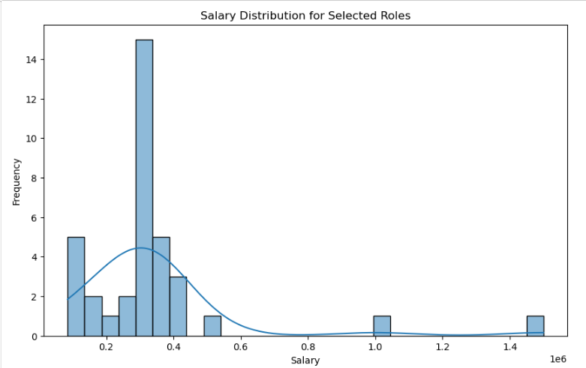
CLAIMED BY TIMES OF INDIA:
Times of India article dated Jan 18, 2019 states that “After doing your Computer Science Engineering
if you take up jobs as a Programming Analyst, Software Engineer, Hardware Engineer and Associate Engineer
you can earn up to 2.5-3 lakhs as a fresh graduate.” Test this claim with the data given to you.
OBSERVATION:
We fail to reject null hypothesis and Avergae salary is equal to 250k - 300k

Slide 10
CONCLUSION:
Most of Amcat Aspirants are male working in IT domain with an experience of around 5years with degree in Btech and specialization in Computer Science from tier-2 college in uttarpradesh with an average salary around 300k.
Highpaying jobs taken up by amcat aspirants are mostly from 'IT' Domain.
Software Engineer and Software Developer are the most aimed profession for amcat aspirants.

Slide 11


THANK YOU

