Slide 1

Note: The data and information in this document is reflective of a hypothetical situation and client. This document is to be used for KPMG Virtual Internship purposes only.
Sprocket Central Pty Ltd
Data analytics approach
Pavan S Chavalgi

Slide 2
Note: The data and information in this document is reflective of a hypothetical situation and client. This document is to be used for KPMG Virtual Internship purposes only.
Agenda
Introduction
Data Exploration
Model Development
Interpretation

Slide 3
Note: The data and information in this document is reflective of a hypothetical situation and client. This document is to be used for KPMG Virtual Internship purposes only.
Introduction
Identify and Recommending High Value Customers
Outline of Problem
Sprocket Central is a company that specializes in high-quality bikes and accessories
The marketing team is looking to boost sales.
To target 10000 new customers that will bring the highest value to the business.
Approach to Data Analysis
Bike-related purchases for the last three years.
Top industries contributing the maximum profit and bike-related scales.
Wealth segment by age category
Number of Cars owned in each state
Customer classification

Slide 4
Note: The data and information in this document is reflective of a hypothetical situation and client. This document is to be used for KPMG Virtual Internship purposes only.
Data Exploration
Data Quality Assessment
Key issue dealt with for the data quality issue:
 | Accuracy | Completeness | Consistency | Currency | Relevancy | Validity
Customer Demographic | DOB: Inaccurate Age: Missing | Job Title: Blanks Customer Id: Incomplete | Gender: Inconsistent | Deceased customer: Filtered out | Default Column:
Customer address |  | Customer ID: Incomplete | States: Inconsistent
Transaction | Profit :Missing | Customer ID: Incomplete Online Orders: Blanks Brands: Blanks |  |  | Cancelled Status order : Filtered Out | List Price: Format Product Sold Date: Format

Slide 5
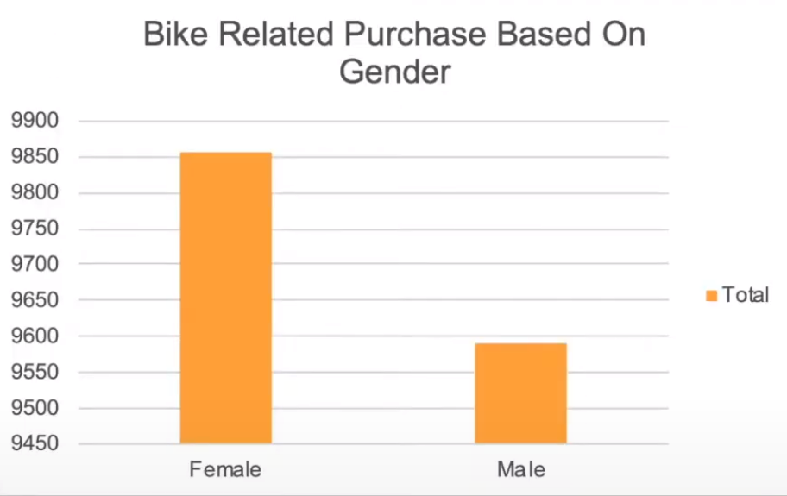
Note: The data and information in this document is reflective of a hypothetical situation and client. This document is to be used for KPMG Virtual Internship purposes only.
Model Development
Bike-Related Purchases Over last 3 Years on Gender
Data shows, on average females have made more bike-related purchases in the last 3 years.
On Average Females have had 1% higher bike related purchases compared o men in the last 3 years

Slide 6
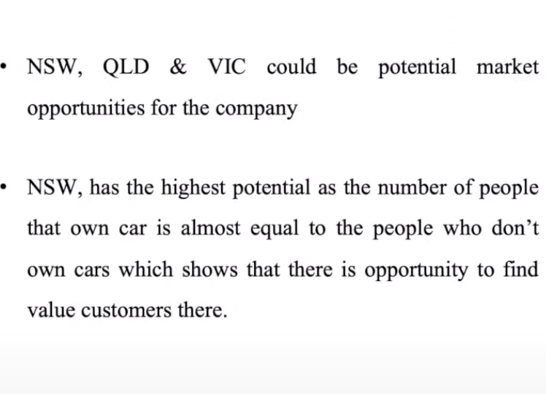
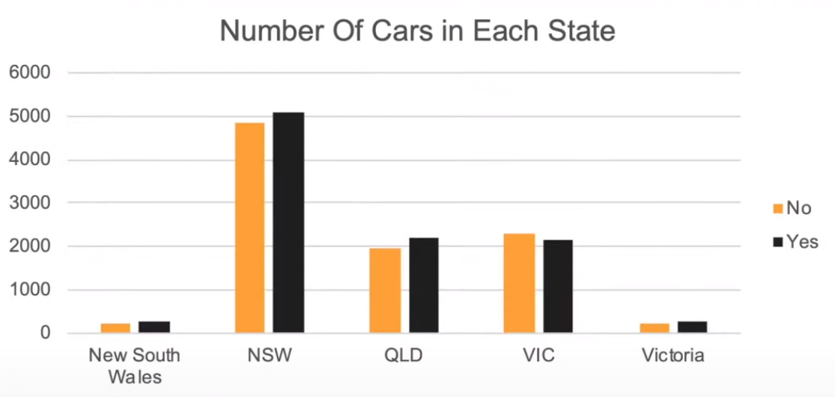
Note: The data and information in this document is reflective of a hypothetical situation and client. This document is to be used for KPMG Virtual Internship purposes only.
Data Exploration
Number of Cars Owned in each state

Slide 7
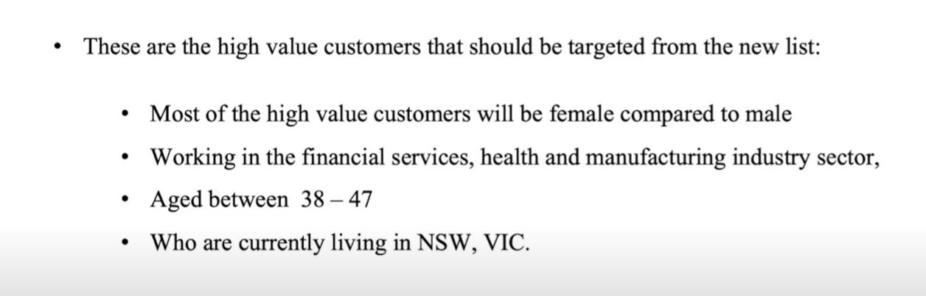
Note: The data and information in this document is reflective of a hypothetical situation and client. This document is to be used for KPMG Virtual Internship purposes only.
Model Development
Customer Classification – Targeting High-Value Customers

Slide 8
Note: The data and information in this document is reflective of a hypothetical situation and client. This document is to be used for KPMG Virtual Internship purposes only.
Thank You

