Slide 1
CS59200 ASE PROJECT
Code Review Automation using Large Language Models with Retrieved Augmented Generation
PAVAN CHAITANYA PENAGAMURI
NISHCHAL
JAGADEESHA
SURAJ SURYA
NARAYANA
KRISHNA SRI IPSIT
MANTRI
KEERTHANA
ASHOKKUMAR

Slide 2
PROBLEM STATEMENT
Automated code review is essential for enhancing software quality and developer productivity. However, existing approaches often lack context-specific understanding, resulting in suboptimal results. Additionally, fine-tuning large language models (LLMs) for code review tasks can be resource-intensive.
OBJECTIVE: To develop a novel approach for automatic code review generation for GitHub repositories leveraging Large Language Models (LLMs) in conjunction with Retrieval Augmented Generation (RAG), addressing the limitations of existing methods.
2

Slide 3
EXISTING WORK
CodeReviewer
CodeReviewer adopts the encoder-decoder Transformer architecture used in the T5 model.
It utilizes four pre-training tasks: diff tag prediction, denoising code diff, denoising review comment, and review comment generation to make CodeReviewer better understand code diffs and generate review comments.
These pre-training tasks demand a lot of data-preprocessing with complex mathematical computations.
3

Slide 4
EXISTING WORK
LLaMA- Reviewer
It leverages LLaMA, a large pre-trained language model, and fine-tunes it using parameter-efficient fine-tuning (PEFT) methods for code review tasks.
It does not require pre-training from scratch, instead utilizing the knowledge already present in the LLaMA model and adapting it to the code review domain.
LLaMA-Reviewer achieves comparable performance to CodeReviewer on code review tasks, even with the smallest LLaMA base model (6.7B parameters) and limited fine-tuning epochs.
However, LLama-Reviewer’s fine-tuning methods are resource-intensive and add additional latency.
4

Slide 5
RELATED WORK
Repocoder
RepoCoder is a repository-level code completion approach.
Leverages large language models (LLMs) and iterative retrieval and generation techniques to complete code within the context of an entire GitHub repository.
Results of such code completion task with repository-level context inspired us to develop a repository-level code review tool.
This code review generation is given context from various project repositories, thereby enriching the quality of the reviews generated by the LLM.
5

Slide 6
TERMINOLOGY
RAG
Retrieval-Augmented Generation (RAG) is the process of optimizing the output of a large language model, so it references an authoritative knowledge base outside of its training data sources before generating a response.
It is a cost-effective approach to improving LLM output so it remains relevant, accurate, and useful in various contexts.
Vector Store
Vector stores, also known as embedding indexes or vector databases, are databases that store vector representations of documents, passages, or other pieces of text.
WEAVIATE: Weaviate is an open source, fast, AI-native vector database which allows you to store and retrieve data objects based on their semantic properties
We used the BAAI general embedding.
6

Slide 7
DATASET
CodeReviewer Dataset
Generation
Quality
Train - 116K
Test - 31.3K
Refinement
Our Dataset
Vector Index Creation: CodeReviewer Quality Test Data
Test: 2 patches from every “project” in CodeReviewer Quality Test Data
patch | y | oldf | idx | id | msg | proj | lang
8

Slide 8
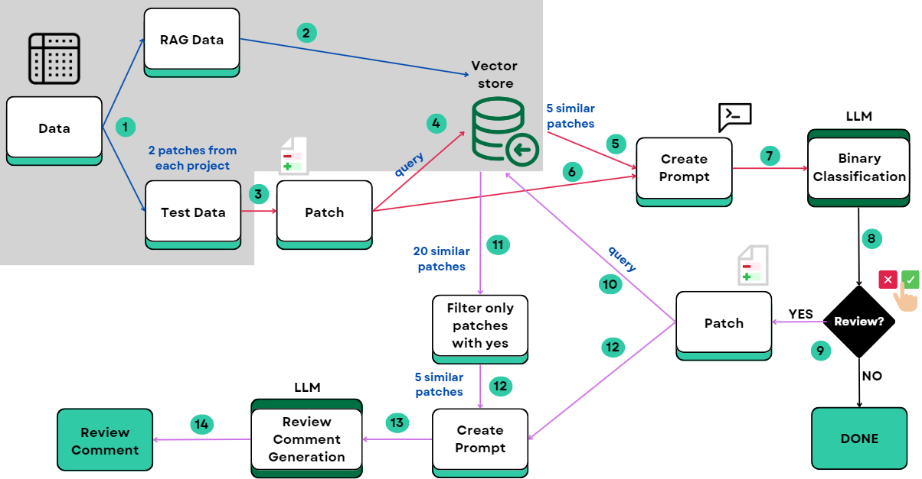
WorkFlow of LLM
9

Slide 9
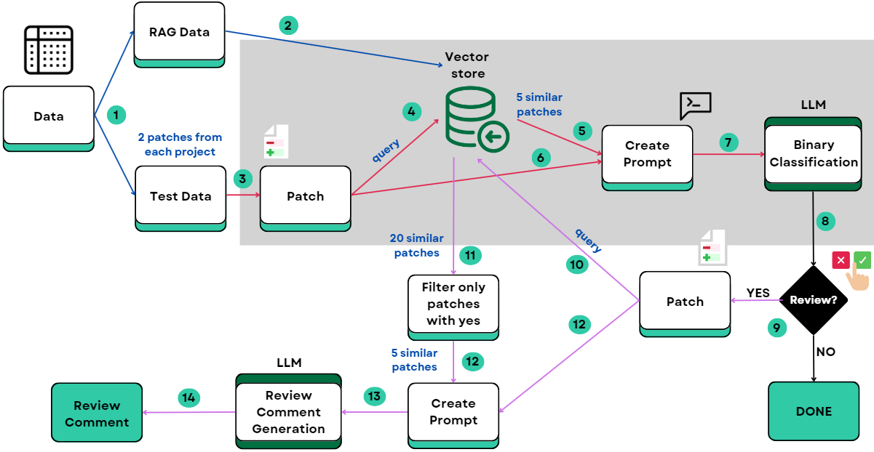
WorkFlow of LLM
9

Slide 10
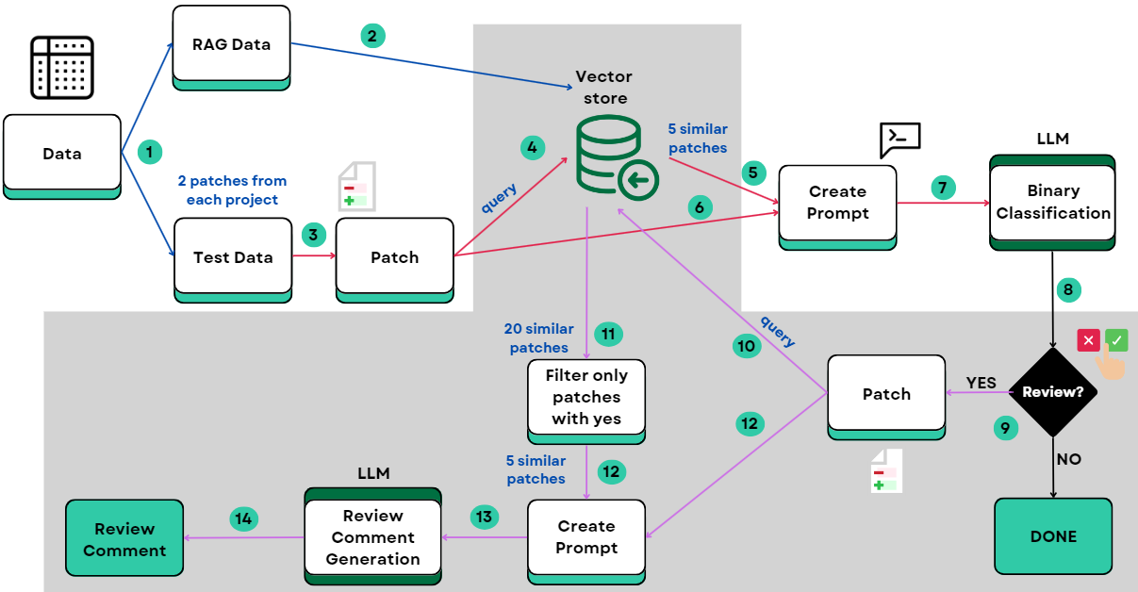
WorkFlow of LLM
9

Slide 11
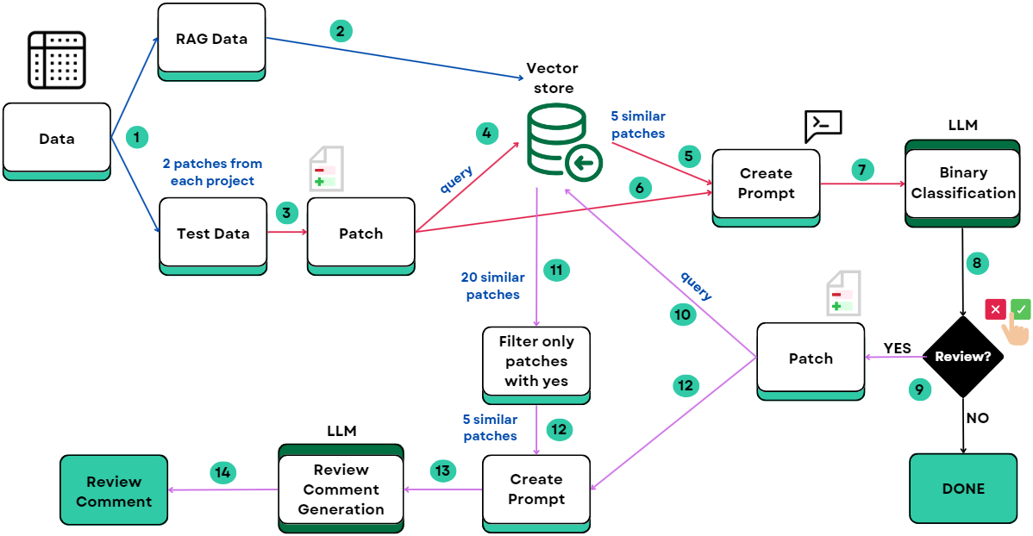
WorkFlow of LLM
9

Slide 12
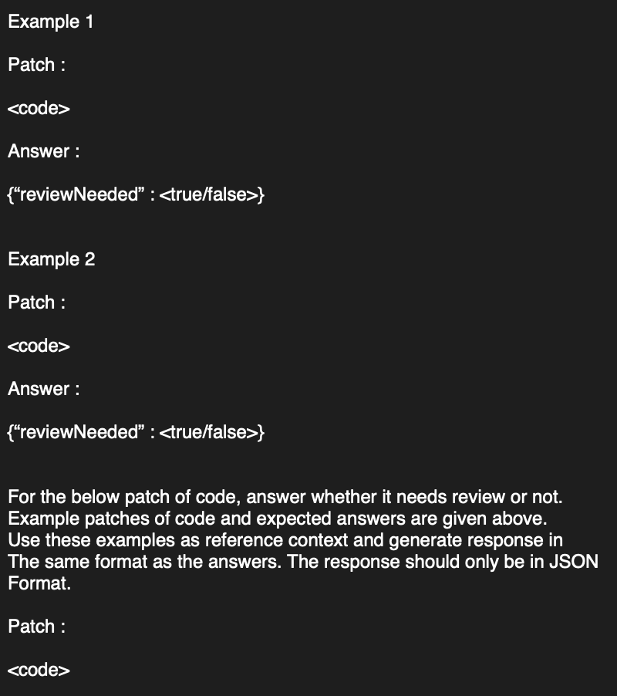
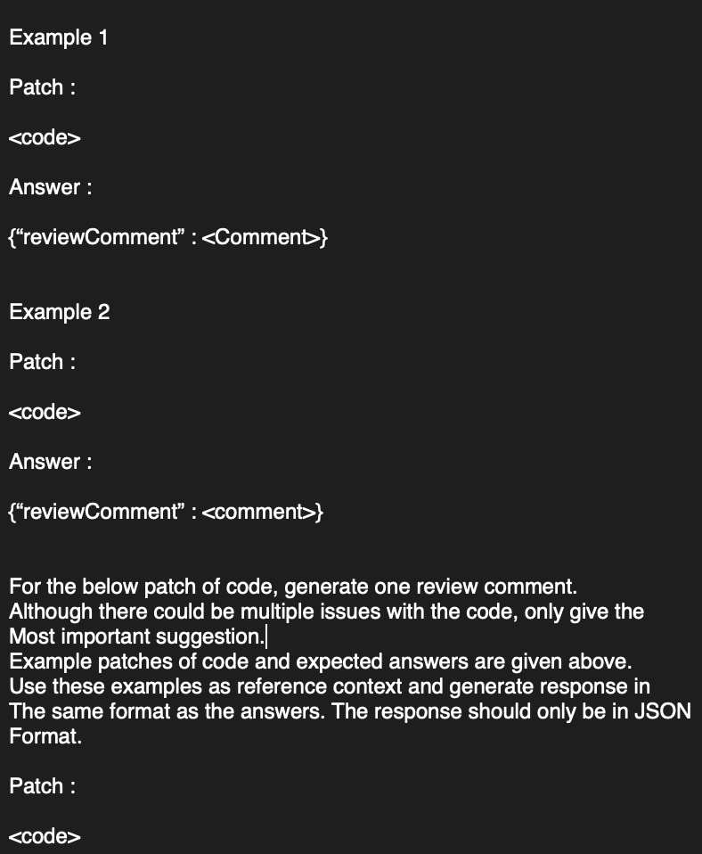
Binary Classification Prompt
Review Comment Generation Prompt

Slide 13
RERANKING - STRATEGY
Proposed Re-ranking Strategy
Use Project Metadata information in each patch to give patches from same project higher score when ranking the similar patches.
Use a gamma factor ~ 1.2 to multiple similarity scores of patches from same project.
Why this re-ranking strategy is not used?
When experiment is run on the test data, we observed that the similar documents returned didn’t contain documents from same project.
7

Slide 14
EVALUATION
Binary Classification Module
Precision: Measure of Quality (more relevant results than irrelevant ones)
Recall: Measure of Quantity (most relevant results)
F1 Score: Harmonic mean of Precision and Recall
Review Comment Generation Module
BLEU-4: n-gram overlap comparison between ground truth and generated comment
10

Slide 15
LLMs Used
LLaMA3
Developed by Meta AI. Has 70 Billion parameters
Utilized API support provided by Perplexity Labs: https://api.perplexity.ai
Mistral
Developed by Mistral AI, with 7 billion parameters.
Utilized API support provided by LemonFox: https://api.lemonfox.ai
GPT3.5
Developed by OpenAI. Has 175 Billion parameters.
Utilized API support provided by OpenAI.
11

Slide 16
EXPERIMENTS
We performed three types of experiments using three LLMs on the test dataset:
Binary classification with RAG + Review Comment Generation with RAG
Binary classification without RAG + Review Comment Generation without RAG
Review Comment Generation with RAG
12

Slide 17
RESULTS
Binary Classification task
Review Comment Generation task
Model | Run Type | Precision | Recall | F1 Score | BLEU-4
GPT3.5 | RAG + BINARY CLASS. | 0.529 | 0.782 | 0.631 | 7.98E-04
GPT3.5 | NO RAG | 0.508 | 0.847 | 0.635 | 7.62E-04
GPT3.5 | NO BINARY CLASS. | - | - | - | 7.32E-04
LLAMA3 70B | RAG + BINARY CLASS. | 0.624 | 0.685 | 0.653 | 7.97E-04
LLAMA3 70B | NO RAG | 0.522 | 0.81 | 0.635 | 5.56E-04
LLAMA3 70B | NO BINARY CLASS. | - | - | - | 6.50E-04
Mistral 7B | RAG + BINARY CLASS. | 0.528 | 0.819 | 0.642 | 6.64E-04
Mistral 7B | NO RAG | 0.498 | 0.819 | 0.619 | 5.90E-04
Mistral 7B | NO BINARY CLASS. | - | - | - | 6.00E-04
13

Slide 18
RQ - 1
How does RAG-LLM compare to off-the-shelf LLM?
From the second experiment of not using RAG in both the steps, we observed that the precision drops and recall increases in binary classification task for all models.
Drop in precision as well as increase in recall means that more samples (negative & positive) are being classified as positive when RAG is not used. This means, review comments are being generated for patches which don’t need comments.
This shows the effectiveness of using RAG - comments are generated for patches which really need review.
F1-score doesn't change much for GPT & LLAMA, but F1-score decreases for Mistral (0.642 to 0.619), this shows that having RAG is good for smaller models.
14

Slide 19
RQ - 2
How does RAG-LLM compare to existing models?
Precision, Recall and F1-Score metrics for binary classification are good
LLAMA3 70B RAG: 0.653
But are still lower than CodeReviewer (Not an exact comparison)
F1 score: 0.715
This is expected as trained or fine-tuned models are better than RAG
BLEU-4 score for review comment generation is very low compared to CodeReviewer
LLAMA3 70B RAG: 7.97e-4
CodeReviewer ~ 5e-2
15

Slide 20
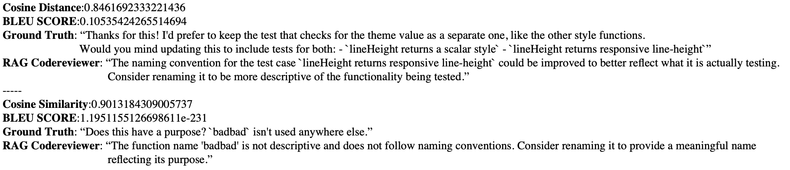
Why is BLEU score low?
Although the actual meaning of the comment is same, the wording may vary.
LLM and the ground truth may be addressing different issues in the same code patch.
Is BLEU a good metric for measuring review comment prediction?
Can we use Cosine similarity instead?
16

Slide 21
RQ-3
Is the binary Classification Task Important?
Ablation study by removing the binary classification task
BLEU score is computed and used to compare
BLEU score is observed to be lesser
This shows having binary classification task is important
Model | BLEU
GPT (RAG + binary classification) | 7.98E-4
GPT (RAG only) | 7.32E-4
LLAMA (RAG + binary classification) | 7.97E-4
LLAMA (RAG only) | 6.50E-4
Mistral (RAG + binary classification) | 6.64E-4
Mistral RAG only) | 6.00E-4
17

Slide 22
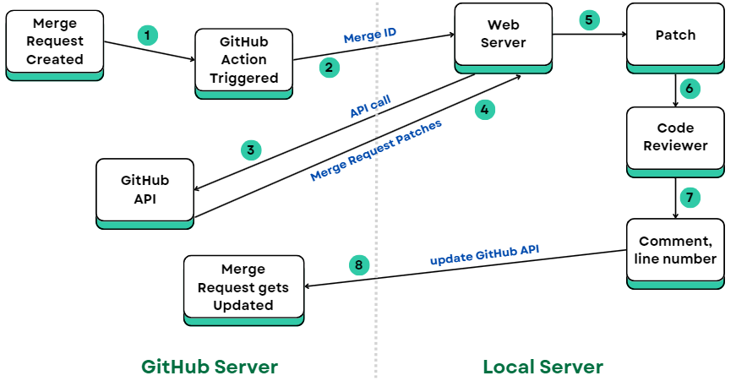
GitHub Bot
18

Slide 23

DEMO
19

Slide 24
FURTHER WORK
Comparison with Code Reviewer
Create Vector Store from Train data of code reviewer data set
Test with the test dataset
This will provide more accurate comparison with code reviewer
Create better prompts
Utilize dspy framework for prompting to generate better prompts
Add commit messages to the prompt
Migrate to cloud
Create vector store instance in cloud and create vector store indices
Run the web service in cloud
20

Slide 25
INTERESTING FINDINGS
We found some discrepancies in the train and test data of Code Reviewer dataset
There are repeated patches in both the Code Reviewer train and test dataset
11 % of test data is repeated
19 % of train data is repeated
We performed experiments after removing the repeated data
Are the metrics reported by CodeReviewer paper accurate considering the repeated data?
21

Slide 26
CONCLUSION
We propose a RAG based approach to automate code reviews by eliminating the need to fine-tune or pre-train the review generation model.
We leverage this framework to build an end-to-end tool which auto-generates reviews on Github repositories.
Answer the question does RAG give improvement?
22

Slide 27
CS59200 ASE PROJECT
THANK YOU
PAVAN CHAITANYA PENAGAMURI
NISHCHAL
JAGADEESHA
SURAJ SURYA
NARAYANA
KRISHNA SRI IPSIT
MANTRI
KEERTHANA
ASHOKKUMAR

