Slide 1
Deep Web &
Dark Web
Pavan
pavanchow@protonmail.com

Slide 2


WEB

Slide 3

Network of servers

Slide 4
Types
- Surface Web
- Deep Web
- Dark We

Slide 5
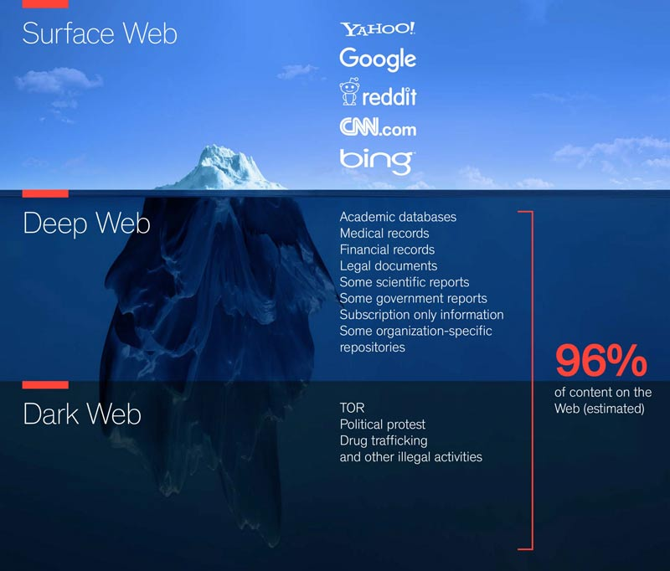

Slide 6

The TOR Project

Slide 7
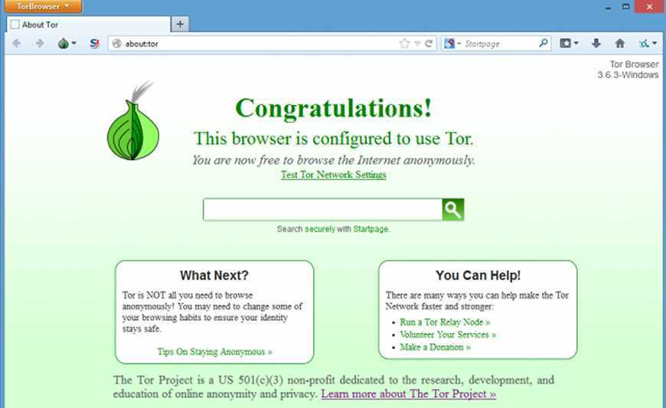
Why TOR?

Slide 8
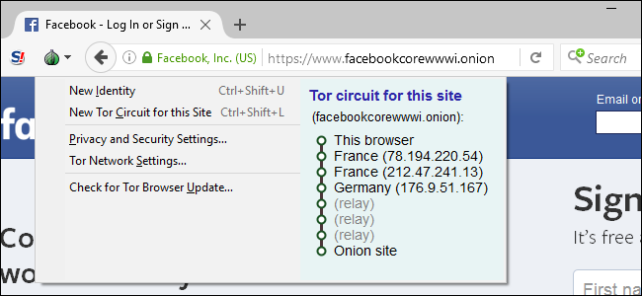
.Onion

Slide 9
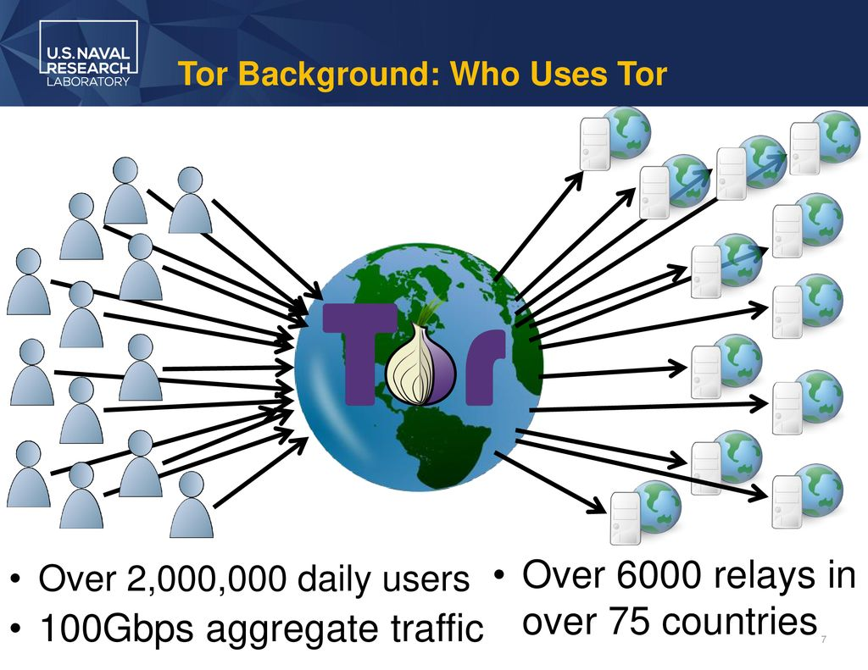
USERS

Slide 10
- Thank You

