Slide 1
BCA FINAL YEAR ACADEMIC PROJECT PRESENTATION
Samarth Computers Khandala
Modern Computer Education & Digital Services Platform
MKCL Authorized Learning Center (ALC 13210399 / 13210273) | Full-Stack Web Application
Notes:
Good morning respected examiners and faculty members. Today I am presenting my BCA final year project: Samarth Computers Khandala, a full-stack digital platform for computer training and government service assistance.

Slide 2
BCA PROJECT PRESENTATION
Project Overview & Background
What is Samarth Computers?
• Established MKCL Authorized Learning Center in Khandala, Satara.
• Offers IT courses: MS-CIT, Tally Prime GST, Typing (GCC-TBC), Advanced Excel.
• Operates an official CSC Digital Seva Kendra for citizen services.
Purpose of Digital Platform
• Bridge student aspirations with 24/7 web course discovery.
• Eliminate document confusion for government service applicants.
• Provide automated student certificate verification.
System Architecture Scope
• High-converting public marketing website.
• Comprehensive Admin Operations Dashboard.
• Real-time data synchronization backed by Supabase PostgreSQL.
Notes:
Samarth Computers is a trusted IT institute in Khandala. This project delivers a production-grade web platform combining a public portal for course/CSC discovery with a full Admin Dashboard.

Slide 3
BCA PROJECT PRESENTATION
Problem Statement: Challenges in Traditional Management
Manual Content & Pamphlet Dependency
• Course syllabus, fee details, and batch timings relied on printed flyers and verbal explanation.
• No single digital destination for prospective students to review course curriculum.
Difficult Service & Fee Updates
• Updating batch timetables or fees required physical poster re-printing.
• Static websites required developer intervention for basic text modifications.
Scattered Student & Customer Data
• Student admission inquiries were written manually in physical registers.
• High risk of lost phone numbers, unorganized leads, and delayed follow-ups.
Limited Citizen Guidance & Accessibility
• Citizens frequently arrived at CSC center without required application documents.
• No online mechanism for employers to verify course completion certificates.
Notes:
Before this application, institute inquiries were logged in paper registers, document checklists were explained verbally, and content updates required manual manual effort.

Slide 4
BCA PROJECT PRESENTATION
Project Objectives
1. Digitalize Institute Information
• Provide 24/7 web access to MKCL course syllabi, fee schedules, faculty profiles, and campus facilities.
2. Streamline CSC & Govt Services
• Eliminate citizen confusion with interactive document checklists and step-by-step application instructions.
3. Centralize Administration
• Build a secure Admin Dashboard featuring rate-limited auth, lead inbox management, and 19 CRUD sub-panels.
4. Enable Certificate Verification
• Implement instant online verification of student completion certificates using registration numbers.
5. Responsive & Bilingual Experience
• Deliver zero-reload dynamic language switching between Marathi and English with mobile-first layouts.
Notes:
Our core objectives were to digitize institute communications, streamline CSC document guidance, centralize administration, provide certificate verification, and deliver a bilingual Marathi/English user experience.

Slide 5
BCA PROJECT PRESENTATION
Proposed System & Operational Flow
Public Visitor Workflow
• Explore MKCL Courses & Syllabus Modules
• Review CSC Document Checklists
• Check Live Batch Timetables
• Verify Student Completion Certificates
• Submit Admission & Service Inquiry Leads
React 19 App Shell
• Client-side SPA Router (currentView)
• Bilingual Engine (Marathi / English)
• Stitch Design System Tokens
• AuthContext & Security Rate Limiter
• sharedStore LocalStorage Observer Cache
Admin & Database Backend
• Rate-limited Admin Login Authentication
• Real-Time Digital Leads Inbox
• 19 Modular CRUD Control Panels
• Supabase PostgreSQL (10 RLS Tables)
• Supabase Storage (samarth-media bucket)
Notes:
The proposed system replaces manual logbooks with a unified React single-page application connected directly to Supabase cloud infrastructure for real-time lead tracking and content management.

Slide 6
BCA PROJECT PRESENTATION
Technology Stack & Frameworks
React 19 (Frontend UI Library)
• Client-side rendering, component-driven UI architecture.
Vite 6 (Build Tool & Dev Server)
• Ultra-fast HMR compilation, optimized production bundling.
Tailwind CSS 3.4 (Design System)
• Stitch design tokens, responsive grid layouts, custom typography.
Supabase Cloud (Backend Infrastructure)
• PostgreSQL database, Auth, Storage bucket, instant APIs.
PostgreSQL (Relational Database)
• 10 tables with Row Level Security (RLS) policies.
Cloudflare Pages (Hosting & Edge CDN)
• Global high-availability deployment with SSL & deep-link routing.
Notes:
We selected React 19 and Vite 6 for high-speed client rendering, Tailwind CSS 3.4 for UI styling, Supabase PostgreSQL for backend persistence, and Cloudflare Pages for edge hosting.

Slide 7
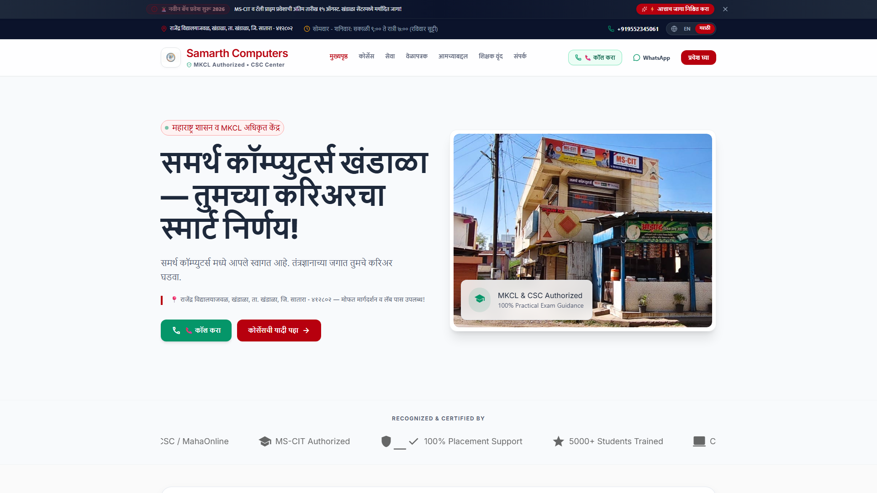
BCA PROJECT PRESENTATION
Public Website Features
Key User Modules
• Home Page: Hero banner, MKCL badges, statistics counter.
• Course Catalog: Filterable MS-CIT, Tally, Typing, Excel cards.
• CSC Services Desk: Identity & Revenue scheme guides.
• Faculty Directory: Teacher credentials & experience.
• Batch Timetable: Morning/Afternoon/Evening schedule slots.
• Certificate Verification: Search by Registration Number.
• Contact Page: Address, click-to-call, embedded map.
Notes:
The public website provides an intuitive interface for students and citizens to explore courses, check timetables, verify certificates, and locate the institute.

Slide 8
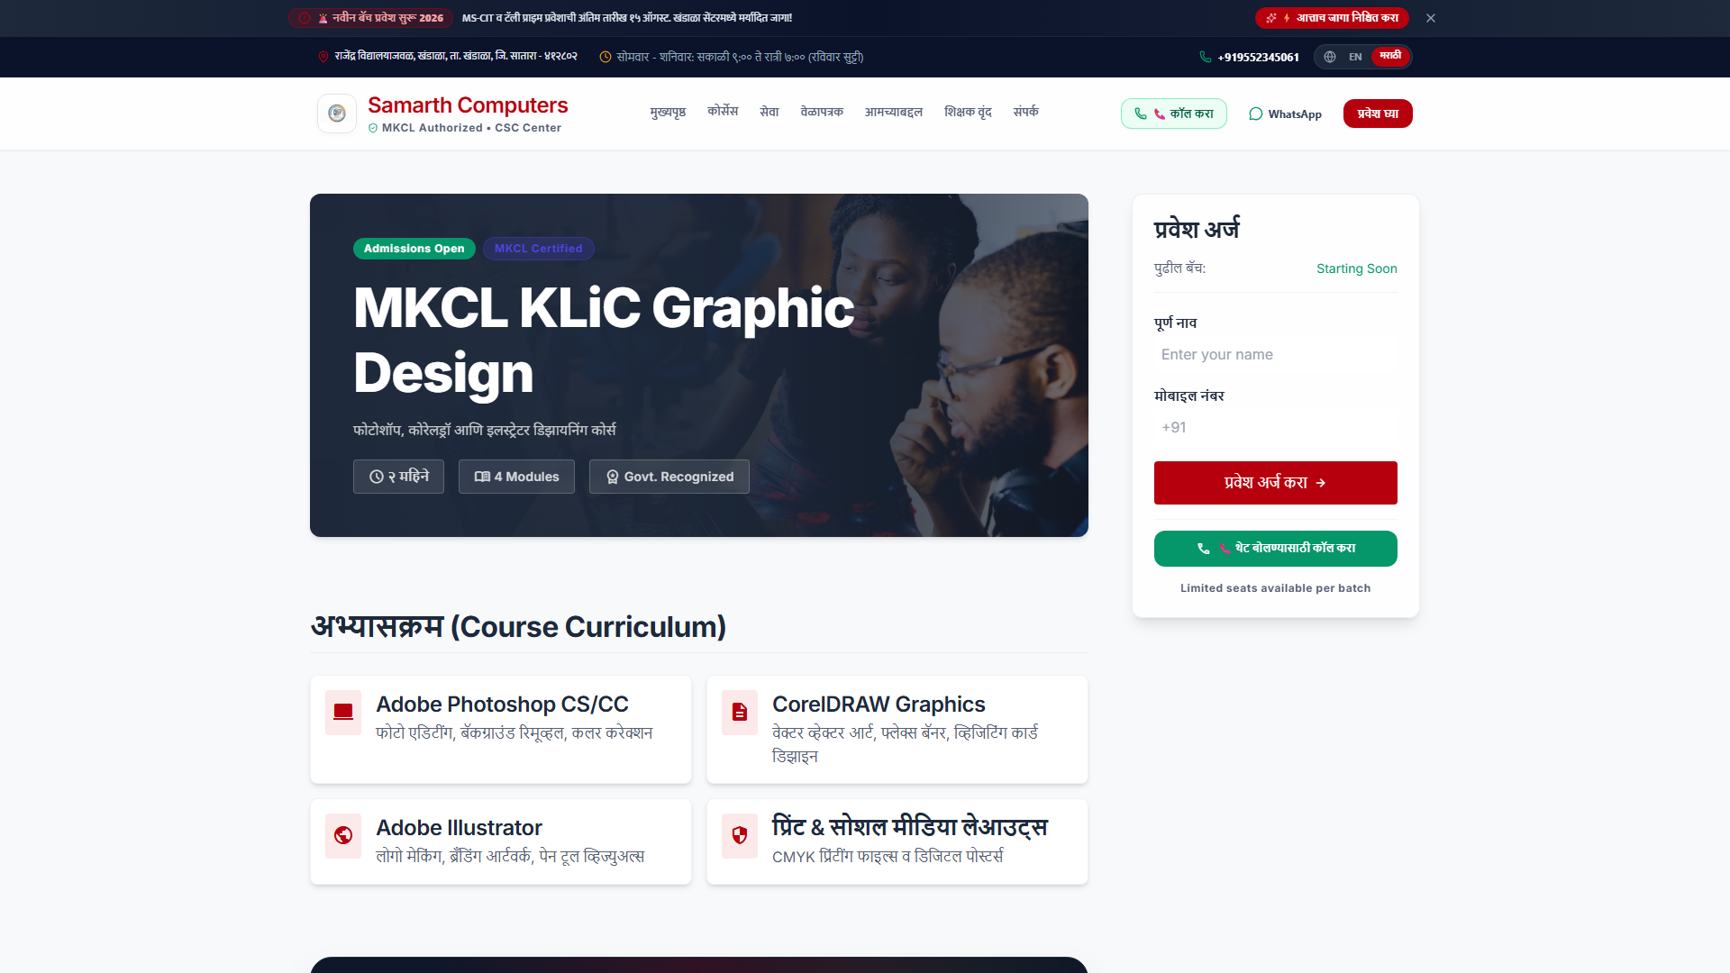
BCA PROJECT PRESENTATION
Courses & CSC Government Services Desk
Interactive Discovery
• Categorized Course Exploration: MS-CIT, Tally Prime GST, Typing (GCC-TBC 30/40 wpm), Advanced Excel.
• Course Detail Modal: Syllabus modules list, duration, fee estimates, and career opportunities.
• CSC Identity Services: Aadhaar Card, PAN Card, Voter ID.
• Revenue Services: 7/12 Utara, Domicile, Income Certificate.
• Document Checklist Modal (DocChecklistModal): Clear step-by-step document guidance for local citizens.
Notes:
Students can open detailed syllabus drawers for any course, while citizens receive exact document checklists before visiting the center for government certificate applications.

Slide 9
BCA PROJECT PRESENTATION
Centralized Admin Operations Dashboard
Management Capabilities
• Overview Analytics: Live KPI cards for total leads, active courses, CSC services, and faculty count.
• Quick Action Bar: One-click creation for courses, timetable slots, gallery photos, and news.
• Real-Time Leads Inbox: Captures student inquiries with status tags (New Lead, In Process, Completed).
• Live Database Persistence: All administrative edits sync directly with Supabase PostgreSQL.
Admin Overview Screen
• KPI Cards, Quick Action Bar, Live Leads Feed
Notes:
The Admin Dashboard gives institute managers total control over student lead tracking, course catalogs, timetable slots, and center announcements from a single screen.

Slide 10
BCA PROJECT PRESENTATION
Admin Sidebar Architecture & Accordion Redesign
3-Tier Structure
• Tier 1: MAIN NAVIGATION - Dashboard, Inbox Leads, Courses, CSC Services, Faculty, News, Timetable, Photos.
• Tier 2: WEBSITE PAGES - Home Page, About Page, Contact & Call CTA configuration.
• Tier 3: SETTINGS & CONFIG ACCORDION - Consolidated single collapsible menu housing 10 sub-panels:
• └ Navigation, Branding, Govt Certificates, Theme, Site Info, SEO, Social Links, Footer.
Redesigned 3-Tier Sidebar
• Main Nav, Website Pages, Settings Accordion
Notes:
To improve admin usability, we restructured the sidebar into three distinct categories and consolidated secondary site configuration controls into a clean expandable accordion.

Slide 11
BCA PROJECT PRESENTATION
Supabase Database & Data Flow Architecture
React 19 Frontend
• App Shell (App.jsx)
• State View Router
• AuthContext Rate Limiter
• Stitch UI Components
• Bilingual Prop State
Repository Layer
• AdminRepository.js
• CourseRepository.js
• InquiryRepository.js
• sharedStore (Cache)
• StorageService.js
Supabase Cloud
• PostgreSQL Engine
• 10 RLS Tables
• Supabase Auth
• samarth-media Bucket
• Base64 Fallback Engine
Notes:
The application follows a clean 3-tier data architecture linking the React client to repository abstractions, which query Supabase cloud database and storage services.

Slide 12
BCA PROJECT PRESENTATION
Database Modules: 10 Verified PostgreSQL Tables
table: public.inquiries
• Leads inbox storing student admissions & service inquiries.
table: public.courses
• Course catalog with JSONB syllabus modules & fee structure.
table: public.csc_services
• CSC identity services with JSONB document checklists.
table: public.govt_services
• Revenue services with JSONB application steps.
table: public.faculties
• Instructor profiles, designations, & specializations.
table: public.site_gallery
• Campus lab photos & event gallery records.
table: public.site_settings
• Central center configuration record (main_settings).
table: public.batches
• Morning, afternoon, evening timetable slots.
table: public.news
• Institute announcements & examination news updates.
table: public.certificates
• Student completion records for online verification.
Notes:
The backend relies on 10 verified PostgreSQL tables in Supabase. We utilize JSONB columns for flexible syllabus modules and document checklists.

Slide 13
BCA PROJECT PRESENTATION
Site Settings & Configuration Persistence
Configurable Sub-Panels
• Navigation: Custom menu order & visibility.
• Branding: Institute logo upload & hero banner background.
• Govt Certificates: MKCL ALC code & CSC registration ID.
• Theme: Custom primary & secondary color accents.
• Site Information: Office hours, contact numbers, map URL.
• SEO & Meta: Search meta title, description, and keywords.
• Social Links: Facebook, Instagram, YouTube URLs.
• Footer: Tagline, copyright notice, & quick links.
Settings Control Panel
• Branding, Logo Upload, SEO, Social Links
Notes:
All center parameters, logos, contact numbers, and SEO metadata are managed dynamically through the site settings accordion and saved to Supabase.

Slide 14
BCA PROJECT PRESENTATION
Security & Data Protection Engine
Admin Auth & Brute-Force Protection
• Allowed Emails List: Access restricted to authorized center emails (pawansingh3760@gmail.com).
• Failed-Login Rate Limiter: Lockout timer triggers after 5 failed password attempts.
PostgreSQL Row Level Security (RLS)
• RLS enabled across all 10 database tables.
• Public SELECT for public catalog tables; Public INSERT strictly for lead inquiries.
Session Management
• Encapsulated AuthContext provider.
• Persistent encrypted session tokens stored in LocalStorage (samarth_admin_session).
Environment & Storage Security
• VITE_SUPABASE_URL & ANON_KEY environment isolation.
• Protected storage bucket upload policies (samarth-media).
Notes:
Security is enforced at multiple levels: rate-limited login, allowed email validation, LocalStorage session persistence, and PostgreSQL Row Level Security policies.

Slide 15
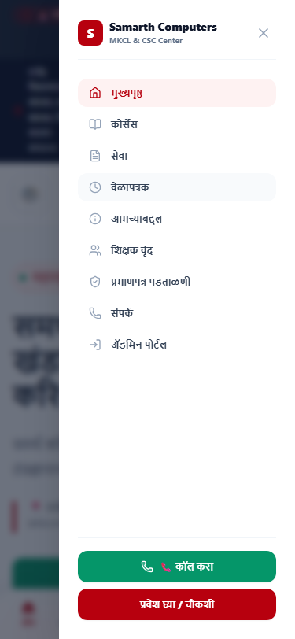
BCA PROJECT PRESENTATION
Responsive UI & Bilingual (Marathi / English) Engine
Accessibility & Globalization
• Dynamic Language Switching: Zero-reload toggle between Marathi (मराठी) and English across all UI components.
• Dual-Language Data Model: Backend schemas support dual text fields (title_mr / title_en, overview_mr / overview_en).
• Mobile-First Layout: Responsive grid scaling gracefully across smartphones, tablets, and 4K desktop screens.
• Touch-Friendly Controls: Mobile navigation drawer, high-contrast buttons, and smooth touch scrolling.
Notes:
The application is built mobile-first and offers seamless bilingual switching between Marathi and English without refreshing the page.

Slide 16
BCA PROJECT PRESENTATION
Testing & Quality Assurance Results
Production Build Audit
• npm run build executed successfully with 0 errors.
• Vite 6 production bundle compiled in 18.46 seconds.
• Zero broken imports or syntax errors.
End-to-End Persistence QA
• 100% verification across all 19 admin management modules.
• Verified real-time CRUD persistence on Supabase PostgreSQL.
Storage & Image Upload QA
• Direct file uploads to samarth-media bucket verified.
• Automatic cache-busting versioned URLs (?v=timestamp) generated cleanly.
Cross-Device UI Verification
• Mobile responsive drawer menu tested on iOS & Android.
• Certificate verification search engine tested against test registration numbers.
Notes:
Our testing confirmed 100% data persistence across all 19 admin modules, passing production build checks with zero compilation errors.

Slide 17
BCA PROJECT PRESENTATION
Deployment & Production Operations Architecture
1. Code & CI/CD
• GitHub Repository: pavancsingh/SamarthComputer
• Branch: main
• Automated Cloudflare Pages build hook triggered on git push.
2. Production Build
• Build Command: npm run build
• Output Directory: dist/
• Single-Page Routing Rule: _redirects (/* /index.html 200).
3. Live Hosting & Backend
• Production URL: https://samarth-computers.pages.dev
• Global Edge CDN distribution.
• Supabase Cloud PostgreSQL & Storage connected via environment variables.
Notes:
The project is deployed live on Cloudflare Pages global edge CDN, integrated directly with GitHub for CI/CD and connected securely to Supabase.

Slide 18
Conclusion & Future Roadmap
Project Conclusion
• Modernized institute operations with a full-stack digital platform.
• Eliminated paper register overhead with a real-time digital leads inbox.
• Simplified citizen CSC document requirements with interactive checklists.
• Delivered high-performance React 19 architecture with Supabase PostgreSQL.
Future Roadmap (v2.0)
• Online Fee Payment Gateway: Direct Razorpay & UPI QR code integration.
• Automated SMS & WhatsApp Alerts: Instant lead receipt confirmation.
• Student Learning Portal: Dedicated dashboard for typing tests & study notes.
• Online Admission Workflow: Direct document upload for student admissions.
Notes:
In conclusion, Samarth Computers Khandala is a complete digital solution for computer education and government services. In future updates, we plan to add online fee payments and automated SMS alerts. Thank you!

