Slide 1
Hypothesis Testing Exercise
A F&B manager wants to determine whether there is any significant difference in the diameter of the cutlet between two units. A randomly selected sample of cutlets was collected from both units and measured? Analyze the data and draw inferences at 5% significance level. Please state the assumptions and tests that you carried out to check validity of the assumptions.
Minitab File : Cutlets.mtw

Slide 2
library(readr)
data <- read.csv(file.choose())
View(data)
summary(data)
attach(data)
# Descriptive stastics
# Unit.A Unit.B
# Min. :6.438 Min. :6.038
# 1st Qu.:6.832 1st Qu.:6.754
# Median :6.944 Median :6.940
# Mean :7.019 Mean :6.964
# 3rd Qu.:7.281 3rd Qu.:7.195
# Max. :7.517 Max. :7.546
# Doing the normality test for the variable
shapiro.test(Unit.A)
# p=0.32 is greater then p=0.05 p>0.05 accept the null hypothesis so the data is normal
shapiro.test(Unit.B)
# p=0.5225 is greater then p=0.05 p>0.05 accept the null hypothesis so the data is normal
# Doing the variance test
var.test(Unit.A,Unit.B)
# The p=0.705 the p>0.05 then accept null hypothesis is the variance are equal
# Doing sample t test
t.test(Unit.A,Unit.B,alternative = "two.sided",conf.level = 0.95,correct = TRUE)#two sample T.Test
# alternative = "two.sided" means we are checking for equal and unequal
# means
# null Hypothesis -> Equal means
# Alternate Hypothesis -> Unequal Hypothesis
# p-value = 0.4723> 0.05 accept null HYpothesis
# Equal meansa and unit b
# So there is no difference in the the diameter from the unit a and unit b
#similarity between unit a and b

Slide 3
Hypothesis Testing Exercise
A hospital wants to determine whether there is any difference in the average Turn Around Time (TAT) of reports of the laboratories on their preferred list. They collected a random sample and recorded TAT for reports of 4 laboratories. TAT is defined as sample collected to report dispatch.
Analyze the data and determine whether there is any difference in average TAT among the different laboratories at 5% significance level.
Minitab File: LabTAT.mtw

Slide 4
library(readr)
data <- read.csv(file.choose())
View(data)
summary(data)
# Descriptive stastics
# Laboratory.1 Laboratory.2 Laboratory.3 Laboratory.4
# Min. :138.3 Min. :140.6 Min. :159.7 Min. :124.1
# 1st Qu.:170.3 1st Qu.:168.0 1st Qu.:188.2 1st Qu.:154.1
# Median :178.5 Median :178.9 Median :199.8 Median :164.4
# Mean :178.4 Mean :178.9 Mean :199.9 Mean :163.7
# 3rd Qu.:186.5 3rd Qu.:189.1 3rd Qu.:211.3 3rd Qu.:172.9
# Max. :216.4 Max. :217.9 Max. :238.7 Max. :205.2
stacked_data <- stack(data)
##normality test##
library(nortest)
ad.test(stacked_data$values)##Anderson Darling normality test##
##p=0.05072 is greater then p=0.05 so the data is normal##
## variance test##
library(car)
leveneTest(stacked_data$values ~ stacked_data$ind, data=stacked_data)##Test for equal variance##
##p=0.05161 is greater then p=0.05 so the data the variance is equal##
##one way Anova Test##
attach(stacked_data)
Anova_results <- aov(values~ind,data=stacked_data)
summary(Anova_results)
##pvalue is less then the p=0.05 so reject the null hyphotheis and accept alternative hypothesis that is All the proportions are not equal##

Slide 5
Hypothesis Testing Exercise
Sales of products in four different regions is tabulated for males and females. Find if male-female buyer rations are similar across regions.
 | East | West | North | South
Males | 50 | 142 | 131 | 70
Females | 550 | 351 | 480 | 350
Check p-value
If p-Value < alpha, we reject Null Hypothesis
H0
All proportions are equal
Ha
Not all Proportions are equal
Buyer Ratio.mtw

Slide 6
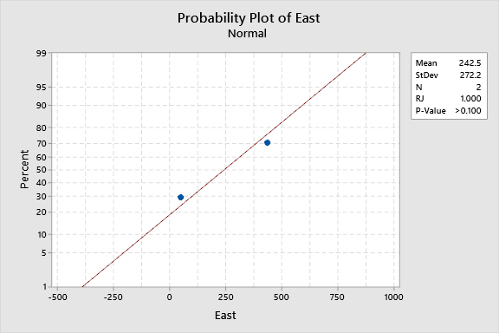
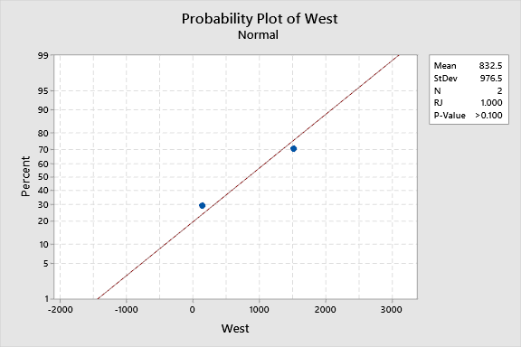
Normality test for each variable
P>0.05 ,p=0.1,accept null hyp for variable east i.e variable is following normalization
P>0.05 ,p=0.227,accept null hyp for variable east i.e variable is following normalization

Slide 7
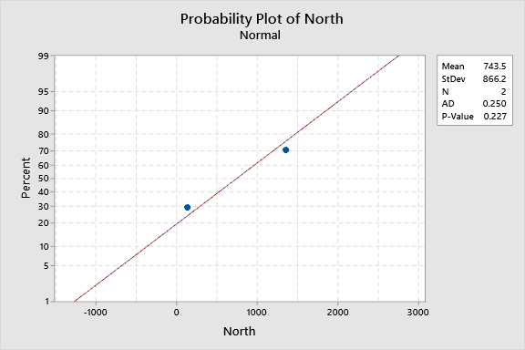
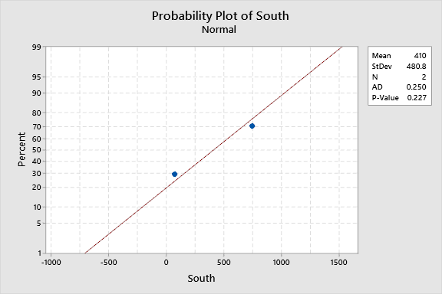
P>0.05 ,p=0.227,accept null hyp for variable east i.e variable is following normalization
P>0.05 ,p=0.227,accept null hyp for variable east i.e variable is following normalization

Slide 8
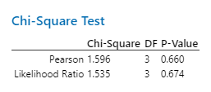
Chi square test (more than 2discrete variable and dependent variable is discrete
HNULL:all averages are equal,Halt:all averages are not equal
P>0.05 accept Null Hypothesis male and female ratios are same across the variables

Slide 9
Hypothesis Testing Exercise
TeleCall uses 4 centers around the globe to process customer order forms. They audit a certain % of the customer order forms. Any error in order form renders it defective and has to be reworked before processing. The manager wants to check whether the defective % varies by centre. Please analyze the data at 5% significance level and help the manager draw appropriate inferences
Minitab File: CustomerOrderForm.mtw

Slide 10
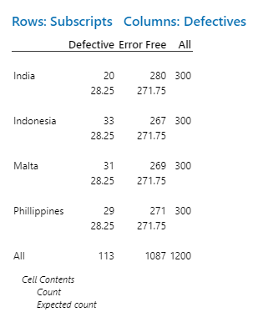
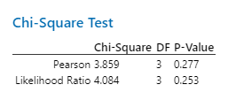

Slide 11
Hn: all the defective across different are equal Ha:atleast one is different
P>0.05 so accept null hypothesis
Hn: all the defective across different are equal

Slide 12
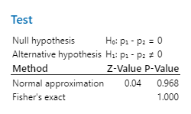
Fantaloons Sales managers commented that % of males versus females walking in to the store differ based on day of the week. Analyze the data and determine whether there is evidence at 5 % significance level to support this hypothesis.
Minitab File: Fantaloons.mtw

Slide 13
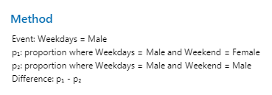
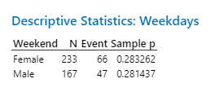
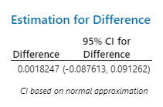

Slide 14
Hnull:proportion of the male and female equal in weekdays and weekends Halt: proportion of the male and female are different in weekdays and weekends
P>0.05 p=0.9 so accept the null hypothesis
Hnull:proportion of the male and female equal in weekdays and weekends

