Slide 1
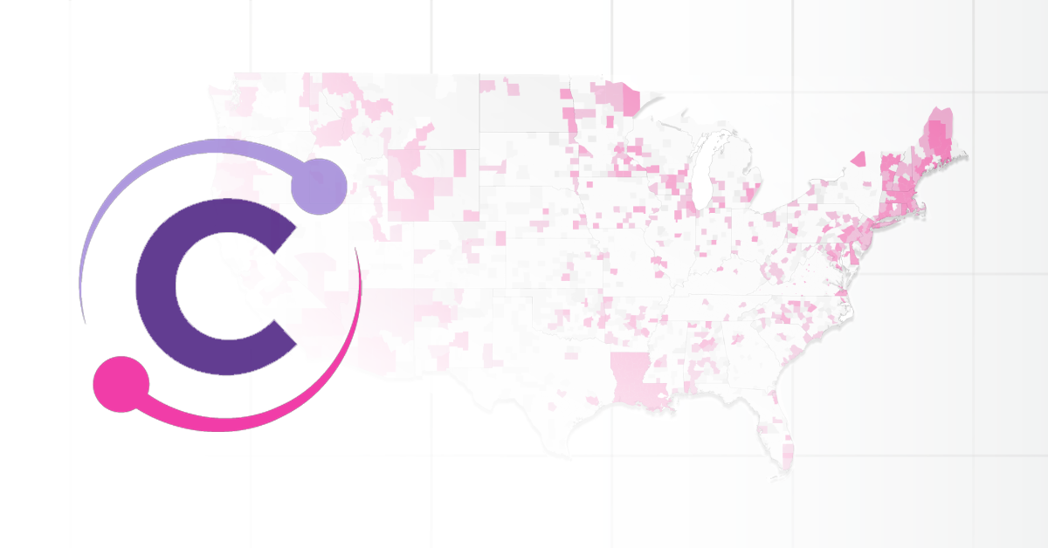
Clinical Decision Making and Pattern Recognition in Health Care Presenter : Pavan Ajith Varma Datla University of South Florida, Tampa Department of Business Analytics and Intelligence
Clinical Decision Making and Pattern Recognition in Health Care Presenter : Pavan Ajith Varma Datla University of South Florida, Tampa Department of Business Analytics and Intelligence

Slide 2
Overview
Relevant Trends for Cotiviti:
AI-driven Healthcare Analytics
Clinical Decision Support Systems (CDSS
Population Health Management
Opportunities for Cotiviti
Potential Threats for Cotiviti
Proposed Actions for Cotiviti
POC
Conclusion

Slide 3

AI in Healthcare Analytics
Improves payment accuracy by:
Validating claims, detecting fraud, and ensuring correct coding.
Example:
Predictive models detect anomalies in billing patterns, reducing overpayments.
Technologies:
Machine Learning, NLP, Data Visualization.

Slide 4
Clinical Decision Support (CDSS)
Helps in identifying:
High-risk patients and suggest personalized treatments.
Example:
Neural networks predict cardiac events; rule-based systems recommend specific interventions.
Technologies:
Machine Learning, Expert Systems, NLP, EHR Integration.

Slide 5
Population Health Management
AI helps in:
Forecasting health risks and tailoring health plans for different population segments.
Example:
AI predicts a rise in diabetes, leading to tailored health plans with preventive measures.
Technologies:
Predictive Analytics, Geospatial Analysis, Risk Stratification, Epidemic Modeling.

Slide 6
Opportunities for Cotiviti
Opportunity:
Invest in AI-driven healthcare analytics platforms.
Benefit:
Enhances clinical and financial data analysis.
1
Opportunity:
Partner with AI-powered decision support tool companies.
Benefit:
Improves risk assessments and treatment strategies.
2
Opportunity:
Incorporate AI solutions.
Benefit:
Improves risk stratification and tailored health plan.
3

Slide 7
Potential Threats for Cotiviti
Data Privacy and Security
Increased use of AI and big data raises the risk of cyberattacks.
Regulatory Challenges
Navigating the complex and evolving healthcare regulations related to AI.

Slide 8
Proposed Strategic Actions for Cotiviti
Pursue partnerships and acquisitions with AI-driven healthcare startups.
Invest in R&D to advance AI technologies in healthcare analytics.
Focused investments on privacy to comply with HIPPA.

Slide 9

Proof of Concept (POC)
Project:
Developed a Machine learning model to predict patient outcomes based on clinical data.
Technologies used:
Random Forest, SVM, XGBoost, Data Visualization.
Results:
Identified the best model with high accuracy for predicting health risks

Slide 10
Conclusion
AI-driven solutions in healthcare enhance decision-making, payment accuracy, and patient outcomes.
Cotiviti can leverage these technologies to optimize healthcare plans and improve clinical and financial results.

