Slide 1

A Data Analysis Project Second hand Bike Purchase Assistance
M.Pavan Datta
Batch 403
Innomatics Research Labs Dilsukhnagar

Slide 2
Contents
Introduction
Problem Statement
Tools Used
Steps For Collecting Data
Collected Data
Steps For Cleaning Data
Cleaned Data
Data Visualization
Conclusion

Slide 3

Introduction to Bikekharido.com(An Online Marketplace for Bikes:
BikeKharido.com is an Indian online classifieds portal for buying and selling motorcycles. It serves a similar purpose to larger, more established platforms like BikeWale, Olx, Cars24, or CarDekho, but likely on a different scale..
It hosts listings from both authorized dealerships (for new bikes) and individual private sellers. A large database of motorcycles and scooters from various brands (like Hero, Honda, Bajaj, Yamaha, Royal Enfield, KTM, etc..

Slide 4
PROBLEM STATEMENT(Objective):
Prospective buyers of second-hand bikes face the risk of overpaying due to information asymmetry and the difficulty of assessing a bike's true worth from listed prices. This project tackles this problem by deconstructing the factors that influence resale value. Through exploratory data analysis and visualisation , we provide a clear framework for buyers to identify fairly priced bikes and negotiate effectively, ensuring they get the best value for their money.

Slide 5

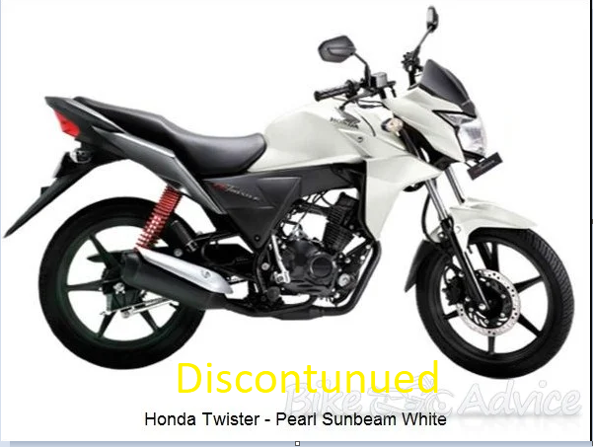
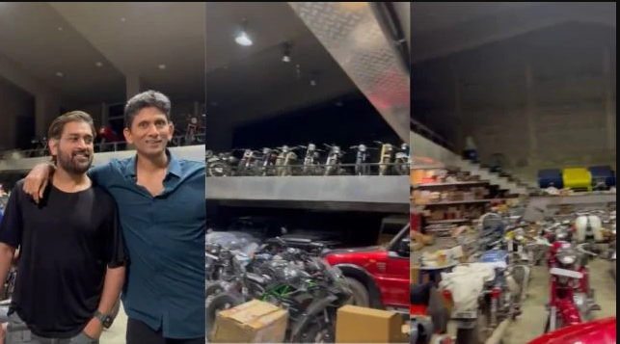


Slide 6
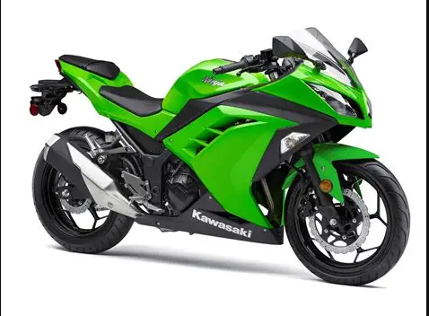
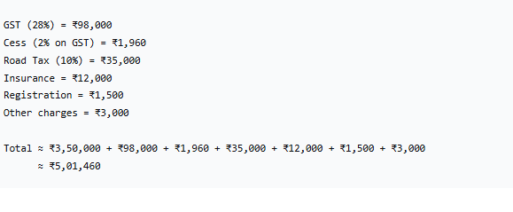

Slide 7

Spend your hard earned money sensibly

Slide 8
Motives
What amount is required to buy a vehicle (second hand)?
How Registered year impact price of the vehicle.
Which Vehicle to choose an over-travelled one or the vehicle that has travelled less Km’s.
What should your trust (brand or Service)?
Where to look for more options?

Slide 9
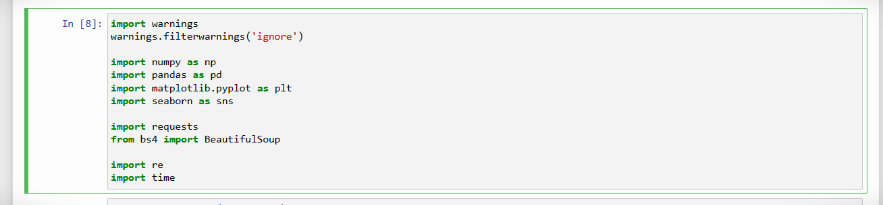
TOOLS
# importing all required libraries

Slide 10
Steps For Collecting Data
Install Necessary Libraries
Inspect the Website
Write the Python Script
Send an HTTP Request
Check Request Status
Parse HTML Content using BeautifulSoup
Identify HTML Elements
Handle Pagination and Dynamic Content
Data Storage

Slide 11
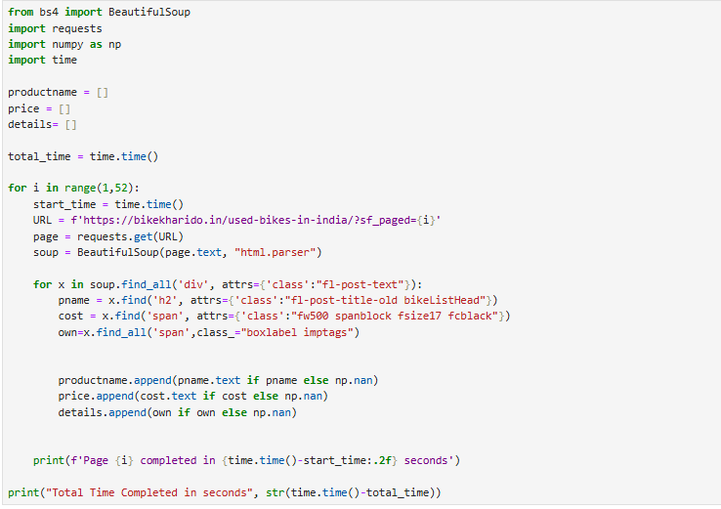
Sample Code

Slide 12
Collected Data
Vehicle : Name of the Model.
Year : First registered year of the bike
Price : Price of the bike
Km : Distance in Km the bike has travelled
Location : City where the bike is for sale
Hand : How the seller has bought the vehicle
Brand : The Manufacturing company of the vehicle

Slide 13
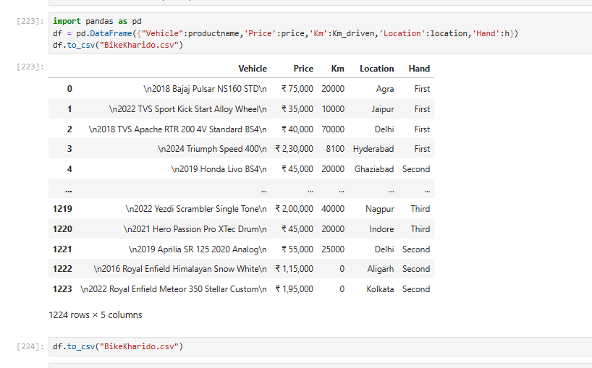
Raw Data

Slide 14
Steps For Cleaning Data
After executing the program , create a DataFrame using dictionary and check whether the data inside it is cleaned or not .
For cleaning the data in the dataframe ,check for the null values and duplicate data, if all the null values in columns is zero then it is appropriate for further processing.
Clean text data by removing unnecessary whitespaces, special characters, and HTML tags from text data and remove irrelevant information using Regex.
Removed \n,\div, rupee symbol . Extracting Brand and year for product.
Convert the data types. By default all the types of columns are objects, change according to the column like float32 or int32 etc..
Check the shape of the database and save the cleaned data into csv.

Slide 15
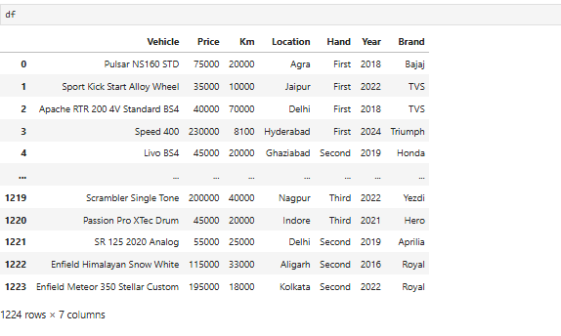
Quick view of Cleaned data

Slide 16
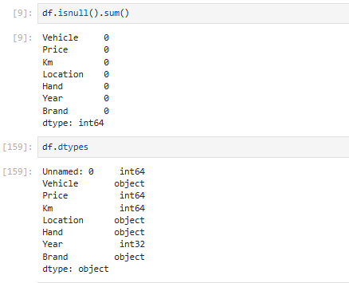

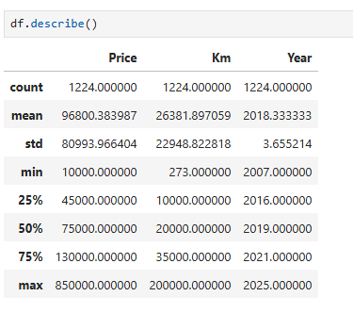
Type and shape of data

Slide 17
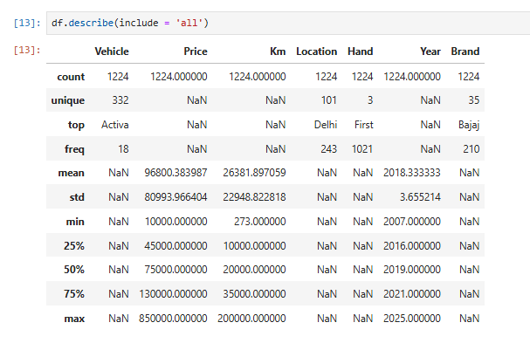
statistical data

Slide 18
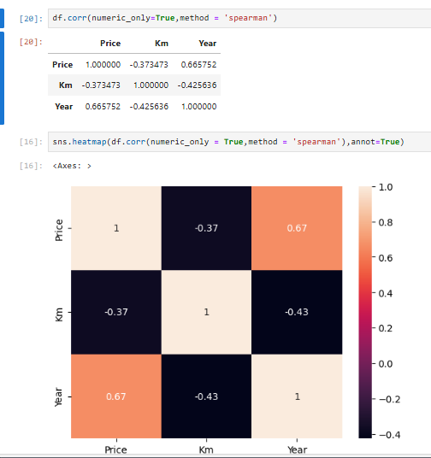
Finding correlation of data
* KM driven are impacting price negatively(Weak)
* Year of the registration is impacting the price of the Positively(moderate).

Slide 19
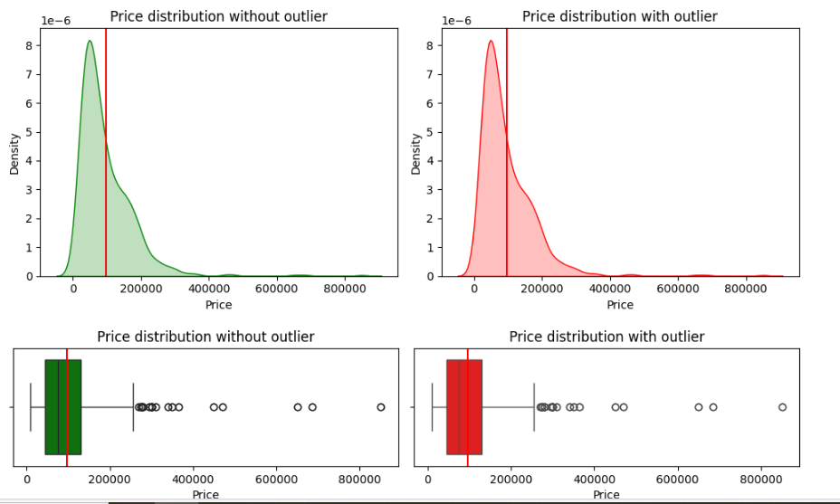
What is the average price of second hand bike and Evaluate the reason for such price(high or low)?
Average Price of a bike is Rs.96800
Most of the bikes cost range from Rs.25000 to Rs.200000
There are High Expensive Bikes beyond Rs.400000
The cost of the most expensive is Rs.850000*
Excluding expensive bikes average price of a bike is Rs.66000.

Slide 20
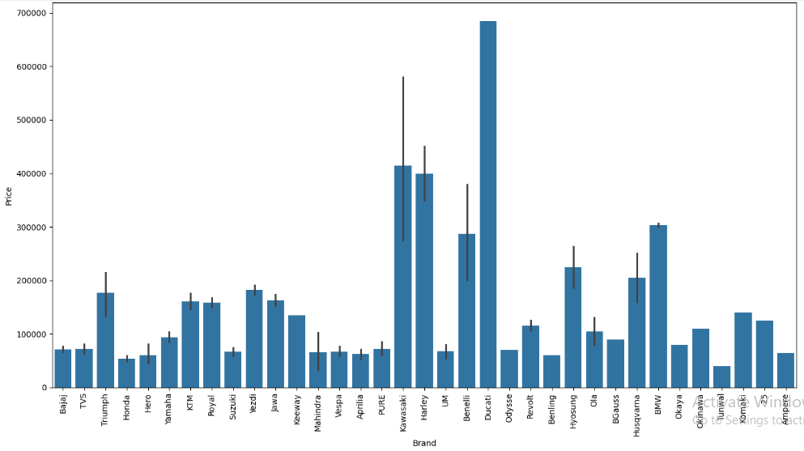
What are those Expensive Bikes?
Ducati,Kawasaki,Harley,BMW,Benelli brand has the highest priced vehicle (Avg:Rs 496666)

Slide 21
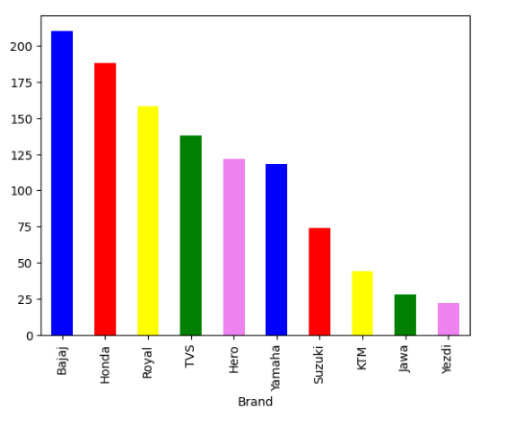
Listings of bikes in different brands
* More vehicles are available in Bajaj(210) brand followed by Honda(188) , Royal Enfield(158) , TVS

Slide 22
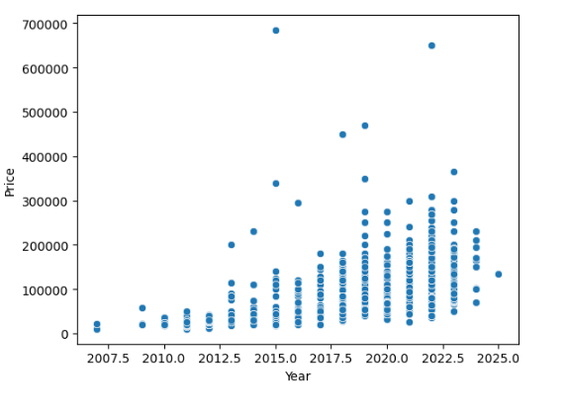
Taking Year into consideration
when we ignore outliers the graph indicates a positive curve which indicates .
The latest bikes are costly than the old bikes.
If you want to own a latest bike you have to pay more

Slide 23
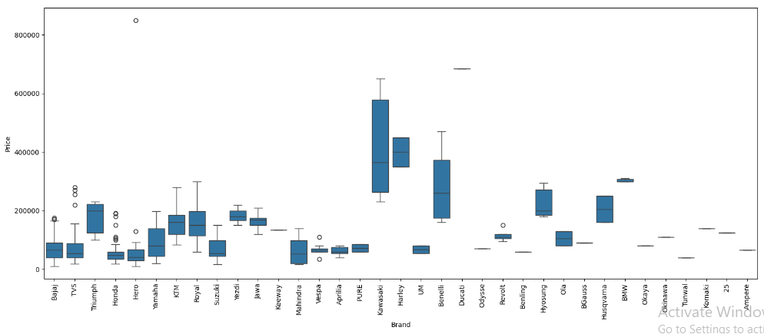
Range of bikes price based on brand?
Brand is highly influensing Price of a bike
Harley bike starting range is more than price is 300000
kawasaki,Benelli,Hyosung bike starting range is more than price is 200000
Most of the bike brands cost is below 200000

Slide 24
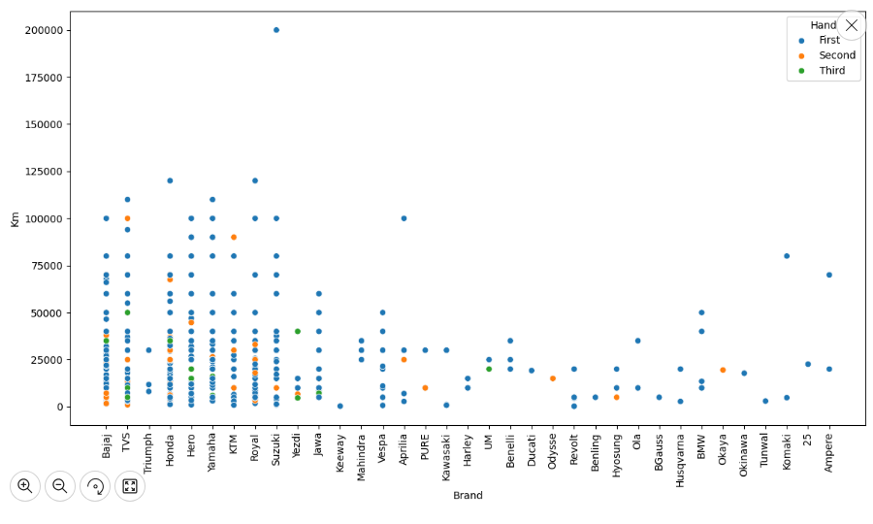
Top performing Brands
A Suzuki vehicle has travelled around 2LAkh KM's. (penetrated brand : Bajaj, Service : Suzuki)
Honda and Royal Enfield vehicle has travelled nearly 1,25,000.
If we choose these vehicles to buy for second hand they might be worthy

Slide 25
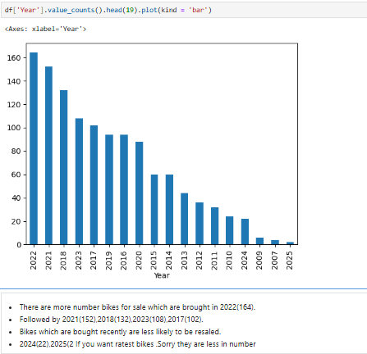
Year distribution

Slide 26
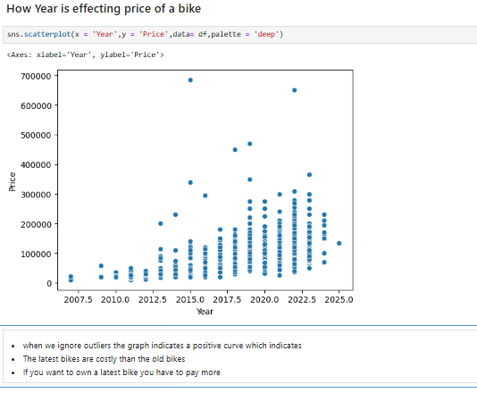
Year vs Price

Slide 27
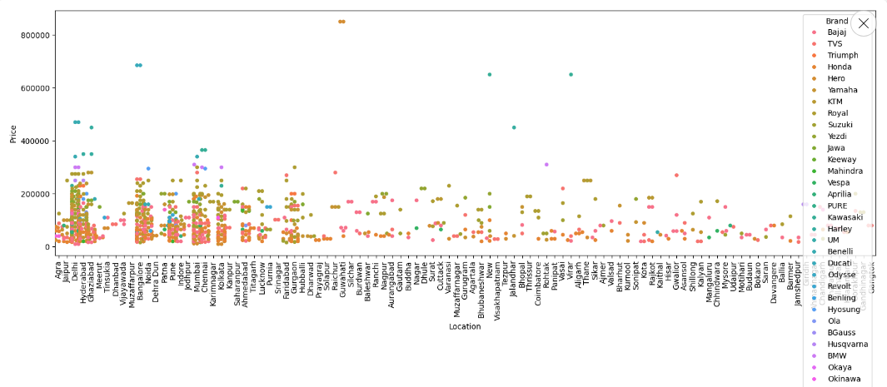

Where you might get more options?

Slide 28
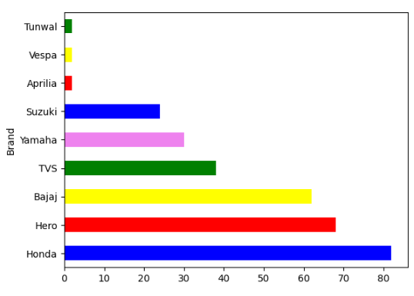
When the budget is between 20 thousand to 50 thousand what are the brands available in this budget?
Honda ,Hero,Bajaj,TVS,Yamaha,Suzuki are the brands available for the budget of 20 to 50 thousand

Slide 29
CONCLUSION
After Scraping and analyzing the data from BikeKharido.com it is evident that More than Registered year, Km’s driven and Brand are influencing the price of a Bike.
Most Penetrated brand is Bajaj where as most performing brand is suzuki.
Metropolitan cities have diverse choices than other areas.
The lesser distance the bike had travelled the more expensive the bike would be.
How latest the bike is as expensive it would be.

Slide 30
Motives
What amount is required to buy a vehicle (second hand)?
How Registered year impact price of the vehicle.
Which Vehicle to choose an over-travelled one or the vehicle that has travelled less Km’s.
What should your trust (brand or Service)?
Where to look for more options?

Slide 31

THANK YOU

