Slide 1

Financial Data Analysis
Power BI
M.Pavan Datta
Batch 403
Innomatics Research Labs
Diksukhnagar

Slide 2
Agenda
Project Overview
Data Overview
Data Preparation
Dashboard Visualizations
Applications & Recommendations
Conclusion
Problem statement:To identify the most promising investment opportunities by evaluating companies based on consistent revenue growth, profitability, asset expansion, and sustainable financial leverage, while flagging companies showing signs of financial distress or declining performance.

Slide 3
Project Overview
Developed a Power BI dashboard to analyze multi-year financial data from Income Statement, Balance Sheet, and Cash Flow reports.
Consolidated financial metrics such as Revenue, Net Income, Assets, Liabilities, and Cash Flow from multiple company datasets.
Built a star schema model with for efficient relationships and accurate analysis.
Created DAX measures for key performance indicators — Operating
Income, Free Cash Flow, and Debt-to-Equity Ratio.
Designed 5 interactive dashboards covering overall performance, profitability, financial structure, liquidity, and comparative analysis.
Enabled decision-makers to identify high-performing companies, analyze growth trends, and assess financial stability across industries.

Slide 4
Data Overview
Dataset Name: Financial Statement Dataset
Time Frame :2012 -2020
File Type: Excel file
Number of Datasets: 6 individual files
  incomeStatementHistory_annually.csv
  incomeStatementHistory_quarterly.csv
  balanceSheetHistory_annually.csv
  balanceSheetHistory_quarterly.csv
  cashflowStatement_annually.csv
  cashflowStatement_quarterly.csv
Total Records: ~10,000 financial records (combined)
Total Columns: 20–30 per file (covering Revenue, Net Income, Assets, Liabilities, Cash Flow, etc.)

Slide 5
Data Preparation
Loaded 6 CSV files — Income Statement, Balance Sheet, and Cash Flow (both annual and quarterly) into Power BI.
Replaced null values with 0 and removed duplicates, standardized date formats, and converted text fields into numeric data types.
Created new calculated fields such as Gross Profit, Free Cash Flow, and Debt-to-Equity Ratio
using DAX.
Verified measure accuracy across all dashboards and ensured consistency between annual and quar
-terly results.

Slide 6
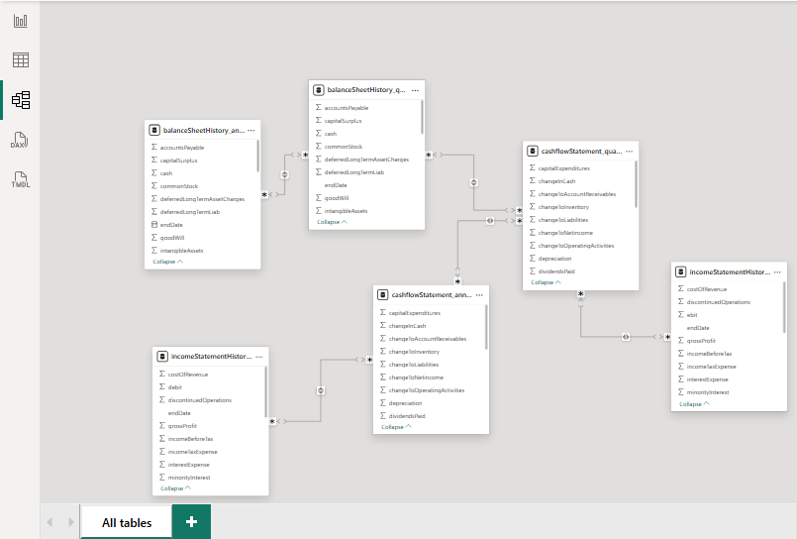
Data Model

Slide 7
Dashboard Visualizations
Financial Performance Dashboard
1.What is the total revenue of each company annually and quarterly? –Matrix Chart
2. Which companies have the highest net income annually? ---AAPL,JPM,MSFT
3. What is the trend of total assets vs total liabilities for each company? –JPM,HSBC,BAC (FIN)
4. How has the retained earnings changed over time for top companies? –XOM,JPM,CVX
5. What are the companies with consistently increasing cash & equivalents? –WFC,JPM,HSBC

Slide 8
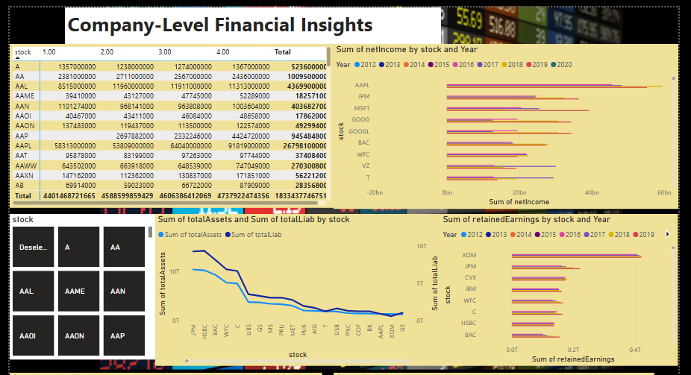

Slide 9
Dashboard Visualizations
Income Statement Analysis Dashboard
6.How does gross profit margin vary by company and year?
WMT,JPM,AAPL
7. Which companies have the highest cost of revenue?
WMT,BP,MCK
8. What is the operating income trend across companies?
AAPL,JPM,MSFT
9. Which companies had a loss (negative net income) in any year?
C,MO,CVX,GM
10. Compare revenue vs. net income trends.—Line Plot
AAPL,JPM,MSFT,GOOGLE,BAC

Slide 10
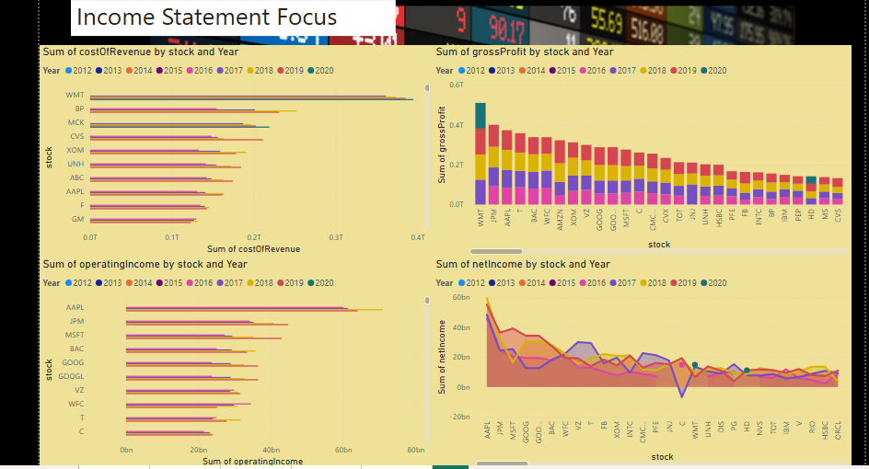
încome Statement Analysis Design
ś
'
°
OpeuT ing Tmo
Revenue vs Net Income Trends

Slide 11
Dashboard Visualizations
Cash Flow Analysis Dashboard
  11. What are the top companies by cash flow from operations? –AAPL,ALPHABET,GOOGLE,MSFT
  12. How do capital expenditures trend over time for each company?
  MINDA AUTOMOTIVES
  13. Which companies have a negative free cash flow?
  FBC,UBS,HSBC,ADM(Mostly Finance Co.)
  14. How do operating, investing, and financing cash flows differ across companies and over time?
  GE,AAPL,ORCL(Line Plot)
  15. Highlight companies with increasing cash flow from financing.
  C,JPM,BAC,HSBC(Mostly financial orgs)

Slide 12
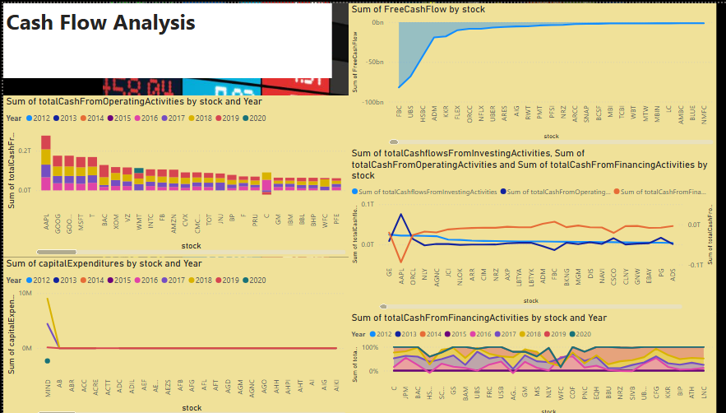

Slide 13
Dashboard Visualizations
Comparative & KPI Analysis Dashboard
  Visuals Used:
  Line Chart → Growth Consistency Analysis (Revenue, Income, and Assets)
  Bar Chart → Net Income Leaders by YearArea Chart → Capital Expenditure Trend
  Gauge → Gross Profit Margin %
  Column Chart → Revenue Growth YoY by Year
  Cards → Total Revenue, Net Income, Total Assets, Revenue Growth YoY, Net Income YoY %
  Purpose: To compare financial performance across multiple years and companies, tracking consistency in growth and profitability.

Slide 14
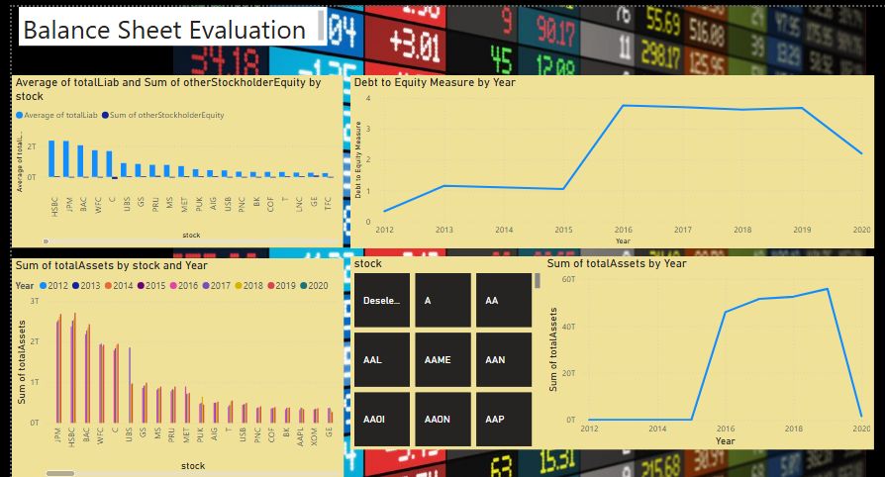

Slide 15
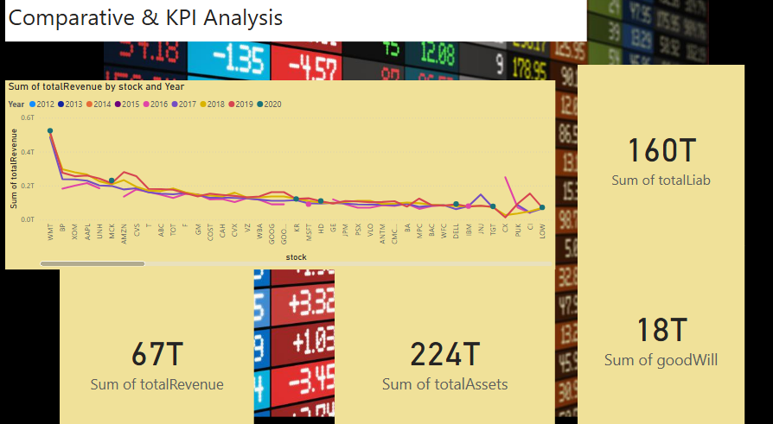

Slide 16
Applications & Recommendations
Applications
Helps management evaluate company performance across Revenue, Profitability, Assets, and Cash Flow for better strategic planning.
Enables comparison between companies to identify industry leaders and underperformers using KPIs like Net Income, Free Cash Flow, and Debt Ratios.
Assists investors and analysts in tracking financial consistency, growth potential, and risk levels before
making portfolio decisions.
Recommendations
Focus on improving profit margins and cash flow efficiency.
Reduce debt dependence to strengthen balance sheet stability.
Maintain steady capital expenditure to support long-term asset growth.

Slide 17
Conclusion
The Power BI dashboards provided a complete view of company performance across Income Statement, Balance Sheet, and Cash Flow data.
Enabled accurate tracking of Revenue, Profitability, Assets, Liabilities, and Cash Flow over time for multiple companies.
Helped identify high-performing companies, financial risks, and investment opportunities through interactive KPIs and visuals..Like Walmart has highest gross Profit.
Revealed consistent growth in top firms like AAPL, JPM, and MSFT, while some companies showed weaker free cash flow trends.
Power BI’s dynamic visuals and DAX-driven measures simplified complex financial analysis into easy-to- understand dashboards..
The project successfully transformed raw financial data into actionable business insights, enabling smarter
financial decisions and strategic planning.

Slide 18


ANY
Queries
?

Slide 19

THANK YOU

