Slide 1

Project Title - Seasonal Agriculture Performance Analysis
[Bandaru Pavan Dattu
Malla Reddy College of Engineering and Technology]
AICTE STU ID : (STU6864341ed349b1751397406)

Slide 2

PROBLEM STATEMENT
Agricultural activities are influenced by seasonal variations in environmental conditions, farming practices, resource availability and market conditions. As a result, agricultural performance may differ from one season to another. However, raw agricultural data does not clearly explain how agricultural performance changes across seasons or what patterns can be observed in different seasonal conditions. The problem is to analyze the given agricultural dataset and investigate seasonal differences in agricultural performance by identifying meaningful patterns, trends, relationships and variations within the available data.

Slide 3
Project Description:
Seasonal Agriculture Performance Data Analytics is a data analytics project that examines agricultural production data across different seasons to identify patterns, trends, and factors affecting crop performance. The project involves data cleaning, handling missing values, exploratory data analysis (EDA), statistical analysis, correlation analysis, and seasonal comparisons. By analysing variables such as crop type, rainfall, temperature, irrigation methods, production, yield, and profit, the project provides meaningful insights that can help improve agricultural planning and decision-making. The findings support farmers and agricultural stakeholders in understanding seasonal impacts on crop productivity and profitability.

Slide 4

WHO ARE THE END USERS?
The primary end users of this system are:
Farmers – to make informed decisions about crop selection and cultivation practices.
Agricultural Officers – to monitor agricultural trends and provide recommendations.
Government Agencies – for policy planning and resource allocation.
Agricultural Researchers – for studying crop performance and seasonal effects.
Agribusiness Companies – to understand production trends and market opportunities.

Slide 5

Technology Used
Programming Language
Python
Libraries Used
Pandas (Data Manipulation)
NumPy (Numerical Computation)
Matplotlib (Data Visualization)
Seaborn (Statistical Visualization)

Slide 6
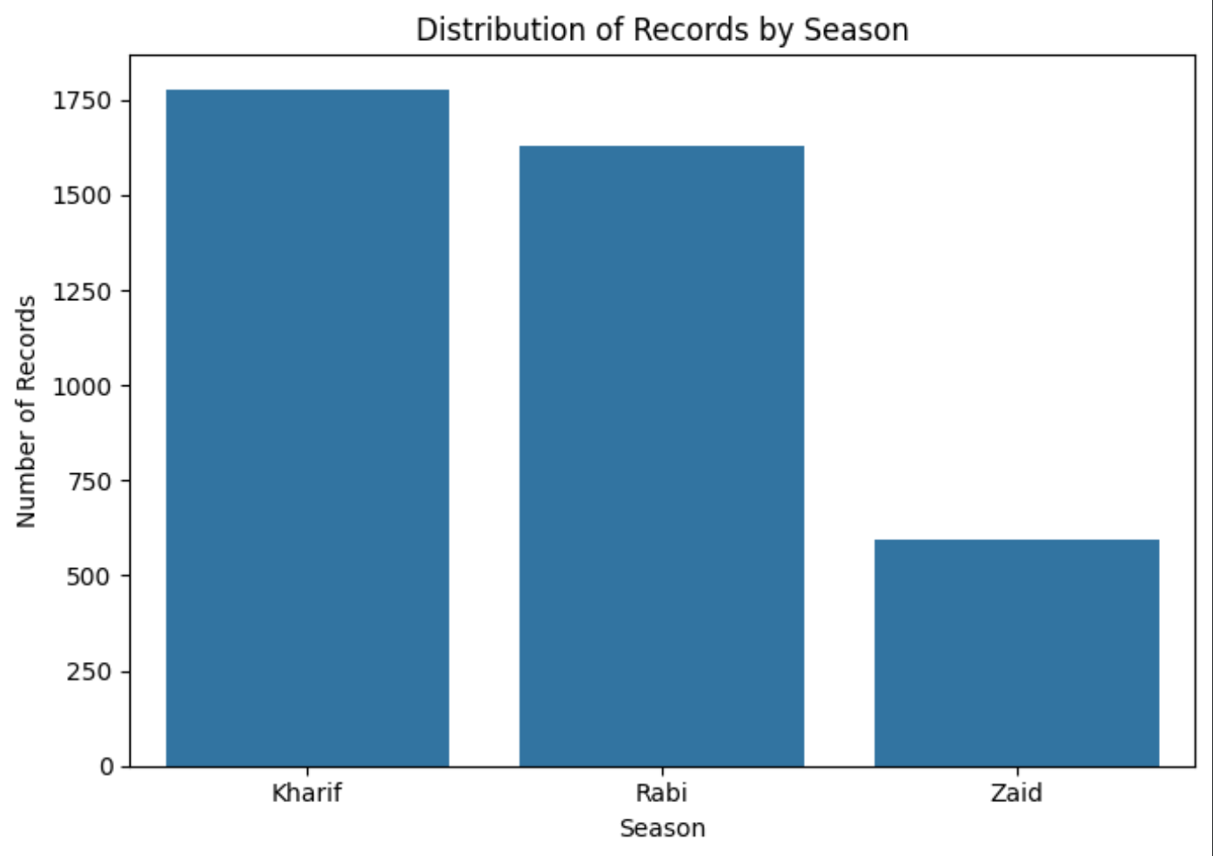
RESULTS
This graph shows the number of records available for each agricultural season.
It helps identify whether the dataset is balanced across seasons.
Seasons with higher bars contain more observations and data points.
A balanced distribution improves the reliability of seasonal comparisons.

Slide 7
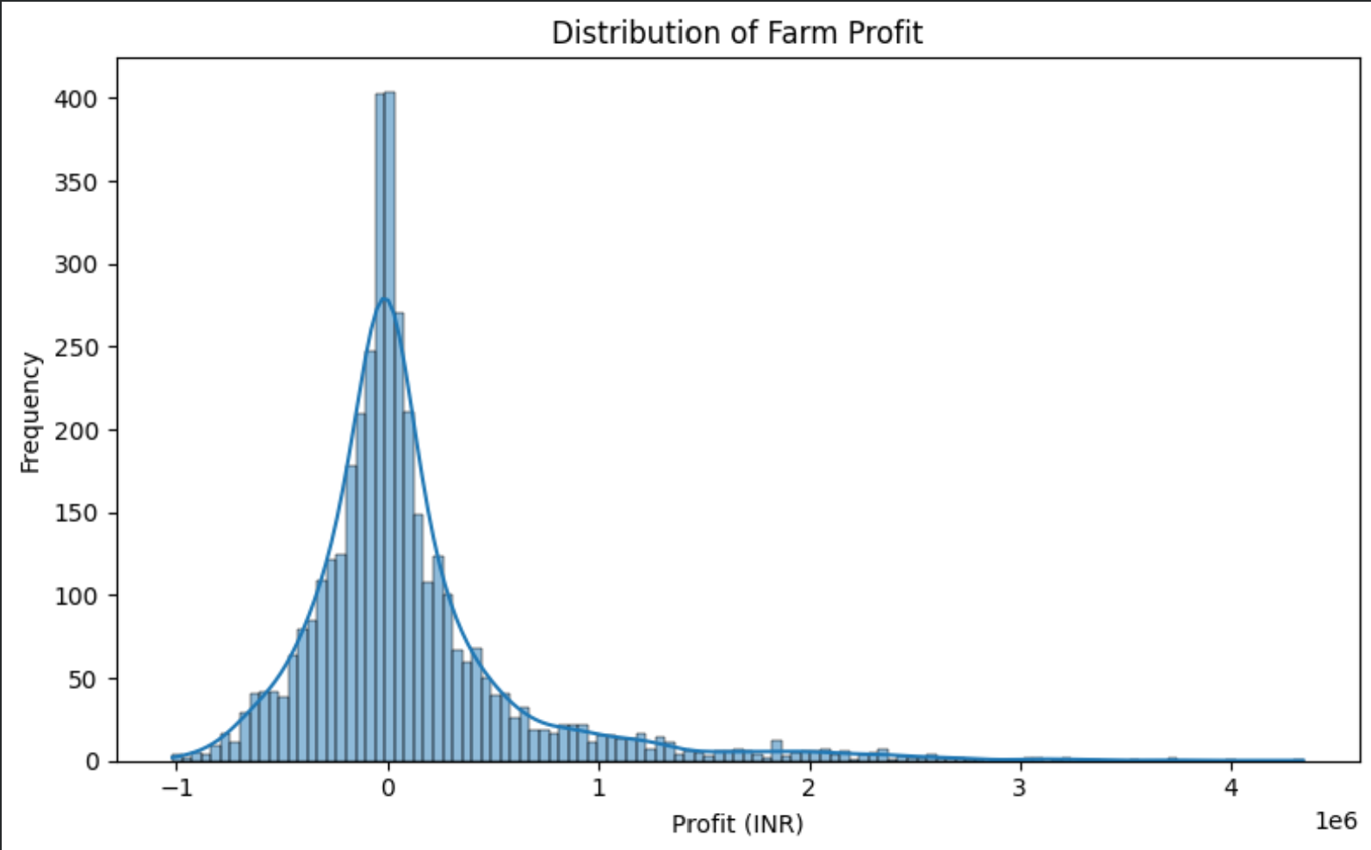
RESULTS
plt.figure(figsize=(8, 5))
sns.histplot(data=df, x="Profit_INR", kde=True)
plt.title("Distribution of Farm Profit")
plt.xlabel("Profit (INR)")
plt.ylabel("Frequency")
plt.tight_layout()
plt.show()
The histogram illustrates the distribution of farm profits across all records.
Most farms appear to fall within a particular profit range, while some show unusually high or low profits.
The KDE curve helps visualize the overall profit trend.
This graph is useful for understanding profitability patterns and detecting skewness.

Slide 8
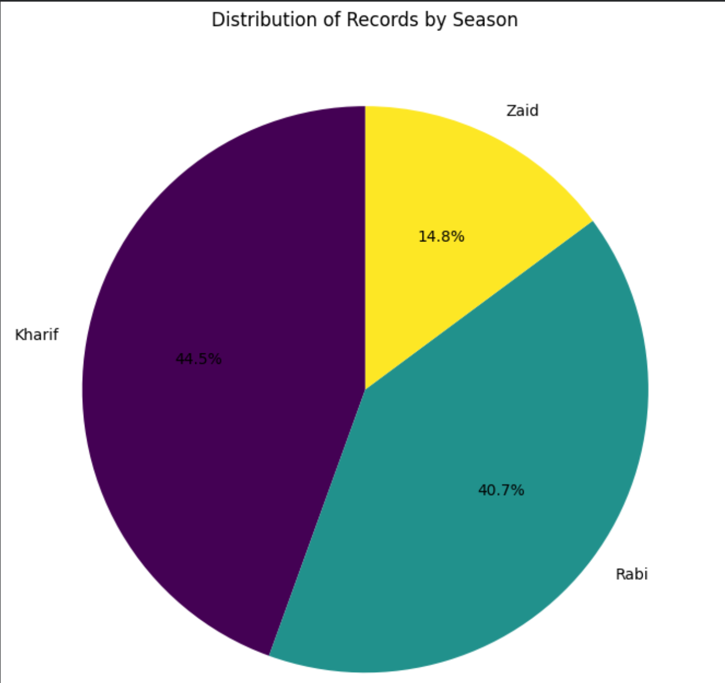
RESULTS
plt.figure(figsize=(7, 7))
df['Season'].value_counts().plot.pie(autopct='%1.1f%%', startangle=90, cmap='viridis')
plt.title('Distribution of Records by Season')
plt.ylabel('') # Remove the y-axis label
plt.tight_layout()
plt.show()
The pie chart shows the percentage contribution of each season to the dataset.
It provides a quick visual comparison of seasonal representation.
Larger slices indicate seasons with more recorded observations.
The chart helps assess whether all seasons are adequately represented in the analysis.

Slide 9
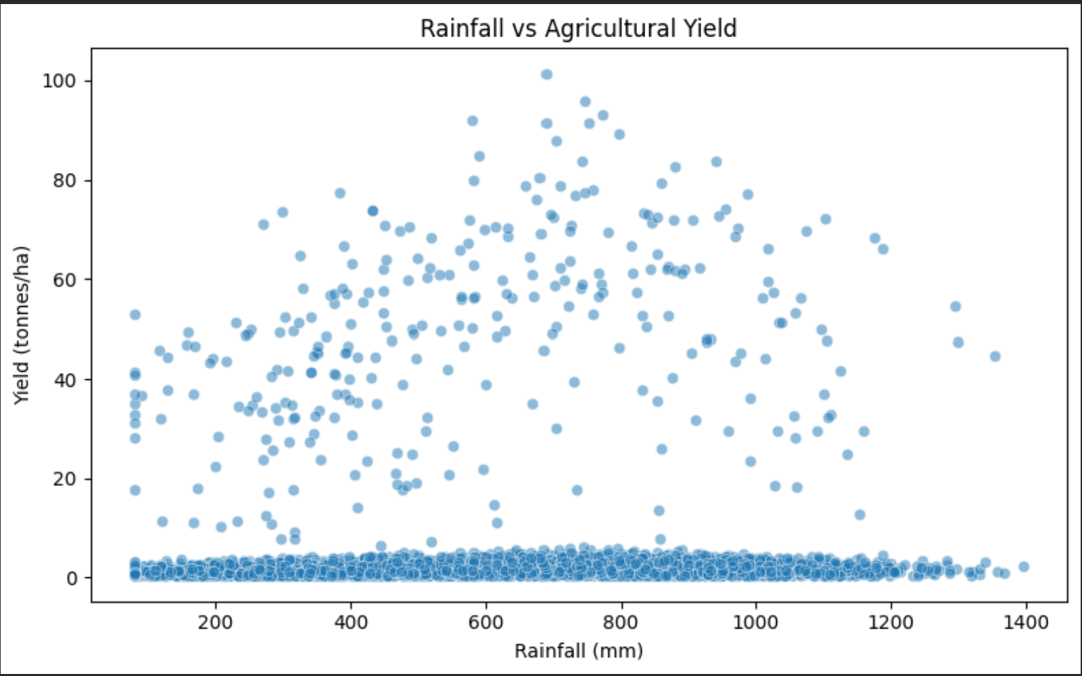
RESULTS
plt.figure(figsize=(8, 5))
sns.scatterplot(data=df, x="Rainfall_mm", y="Yield_Tonnes_Ha", alpha=0.5)
plt.title("Rainfall vs Agricultural Yield")
plt.xlabel("Rainfall (mm)")
plt.ylabel("Yield (tonnes/ha)")
plt.tight_layout()
plt.show()
This graph examines the relationship between rainfall and crop yield.
Each point represents an individual farm record.
A positive trend suggests that higher rainfall may contribute to increased yield.
The plot helps identify patterns, clusters, and unusual observations.

Slide 10
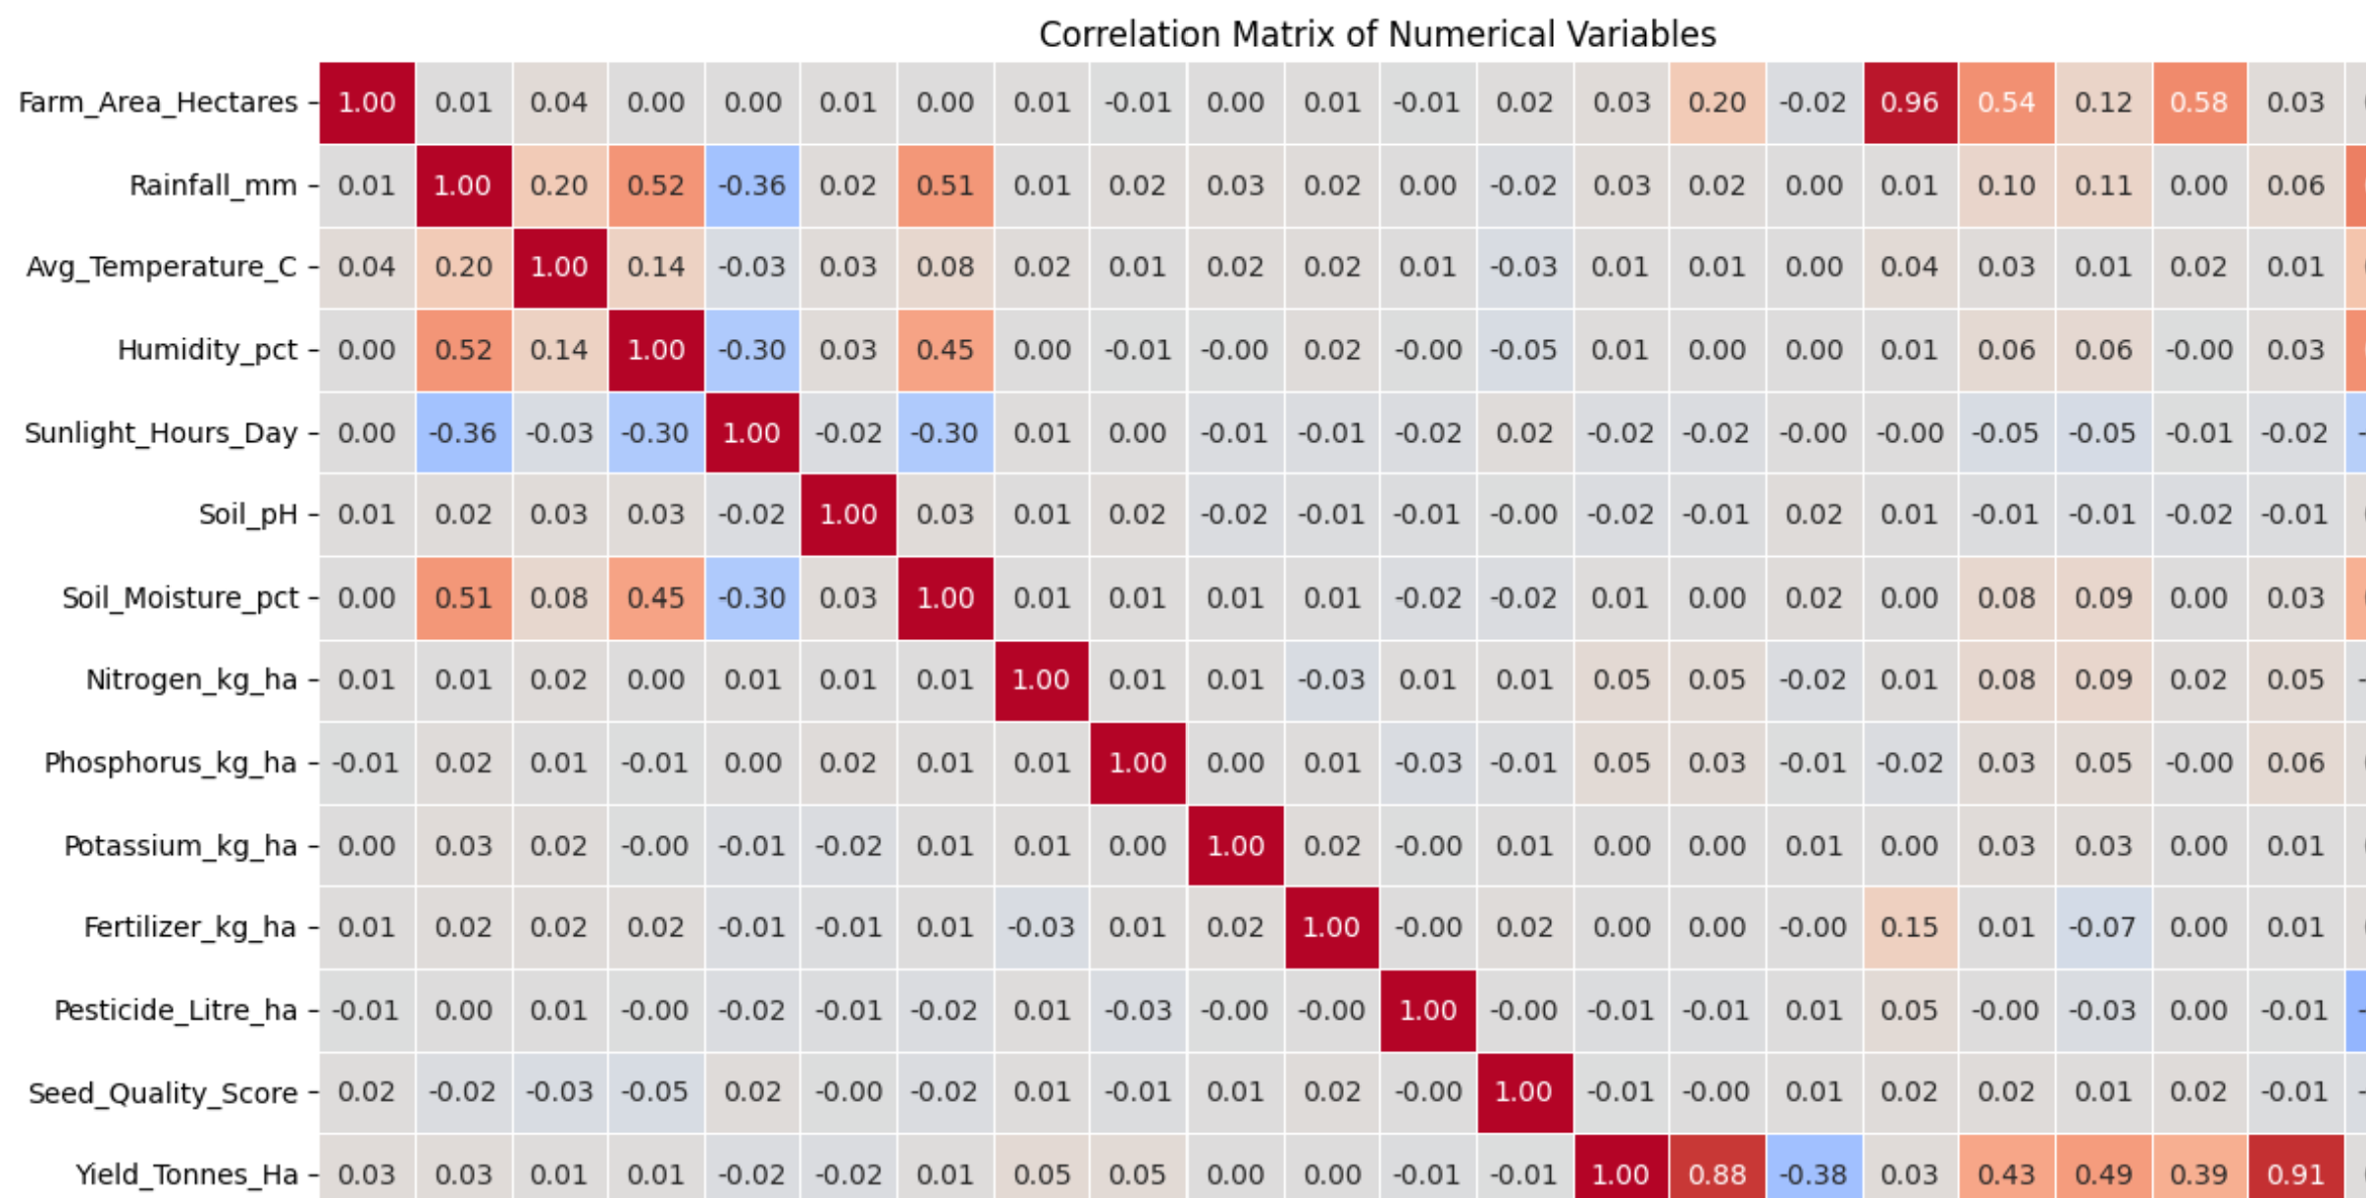
RESULTS
[plt.figure(figsize=(16, 12))
corr = df[numeric_columns].corr(numeric_only=True)
sns.heatmap(
corr,
annot=True,
fmt=".2f",
cmap="coolwarm",
center=0,
linewidths=0.5
)
plt.title("Correlation Matrix of Numerical Variables")
plt.tight_layout()
plt.show()
The heatmap displays correlation coefficients between numerical variables.
Values close to +1 indicate strong positive relationships, while values close to -1 indicate strong negative relationships.
Darker colors represent stronger correlations.
This analysis helps identify factors that significantly influence agricultural performance.

Slide 11
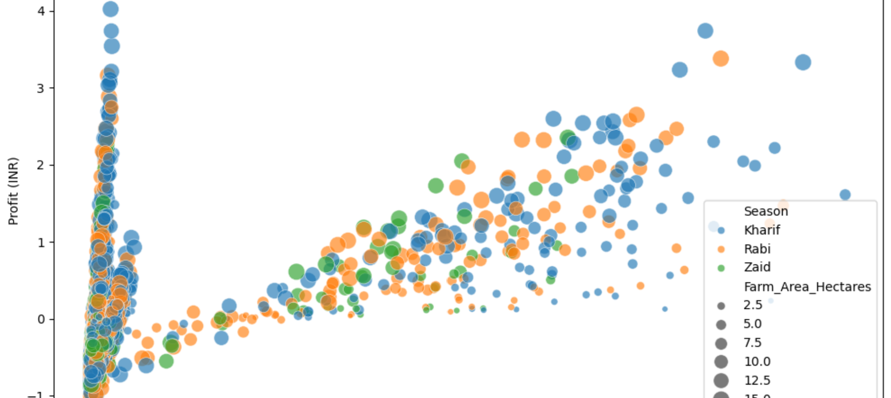
.
RESULTS
This graph simultaneously analyses yield, profit, season, and farm area.
Different colours represent seasons, while point size indicates farm area.
Higher yields are generally associated with higher profits.
The visualization helps compare seasonal performance and understand the combined impact of multiple factors.

Slide 12
Future scope
Develop machine learning models for crop yield prediction.
Build a recommendation system for crop selection based on weather and soil conditions.
Integrate real-time weather and rainfall data.
Create an interactive dashboard using Streamlit or Power BI.
Expand the analysis to include market prices and profit forecasting.
Support region-wise and state-wise agricultural comparisons.
Implement AI-based decision support for farmers.

Slide 13
GitHub Link

Slide 14

VOIS Course completion certificate -
Course name- Data Visualization

Slide 15
Thank you
.
.

