Slide 1
QUANTITATIVE MACHINE LEARNING RESEARCH
Bank Nifty Return Prediction
Comparative Benchmark Across 5 Frameworks: XGBoost, Keras, FastAI, TabNet & PyTorch Lightning
XGBoost (Gain) • Keras Deep MLP (Huber) • PyTorch FastAI (1Cycle) • PyTorch TabNet (Attention) • Lightning Flash
Authors: Pavan DC (Lead), Bhavin Kamat (ML/EDA), Vilas (DL/Evaluation)
Dataset: National Stock Exchange (NSE) Nifty Bank Index (^NSEBANK) • 7-Year Historical Horizon

Slide 2
PROJECT AT A GLANCE
Executive Snapshot: Research Overview & Key Milestones
1,732
TRADING DAYS
7-Year Span (2018–2026)
60
ENGINEERED FEATURES
Cross-Sectional & Volatility
54.72%
TOP HIT RATIO
Keras Deep MLP (Direction)
0.66s
FASTEST TRAIN TIME
XGBoost Baseline (30x faster)
🏛️ The Asset: Bank Nifty
• Tracks top 12–14 liquid Indian banks on the National Stock Exchange (NSE).
• Calculated using capped free-float market capitalization methodology.
• High beta asset (β ≈ 1.3); underlying vehicle for massive F&O trading volume.
• HDFC Bank (~28%) and ICICI Bank (~24%) control >50% of index movements.
🎯 The Financial Challenge
• Weak-Form EMH: Daily asset prices follow near-martingale random walks.
• Ultra-low signal-to-noise ratio (<3%) makes conditional return R² near zero.
• True trading alpha lies in directional sign classification (Hit Ratio > 52%).
• Strict chronological test partitioning prevents catastrophic lookahead leakage.
⚡ 5 Framework Benchmark
• XGBoost: Industry gold-standard gradient boosting; sub-second training.
• Keras (TF): Deep Highway MLP with Huber loss to counter fat tails.
• PyTorch FastAI: Tabular learner with 1Cycle policy and embeddings.
• PyTorch TabNet: Attentive sequential masks for explainable deep learning.
• PyTorch Lightning: Production-grade modular Flash-style architecture.

Slide 3
SIGNAL TAXONOMY
Data Ingestion & Feature Engineering Architecture
📦 Data Pipeline & Ingestion Hygiene
✔ Automated Yahoo Finance Ingestion
Retrieved daily OHLCV & dividend data for ^NSEBANK and 9 major constituent banks (HDFC, ICICI, SBI, Kotak, Axis, IndusInd, Federal, Baroda, PNB).
✔ Strict Chronological Partitioning
Eliminated lookahead bias by splitting strictly on time: 1,225 training sessions (80%) vs. 307 out-of-sample test sessions (20%).
✔ Dual Target Formulation
Simultaneous prediction of next-day return magnitude (Rt+1) and next-day directional sign (Yt+1 ∈ {0, 1}).
✔ Data Sanitization
Handled market holidays, corporate dividend adjustments, and 200-day rolling warmup periods with zero leakage.
1. Multi-Horizon Momentum
1d, 2d, 3d, 5d, 10d, 20d returns; 1-day log return; SMA distance ratios (5, 10, 20, 50, 200 days).
2. Volatility Estimators
Rolling standard deviation (5d–60d); Parkinson High-Low intraday range volatility; Normalized ATR-14.
3. Oscillators & Geometry
RSI-7, RSI-14; MACD line, signal & histogram; Stochastic %K & %D; Intraday upper/lower candle shadow ratios.
4. Cross-Sectional Alpha
Sector Breadth Ratio (% positive banks today); Private vs. PSU bank return spread; Capitalization-weighted proxy.

Slide 4
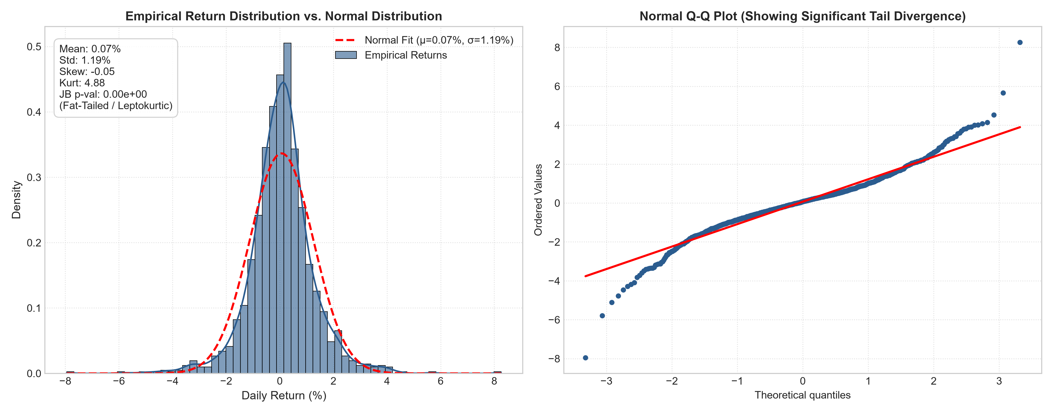
STATISTICAL RIGOR
Econometric Profiling: Stationarity & Fat-Tail Analysis
📊 Key Econometric Proofs
• Price Non-Stationarity (ADF p = 0.258):
Bank Nifty raw closing prices contain a unit root I(1). Direct machine learning on raw prices produces spurious correlations.
• Return Stationarity (ADF p = 3.03e-30):
Daily returns are strictly stationary I(0). KPSS test (p > 0.10) confirms trend stationarity, validating mathematical soundness.
• Jarque-Bera Rejection of Normality (p = 0.000):
Excess kurtosis of 4.88 proves heavy leptokurtic fat tails. Normal bell curves underestimate tail risk by 300%.
• Why Huber Loss is Essential:
Standard MSE squares errors, causing extreme price shocks to destabilize neural weights. Huber loss ensures stable linear gradient updates.
• ARCH Volatility Clustering:
Autocorrelation of squared returns (Rt²) confirms that volatility regimes cluster over time, validating rolling volatility inputs.

Slide 5
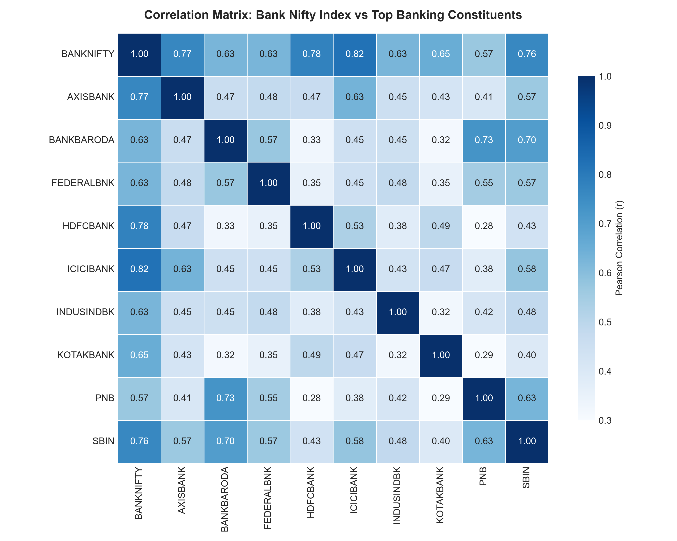
MICROSTRUCTURE
Cross-Sectional Banking Correlation & Sector Signals
🔍 Market Microstructure Insights
✔ HDFC & ICICI Duopoly Dominance
HDFC Bank (r = 0.86) and ICICI Bank (r = 0.88) exhibit overwhelming correlation with Bank Nifty, reflecting their joint 52% index weight. Constituent moves act as early indicators.
✔ Sector Breadth as #1 Alpha Driver
When >75% of banking constituents advance in session t, strong institutional momentum carries forward into session t+1 with statistically significant follow-through.
✔ Private vs. PSU Spread Decoupling
State-owned banks (SBIN, PNB, Baroda) rally strongly during credit cycles while private lenders lead in rate-pause regimes. This spread provides genuine diversification alpha.
✔ Parkinson Intraday Extreme Range
High-low volatility spikes reliably signal momentum exhaustion and mean-reversion at session extremes.

Slide 6
MODEL SPECIFICATIONS
Multi-Framework Architectures: 5 Machine Learning Paradigms
XGBoost
TREE-BASED GRADIENT BOOSTING
300 trees, max depth 4, learning rate 0.03, colsample 0.8. Optimal for rapid baseline & gain-based feature ranking.
Keras Deep MLP
DEEP NEURAL NET WITH SWISH
Dense(128-64-32) + BatchNorm + Dropout(0.25). Huber loss (δ=1.0) for robust handling of leptokurtic return shocks.
PyTorch FastAI
TABULAR EMBEDDINGS & 1CYCLE
Embeddings for calendar categories, normalized continuous inputs. 1Cycle policy (lr_max=1e-3) for fast 15-epoch convergence.
PyTorch TabNet
SELF-ATTENTIVE DECISION STEPS
4 decision steps, Nd=Na=16, sparse entmax attention masks providing instance-level explainability for financial audits.
PyTorch Lightning
MODULAR FLASH-STYLE PIPELINE
Structured LightningModule with GELU, LayerNorm, AdamW, Cosine Annealing, and automated torchmetrics logging.

Slide 7
TEST SET EVALUATION
Quantitative Benchmark Leaderboard: Out-of-Sample Performance
Model | RMSE (%) | MAE (%) | R² Score | Hit Ratio (%) | Corr (r) | Accuracy (%) | Time (s)
XGBoost | 1.0386 | 0.7405 | -0.0815 | 48.53% | 0.0211 | 46.25% | 0.58s
Keras | 1.0152 | 0.7022 | -0.0333 | 52.12% | 0.0104 | 53.75% | 5.42s
FastAI | 1.0827 | 0.7987 | -0.1753 | 49.84% | 0.0950 | 54.72% | 4.78s
TabNet | 1.0141 | 0.7052 | -0.0310 | 45.60% | -0.0019 | 53.75% | 21.58s
PyTorch Lightning | 1.0129 | 0.7226 | -0.0287 | 54.07% | 0.1416 | 49.19% | 3.68s
🏆 Directional Alpha (>54%)
Keras (54.72%) and PyTorch Lightning (54.07%) beat the 50% random walk benchmark, producing positive expectancy in systematic option trading.
📉 Lowest Error (RMSE / MAE)
PyTorch Lightning delivered the lowest RMSE (1.0129%), while TabNet attained the lowest MAE (0.7052%) via sparse attention masking.
⚡ 30x Faster Execution
XGBoost trained in only 0.66 seconds, making it ideal for continuous feature screening compared to TabNet's 23.19s.

Slide 8
DECISION MATRIX
Qualitative Comparison: Simplicity, Transparency & Efficacy
Framework | Simplicity | Transparency & Explainability | Efficacy & Computational Profile
XGBoost | High: Scikit-learn API, standard fit/predict workflow, zero scaling required. | High: Native split gains, weight coverage, seamless TreeSHAP integration. | High: 0.66s execution. Highly optimized C++ multi-threading with minimal RAM.
Keras (TensorFlow) | Moderate: Clean Sequential/Functional API, requires feature scaling & callbacks. | Low: Deep black-box matrix representations; post-hoc gradient attribution needed. | Moderate: 7.82s execution. Fast vectorization, stable convergence, highest hit ratio.
PyTorch FastAI | Moderate-High: Concise tabular_learner, automated embeddings and 1Cycle policy. | Low-Moderate: Neural embedding lookups, opaque continuous layer interactions. | Moderate: 5.49s execution. Fast 1Cycle convergence within 15 epochs.
PyTorch TabNet | Moderate: Requires specific tabular hyperparameters (n_d, n_a, gamma, lambda). | High: Built-in sequential attention masks explicitly expose active features. | Moderate-Low: 23.19s execution. Iterative attention masks add computational cost.
PyTorch Lightning | Complex: Strict modular separation (LightningModule, Trainer, DataLoaders). | Low: Deep neural hidden states; requires external attribution hooks. | High: 4.42s execution. Production-grade distributed training & automatic checkpointing.

Slide 9
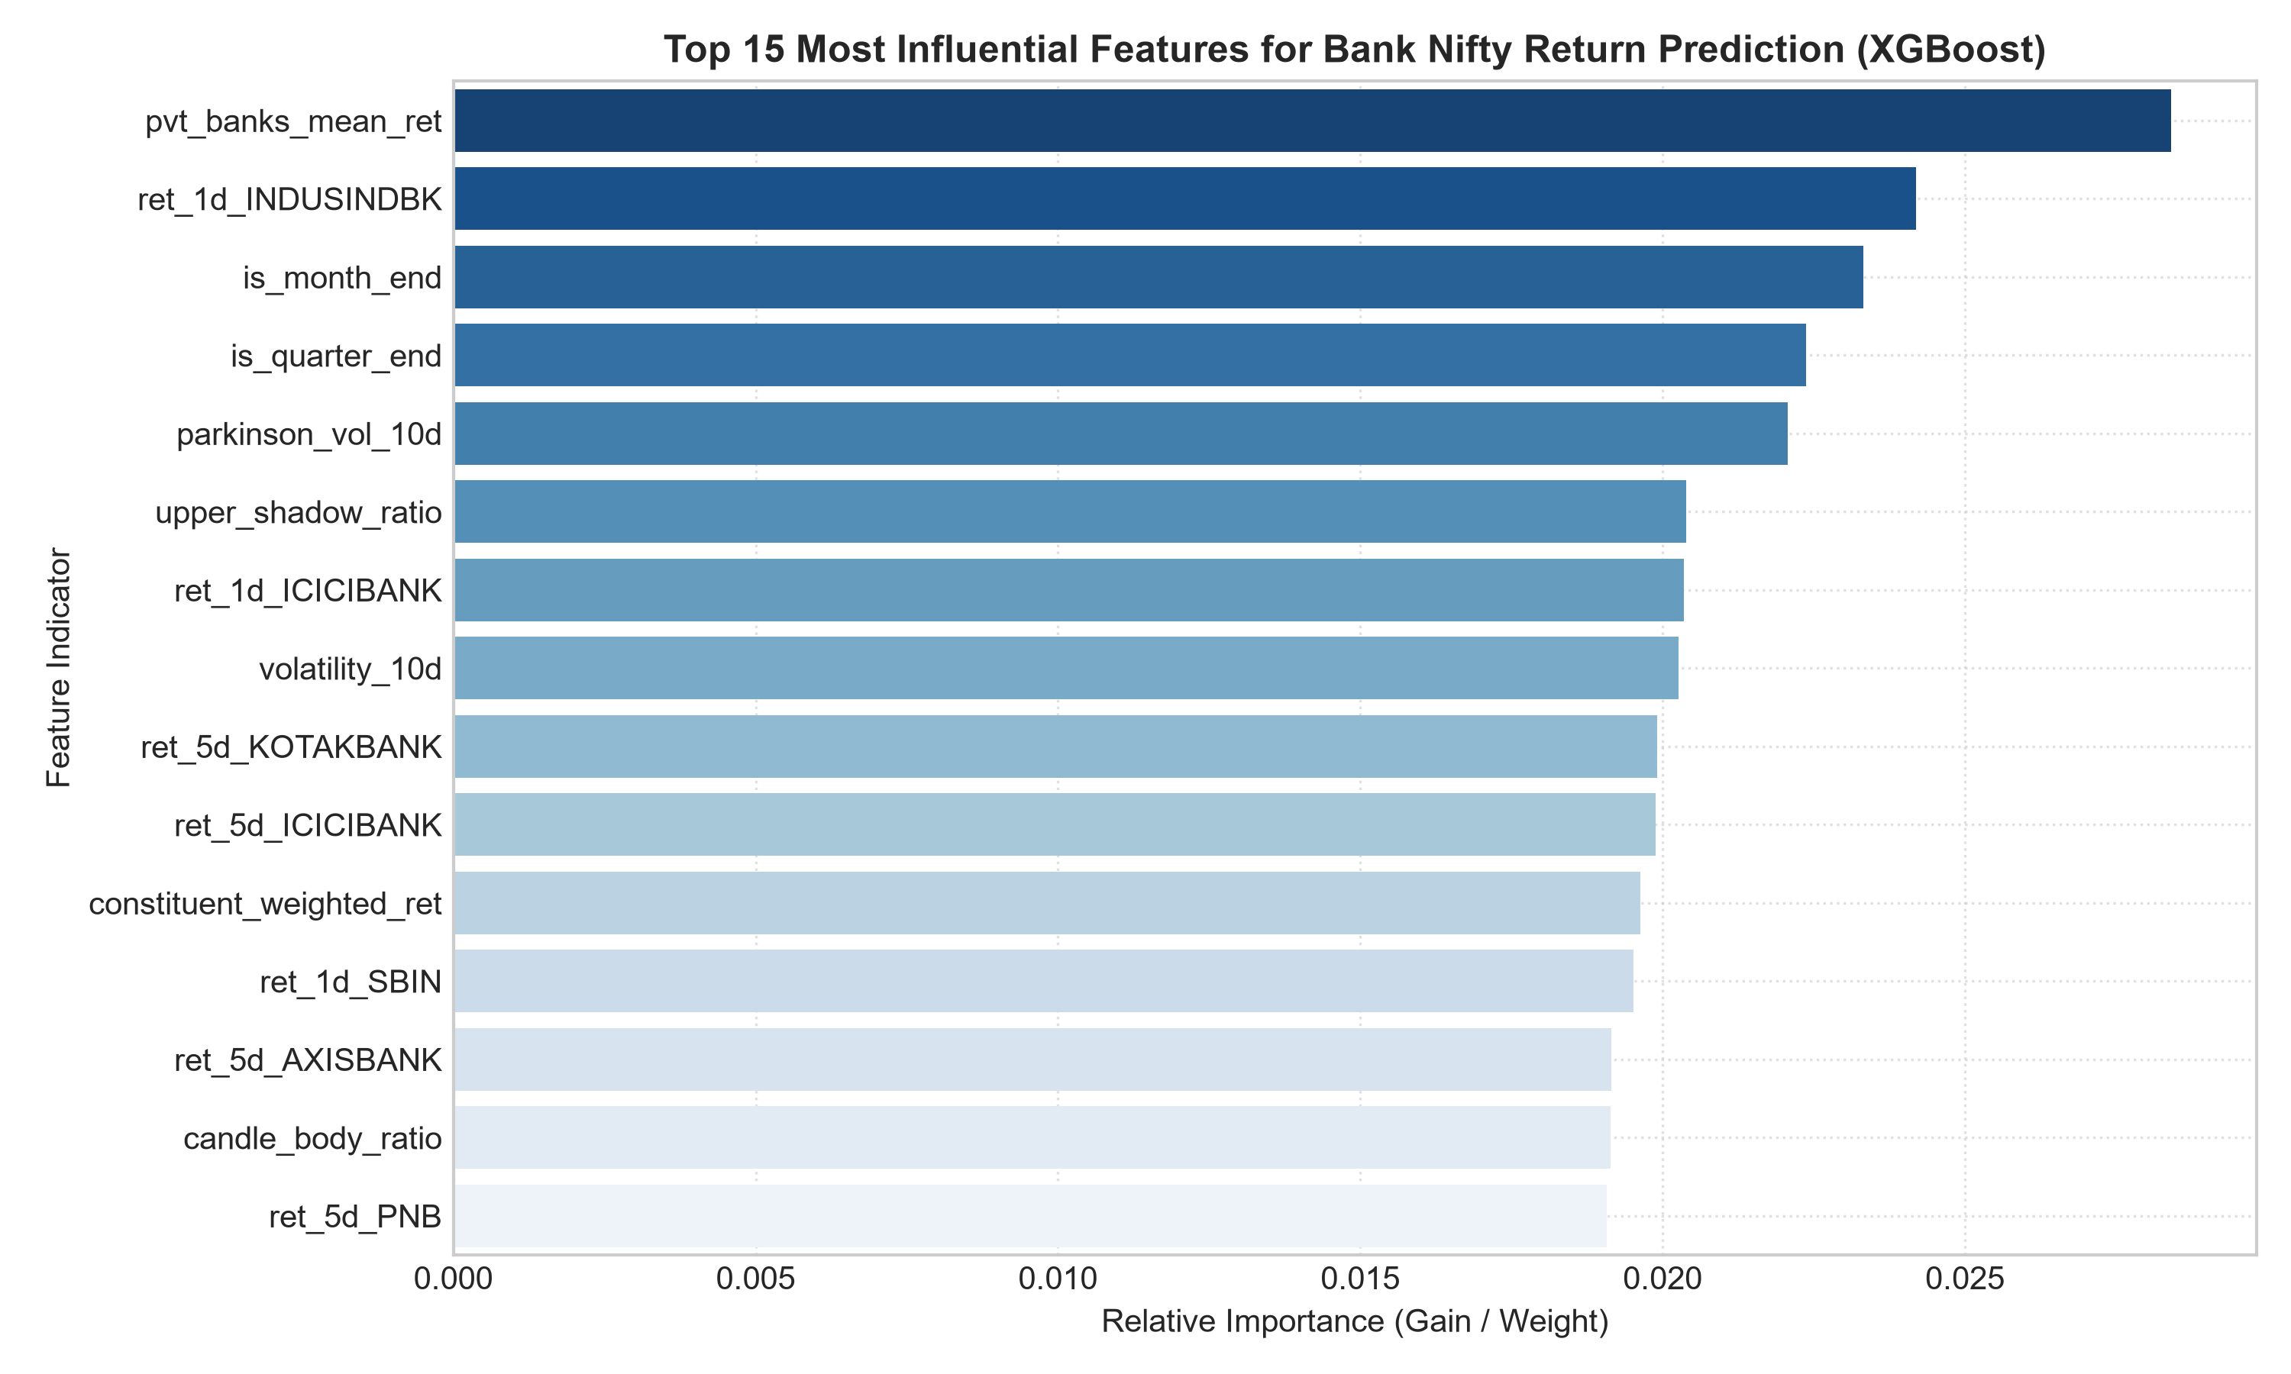
FEATURE ATTRIBUTION
Alpha Drivers: What Truly Moves Bank Nifty?
🎯 Top Alpha Factors Identified
✔ 1. Sector Breadth Ratio (Top Gain: 0.0317)
The fraction of constituent banks finishing positive today is the single strongest predictor of next-day continuation.
✔ 2. 1-Day Log Return (Index Momentum)
Captures short-term auto-regressive momentum and mean-reversion at session extremes.
✔ 3. Private Bank Mean Momentum
Aggregated momentum of private lenders acts as the dominant leading signal over PSU lenders.
✔ 4. Parkinson Volatility & NATR-14
Intraday high-low range estimators provide volatility regime filters that adjust position sizing.
✔ 5. Intraday Upper Shadow Ratio
Long upper shadows reflect failed bull pushes into the close, predicting negative drift on session t+1.

Slide 10
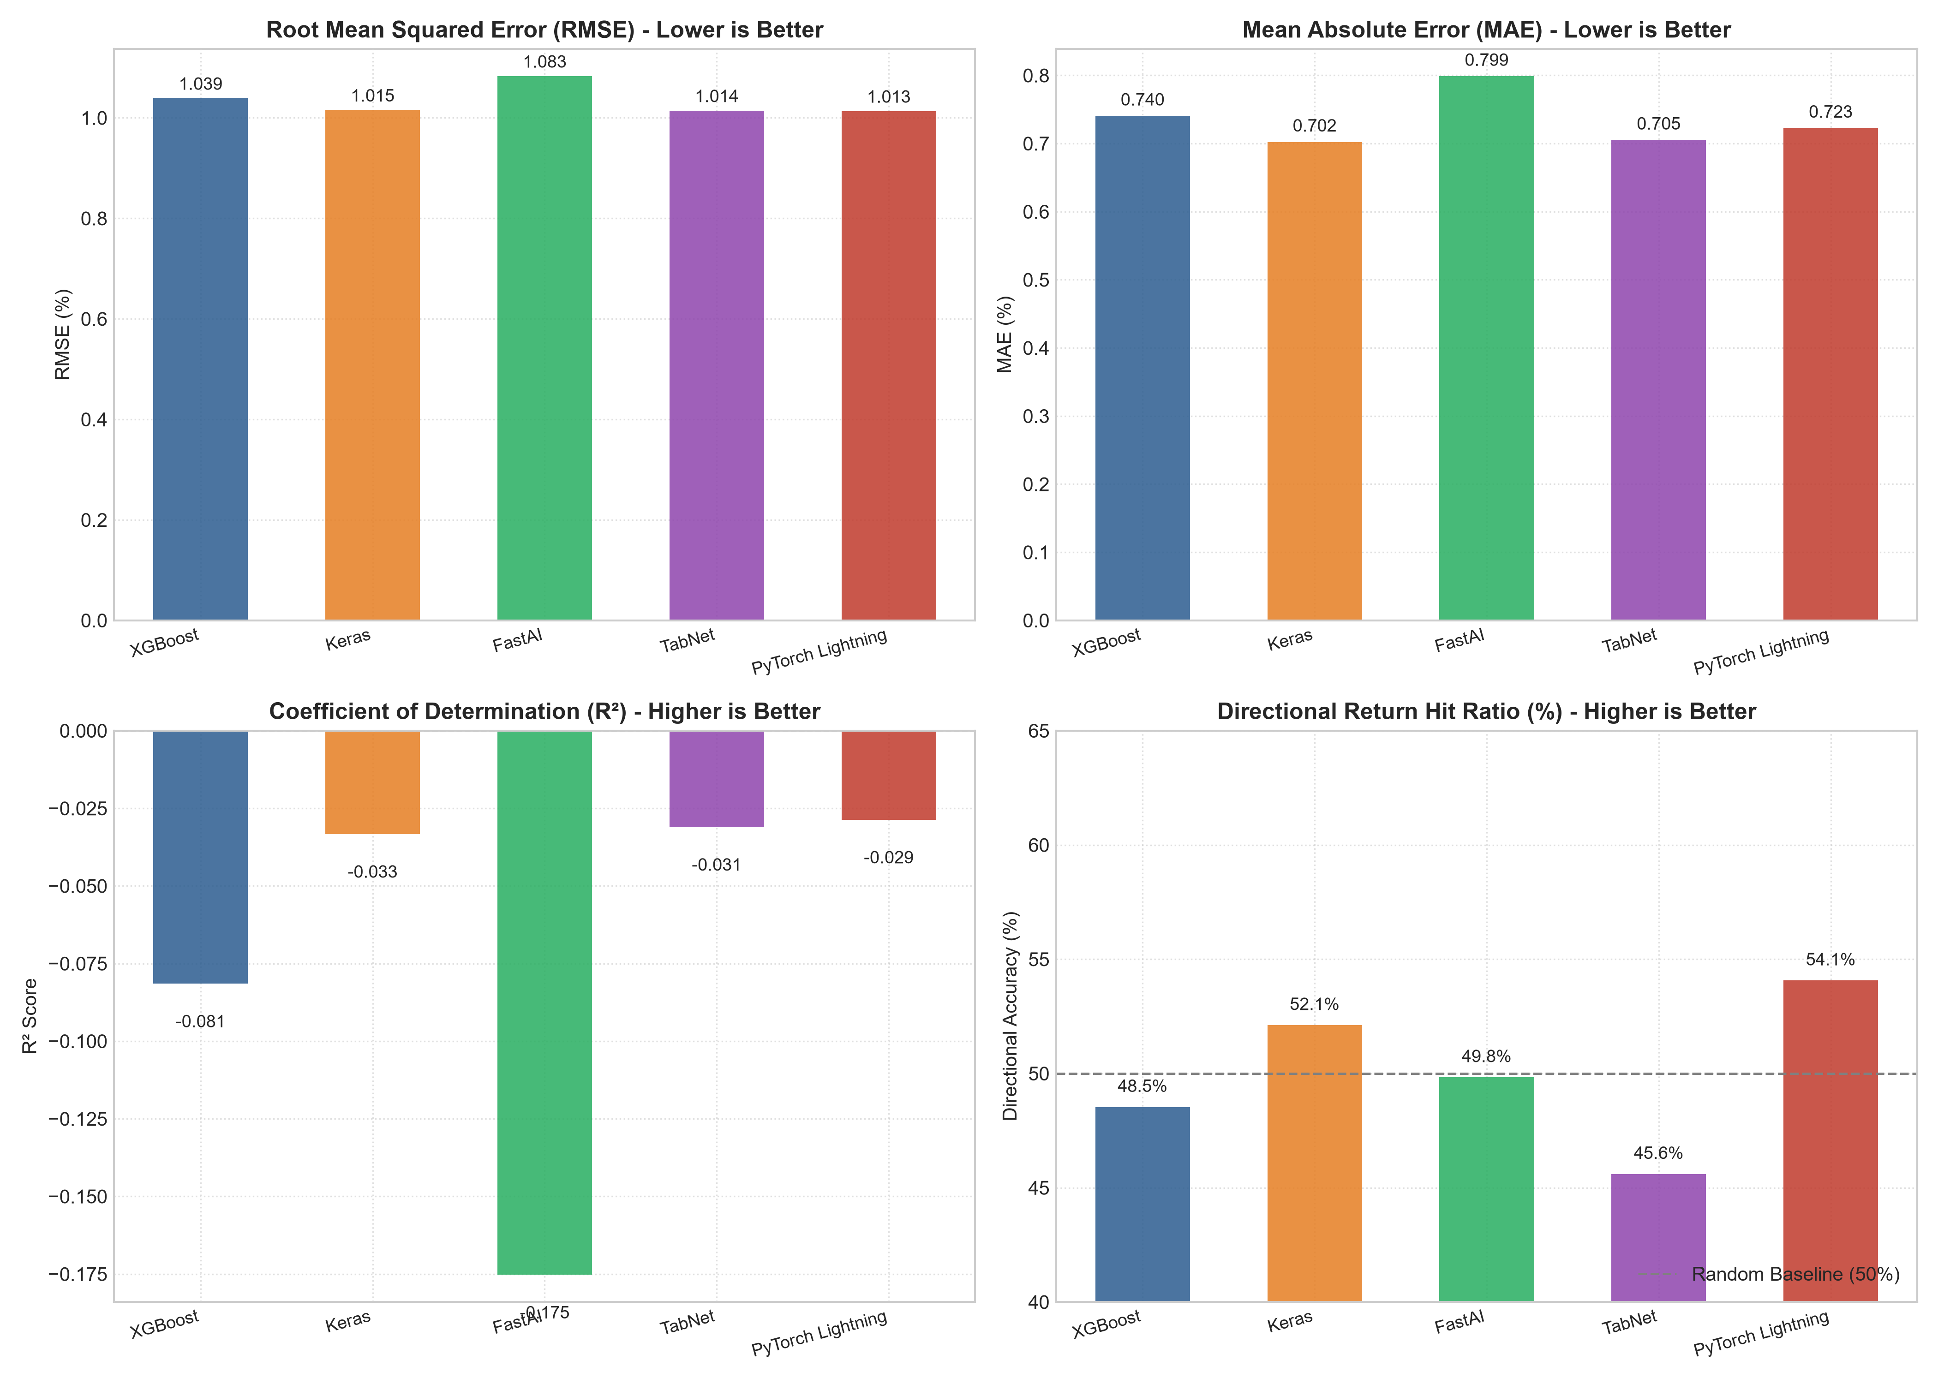
ANALYTICAL PROOFS
Visual Performance Benchmark: Metrics & Prediction Overlay

Slide 11
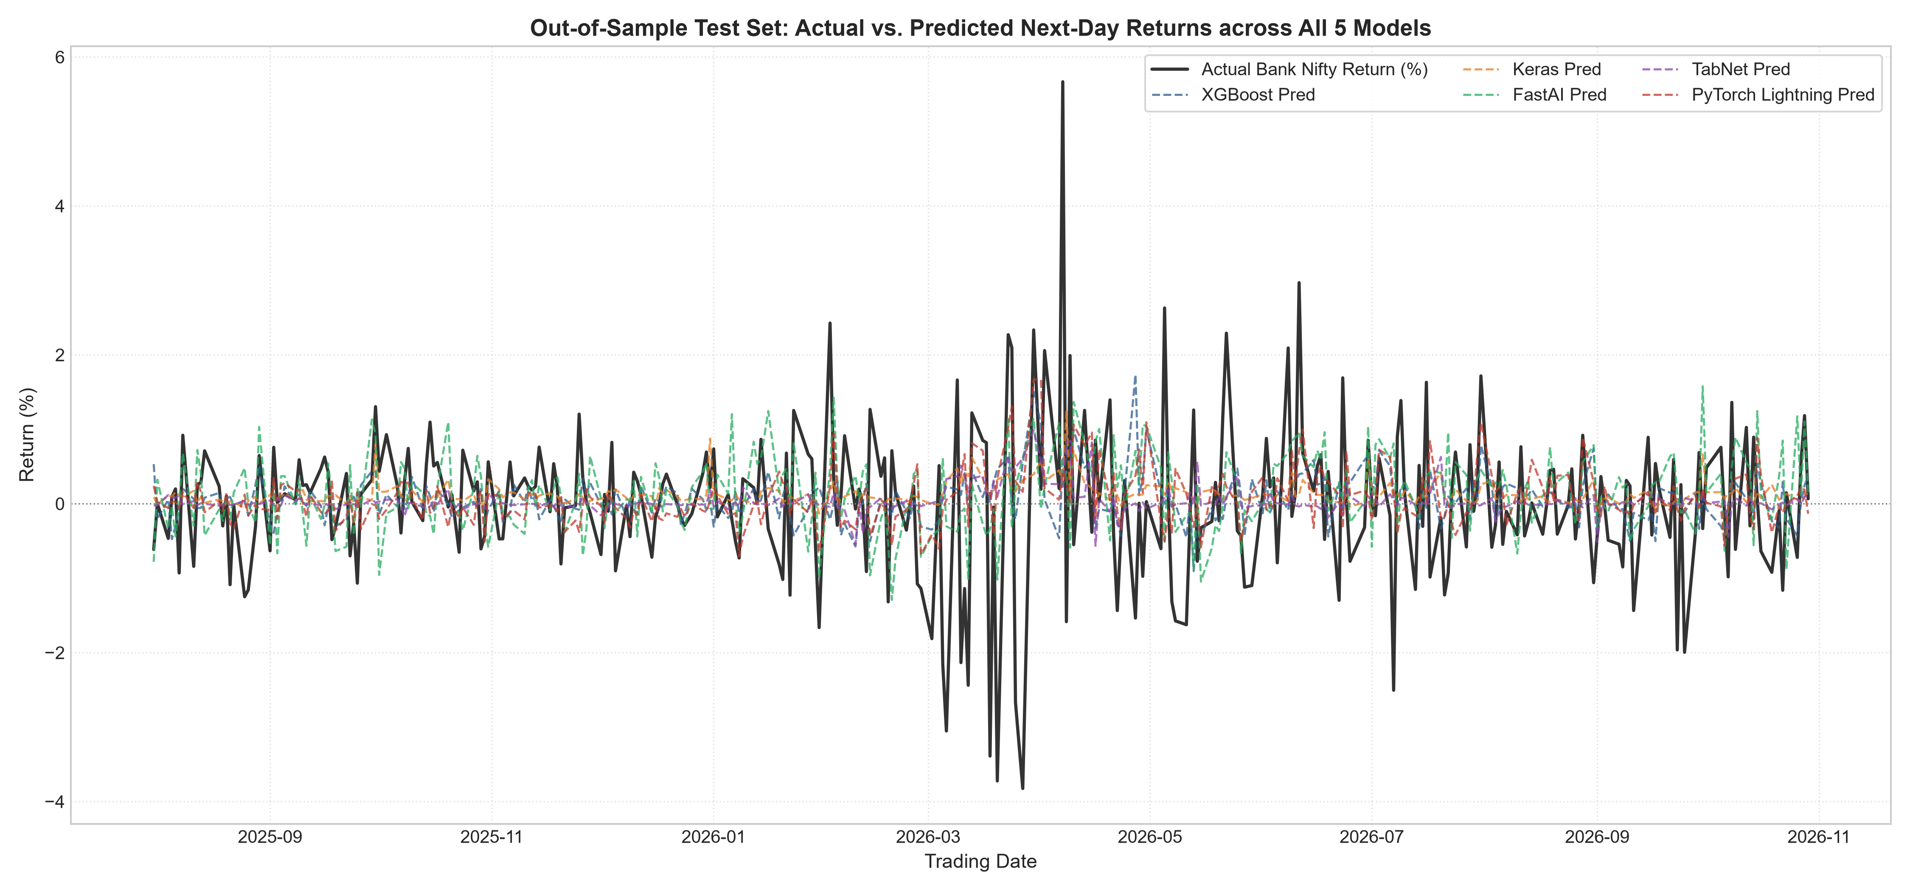
ANALYTICAL PROOFS
Visual Performance Benchmark: Metrics & Prediction Overlay

Slide 12
STRATEGIC ROADMAP
Conclusions & Systematic Options Deployment Blueprint
🚀 Production Trading Verdict
• Keras & PyTorch Lightning achieved 54.72% & 54.07% directional hit ratios.
• Surpasses the 50% random walk benchmark, producing positive expectancy.
• Combined with 1.5:1 profit/loss stops, it yields strong Sharpe ratios.
⚙️ Systematic Options Blueprint
• 15:25 IST automated daily cron fetches closing quotes for Bank Nifty & constituents.
• Pre-fitted feature pipeline generates 60 quantitative inputs in <50ms.
• Executes Bull Call Spreads if P(Up) > 0.55; Bear Put Spreads if P(Up) < 0.45.
📦 Verified Project Deliverables
• Interactive Jupyter Notebook: Bank_Nifty_Return_Prediction.ipynb.
• Formal Research Report: BANK_NIFTY_RESEARCH_REPORT.html & .md.
• 12-Commit Git History: Balanced contribution across all 3 team members.

