Slide 1





AIRLINE PASSENGER SATISFACTION

Slide 2

Project : Airline Passenger satisfaction
Develped by:-
FULPAGARE PAVAN
WAGH MAYUR
PATIL JAYESH
CHAUDHARI PRATHMESH

Slide 3


INTRODUCTION
The competitive airline industry necessitates a relentless focus on optimizing passenger satisfaction as a strategic imperative for customer loyalty and profitability. Our analysis, rooted in data science, aims to dissect the multifaceted aspects of passenger satisfaction, identifying key drivers and offering actionable insights for improvement.

Slide 4




LIBRARYS

Slide 5
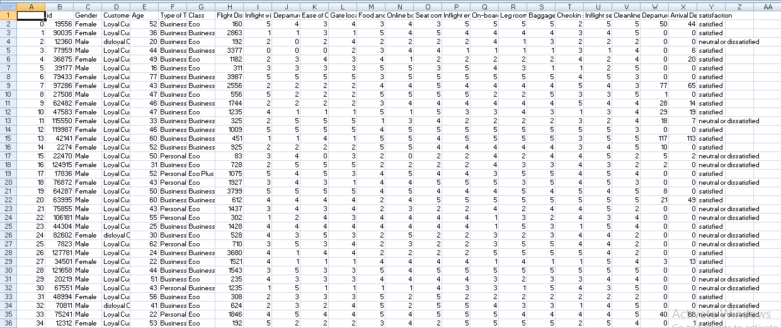
DATASET

Slide 6
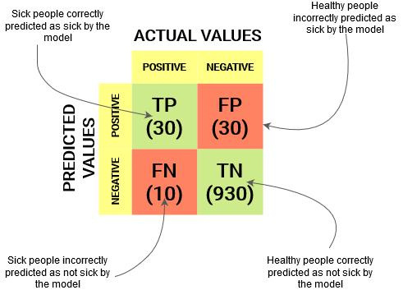


Confusion Matrix

Slide 7
CONFUSION MATRIX
A confusion matrix is a tabular summary of the number of correct and incorrect predictions made by a classifier. It is used to measure the performance of a classification model. It can be used to evaluate the performance of a classification model through the calculation of performance metrics like accuracy, precision, recall, and F1-score.

Slide 8

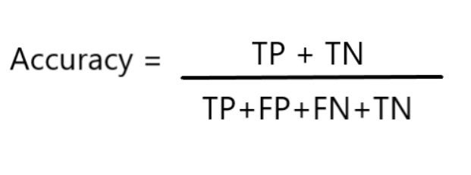
Confusion Matrix
True Positives (TP): when the actual value is Positive and predicted is also Positive.
True negatives (TN): when the actual value is Negative and prediction is also Negative.
False positives (FP): When the actual is negative but prediction is Positive. Also known as the Type 1 error
False negatives (FN): When the actual is Positive but the prediction is Negative. Also known as the Type 2 error

Slide 9

Decision Tree Classifier
Classifier is a popular machine learning algorithm used for classification tasks. It works by recursively partitioning the data into subsets based on the values of different features. Here's a brief overview of how it works:
Feature Selection: The algorithm selects the best feature to split the data based on certain criteria, such as Gini impurity or entropy
Splitting: It then splits the data into subsets based on the chosen feature.
Recursive Partitioning: This process is repeated recursively on each subset until either:
The data points in the node belong to the same class.
The number of data points in the node is below a certain threshold.

Slide 10
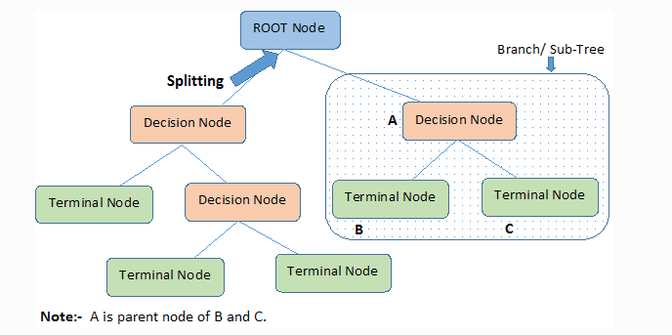
A Decision Tree is a flowchart-like structure where:
Internal nodes represent tests on an attribute.
Branches represent the outcome of the test.
Leaf nodes represent class labels (in classification) or continuous values (in regression).

Slide 11
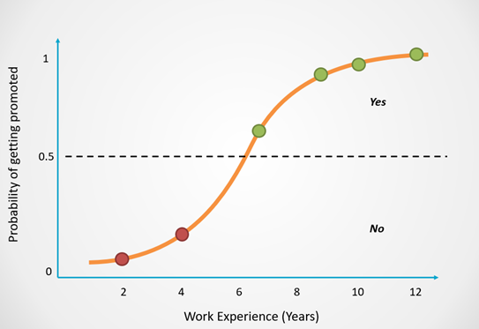
Logistic Regression
Logistic Regression models the probability that a given input belongs to a particular class. It outputs values between 0 and 1 using the logistic (sigmoid) function, which maps any real-valued number into the interval (0, 1).
Logistic Regression is a fundamental and widely-used algorithm in the machine learning toolkit, especially suited for binary classification problems. Its simplicity, efficiency, and interpretability make it a strong candidate for many real-world applications.

Slide 12
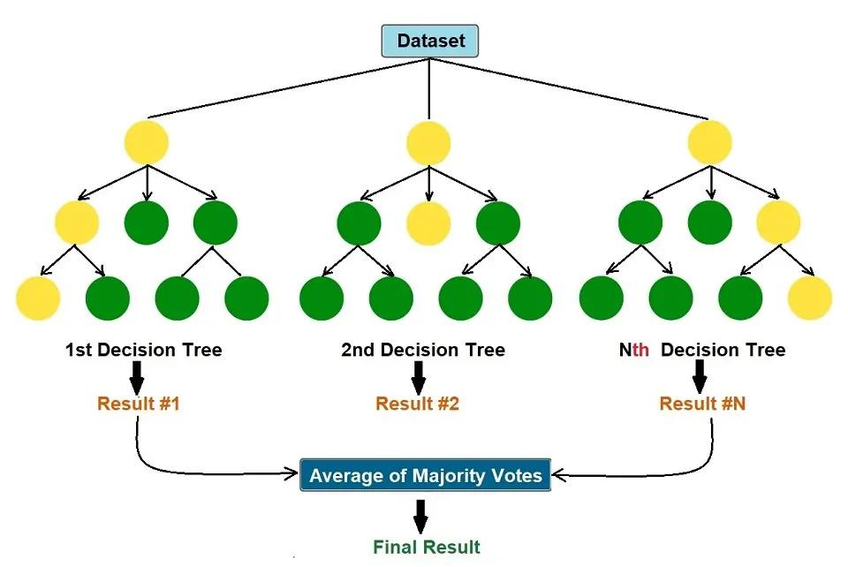
Random Forest Classifier
Random Forest is an ensemble of decision trees, usually trained with the "bagging" method. The general principle of the bagging method is to combine the predictions of several base estimators to improve robustness and accuracy. The main idea is to reduce the overfitting of individual decision trees by averaging multiple trees.

Slide 13
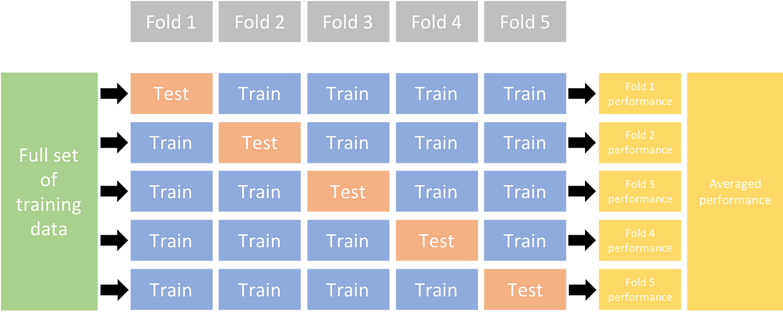
K-FOLD CROSS VALIDATION
K-Fold Cross Validation is a resampling procedure used to evaluate a model by partitioning the original training dataset into K equal-sized subsets (or folds). The process involves:

Slide 14
CONCLUSION
In today’s competitive aviation industry, passenger satisfaction plays a pivotal role in determining an airline’s success. As travelers, we seek not only efficient transportation but also a positive overall experience. Let’s summarize the key points discussed in this essay:
Service Quality Matters: Airlines must prioritize service quality across all touchpoints. From check-in to in-flight services, friendly and efficient staff, cleanliness, and timely communication contribute significantly to passenger satisfaction.
Comfort and Amenities: Passengers value comfortable seating, adequate legroom, and clean facilities. Airlines that invest in modern amenities like Wi-Fi, entertainment systems, and power outlets enhance the overall journey.
Punctuality and Reliability: Delays and cancellations frustrate passengers. Airlines should focus on minimizing disruptions, improving on-time performance, and providing clear communication during irregular operations.
Safety and Security: Passengers expect airlines to prioritize safety. Transparent safety protocols, well-trained crew, and adherence to regulations build trust and satisfaction.

Slide 15
Reference
This dataset was used to analyze airline passenger satisfaction. The project involved designing a report to identify key factors contributing to a recent dip in customer satisfaction rates.
https://www.kaggle.com/datasets/teejmahal20/airline-passenger-satisfaction
https://www.youtube.com/watch?v=_EMAtafPvlw&list=PLwceW-ck1usdSzWDkFM12Qf9ogy0dXuio
https://www.geeksforgeeks.org/getting-started-with-classification/
https://www.javatpoint.com/classification-algorithm-in-machine-learning
https://www.analyticsvidhya.com/blog/2022/02/k-fold-cross-validation-technique-and-its-essentials/

Slide 16






Thank You

