Slide 1
Birla Vishvakarma Mahavidyalaya
Project Advanced Programming Lab
Share Price Prediction
Using Multiple Linear Regression
ID NO.
18CP047
18CP042
Notes:
Chapter 15
Basic Biostatistics

Slide 2
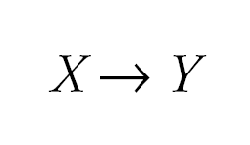
The General Idea
Simple regression considers the relation between a single explanatory variable and response variable

Slide 3
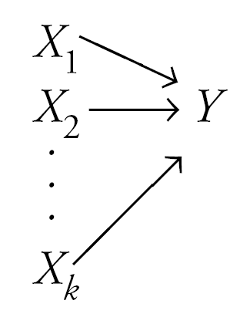
The General Idea
Multiple regression simultaneously considers the influence of multiple explanatory variables on a response variable Y
The intent is to look at the independent effect of each variable while “adjusting out” the influence of potential confounders

Slide 4
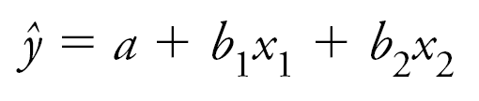
Multiple Regression Model
Again, estimates for the multiple slope coefficients are derived by minimizing ∑residuals² to derive this multiple regression model:

Slide 5
R - Multiple Regression
lm() Function
This function creates the relationship model between the predictor and the response variable
Syntax
The basic syntax for lm() function in multiple regression is − lm(y ~ x1+x2+x3...,data)

Slide 6
R - Multiple Regression
Following is the description of the parameters used −
* formula is a symbol presenting the relation between the response variable and predictor variables.
* data is the vector on which the formula will be applied.

Slide 7
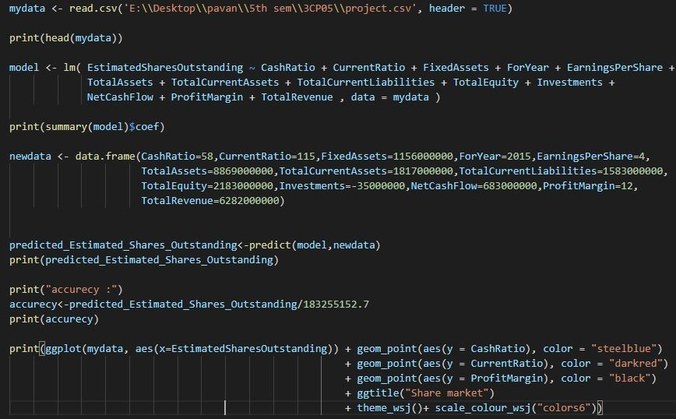
Code :

Slide 8
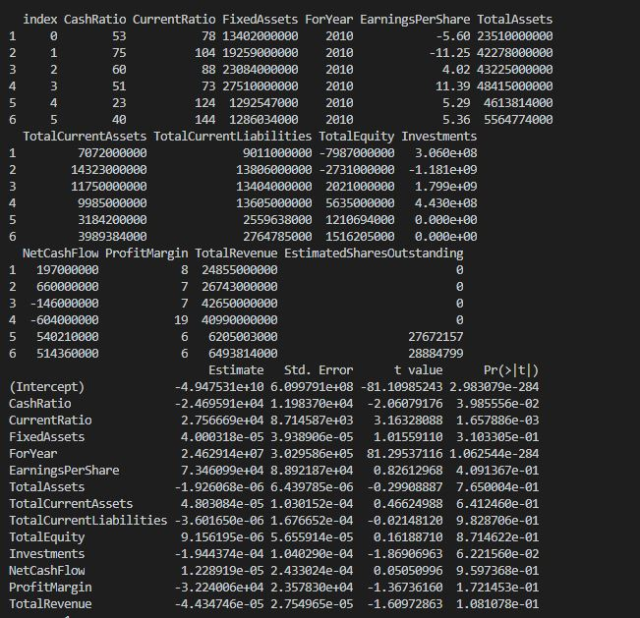
Output :

Slide 9
R - Multiple Regression
Estimate: the beta coefficient estimates associated to each predictor variable
Std.Error: the standard error of the coefficient estimates. This represents the accuracy of the coefficients. The larger the standard error, the less confident we are about the estimate.
t value: which is the coefficient estimate (column 2) divided by the standard error of the estimate (column 3)
Pr(>|t|): The p-value corresponding to the t-statistic. The smaller the p-value, the more significant the estimate is.
Notes:
Chapter 15
Basic Biostatistics

Slide 10
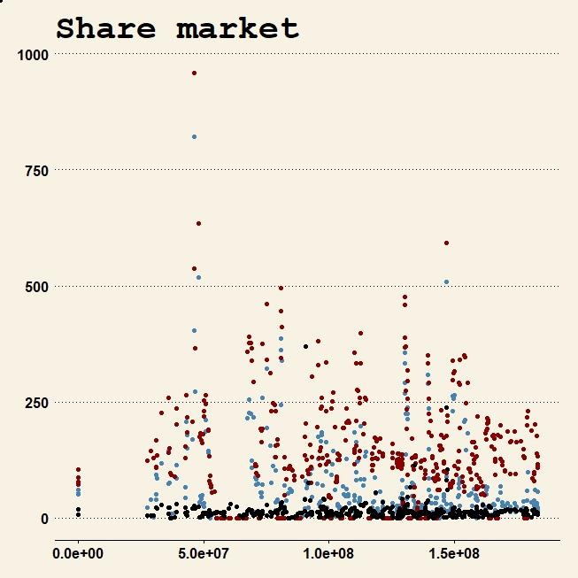
y = CashRatio , color = "blue"
y = CurrentRatio , color = "red"
y = ProfitMargin, color = "black"
y = CashRatio , color = "blue"
y = CurrentRatio , color = "red"
y = ProfitMargin, color = "black"
X = Estimated Shares Outstanding

Slide 11
R - Multiple Regression
Predicted_value – 153907699
> CONCLUSION :
By using Multiple Linear Regression, we have found the
accuracy of our model is
"accuracy” : 0.8398547
We only test one data and measure accuracy of output with original share price, which is more than 83%.

Slide 12
Thank You

