Slide 1
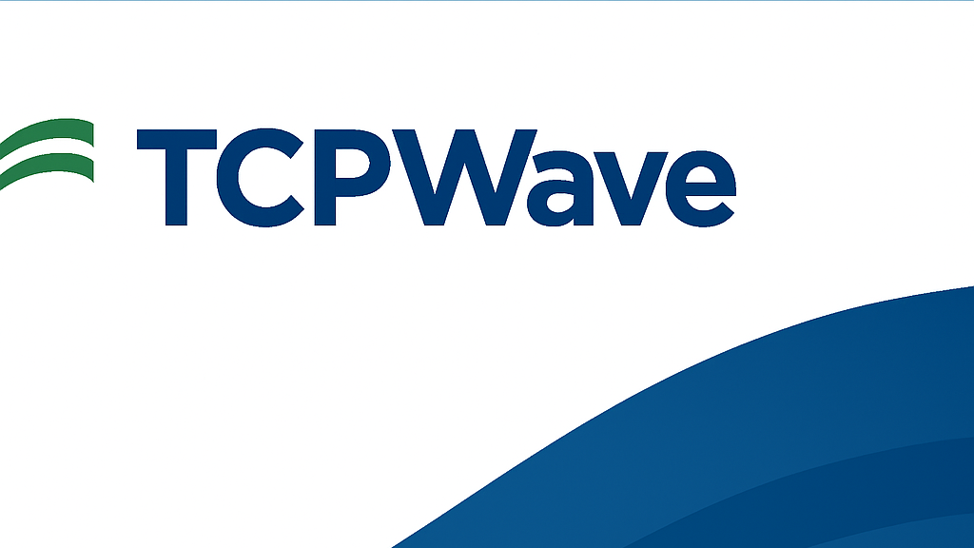
Gap Analysis Report on
TCPWave WAF Solution

Slide 2

Market Competitors (2025) in WAF Space & TCP Ranking
Rank | Vendor | Strengths | Weaknesses
1 | AWS WAF | Scalable, integrated with AWS Shield, Bot Control | AWS-focused
2 | Cloudflare | Excellent global CDN, Zero Trust, Bot mitigation | Limited logging granularity
3 | Akamai | Advanced threat intelligence, global network | Expensive
4 | Imperva | Full-stack protection, DDoS + WAF | UI complexity
5 | Fortinet | Tight integration with FortiGate, strong security DNA | Steep learning curveF5 (BIG-IP)
6 | F5 (BIG-IP) | Custom rules engine, strong enterprise-grade WAF | Costly, requires expertise
7 | Barracuda | SMB-friendly, cost-effective | Not as scalable
8 | TCPWave | DNS, IPAM, WAF combo, flexible deployment | Lacks behavioural AI/ML, Threat Intel feeds

Slide 3
TCPWave WAF - Strengths
Integrated DNS-DDI-WAF platform.
Flexible appliance & cloud deployment models.
Custom rule configuration (scripting support).
Scalable WAF for enterprise environments.
Seamless SIEM integration for logging.

Slide 4
TCPWave WAF - Weaknesses
No native behavioural AI-based anomaly detection.
Limited bot management capabilities.
Lacks curated global threat intelligence feeds.
No built-in anti-malware or sandboxing.
Interface could be enhanced for SOC analysts..

Slide 5
GAP Analysis
Area | Competitor Feature Available | TCPWave Current State | GAP Severity | Recommendation
Bot Management | Cloudflare, Akamai | Manual Rule Creation | High | Add behavioral bot detection module
Threat Intelligence Feeds | Imperva, AWS, F5 | No native integration | High | Integrate MISP or commercial feeds
AI-Based Detection | F5, Fortinet | Rule-based detection | Medium | Include ML-driven analytics engine
UI/UX for SOC | Akamai, AWS | Moderate complexity | Medium | UI streamlining for tier-1 analysts
Malware Sandbox | Fortinet, Akamai | Not available | High | Partner with AV/sandbox vendors
Global CDN + WAF | Cloudflare, Akamai | Limited CDN presence | Medium | Explore CDN partnerships

Slide 6
NABARD Use Case – Can TCPWave Help?
Issue: NABARD ransomware incident due to lateral movement & phishing
TCPWave Can Help With:
DNS Sinkholing to prevent callback to malicious domains
Web Application Protection for internal apps
Network segmentation visibility via DDI
SIEM Integration for rapid detection & response
Limitations:
No native email threat filtering
Needs 3rd-party EDR/Backup tools to form full stack

Slide 7
Recommendations to TCPWave for NABARD Solution
Short-Term (0–3 months) |  | Mid-Term (3–6 months) | Long-Term (6+ months)
Deploy TCPWave DNS Security and WAF. Integrate with existing SIEM and firewall. Enable logging and anomaly alerts. |  | Partner with EDR vendors for endpoint control. Integrate with MISP/STIX threat intelligence. Build Zero Trust access control using DNS/IPAM policies. | Expand into sandboxing, phishing protection tools. Refine behavioural analytics using AI engine. Build integrated ransomware playbook.

Slide 8
Conclusion
TCPWave has strong foundational WAF capabilities.
Key areas like threat intel, bot mitigation, and ML require enhancement.
With proper partnerships and roadmap execution, TCPWave can mature into a full ransomware defence suite.

