Slide 1
CLINICAL DESCISION SUPPORT SYSTEM(AI)
GUIDE:
Prof. Shola Usha Rani
Submitted By:
G. Pavan Kumar
16MIS1097

Slide 2
PROBLEM DEFINITION
Even with the latest tech-advancements the “Lack of Information and Clinical Decision Making” are becoming difficult to health caretakers.

Slide 3
OBJECTIVES:
Improved health of the mass.​
Improved experience for patient and medical personnel.​
An ubiquitous platform for Predictive analysis, Diagnosis Info and Access to Patient Related Data.

Slide 4
FUNCTIONAL REQUIREMENTS:
Module | Functional Requirements
1.Homepage | Administrator, End User.
2.Login | Administrator. Database. Authentication. Security. End User.
3.Diagnosis | Database. Patient Related Data. Predictive Analysis. Decision Making. End User. Administrator
4.Logout | Administrator. Database. Security.

Slide 5
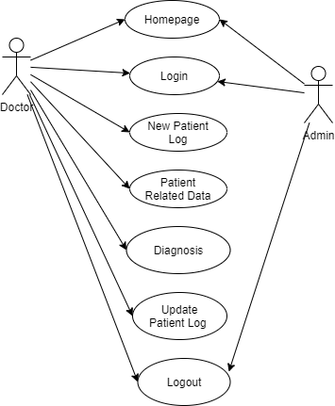
UML DIAGRAMS:

Slide 6
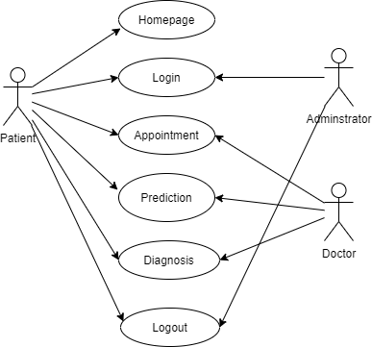

Slide 7
IMPLEMENTATION:
Used Logistic Regression Technique that will predict the probability of being “COVID-19” Positive.
Achieved Efficient Results.

Slide 8
Logistic Regression:
The Logistic Regression(LR) is a regression model in which the response variable (dependent variable) has categorical values such as True/False or 0/1.
Reason for (LR):
Since the output should be of a “Probability” type we have chosen logistic regression instead of linear.

Slide 9
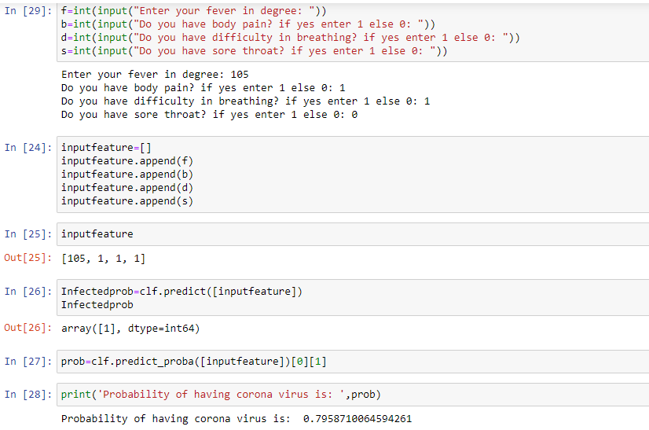
RESULTS:

Slide 10
FUTURE WORK:
Induction of Electronic Health Records(EHR).
Prediction of Covid-19 Using X-ray scans.
Building a Website.

Slide 11
REFERENCES:
[1] Koppar, Anant R, and Venugopalachar Sridhar, “A workﬂow solution for electronic health records to improve healthcare delivery efﬁciency in rural India,” In eHealth, Telemedicine, and Social Medicine, 2009. eTELEMED’09. International Conference on, pp. 227–232, IEEE, 2009.
[2] Bhatia, Gresha, Algenti Lala, Ashish Chaurasia, and Ramandeep Rajpal, “Implementation of Cloud computing technology for the improvement of entire healthcare services in India,” In Advances in Technology and Engineering (ICATE), 2013 International Conference on, pp. 1–5, IEEE, 2013.
[3] Chipara, Octav, Chenyang Lu, Thomas C. Bailey, and Gruia-Catalin Roman, “Reliable clinical monitoring using wireless sensor networks: experiences in a step-down hospital unit,” In Proceedings of the 8th ACM Conference on Embedded Networked Sensor Systems, ACM, pp. 155–168, 2010.
[4] Khambete, N. D, and A. Murray, “National efforts to improve healthcare technology management and medical device safety in India,” Appropriate Healthcare Technologies for Developing Countries, 7th International Conference on, IET, pp. 1–5, 2012.
[5] Hung, K., Y. T. Zhang, and B. Tai, “Wearable medical devices for telehome healthcare,” In Engineering in Medicine and Biology Society, IEMBS’04. 26th Annual International Conference of the IEEE, vol. 2, pp. 5384–5387, 2004.

Slide 12
Stay Safe, Be Happy Thank you.!!

