Slide 1
GridRescue AI
GLOBAL ENERGY HACKATHON 2026 · INNOVATIVE & AFFORDABLE SOLUTIONS
HOW THIS PITCH IS SCORED
The problem, with evidence: hospitals on weak grids keep their theatres alive on diesel, and a hospital that moves cannot take rooftop solar with it.
Impact
25%
THE MARKET · PUBLISHED FIGURES, SOURCE ON EACH
About half
of hospitals in sub-Saharan Africa have reliable electricity
WHO · World Bank · IRENA · SEforALL, Energizing health
≈ 60 % · ≈ 1 %
of the world's best solar resources are in Africa — with about 1 % of installed solar capacity
IEA, Africa Energy Outlook
₦3,277 / L
diesel, up 86 % in a year — national average, not an Enugu pump price
NBS Automotive Gas Oil price watch
Innovation
25%
Sustainability
25%
Most firms in sub-Saharan Africa report power outages (World Bank Enterprise Surveys). Five outage challenges the platform addresses: grid interruptions and load shedding · transmission and distribution failures · severe weather and infrastructure damage · diesel shortages, cost and generator failures · cyber or operational disruptions (planned scenario).
Feasibility
15%
WORKED EXAMPLE · NATIONAL ORTHOPAEDIC HOSPITAL, ENUGU · 350 BEDS (REPORTED)
≈ 6 h
of grid a day — head engineer (reported)
1,550 kW
connected; unstable supply hits equipment (reported)
≈ 5 years
until the move to a new building (brief)
10–30 s
to the generator at every grid drop (reported)
Scalability
10%
BRIEF
12 · Relocatable solar for a hospital on the move
TRACK
Clean Energy Solutions
TEAM
Secure AI Grid · Pavan Manjunath · Thomas Prüfer
Pavan: product, AI and engineering · Thomas: energy systems and the business case
Access · Affordability · Availability “realistic to implement within 6–18 months · adaptable across different global contexts”
Notes:
We are team Secure AI Grid with GridRescue AI, answering Brief 12 in the Clean Energy Solutions track. About half of the hospitals in sub-Saharan Africa have reliable electricity; Africa holds about 60 percent of the world's best solar resources but about 1 percent of installed solar capacity; and diesel in Nigeria costs 3,277 naira a litre, up 86 percent in a year. Most firms in the region report outages. Our worked example is the National Orthopaedic Hospital in Enugu: about six hours of grid a day, 1,550 kilowatts connected, 10 to 30 seconds to the generator at every grid drop, and a move to a new building in about five years, so rooftop solar would be stranded.

Slide 2

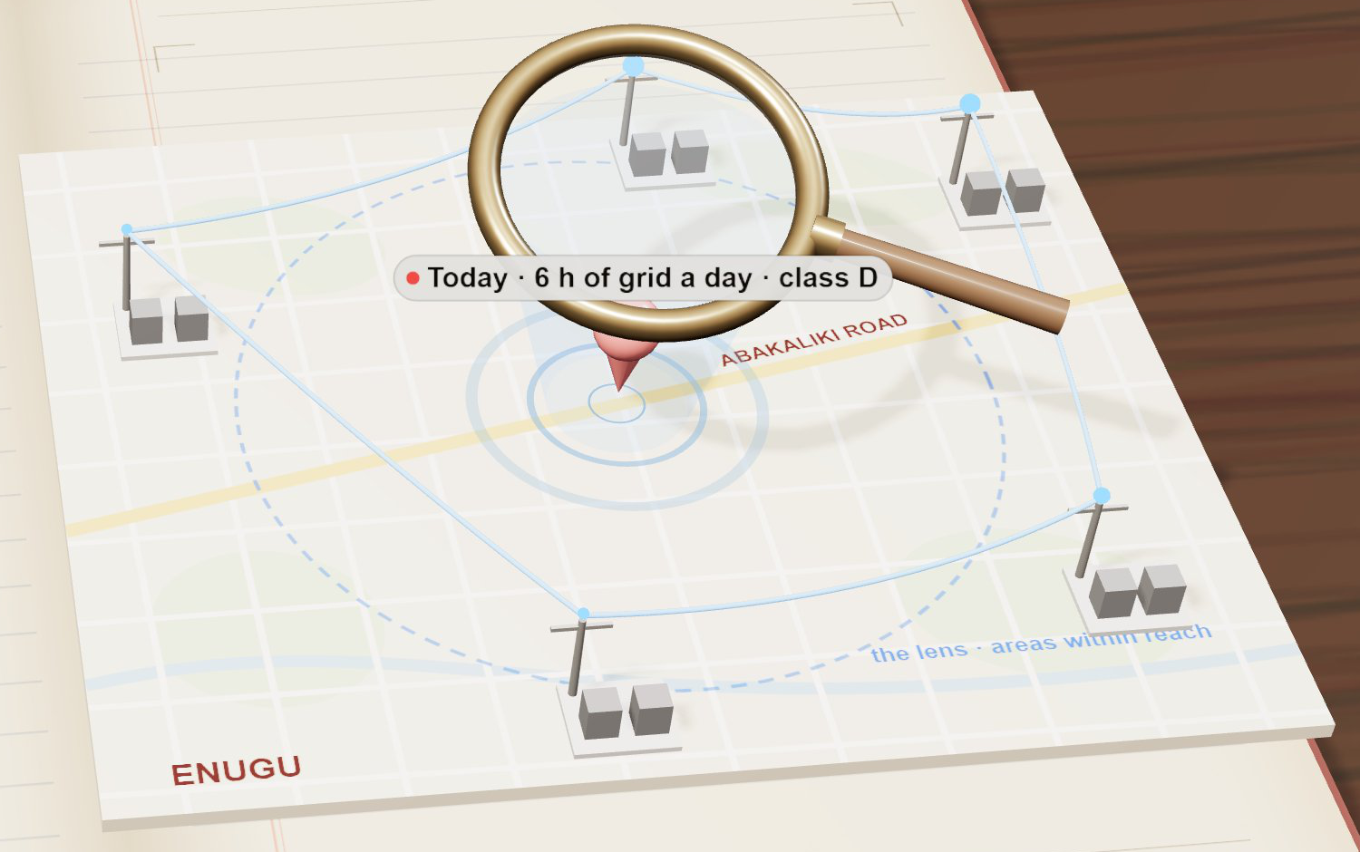
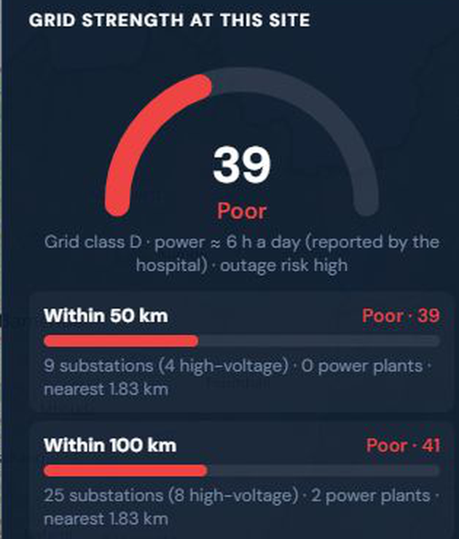



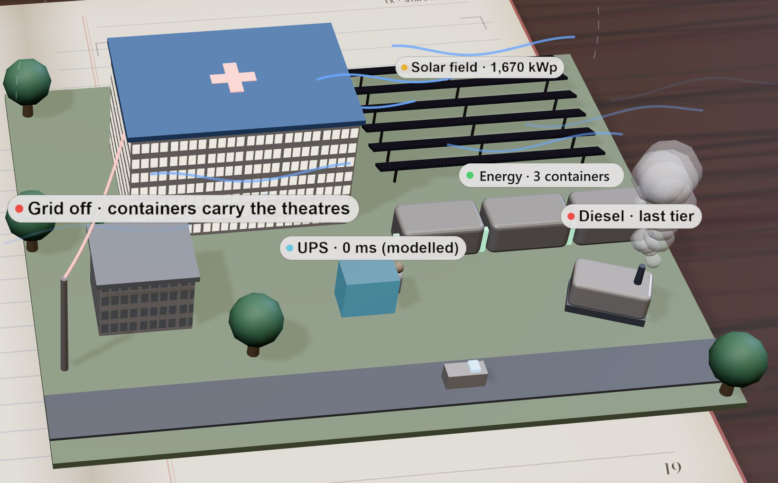

From a map pin to an investment-ready plan
INNOVATION · 25% OF SCORE · WHAT WAS BUILT
ACCESS · AFFORDABILITY · AVAILABILITY
GridRescue AI is vendor-neutral decision-support software: pin a hospital on the map and it reads the site from open data, simulates every outage hour by hour, designs the solar + energy system + UPS + generator stack, prices it, plans the move and writes the ESG report — in minutes, for any pin on the map.
BUILT DURING THE GLOBAL ENERGY HACKATHON 2026 · FOUR MODULES, ONE FLOW
1 · GRID MAPPER + NEW-SITE LENS
Grid strength within 50 and 100 km, supply hours and tariff from open data; the lens ranks new sites within 12 km.
2 · RELOCATION PLAN
The brief's five questions answered: two sites, theatres-first loads, move plan, 5- and 10-year money, funders.
3 · 3D OUTAGE SIMULATION + ML PICK
Hour by hour, four stress tests; Random Forest pick of the energy system (80.4 % agreement), verified by the simulation.
Unique: the grid mapper reads grid strength within 50 and 100 km and the “hospital is moving” lens ranks the new site.
Three layers: online UPS on theatres and ICU, 0 ms (modelled) · solar by day, energy containers by night · generator last.
Three A's: Access: any site in seconds · Affordability: ₦0 upfront, from the diesel budget · Availability: power that moves.
User · who pays: hospital engineering teams; GridRescue AI earns software fees, not the energy fee.
4 · ESG REPORT
Scope 1 and Scope 2, E·S·G lines, carbon value — written only after the simulation verifies the design.
Notes:
GridRescue AI is vendor-neutral decision-support software. Pin a hospital on the map and it reads the site from open data, simulates every outage hour by hour, designs the solar, energy system, UPS and generator stack, prices it, plans the move and writes the ESG report, in minutes. Four modules were built during the Global Energy Hackathon 2026: the grid mapper with the new-site lens, the relocation plan, the 3D outage simulation with four stress tests and a machine-learning pick of the energy system that the simulation verifies, and the ESG report. Three layers protect the theatres: an online UPS, solar by day and energy containers by night, the generator last. GridRescue AI earns software fees, never the energy service fee.

Slide 3

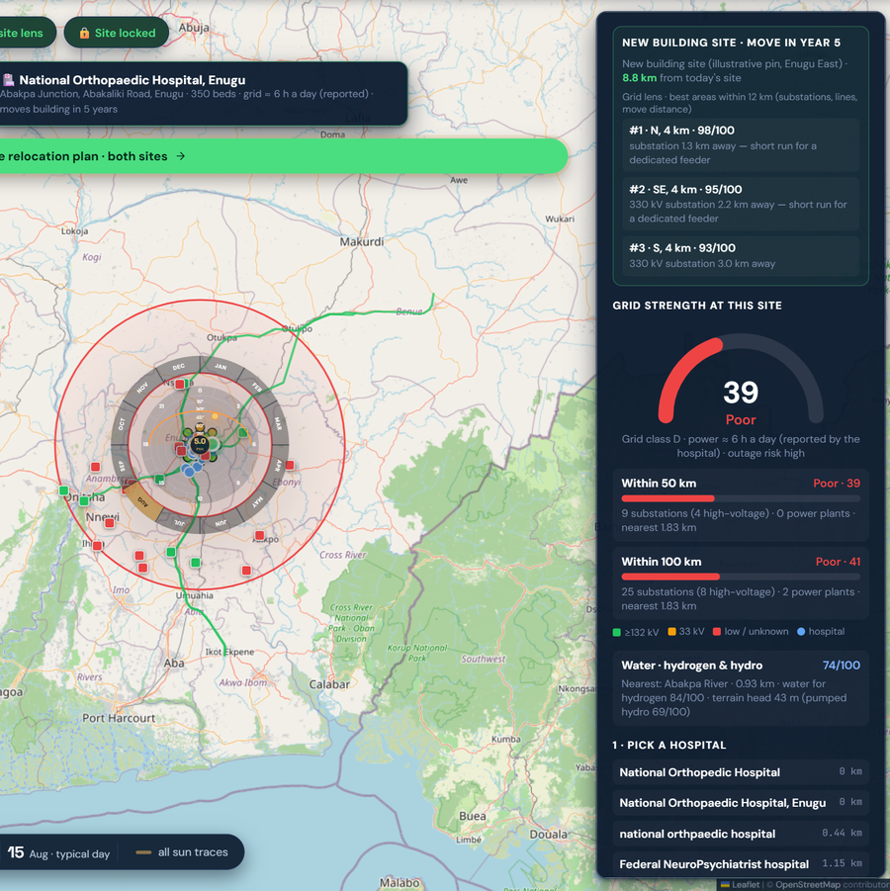
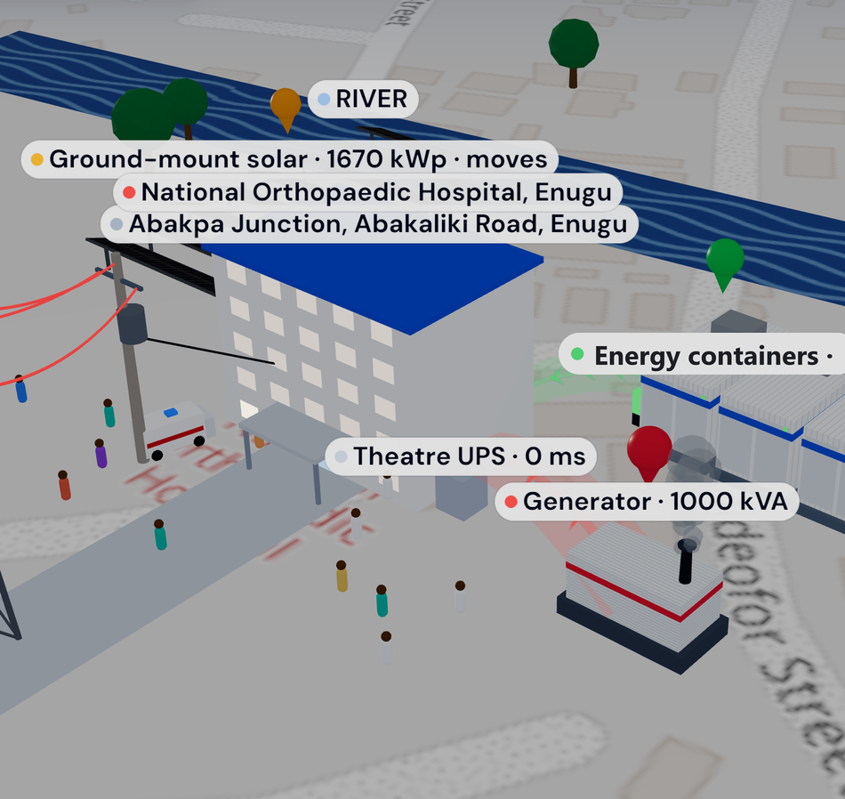
The prototype, running on the worked example
FEASIBILITY · 15% OF SCORE · SHOW, DON'T CLAIM
ACCESS · AFFORDABILITY · AVAILABILITY
PIN DROP → SITE READ → SIMULATION → DESIGN → COST → PAYBACK → REPORT
1
PIN DROP
National Orthopaedic Hospital, Enugu, Abakpa Junction — any pin on the map runs the same flow
INPUT
2
SITE READ
≈ 6 h grid a day (reported) · grid class D “Poor”, 9 substations within 50 km (OpenStreetMap, modelled) · 5.48 peak-sun hours (four open sources) · ₦160/kWh EERC Band A · diesel ₦3,277/L (published)
REPORTED · PUBLISHED
3
OUTAGE SIMULATION
Hour by hour in 3D: 4 of 4 stress tests pass (12 h evening outage, 24 h grid collapse, worst solar month, 18 h); 100 % of the critical load in the modelled outages; any outage up to 24 h survived
MODELLED
4
RECOMMENDED DESIGN
1,670 kWp ground-mounted solar · 5,020 kWh containerised energy system (8.7 h) · 500 kVA online UPS, 0 ms (modelled) · existing 1,000 kVA generator last · ML pick 76 %, verified by the simulation
MODELLED
Grid mapper: strength 39 / Poor; the new-site lens ranks areas for the move
3D scene: solar that moves, containers, theatre UPS, generator last
5
COST
Capex ₦3.85 bn bought outright; as a service ₦69.1 M a month, ₦0 upfront, against ₦299.2 M a month of modelled diesel for the protected load
MODELLED
BUILT DURING THE GLOBAL ENERGY HACKATHON 2026
Measured or published inputs: the hospital's reported supply hours, the NBS diesel price, the EERC tariff, four open sun sources, OpenStreetMap grid data. Modelled outputs: everything the engine computes — ±30 %, to be confirmed with the hospital's load data.
6
PAYBACK
Bought outright: diesel savings repay the system and the move in 1.6 years. 10 years, all energy costs of the protected load: ₦37.6 bn → ₦15.9 bn
MODELLED
7
REPORT
ESG: 2,246 t CO₂ a year avoided, net (Scope 1 − Scope 2) · move plan: lens area #1, 4 km north, about three weeks, ₦678 M, 88 % of the investment reused
MODELLED
Judges look for: a working prototype, shown not claimed — every input above is labelled reported or published, every output modelled (engine results, ±30 %, to be confirmed with the hospital's load data).
Notes:
Here is the prototype on the worked example. We drop a pin on the hospital in Enugu. The site read returns about six hours of grid a day, a poor grid class with nine substations within 50 kilometres, 5.48 peak-sun hours, the published tariff and diesel price. The hour-by-hour simulation passes four of four stress tests and keeps 100 percent of the critical load in the modelled outages. The design: 1,670 kilowatts of ground-mounted solar, a 5,020 kilowatt-hour containerised energy system, a 500 kVA online UPS and the existing generator last; the machine-learning pick of the energy system, at 76 percent, is verified by the simulation. Inputs are reported or published; outputs are modelled, plus or minus 30 percent.

Slide 4

Theatres on in every modelled outage
IMPACT · 25% + SUSTAINABILITY · 25% OF SCORE
ACCESS · AFFORDABILITY · AVAILABILITY
KPI (engine result, modelled) | Today (diesel) | With the system | What changed
Theatre-hours a year without grid (4 suites, 12,480 a year) | 4,992 (40 %) | 0 | Theatres on in every modelled outage
Generator switchovers reaching equipment, a year | ≈ 1,460 | 0 (online UPS; 0 ms, modelled) | No 10–30 s gap mid-surgery
Diesel for the protected load, a year | ≈ 1,042,790 L | ≈ 176,000 L | 866,678 L avoided (83 %)
Operating cost of the protected load, a month | ₦299.2 M modelled diesel | ₦69.1 M service fee, ₦0 upfront | Saves whenever real diesel > ₦117.9 M
CO₂ a year (2.68 kg per litre, IPCC default) | 2,323 t Scope 1 (diesel) | 77 t Scope 2 grid charging | 2,246 t avoided, net
WHO FUNDS THE HARDWARE
Rural Electrification Agency public-sector solarisation programme (1.5 MW solar hybrid at the National Orthopaedic Hospital, Dala, Kano) · EU and Enugu State ₦4.3 bn Solar for Health programme (25 facilities) · development-bank financing for health-facility electrification · ESCOs with concessional debt: the ESCO owns, maintains and moves the kit; the hospital pays a service fee from its diesel budget.
THREE MONEY STORIES, NEVER MIXED
(a) the hospital's savings: diesel avoided minus service costs (year one ₦3,764.5 M → ₦1,588.9 M of energy costs, engine); simple payback applies only when the hospital buys outright. (b) the ESCO's project cash flow: fee, capex, O&M, relocation clause, concessional debt — the ₦69.1 M a month is this story, not our revenue. (c) GridRescue AI's software revenue minus operating costs. All figures are engine results, ±30 %, to be confirmed with the hospital's load data; the real diesel bill is partner data still owed.
1.6 years
Bought outright: diesel savings repay the system and the move (modelled)
₦21.8 bn saved
10 years, all energy costs of the protected load: ₦37.6 bn → ₦15.9 bn (modelled)
88 % reused
of the investment after the move: 4 km north, about three weeks, ₦678 M (modelled)
Judges look for: a large, quantified benefit on the brief's own metric, a solution that pays for itself and lowers environmental impact — every figure here is an engine result (modelled, ±30 %) for the worked example, with the funders named.
Notes:
These are engine results, plus or minus 30 percent, to be confirmed with the hospital's load data. Theatre-hours without grid fall from 4,992 a year to zero. Generator switchovers reaching equipment fall from about 1,460 to zero. Diesel drops from about 1,042,790 litres to about 176,000, 83 percent avoided. Monthly cost moves from 299.2 million naira of modelled diesel to a 69.1 million naira service fee. CO2 avoided is 2,246 tonnes a year, net. Bought outright, diesel savings repay the system and the move in 1.6 years. Over ten years, counting all energy costs, 21.8 billion naira is saved, and 88 percent of the investment is reused after the move.

Slide 5

Why fund this software company
SCALABILITY · 10% OF SCORE · BUSINESS MODEL AND ASK
ACCESS · AFFORDABILITY · AVAILABILITY
CUSTOMER SEGMENTS
Hospitals and clinics on weak grids (first: federal and teaching hospitals, Nigeria) · Healthcare networks and health programmes · ESCOs, energy-system integrators, hospital energy contractors · Utilities (feeder planning) · Later: data centres, water, telecom, industrial and agricultural sites.
VALUE PROPOSITION
One workflow from a map pin to an investment-ready plan: site read from open data → hour-by-hour outage simulation → vendor-neutral solar + energy system + generator design → cost, payback and ESG report · Transparent assumptions, no hardware sales.
REVENUE STREAMS
Paid site assessment (US$ 2,000 per site, proposed) · Annual software licence (US$ 3,000 per site, proposed) · Enterprise multi-site and utility licences · Integration / white-label fees · Later: performance-based fee after verified savings.
THE ASK · US$ 150,000 SEED IN TWO TRANCHES
Use of funds (US$): Software engineering and productionisation 70,000 · Energy engineering and model validation 20,000 · Hospital pilot integration and field validation 15,000 · Security, testing and hardening 12,000 · Customer acquisition and partner onboarding 10,000 · Contingency 10,000 · Cloud hosting, weather and geospatial data 8,000 · Legal, contracts and IP 5,000 · Total 150,000
Tranche 2 (US$ 75,000) after the engine passes agreed validation tests against hospital data and a pilot partner is secured. Software only; hospital hardware is project-financed separately.
Roadmap 6–18 months: 0–3 validate the engine on the hospital's load audit and generator logs, security hardening · 3–9 two paid pilots (Enugu first) by month 9, with an ESCO and the local distribution company · 9–12 commercial release, 10 paying sites by month 12 · 12–18 utilities and other critical facilities, further outage scenarios (weather groups, cyber/operational contingencies), new countries by adding a tariff table — any pin on the map works.
WHY PAY WHEN REOPT IS FREE
REopt (NREL, free): sizes PV, energy systems and a generator so a site survives a specified outage; built for energy experts.
HOMER Pro (UL Solutions, commercial): annual microgrid simulation and least-cost design; priced for consultants.
HOMER Powering Health Tool (World Bank/ESMAP, free): a sizing and cost tool, not an outage-by-outage simulation.
Odyssey Energy Solutions: project planning, financing, procurement and monitoring for developers.
MapYourGrid / OpenStreetMap: our data partner, not a competitor.
WHAT NONE OF THEM DOES IN ONE FLOW — GRIDRESCUE AI DOES TODAY
1 From a map pin to an investment-ready hospital plan in minutes, on open data, with no API keys and no expert.
2 The grid mapper with the “hospital is moving” new-site lens: substations and lines within 50 and 100 km, published supply hours, areas ranked for the new building — then a relocation plan with a move cost and a reuse percentage.
3 Every energy-system option simulated hour by hour on the site's own sun, grid hours and load, four stress tests, with a vendor-neutral ML classification of the energy system that the simulation verifies.
4 Local market assumptions built in: the NBS diesel price, the state tariff, Nigerian funders and programmes.
5 The ESG report (Scope 1 and Scope 2, E·S·G lines) and the before → after KPIs written before anything is bought.
GridRescue AI turns energy planning into investment-ready decisions. We start with hospitals, where power is life, and grow to every critical facility. Map the grid. Keep the theatres on. Move with the hospital.
Notes:
GridRescue AI is a software company. Customers are hospitals on weak grids first, then health networks, ESCOs, integrators and utilities. Revenue is software: a 2,000-dollar site assessment, a 3,000-dollar annual licence per site, enterprise and integration licences, all proposed prices. REopt, HOMER and Odyssey are good tools; none runs the hospital workflow in one flow. We ask for 150,000 dollars of seed in two tranches, for software only: two paid pilots by month nine, ten paying sites by month twelve. GridRescue AI turns energy planning into investment-ready decisions. We start with hospitals, where power is life, and grow to every critical facility. Map the grid. Keep the theatres on. Move with the hospital.

