Slide 1
Code Rec
Guided by
Mr. Mayank Saxena
Submitted By:
Kshitiz Kumar Singh (201500357)
Mohit Varshney (201500409)
Pavan Gupta (201500467)
Utkarsh Srivastav (201500762)

Slide 2
Abstract
CodeRec is a web application that enables users to compare their coding skills and achievements with other programmers from GitHub, LeetCode, and CodeChef. By entering the usernames or profile URLs of the users they want to compare, CodeRec fetches the user data from each platform and displays it in charts and graphs for easy comparison. CodeRec uses React for the frontend, Node.js and Express for the backend, GitHub API for data retrieval, and Chart.js for data visualization.

Slide 3
The motivation for this project was to provide a tool for programmers to benchmark their coding abilities and learn from others. The main challenge was to handle the different APIs and data formats of each platform. The future plans for this project include adding more features like filtering, sorting, and sharing the comparison results.

Slide 4
Scope of the project
To provide a user-friendly interface for users to enter the usernames or profile URLs of the users they want to compare.
To fetch the user data from GitHub, LeetCode, and CodeChef using their respective APIs.

Slide 5
To display the user data in charts and graphs for easy comparison using Chart.js.
To add more features like filtering, sorting, and sharing the comparison results.

Slide 6
Existing System
The user needs to go to the website separately and have to enter the profile username but there is no way to compare two or more profiles. It is a time consuming job.
Disadvantage:
Time consuming job.
No way to compare two or more profiles on the same platform.

Slide 7
Proposed System
CodeRec is a web application that aims to fill this
gap by enabling users to compare their coding
skills and achievements with other programmers
from GitHub, LeetCode, and CodeChef. By
entering the usernames or profile URLs of the
users they want to compare, CodeRec fetches the
user data from each platform and displays it in
charts and graphs for easy comparison. CodeRec
uses React for the frontend, Node.js and Express
for the backend, GitHub API for data retrieval,
and Chart.js for data visualization.

Slide 8
SOFTWARE AND HARDWARE REQUIREMENTS
HTML5
CSS3
JavaScript
React
Node.js
Express.js
GitHub API

Slide 9
Feasibility Study
Technical feasibility:
HTML, CSS, JavaScript allows software development using the language to function on any windows operating system, so the software will run on all windows.
Economic feasibility:
All software necessary for creation of the program is available freely to me at no extra cost. Graphics can be obtained for free from a variety of sources, including the internet, outsourcing and self- creation, and need extra hardware is required for the software to perform. No budget is available or required, so the project is economically feasible
Operational feasibility:
The expertise for the project can be obtained through the course of the project, the resources for the project are obtainable with effort. In the maintenance will need to be performed as the use will have been fulfilled

Slide 10
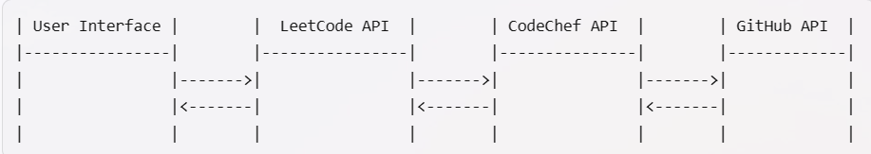
System Architecture
The user interface communicates with three
different APIs (application programming interfaces)
that provide access to the data of each platform. The
APIs are the components that handle the requests
from the user interface and return the responses
with the profile information. The APIs also interact
with the databases of each platform to retrieve the
data.

Slide 11
Modules
Enter the username
Comparison of Profiles
Conclusion of Profiles

Slide 12
Entering the username
The entering the usernames part is the first step of the
project that allows the user to specify the user they want
to compare. The user interface provides a text box
where the user can type or paste a username. The user
interface also provides a button to submit the username
and proceed to the next step. The user interface
validates the username and checks if it exists on all three
platforms. If the username is valid and exists, the user
interface sends a request to each API with the username
as a parameter. If the username is invalid or does not
exist, the user interface displays an error message and
asks the user to enter a different username.

Slide 13
Comparison of Profiles
The comparison of profiles part is the second step
of the project that allows the user to see and
compare the profiles of the user they entered on
each platform. The user interface receives the
responses from each API with the profile data
and displays them on a single page. The user
interface also provides some metrics and
visualizations to compare the profiles and
highlight the strengths and weaknesses of each
user.

Slide 14
The metrics and visualizations include:
The number of problems solved, contests participated, and stars earned on each platform.
The distribution of problems by difficulty level, language, and topic on each platform.
The ranking, rating, and badges of the user on each platform.
The number of repositories, commits, and followers on GitHub.
The similarity score between the profiles based on their coding skills and interests.

Slide 15
The user interface allows the user to switch
between different views and filters to explore
the profiles in more detail. The user interface
also provides some recommendations and
feedback to the user based on their comparison
results. For example, the user interface may
suggest the user to try some new problems or
languages on a platform where they are less
active or proficient, or to follow some users or
projects on GitHub that match their interests or
goals.

Slide 16
Conclusion of Profiles
The conclusions of profiles part is the final step
of the project that allows the user to review and
reflect on their comparison results and
recommendations. The user interface summarizes
the main findings and insights from the
comparison of profiles and provides some
actionable suggestions and tips to the user. The
user interface also allows the user to share their
comparison results and feedback with others via
social media or email.

Slide 17
The summary and suggestions include:
The overall strengths and weaknesses of the user on each platform and across platforms.
The areas where the user can improve their coding skills, achievements, and contributions.
The opportunities and challenges that the user may face on each platform and in the coding community.
The resources and tools that the user can use to learn new skills, solve new problems, or join new projects.
The goals and plans that the user can set for themselves to track their progress and performance.

Slide 18
The user interface encourages the user to take action
on their suggestions and tips and to revisit their
comparison results periodically to monitor their
improvement. The user interface also invites the user
to provide feedback on the project and to rate their
experience and satisfaction.

Slide 19
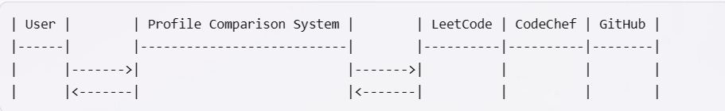
Data Flow Diagram Level 0
The level 0 DFD shows the user as the external
entity that interacts with the profile comparison
system. The user provides a username as an input
and receives the comparison results as an output.
The profile comparison system is the single
process node that represents the functions of the
entire system. The profile comparison system
interacts with three other external entities:
LeetCode, CodeChef, and GitHub.

Slide 20
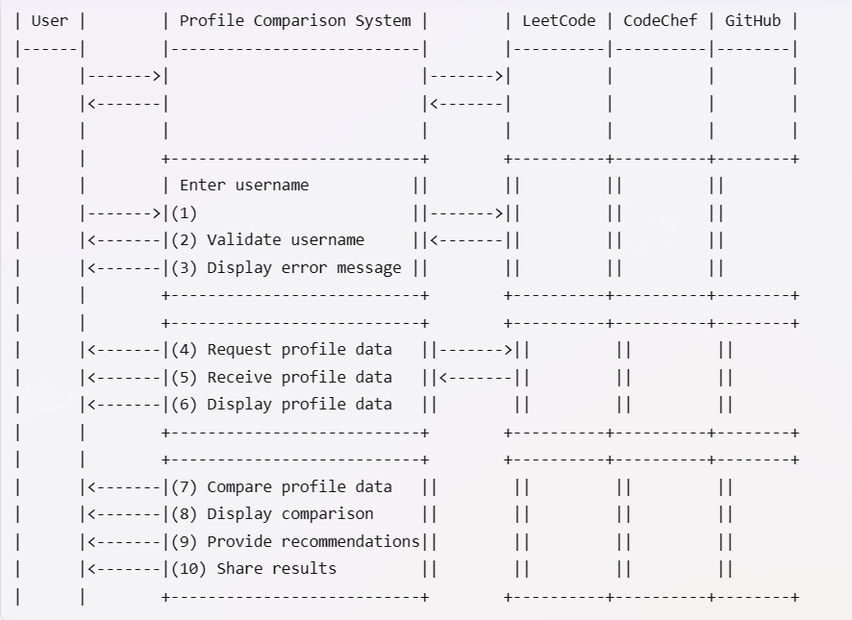
Data Flow Diagram Level 1

Slide 21
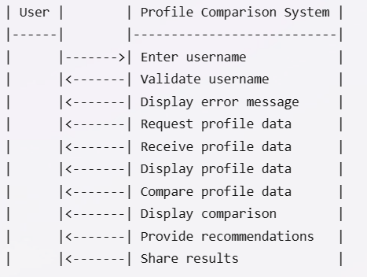
Use Case Diagram

Slide 22
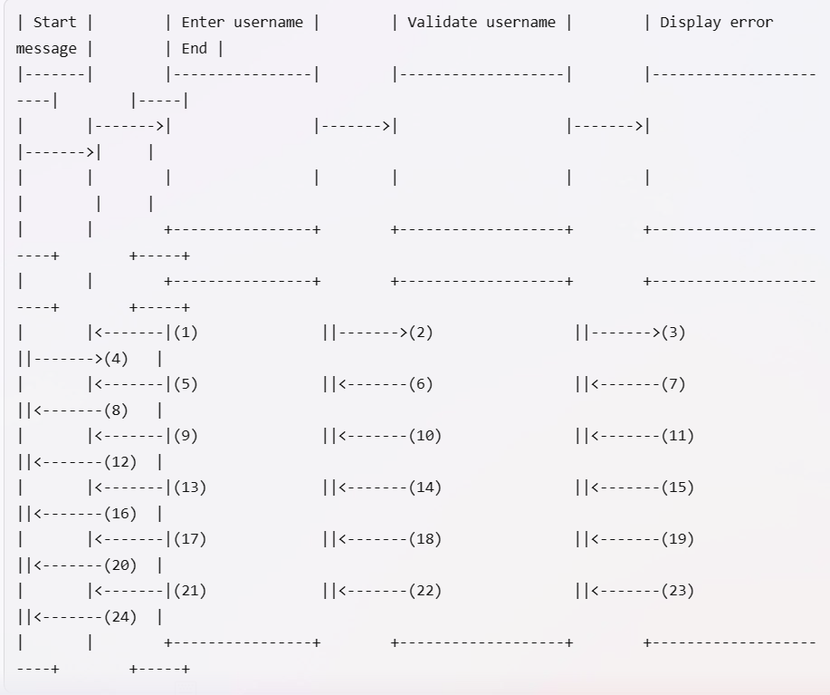
User Activity Diagram

Slide 23
The activity diagram shows that after entering a
username, the system validates it by checking if it
exists on all three platforms (LeetCode, CodeChef,
and GitHub). If yes, then the system proceeds to
request profile data from each platform. If no, then
the system displays an error message and asks the
user to enter a different username. The activity
diagram does not show the details of how the
profile data is requested, received, displayed,
compared, or shared. This is a simple and high
level activity diagram that shows the main
activities and transitions of the user activity. You
may need to add more details and refine the
diagram according to your specific requirements
and design choices.

Slide 24
Conclusion
The conclusion part is the final step of the project
that summarizes the main findings and insights
from the comparison of profiles and provides
some actionable suggestions and tips to the user.
The user interface displays a brief overview of
the strengths and weaknesses of the user on each
platform and across platforms. It also highlights
the areas where the user can improve their coding
skills, achievements, and contributions. It also
suggests some resources and tools that the user
can use to learn new skills, solve new problems,
or join new projects.

Slide 25
The user interface also allows the user to set some
goals and plans for themselves to track their progress
and performance. The user interface encourages the
user to take action on their suggestions and tips and
to revisit their comparison results periodically to
monitor their improvement. The user interface also
invites the user to provide feedback on the project
and to rate their experience and satisfaction.

Slide 26
Libraries and Modules
React: a JavaScript library for building user interfaces
HTML: a markup language for creating web pages
CSS: a style sheet language for designing web pages
JavaScript: a scripting language for adding interactivity to web pages

Slide 27
Node.js: a JavaScript runtime environment for executing JavaScript code outside the browser
Express: a web framework for Node.js
GitHub API: an application programming interface for accessing GitHub data
Chart.js: a JavaScript library for creating charts and graphs

Slide 28
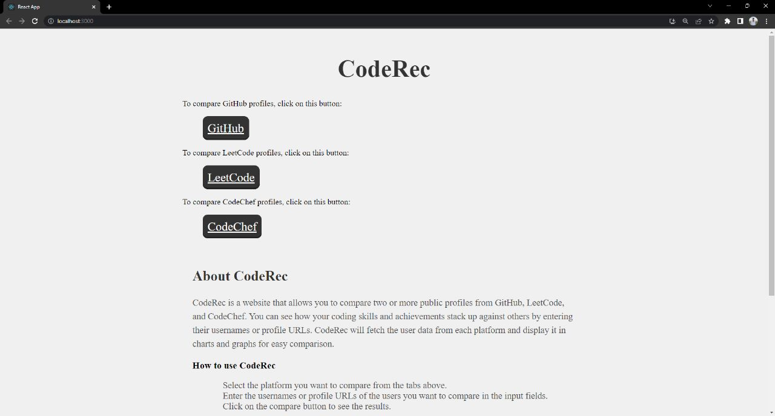
Screenshots

Slide 29
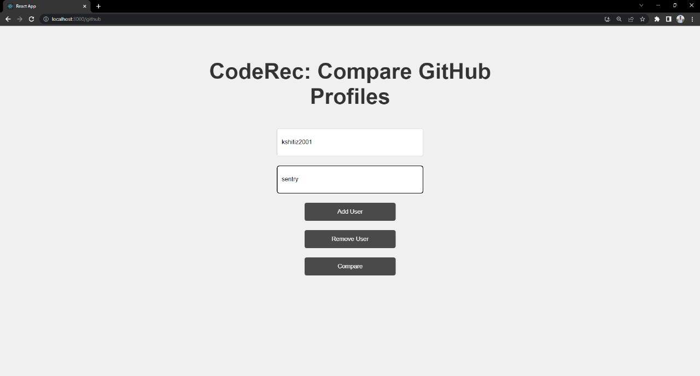

Slide 30
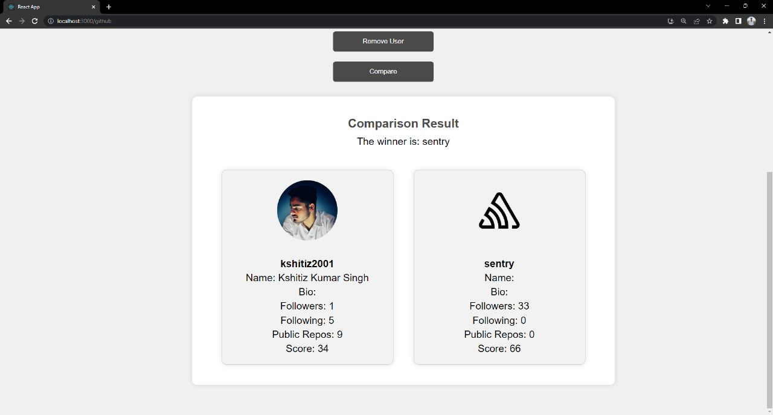

Slide 31
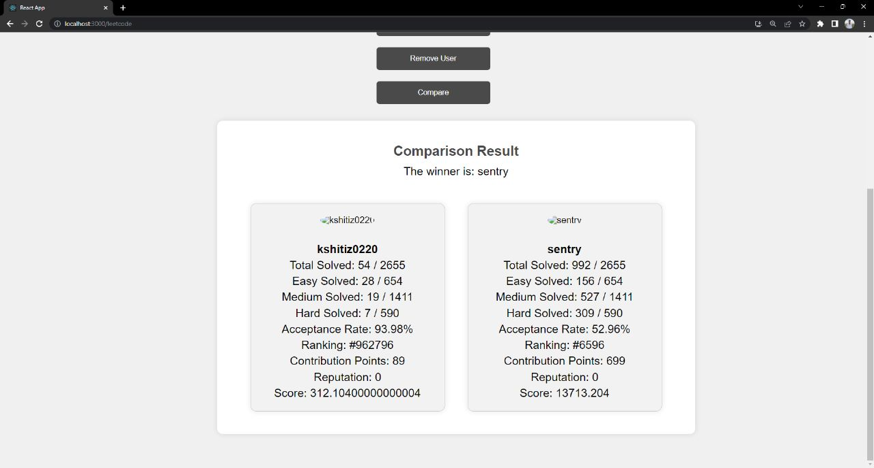

Slide 32
References
Websites:
Scribbr. (n.d.). How to cite a website in APA style | Format & examples. https://www.scribbr.com/apa-examples/website/
Visual Paradigm. (n.d.). What is sequence diagram? https://www.visual-paradigm.com/guide/uml-unified-modeling-language/what-is-sequence-diagram/

Slide 33
Faculty Guidelines:
Mr. Mayank Saxena
(Technical Trainer in GLA University)
GitHub Repository link:
https://github.com/pavangupta352/CodeRec

