Slide 1
Graphing & Spreadsheets
Pavan R Hebbar CCIS 2-108 hebbar@ualberta.ca

Slide 2


Who am I?

Slide 3
Admin stuff
Bear with me, I have to do this
UGL staff: Kyle Foster, William Morrish, Prof. Al Meldrum
physugl@ualberta.ca
Access course content, submit assignments & grading via Canvas
Lab reports due 48 hrs after the end of lab session
Upload ***ONE***, computer generated PDF file (< 4 pages)
Late assignments w/o prior approval shall be graded ZERO

Slide 4
Admin stuff
Bear with me, I have to do this
Attendance is mandatory: Sign-in and Sign-out
If you are more than 15 min late, your attendance will not be recorded.
If you sign out early, you only get to ask 2 questions through e-mail.
Excused absences: Apply for redo lab within 48 hrs of the missed lab. Email me, too.
Email me, or use anonymous forum to ask questions.

Slide 5
Admin stuff
Bear with me, I have to do this
DO NOT plagiarize
You can refer online resources, but use your own words
Submit reports individually
Grade disputes: Contact me within 5 days.
If we cannot resolve, contact PhysUGL. Re-assesments are holistic

Slide 6
Lab 1: Goals
How to use Spreadsheets (for future labs)
Google sheets/MS Excel
Linear fitting
LINEST
How to represent data:
Significant figures & Error propagation
Tabulating the data and plotting graphs

Slide 7
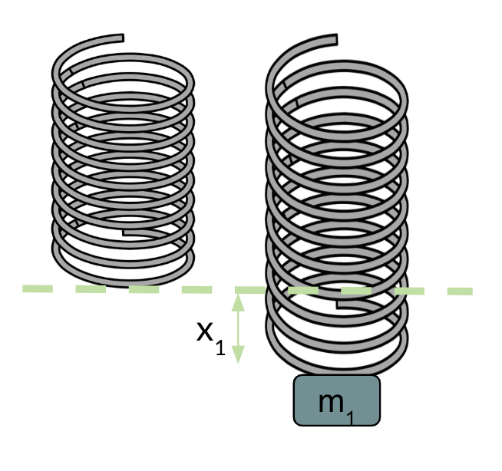

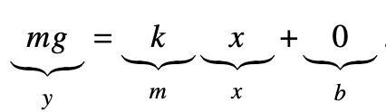
Linear Data set
Credits: Katryna Fast

Slide 8
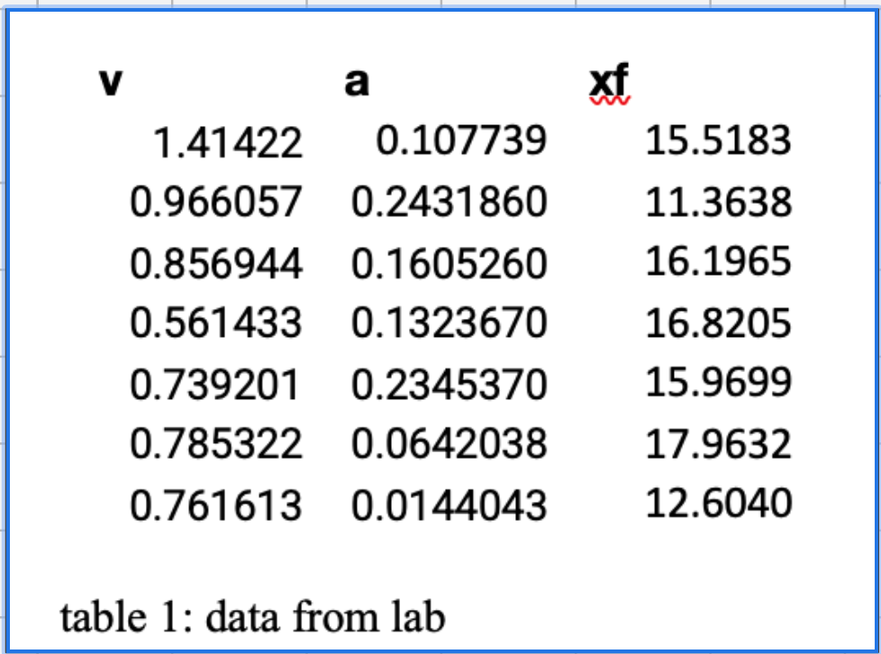
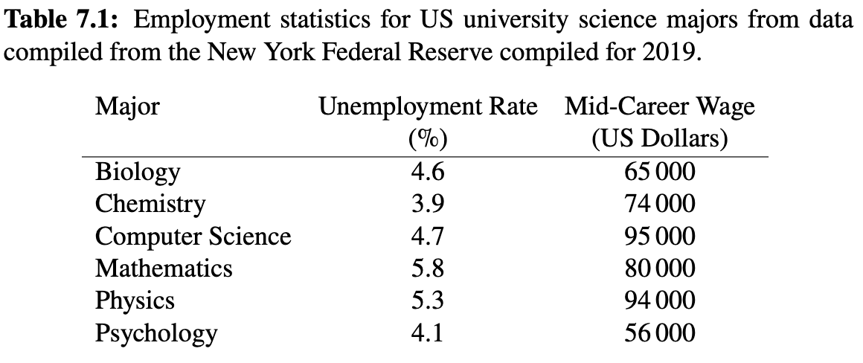
Step 1: Collecting & representing data
Get data (mass vs. spring extension) from Canvas Module “Experimental data”
Title/Caption explaining
the source
Column headers with units & uncertainities
Well formatted data: Aligned & proper number of significant digits

Slide 9
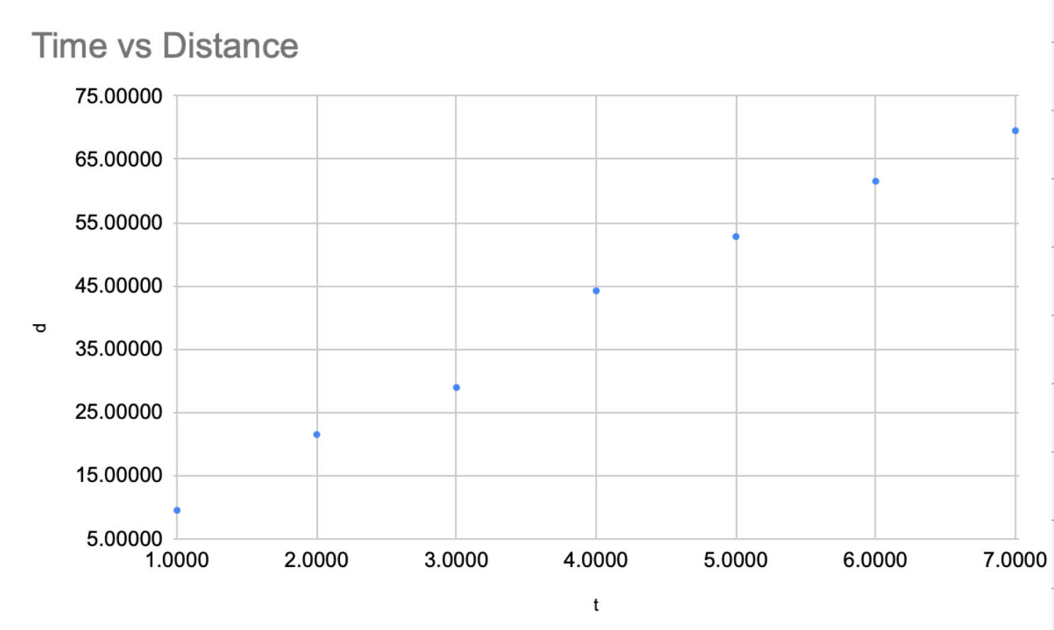
Step 2: Plotting data
What is missing?
Credits: Rohit Vedhthaanth Sekar

Slide 10
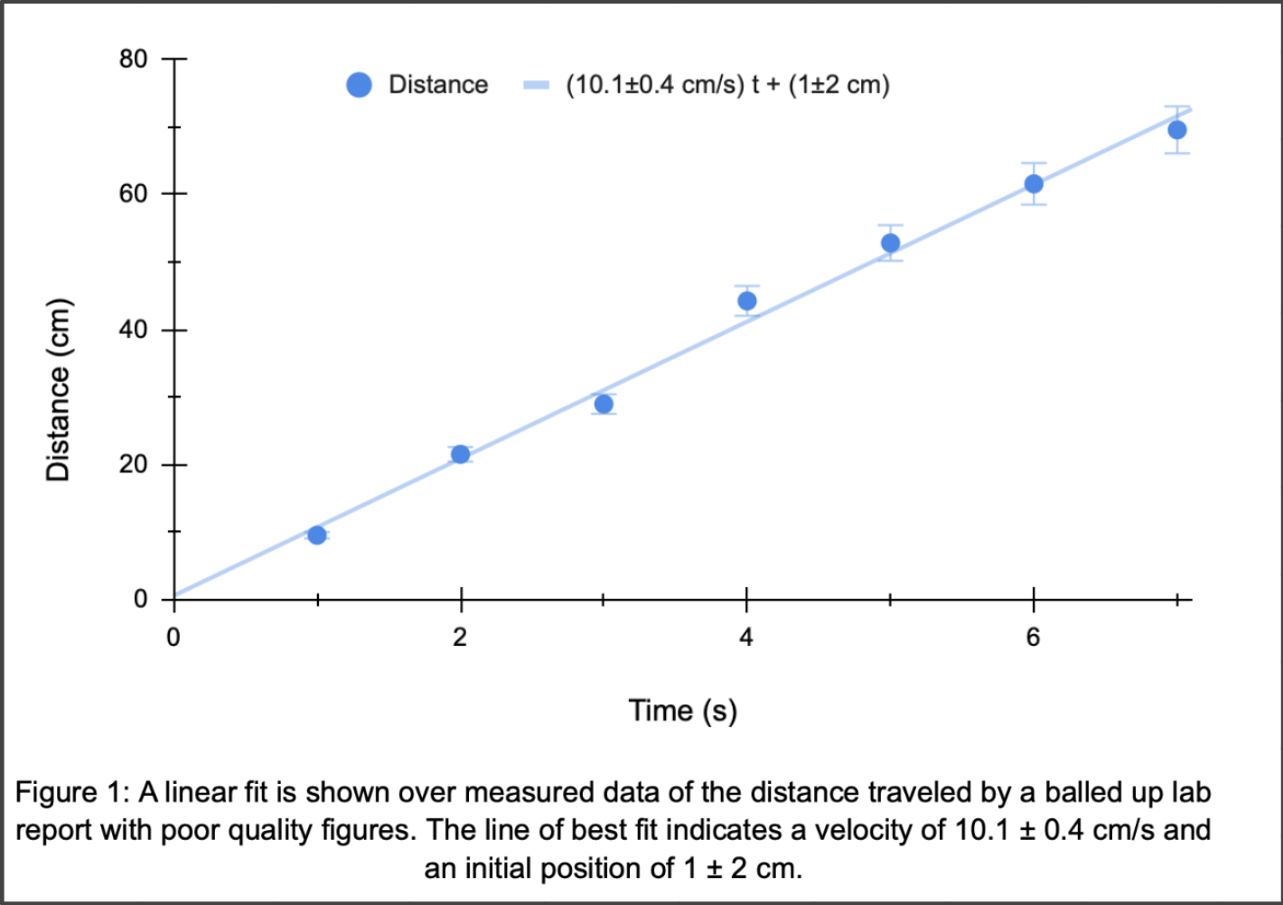
Step 2: Plotting data
Caption
Optimize axis limits so that all data is on graph while reducing white space
Axis labels with units
Linear trendline
Credits: Rohit Vedhthaanth Sekar

Slide 11
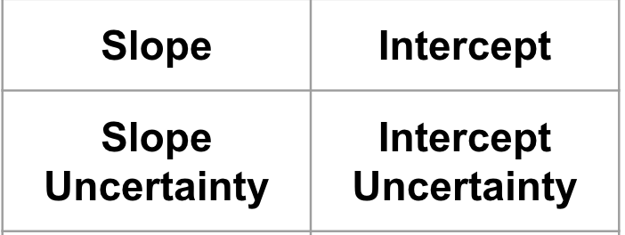
Step 2: Fitting the data
LINEST (Y_data, X_data, True, True)
For this lab, focus on the first two rows and columns

Slide 12
Significant digits and error-propagation
Everything other than leading zeros is a significant digit
Round uncertainty to 1 significant digit
Round the value to the same number of decimal places
E.g. 36042.149 ± 423.681 N 36.0 ± 0.4 kN or (3.60 ± 0.04) × 10⁴ N
Check 5.3 of lab manual for error propagation rules

Slide 13
Are your results consistent?
If you measure a quantity y’ and the expected value is y₀, and you expect an error of ∆y,
Check z = |y’ – y₀|/ ∆y
z < 1: Good agreement
1< z < 2: Moderate agreement 2 < z < 3: poor agreement
z > 3: No agreement
Refer section 3.3.5 of lab manual for details

Slide 14
Let the lab begin!
Check the lab manual
Show me the table and the diagram before you leave

