Slide 1
BANKING SYSTEM
K. Pavani [N190061]

Slide 2
Table of contents
Abstract
Introduction
Related Works/Existing Works
Proposed Method
Experimental Setup
Conclusions
Future Scope
References

Slide 3
ABSTRACT
The Java application presented is a Banking System implemented using Swing for graphical user interface (GUI). It allows users to perform essential banking operations such as creating accounts, logging in securely with password validation, conducting deposits and withdrawals with transaction management using locks for synchronization, and retrieving account balances and transaction histories. The system employs DAO (Data Access Object) design pattern for interacting with persistent storage, ensuring data integrity and security. With its intuitive interface and robust functionality, the Banking System provides a reliable platform for managing financial transactions effectively.

Slide 4
INTRODUCTION
Motivation for the work :
The motivation behind developing this Banking System lies in providing users with a secure and intuitive platform for managing their financial transactions. By incorporating robust features such as account creation, login authentication, transaction handling with synchronized operations, and comprehensive account management, the system aims to enhance user experience while ensuring data integrity and security. This project addresses the practical need for efficient and reliable banking software suitable for both personal and small-scale business use.

Slide 5
INTRODUCTION
Real-world Applications :
Secure Account Management
Transaction Handling
Transaction History and Balance Inquiry
Data Access Object (DAO) Pattern
User Interface (UI) Design
Error Handling and Validation
Account Deletion

Slide 6
Related works/ Existing works
Few Related works and their limitations :
Traditional Banking Systems
Online Banking Systems
Mobile Banking Apps
Limitations:
Limited accessibility
Vulnerability to cyber attacks
Device compatibility issues

Slide 7
PROPOSED METHOD
Accessibility:
Provides offline accessibility through a platform-independent desktop application.
Cybersecurity:
Implements basic security measures like password validation and synchronized transaction handling.
Device Compatibility:
Ensures compatibility across different desktop platforms with Java Swing.

Slide 8
Experimental Setup
I. Technologies/ Libraries used :
Java Swing:
Java's standard GUI toolkit for creating interactive user interfaces.
Concurrency Utilities:
Provides mechanisms for synchronized access to shared resources.
DAO Pattern (Data Access Object):
Separates data access logic from business logic.
Java Collections:
Provides data structures and algorithms for managing collections of objects.
Nimbus Look and Feel:
Provides a modern appearance for Swing applications.

Slide 9
Experimental Setup
II. Datasets:
Account details and transaction records for banking operations.
III. System hardware:
Minimum 2GB RAM, modern multi-core processor, and sufficient SSD storage for optimal performance.

Slide 10
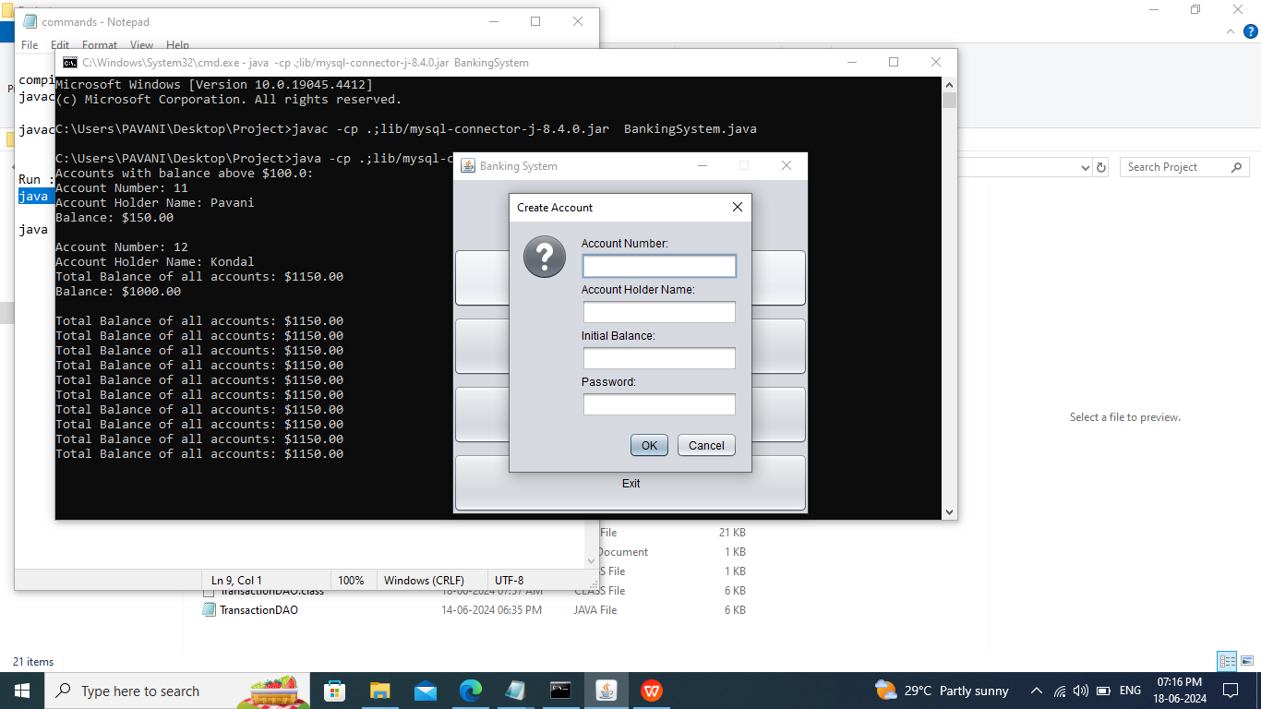
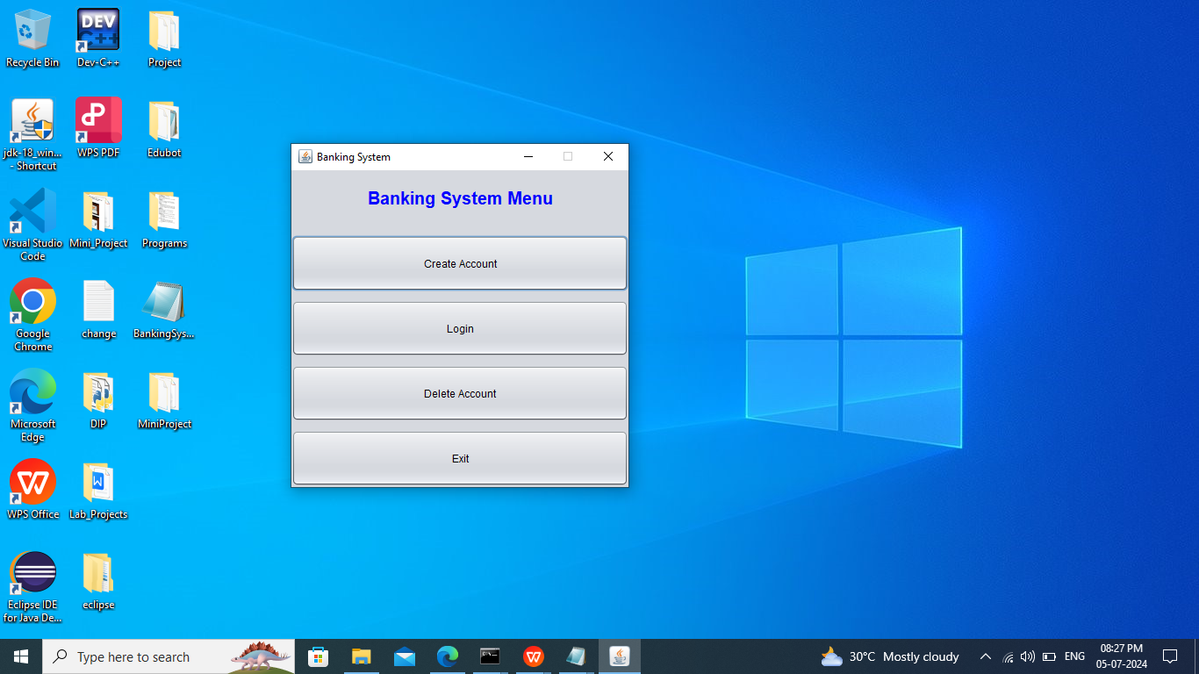
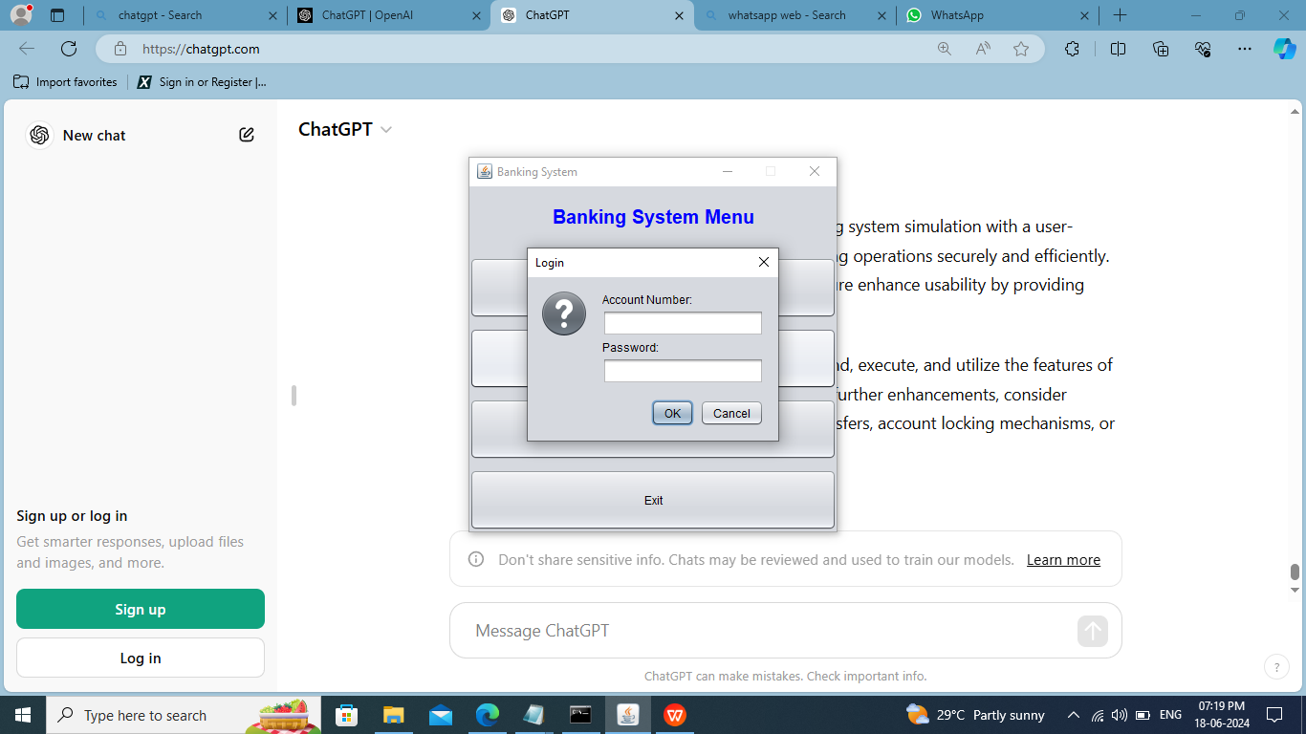
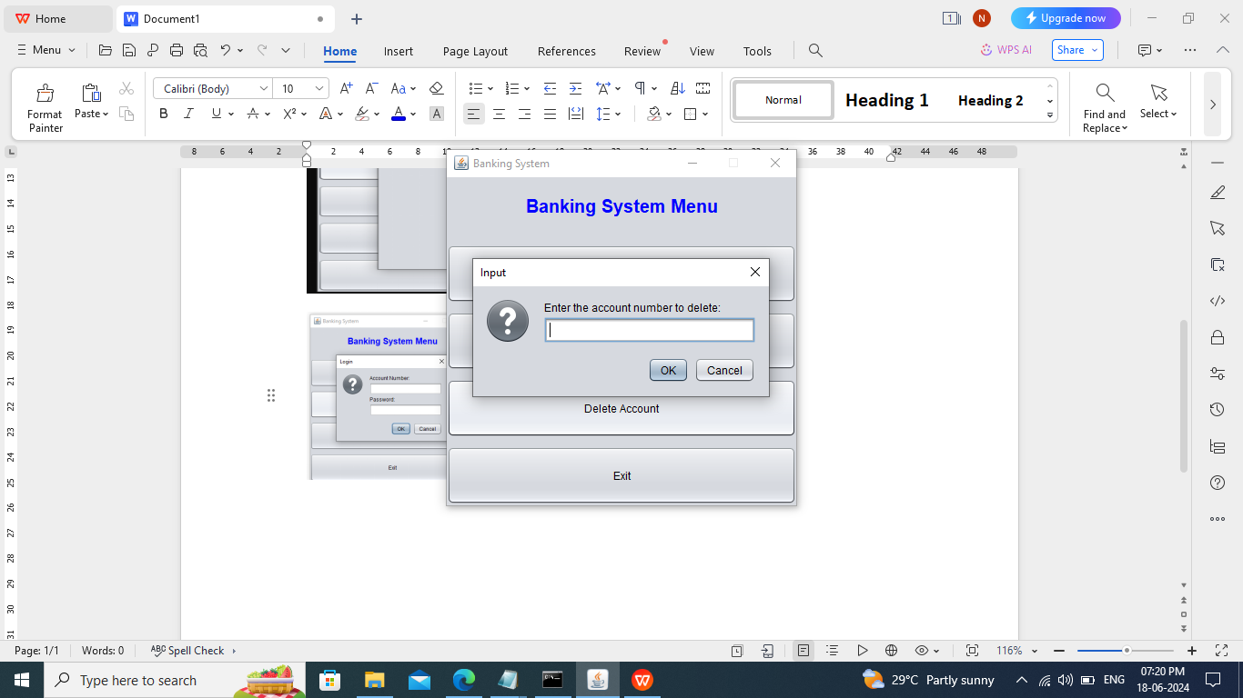
Experimental Setup
IV. Results screenshots :

Slide 11
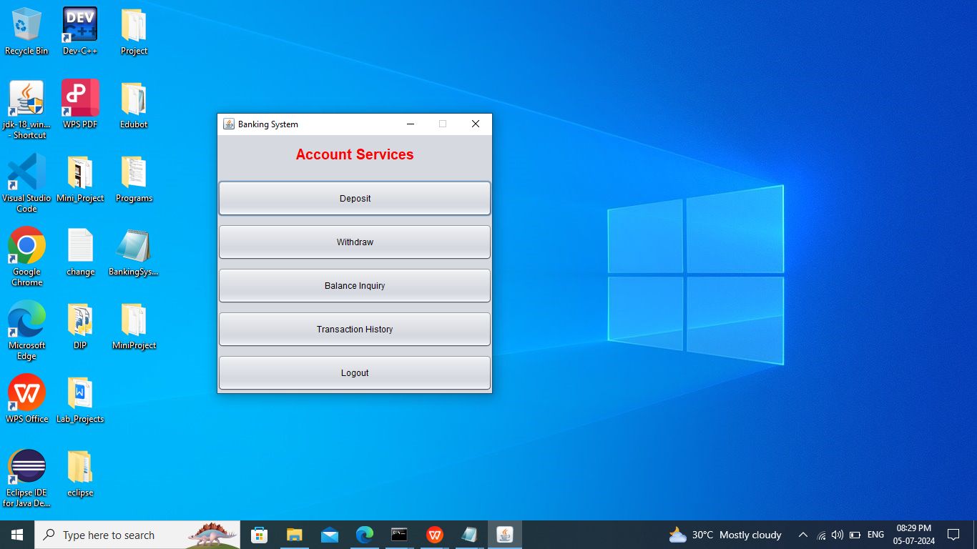
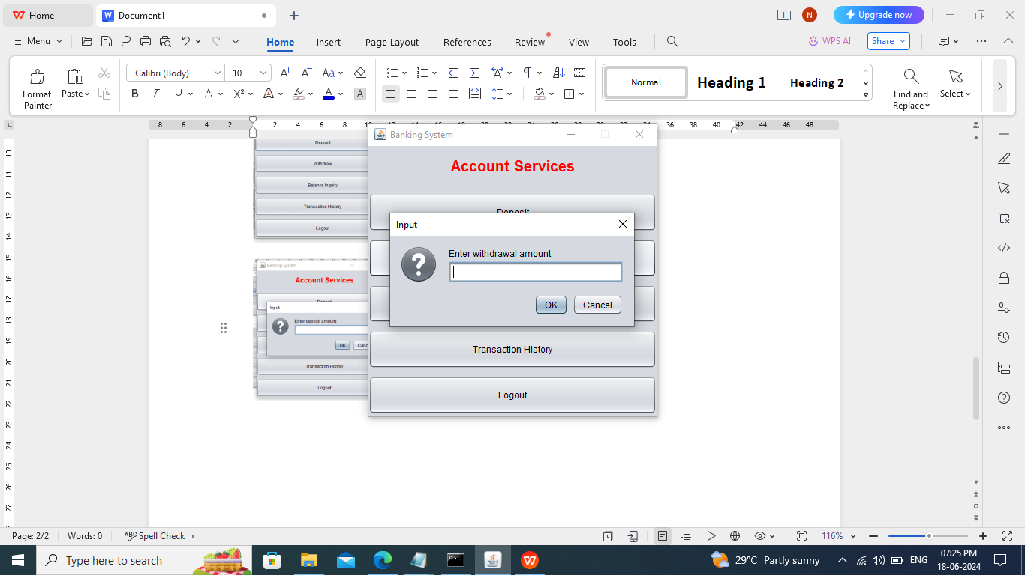
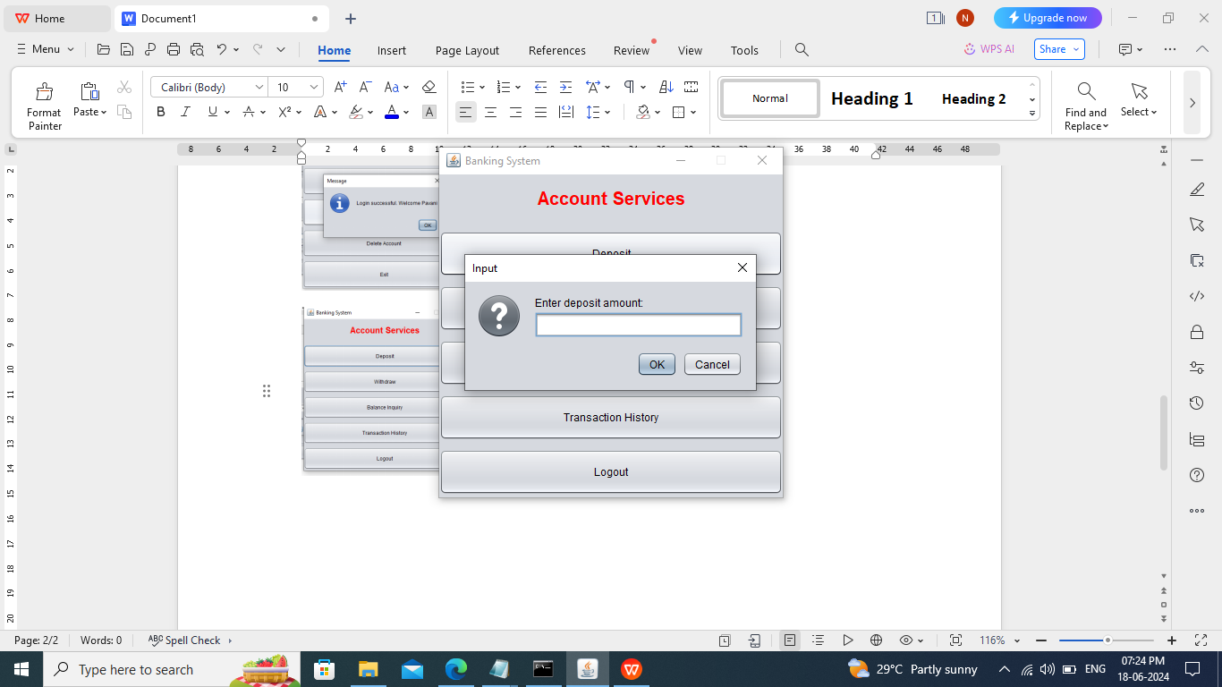
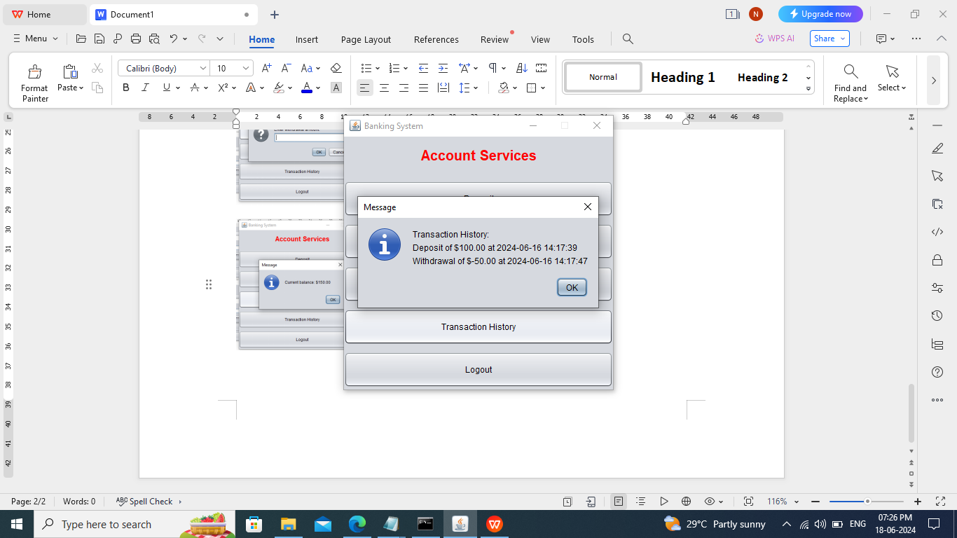
Experimental Setup

Slide 12
Experimental Setup
Results comparision with other approaches :
Comparing results with other approaches, our banking system shows robustness in transaction handling and account management, supporting secure operations and real-time updates.

Slide 13
CONCLUSION
The banking system demonstrates robust functionality with secure account management, efficient transaction handling, and clear user interfaces.
User feedback highlights positive experiences with intuitive navigation and reliable transaction processing, enhancing overall satisfaction.
Future improvements could focus on scalability and optimization to meet growing user demands and further enhance system performance.

Slide 14
FUTURE SCOPE
Enhanced Security: Implementing advanced encryption and biometric authentication.
AI and Machine Learning: Utilizing for personalized services and fraud detection.
Mobile and Contactless Banking: Developing intuitive apps for seamless transactions.
Blockchain Integration: Exploring for transparent and secure transaction handling.

Slide 15
REFERENCES
Java Documentation - Oracle: https://docs.oracle.com/en/java/
Swing Documentation - Oracle: https://docs.oracle.com/javase/tutorial/uiswing/
Concurrency in Java - Oracle: https://docs.oracle.com/javase/tutorial/essential/concurrency/
ReentrantLock Class - Oracle: https://docs.oracle.com/javase/8/docs/api/java/util/concurrent/locks/ReentrantLock.html

Slide 16

K. Pavani [N190061]

