Slide 1

Hotel Reservation Operations Analytics

Slide 2
About me
B.Tech graduate (2025) with a strong interest in Data Analytics and Data Science.
Skilled in SQL and Python, with hands-on experience in data cleaning, exploratory analysis, and visualization.
This project focuses on analyzing hotel reservation data to identify meaningful trends, patterns, and business opportunities using SQL.
Career goal: Build a career in Data Analytics/Data Science by solving real-world business problems through data-driven insights.
LinkedIn Profile URLs :
GitHub Profile URLs : github.com/pavani121224

Slide 3
Table of contents
Project Overview
Business Scenario
Business Objectives
Dataset & Database Overview
ER Diagram & Database Structure
Analysis of the Objectives
Overall Key Findings
Business Recommendations
Conclusion
Q&A

Slide 4
Project Overview
Business Domain: Hotel reservation, booking, and stay management.
Project Goal: Analyze booking patterns, guest behavior, stay outcomes, and hotel operations to identify areas for improvement.
Approach: Work with six relational datasets in MySQL, use SQL queries to answer key business questions, and analyze the results.
Key Outcome: Generate data-driven insights to support better demand forecasting, guest satisfaction, revenue management, and operational efficiency.

Slide 5
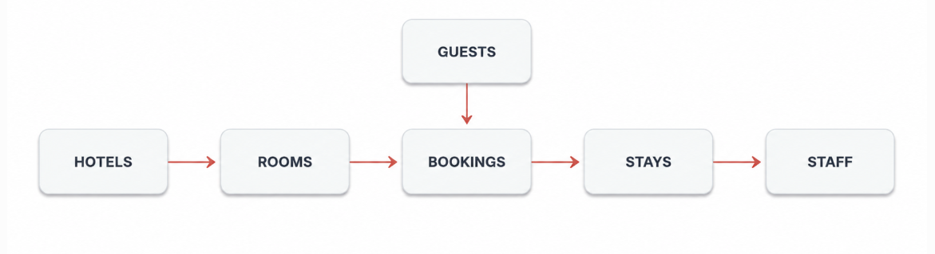
Business Scenario
StayPoint Hospitality operates hotels across multiple cities with different room types.
Bookings are generated through multiple channels and contain requested room type, nights and booking value.
Stays connect bookings with rooms and staff and record outcomes, service requests and duration.
Management needs visibility into demand, guest activity, stay outcomes and operational issues.

Slide 6
Business Objectives
1. Analyze Booking Trends
Identify high-demand hotels, preferred booking channels, and popular room types.
2. Study Guest Patterns
Analyze guest booking behavior, repeat visits, and booking value.
3. Evaluate Stay Performance
Measure stay duration, stay outcomes, and guest service requests.
4. Assess Resource Utilization
Examine staff workload and room-type utilization across the hotel.
5. Detect Booking Issues
Identify patterns in cancellations, no-shows, and hotels experiencing higher booking issues

Slide 7
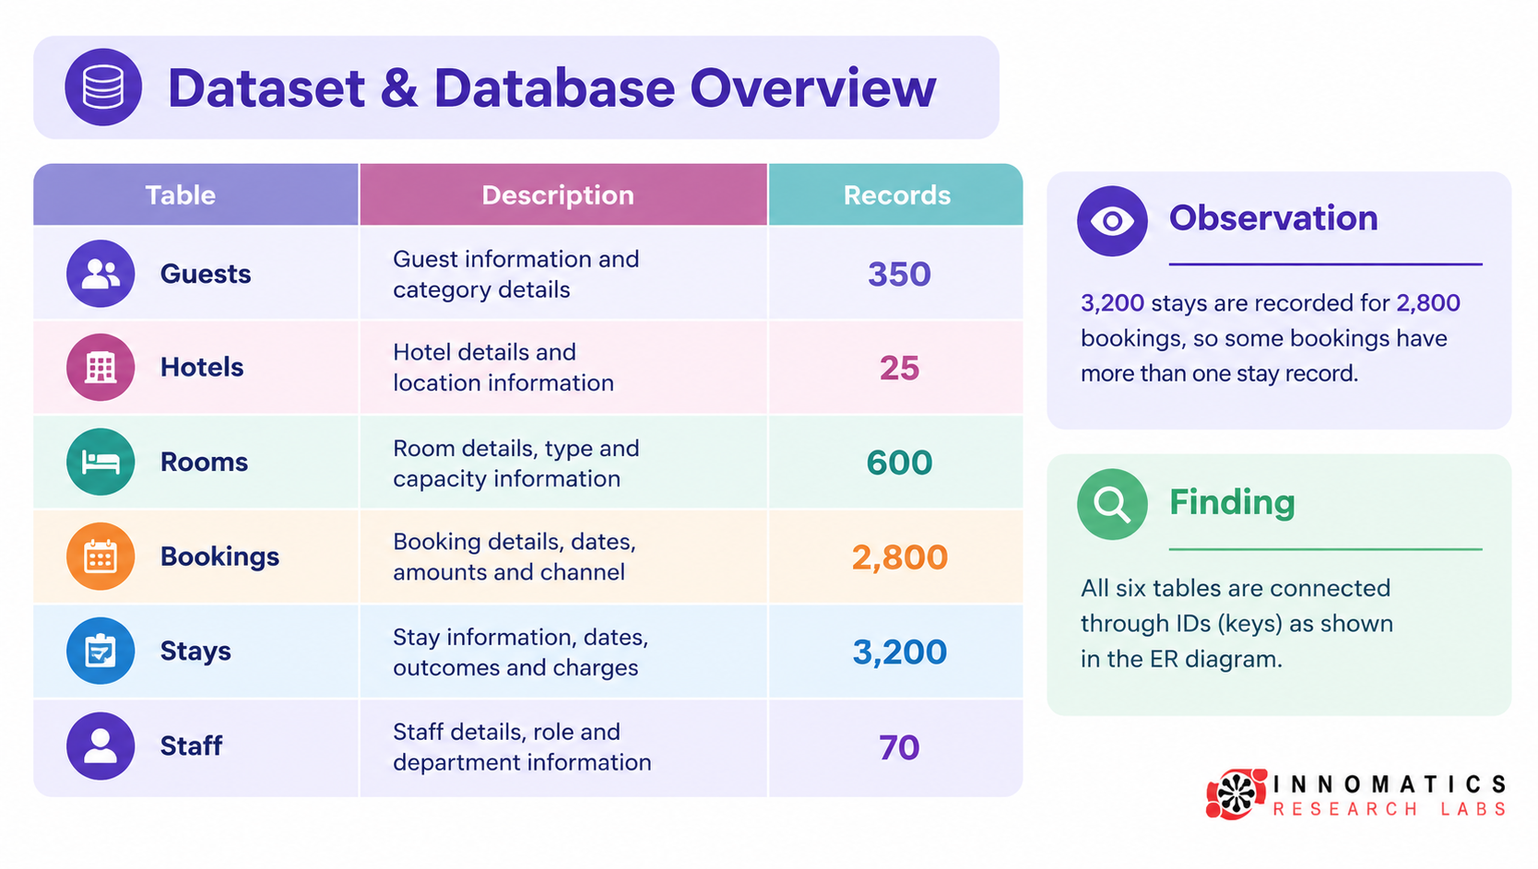
Dataset & Database Overview

Slide 8
ER Diagram & Database Structure
Main Relationships
Guests → Bookings — Guests can make multiple bookings.
Hotels → Bookings — Each booking belongs to a hotel.
Hotels → Rooms — Each hotel has multiple rooms.
Bookings → Stays — Bookings are connected to actual stays.
Rooms → Stays — A room is assigned to a stay.
Staff → Stays — Staff members handle guest stays.

Slide 9
Database Constraints:
Primary Keys
guest_id
hotel_id
room_id
booking_id
stay_id
staff_id
Foreign Keys
Bookings → guest_id
Bookings → hotel_id
Rooms → hotel_id
Stays → booking_id
Stays → room_id
Stays → staff_id

Slide 10
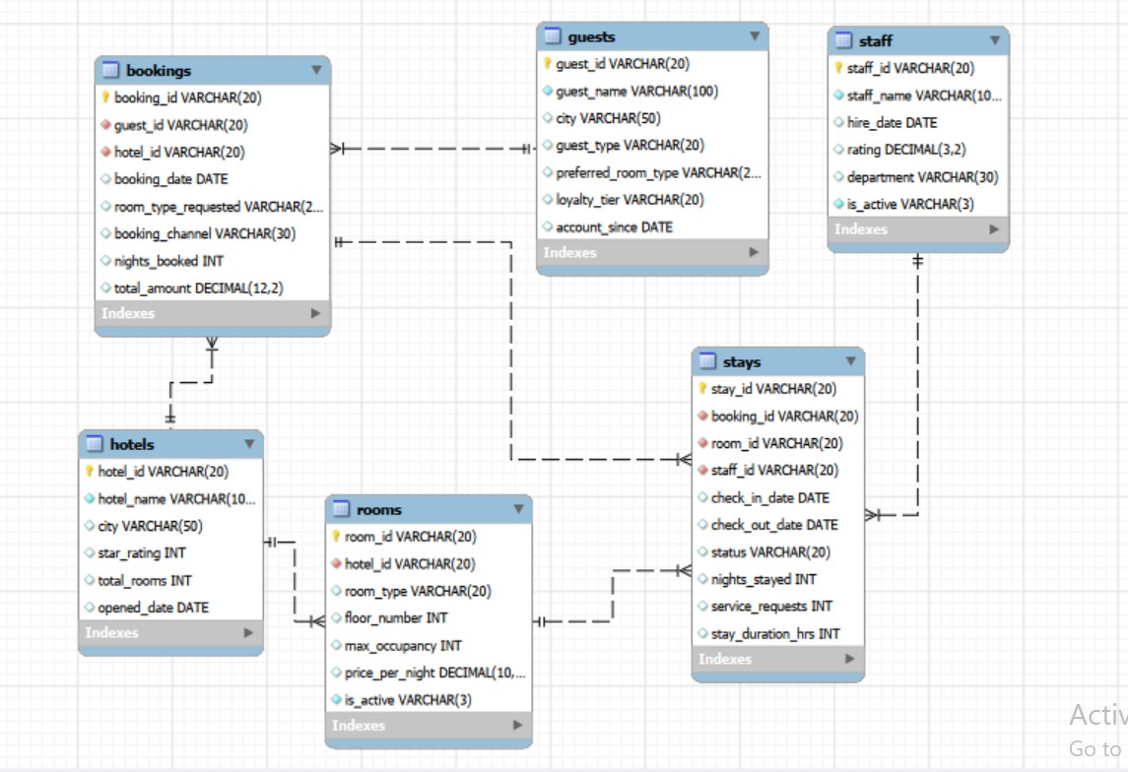

Slide 11

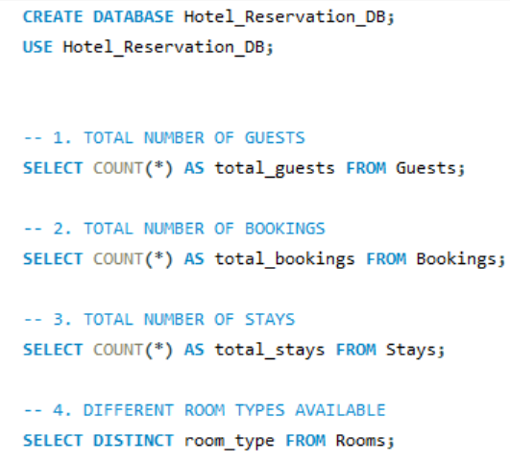


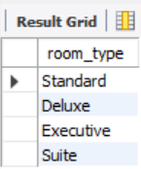
Basic Analysis: SQL Check

Slide 12
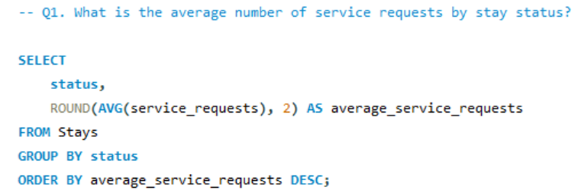
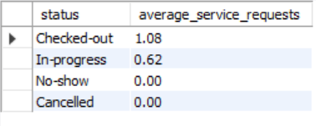
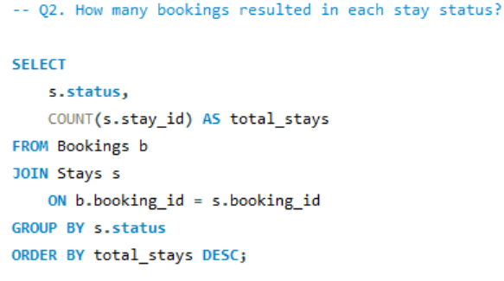
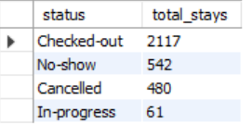

Slide 13
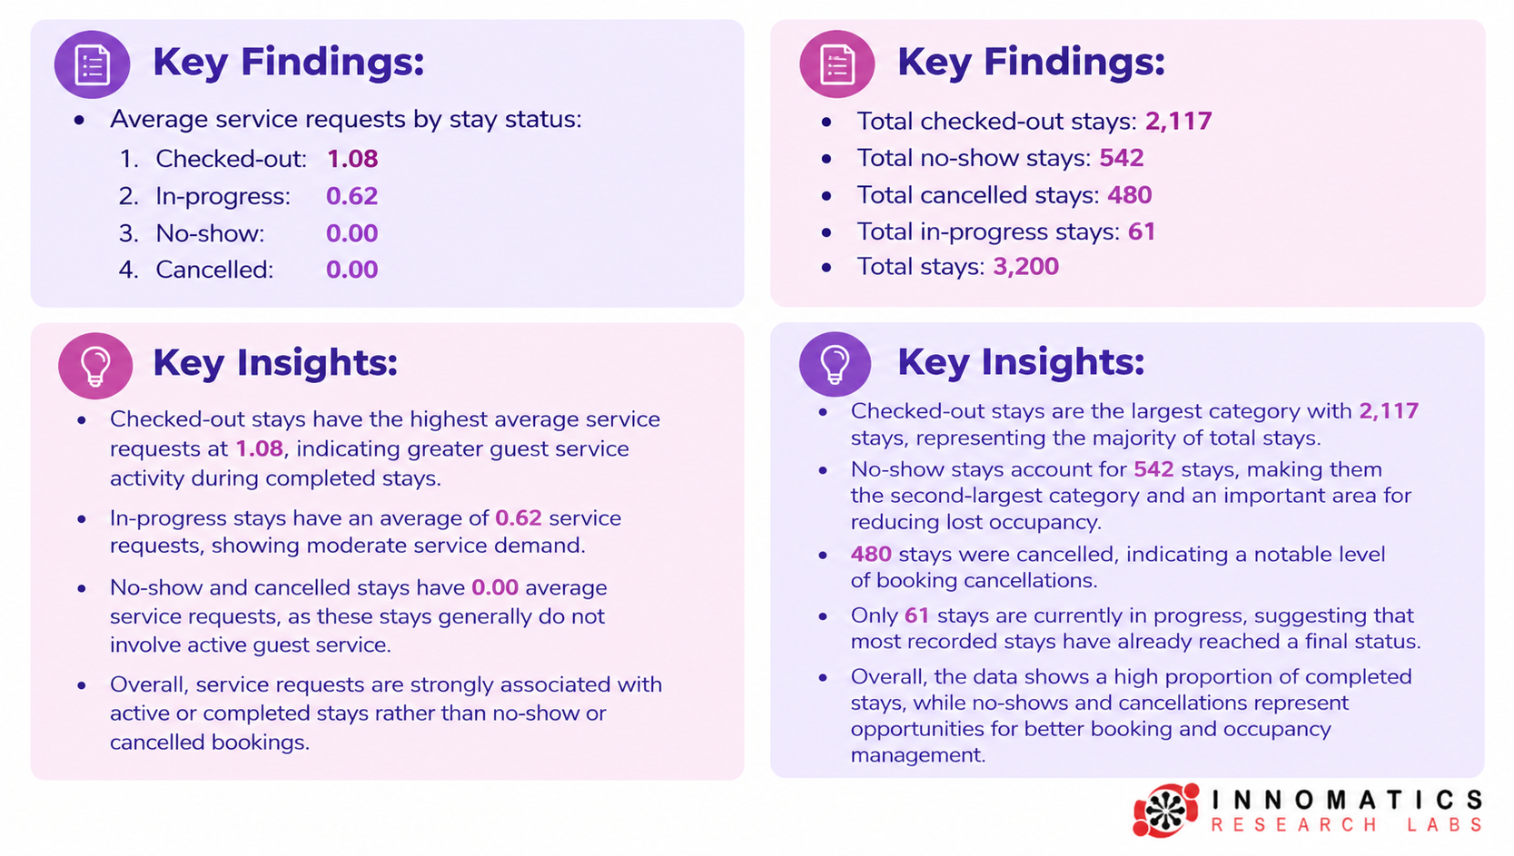

Slide 14
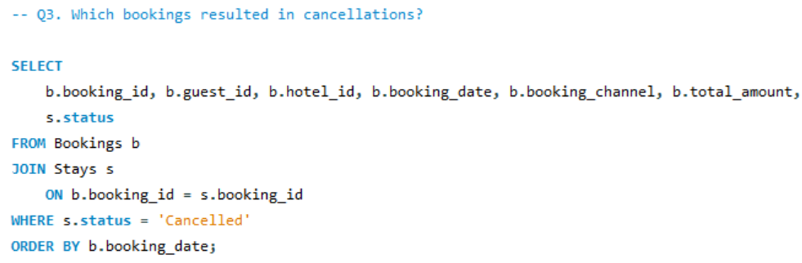
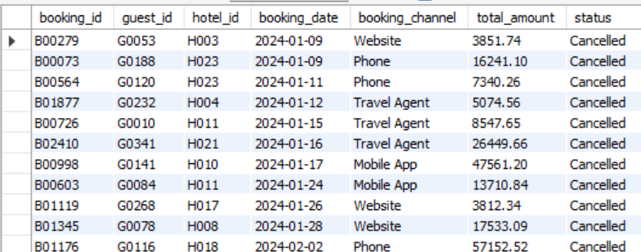

Slide 15
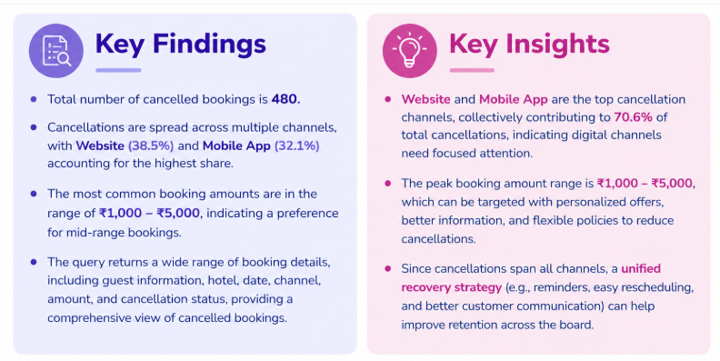

Slide 16
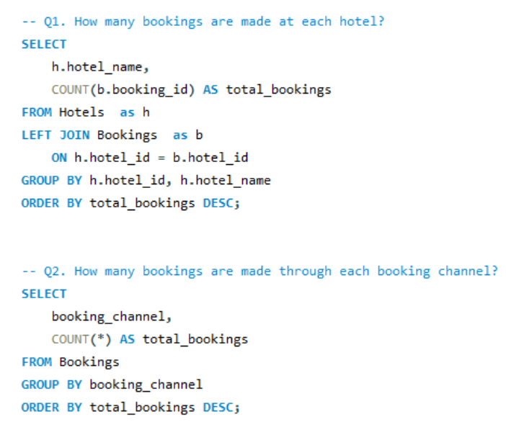
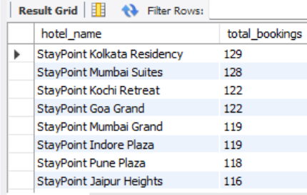
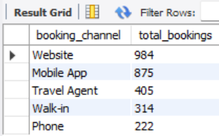
Analysis Of Objectives:

Slide 17
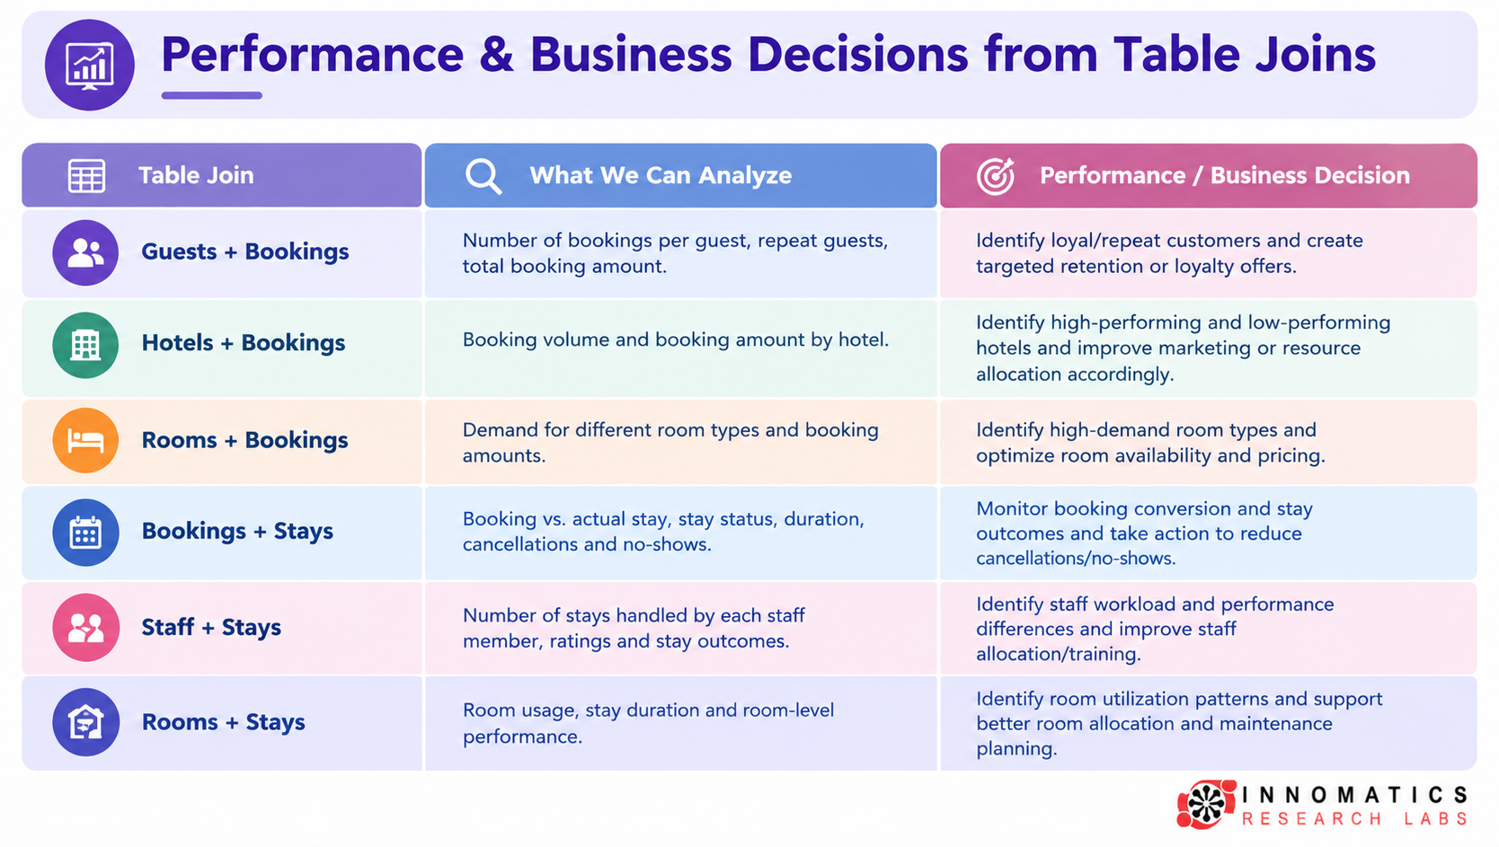

Slide 18
Performance Analysis
Joining related tables provides a 360° view of hotel operations.
Guest–booking analysis supports customer retention.
Hotel–booking and room–booking analysis supports demand and revenue planning.
Booking–stay analysis helps identify cancellations, no-shows and stay outcomes.
Staff–stay analysis supports workload management and staff performance evaluation.
Room–stay analysis helps improve room utilization and operational efficiency.
These decisions align with the project's objectives around booking demand, guest behaviour, stay performance, staff/room utilization, and booking/stay problems

Slide 19
Overall Key Findings
Demand is concentrated in the leading channel (Website) and requested room type (Standard).
StayPoint Kolkata Residency has the highest booking volume among hotels. Guest-level analysis identifies repeat / high-value guests for retention opportunities.
Stay outcomes and service requests provide operational signals beyond booking volume.
StayPoint Kochi Palace has the highest cancellation/no-show problem rate in this analysis.

Slide 20
Business Recommendations
Strengthen the highest-performing booking channel while testing targeted offers in lower-performing channels.
Plan room inventory and pricing around high-demand hotels and the most requested room types.
Create retention offers for repeat and high-value guests using booking frequency and total spend.
Investigate hotels with high cancellation/no-show rates by channel, room type, guest type and time.
Use service-request volume and staff workload to improve staffing allocation and response processeTrack these KPIs monthly to measure whether operational changes reduce problem rates.

Slide 21
Conclusion
The six relational datasets provide a practical view of the hotel reservation lifecycle.
SQL analysis turns booking, guest, room, staff and stay records into measurable business indicators.
Key opportunities are demand planning, guest retention, workload management.
These insights can support better resource allocation, operational planning, customer service and management decisions.
Overall, the project demonstrates how SQL-driven data analysis can transform hotel reservation data into actionable business insights, improve efficiency and enhance the overall guest experience.

Slide 22

THANK YOU

