Slide 1


Student Placement and Internship Analytics Dashboard
Turning Data Into Insights
Domain
Data Analytics
Technologies Used
Microsoft Power BI
Microsoft Excel
Google Forms
Submitted By:
Pavani Yeddala

Slide 2

Project Overview
Objective
The objective of this project is to analyze student placement and internship data using Power BI to identify trends, measure placement readiness, and provide actionable insights for improving student career outcomes.
Dataset
Google Form Survey Responses
50 Student Records
36 Colleges
Multiple Departments

Slide 3
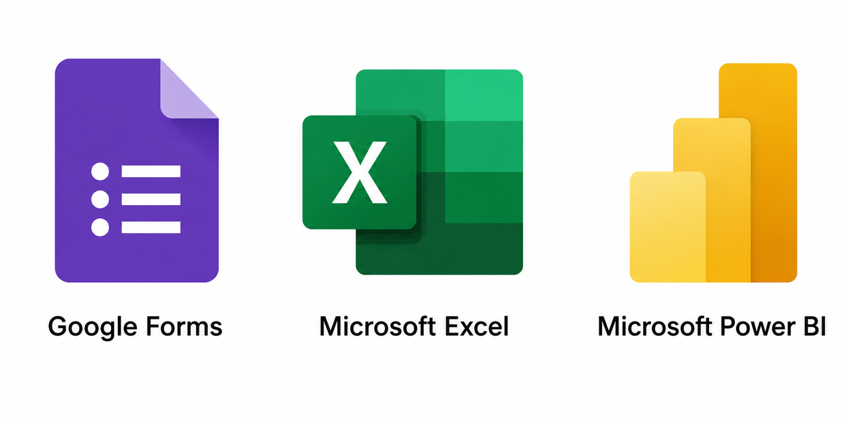
Tools Used
Tool 01
Tool 02
Tool 03

Slide 4

Data Preparation
Data Collection
Collected responses through Google Forms.
Combined survey data with additional sample records.
Data Cleaning
Removed duplicate records.
Standardized department names.
Corrected inconsistent values.
Checked for missing information.
Prepared the dataset for analysis.
Final Dataset
Total Records: 50
Cleaned and analysis-ready.

Slide 5
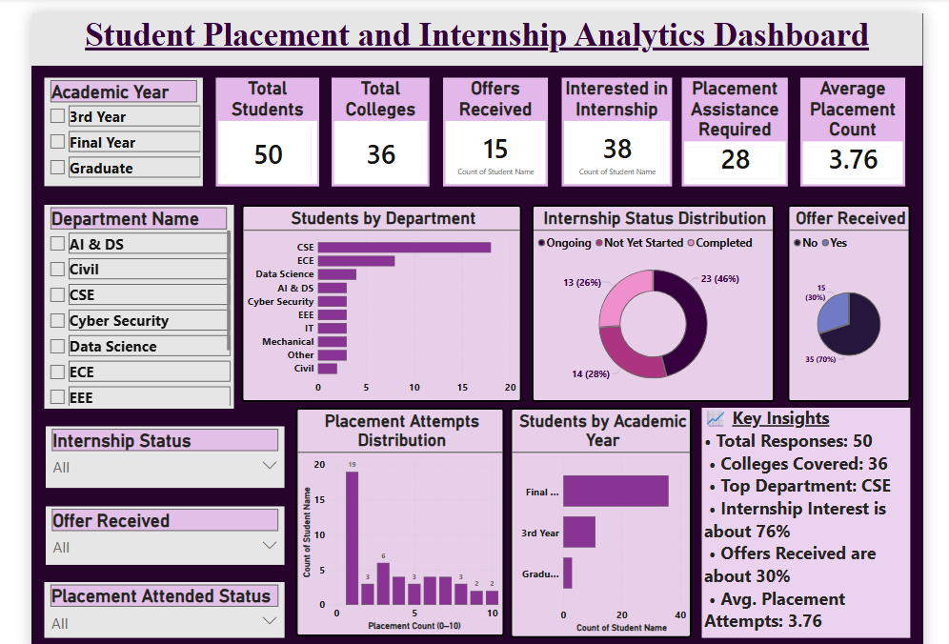
Dashboard Overview
(Interactive Power BI Dashboard)

Slide 6

Dashboard Features
KPI Cards
Interactive Slicers
Department Analysis
Internship Status Distribution
Offer Analysis
Placement Attempts Distribution
Academic Year Analysis
Key Insights Panel

Slide 7

Key Insights
Total Students Surveyed: 50
Colleges Covered: 36
Highest Participation: CSE Department
76% of students are interested in internships.
30% of students have received placement offers.
Average Placement Attempts: 3.76
28 students require placement assistance.

Slide 8

Recommendations
Conduct Resume Building Workshops.
Strengthen Technical Skill Training.
Improve Aptitude Preparation Programs.
Organize Mock Interview Sessions.
Increase Internship Opportunities.
Provide Personalized Career Guidance.
Conduct Industry Interaction Programs.

Slide 9

Conclusion
This dashboard provides meaningful insights into student placement and internship trends through interactive visualizations.
The analysis can help institutions improve placement support, increase internship opportunities, and make informed, data-driven decisions.

Slide 10

Thank you
for your attention

