Slide 1
SUMMER INTERNSHIP
ENHANCED SEISMIC EVENT
DETECTION
BATCH NO: 06
1. 22071A6672 – B. NIKHITHA
2. 22071A6675 – B. PAVANI
3. 22071A6692 - J. OLIVYA
4. 23075A6614 – S. SRAVYA
GUIDE:
MS. PREETY SINGH
ASSISTANT PROFESSOR
DEPARTMENT OF CSE-AIML & IoT

Slide 2
ABSTRACT
The project focuses on developing a machine learning model to predict significant earthquakes based on seismic waveforms.
A dataset of seismic events is used, and CNNs (Convolutional Neural Networks) are integrated with LSTM (Long Short-Term Memory) layers for classification.
The dataset undergoes preprocessing, including normalizing magnitude values and generating input sequences for the model.
The model architecture:
Conv1D layers for feature extraction from seismic waveforms.
LSTM layer to capture temporal dependencies in the data.
Dense layers for binary classification of earthquakes (significant vs. non-significant).
Training is conducted on 80% of the dataset, with 20% reserved for testing.
The model's performance is evaluated using accuracy metrics, achieving a high accuracy in identifying significant earthquakes (magnitude > 5.5).
DEPARTMENT OF CSE-AIML & IoT

Slide 3
EXSISTED SOLUTION
The discrimination of seismic event and nuclear explosion is a complex and nonlinear system. The nonlinear methodologies including Random Forests (RF), Support Vector Machines (SVM), and Naïve Bayes Classifier (NBC) were applied to discriminant seismic events. Twenty earthquakes and twenty-seven explosions with nine ratios of the energies contained within predetermined “velocity windows” and calculated distance are used in discriminators. Based on the one out cross-validation, ROC curve, calculated accuracy of training and test samples, and discriminating performances of RF, SVM, and NBC were discussed and compared. The result of RF method clearly shows the best predictive power with a maximum area of 0.975 under the ROC among RF, SVM, and NBC. The discriminant accuracies of RF, SVM, and NBC for test samples are 92.86%, 85.71%, and 92.86%, respectively. It has been demonstrated that the presented RF model can not only identify seismic event automatically with high accuracy, but also can sort the discriminant indicators according to calculated values of weights.
DEPARTMENT OF CSE-AIML & IoT

Slide 4
RESEARCH GAP IDENTIFIED
The research identified several key research gaps, including the need for assessing the robustness of machine learning models across diverse geological settings, expanding the discrimination capability to include other potential sources of seismic activity, and exploring the effectiveness of advanced deep learning techniques. Additionally, while the study demonstrates promising results with traditional algorithms, further investigation into optimizing deep learning architectures and model training strategies is warranted. Addressing these gaps could lead to more accurate and efficient seismic event detection systems with broader applicability in real-world scenarios.
DEPARTMENT OF CSE-AIML & IoT

Slide 5
PROPOSED SOLUTION
Problem: Predict significant earthquakes from seismic waveforms.
Data Preprocessing:
Normalize magnitudes and create input sequences.
Model:
Conv1D layers: Extract features.
LSTM layer: Capture temporal dependencies.
Dense layers: Binary classification.
Training:
Split data (80% training, 20% testing).
Train and validate for high accuracy.
Outcome:A model that accurately predicts significant earthquakes based on waveform data.
DEPARTMENT OF CSE-AIML & IoT

Slide 6
REQUIREMENTS
FUNCTIONAL REQUIREMENTS | NON-FUNCTIONAL REQUIREMENTS
Data Collection and Pre processing | Performance
Model Development | Reliability
Prediction | Security
User Interface | Usability
Monitoring and Maintenance | Maintainability
 | Compliance
DEPARTMENT OF CSE-AIML & IoT

Slide 7
LITERATURE REVIEW
S.No | Title of the Paper | DOI/Link | Problem/Gap Addressed | Objective of the Paper | Focus of the Paper | Summary
1 | Earthquake prediction model using support vector regressor and hybrid neural networks | N/A | Previous studies did not show optimal prediction accuracy. | To build a model that improves earthquake prediction accuracy using machine learning techniques. | Combines SVR and HNN with Enhanced Particle Swarm Optimization (EPSO) for weight optimization at each layer. | Proposes a multistep prediction model (SVR-HNN) using seismic features and applying to regions like Hindukush and Southern California, showing improved prediction performance.
2 | Study of seismicity in the NW Himalaya and adjoining regions using IMS network | Link | Investigating seismic activity in NW Himalaya. | Use International Data Center data to study earthquakes from 1999 to 2015. | Divides study area into 6 regions, analyzing focal mechanisms and seismic faults. | Examines 7,583 events, using 120 earthquakes for focal mechanism solutions to study seismic faults.
DEPARTMENT OF CSE-AIML & IoT

Slide 8
3 | Earthquake Prediction using Hybrid Machine Learning Techniques | N/A | The challenge of accurate earthquake prediction in Southern California. | To use hybrid ML models to predict earthquake magnitude. | Proposes two models: FPA-ELM and FPA-LS-SVM, using seven seismic indicators. | FPA-LS-SVM outperforms other models in terms of prediction accuracy based on several performance criteria.
4 | Approaches of Earthquake Magnitude Prediction using machine learning techniques | N/A | Earthquake prediction complexity. | To review various ML techniques for earthquake prediction. | Surveys various machine learning techniques and their efficiency in earthquake prediction. | Concludes SVR-HNN hybrid neural network with EPSO is the most efficient among surveyed techniques.
5 | Experimental analysis of earthquake prediction using machine learning classifiers, curve fitting, and neural modeling | Link | Predicting earthquake magnitudes for different regions in India. | Predict earthquake magnitudes using six different classifiers. | Evaluates six classifiers on datasets from different Indian regions. | XGBoost classifier shows highest accuracy in most datasets; study focuses on magnitude prediction.
DEPARTMENT OF CSE-AIML & IoT

Slide 9
6 | Testing earthquake prediction algorithms: statistically significant advance prediction of the largest earthquakes in the Circum-Pacific | Link | Testing prediction algorithms M8 and MSc. | Predict large earthquakes in the Circum-Pacific seismic belt. | Tests algorithms M8 and MSc for predicting earthquakes of magnitude 7.5+ and 8+. | M8 and MSc predict 5 large earthquakes, with statistical significance beyond 99%.
7 | Precursor-Based Earthquake Prediction Research: Proposal for a Paradigm-Shifting Strategy | N/A | Challenges dominant pessimistic view on precursor-based earthquake prediction. | To propose a new research strategy for precursor-based earthquake prediction. | Suggests focusing on unique seismic fingerprints with a multi-parameter approach. | Proposes a costly, long-term international project using AI and sensor data for improved prediction accuracy.
8 | Local earthquakes detection: A benchmark dataset of 3-component seismograms built on a global scale | N/A | Lack of labeled seismograms for machine learning applications in earthquake detection. | To provide a benchmark dataset for ML-based earthquake detection. | Creates a large dataset of 3-component seismograms from global stations for local earthquake detection. | CNN-based model achieves high accuracy (96.7%, 95.3%, and 93.2%) in detecting earthquakes versus noise.
DEPARTMENT OF CSE-AIML & IoT

Slide 10
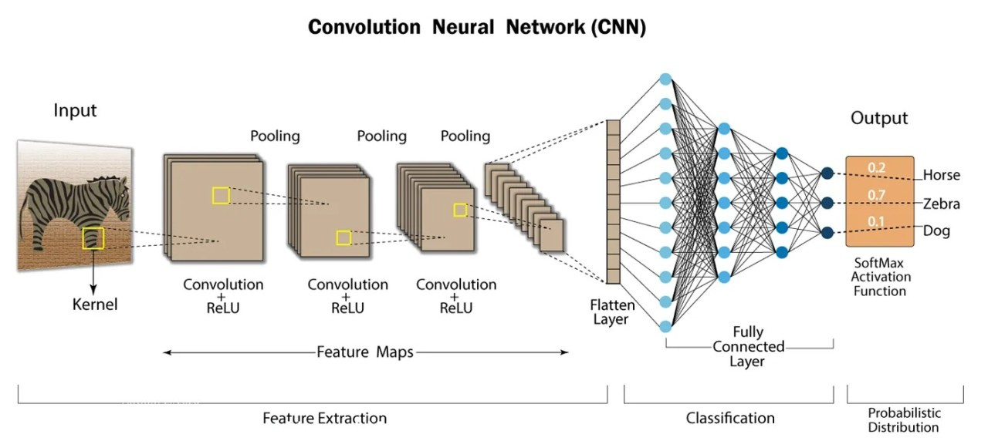
TECHNICAL SPECIFICATIONS
Convolutional Neural Networks(CNN) and LSTM:
DEPARTMENT OF CSE-AIML & IoT

Slide 11
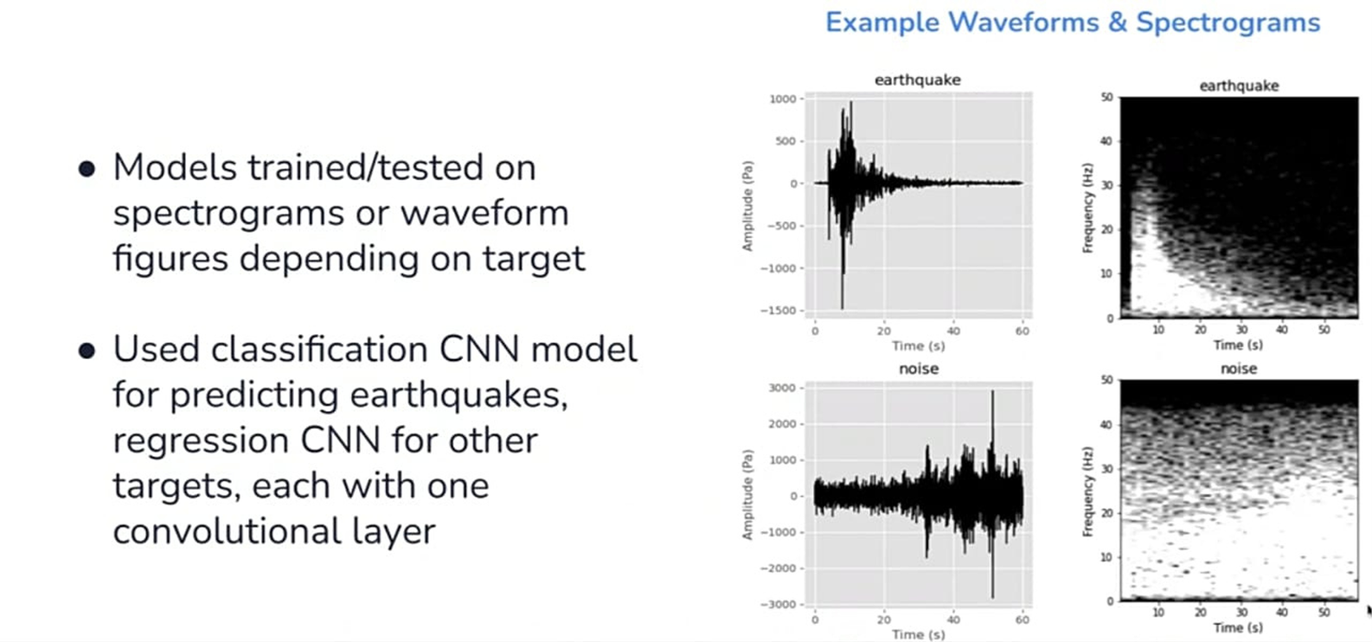
METHOD:CNN
DEPARTMENT OF CSE-AIML & IoT

Slide 12
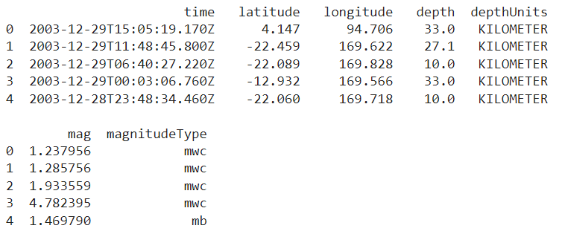
DATASET:
Indian Subcontinent Seismic Dataset (Short)
Focus: Contains seismic waveform and earthquake event data specific to the Indian subcontinent, a tectonically active region.
Features:
Magnitude (mag): Strength of earthquakes on the Richter scale.
Seismic Waveforms: Time series data of ground motion.
Additional Attributes: Event timestamps, locations, depth, and classifications.
Magnitude Distribution: Includes a range of magnitudes from minor tremors to significant earthquakes.
Relevance: Essential for developing models to classify and predict significant seismic events in a high-risk area.
DEPARTMENT OF CSE-AIML & IoT

Slide 13
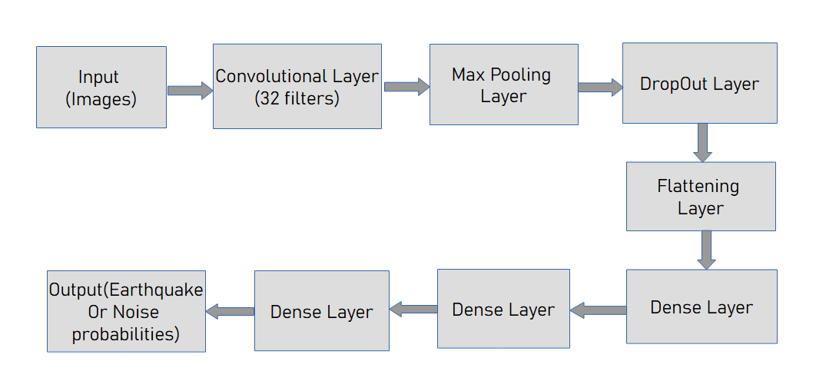
CNN ARCHIETECTURE:
DEPARTMENT OF CSE-AIML & IoT

Slide 14
There are different layers:
Input Layer: Takes in spectrogram images or waveform segments.
Convolutional Layers: Extract features from the input data using convolution operations.
Pooling Layers: Reduce the spatial dimensions of the data, typically using max pooling or average pooling.
Flattening Layers: The Flatten layer transforms the 3D tensor output from the last convolutional layer into a 1D vector.
Dense Layers: The Dense layer interprets these features and performs the final classification.
Fully Connected Layers: Perform classification or regression based on the extracted features.
Output Layer: Depending on the task, this could be a softmax layer for classification (e.g., event detection) or a linear layer for regression (e.g., magnitude estimation)
DEPARTMENT OF CSE-AIML & IoT

Slide 15
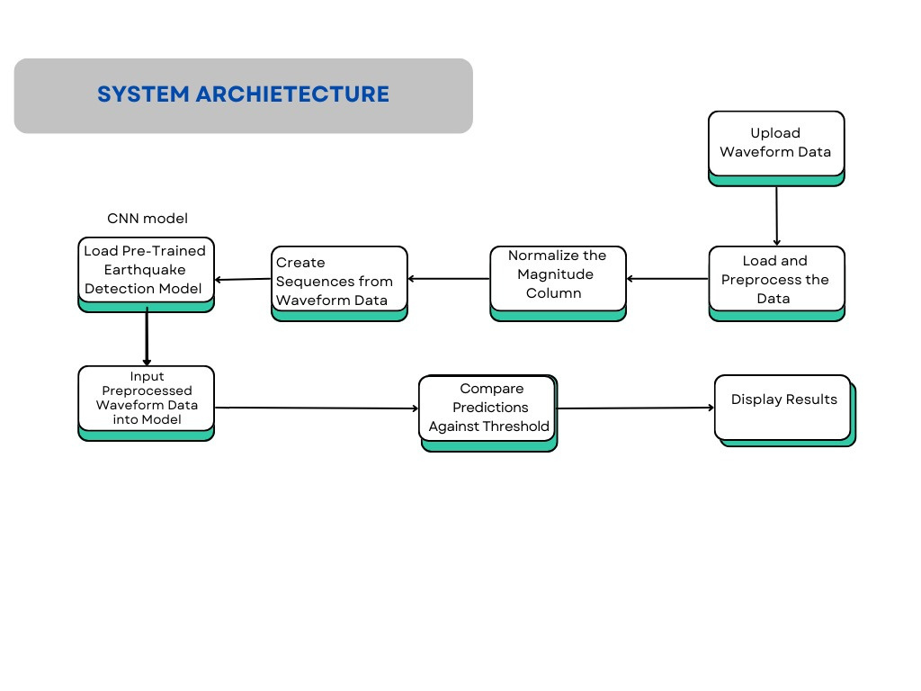

Slide 16
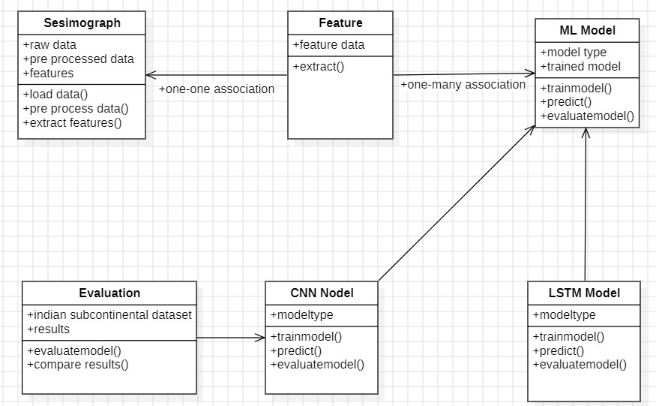
CLASS DIAGRAM
DEPARTMENT OF CSE-AIML & IoT

Slide 17
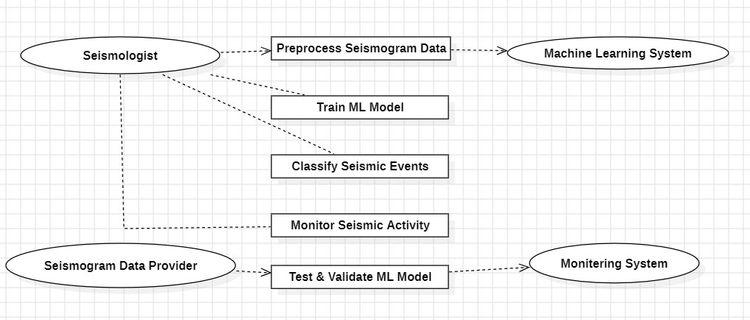
USE-CASE DIAGRAM
DEPARTMENT OF CSE-AIML & IoT

Slide 18
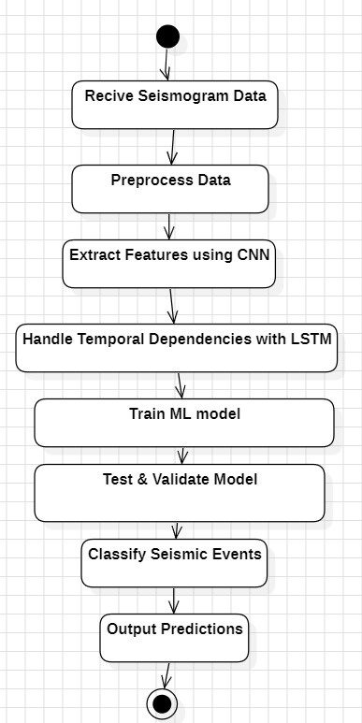
ACTIVITY DIAGRAM
DEPARTMENT OF CSE-AIML & IoT

Slide 19
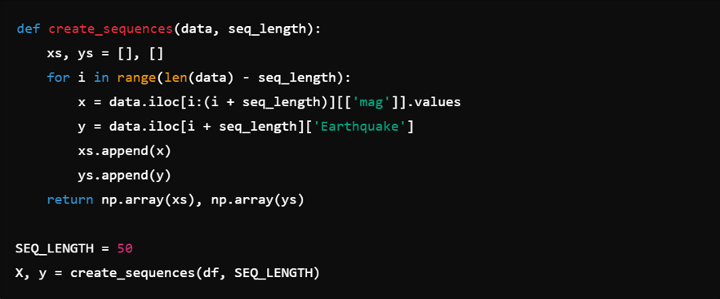
IMPLEMENTATION:
Creating Sequences for the Model
The create_sequences function generates sequences of magnitude values to feed into the model. For each sequence of 50 time steps (controlled by SEQ_LENGTH), the corresponding earthquake label (0 or 1) is extracted.
These sequences (X) and labels (y) are returned as numpy arrays and are used as input for model training.

Slide 20
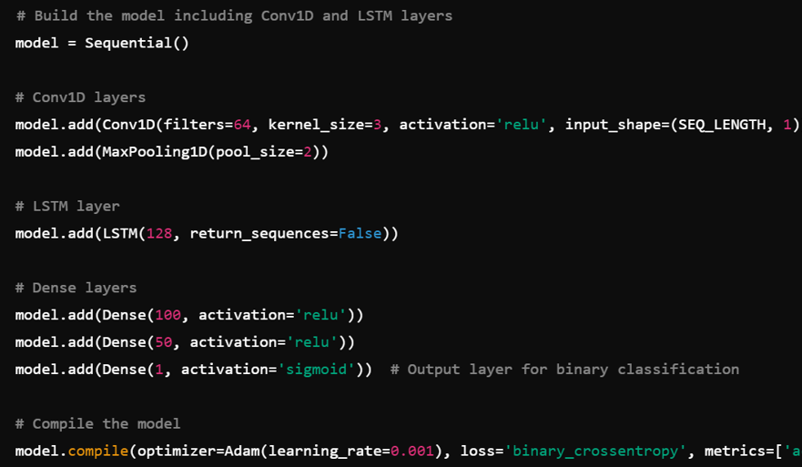
A sequential model is created.
The first layer is a Conv1D layer with 64 filters and a kernel size of 3, followed by max pooling.
Next, an LSTM layer with 128 units is added to capture sequential patterns in the data.
The model is then flattened using dense layers to output a single binary classification (sigmoid activation).
The model is compiled with the Adam optimizer and binary cross-entropy loss.
Building and Compiling the Model

Slide 21
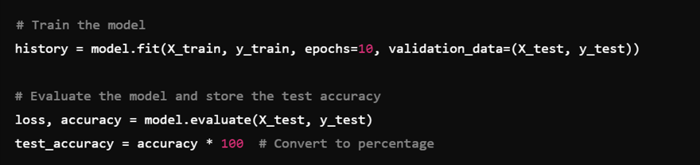
Training and Evaluating the Model
The model is trained for 10 epochs, using the training data and validated on the test data.
After training, the model is evaluated on the test set, and the test accuracy is calculated and stored in the test_accuracy global variable.
DEPARTMENT OF CSE-AIML & IoT

Slide 22
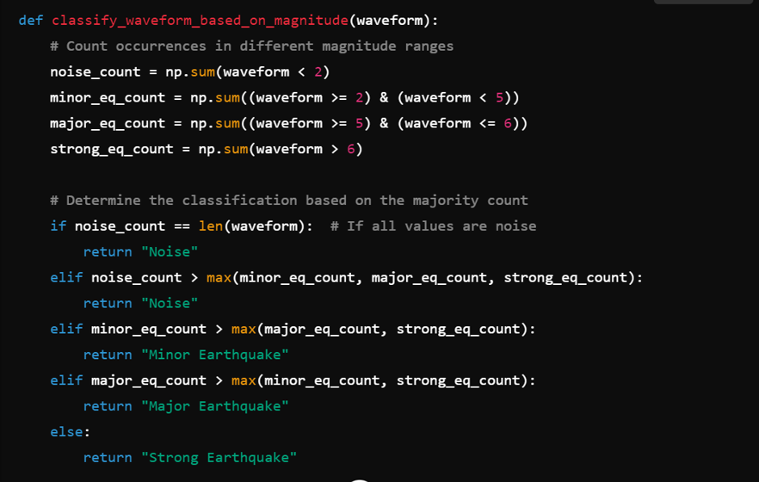
Classify Waveform Based on Magnitude
This function classifies the waveform based on the magnitude ranges.
It checks the count of values in specific magnitude ranges (e.g., noise, minor earthquake, major earthquake, strong earthquake).
The majority count determines the classification label.

Slide 23
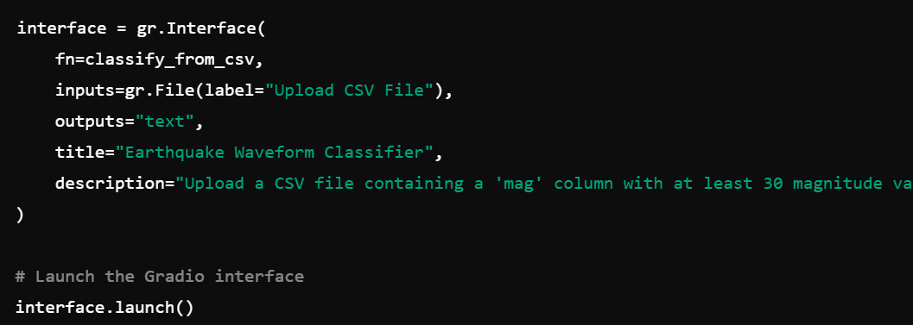
Creating the Gradio Interface
This creates a Gradio interface where users can upload a CSV file, and the app will output both the classification and the test accuracy.
The interface.launch() command launches the interface.
This function handles CSV file input in Gradio.
It reads the file, checks for the existence of the mag column, and verifies that it has at least 30 values.

Slide 24
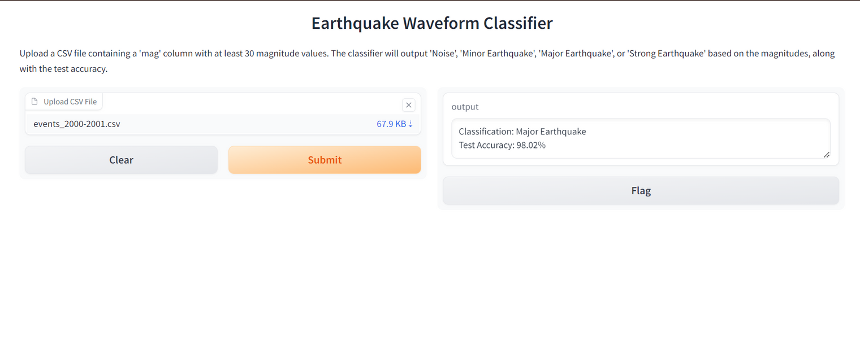
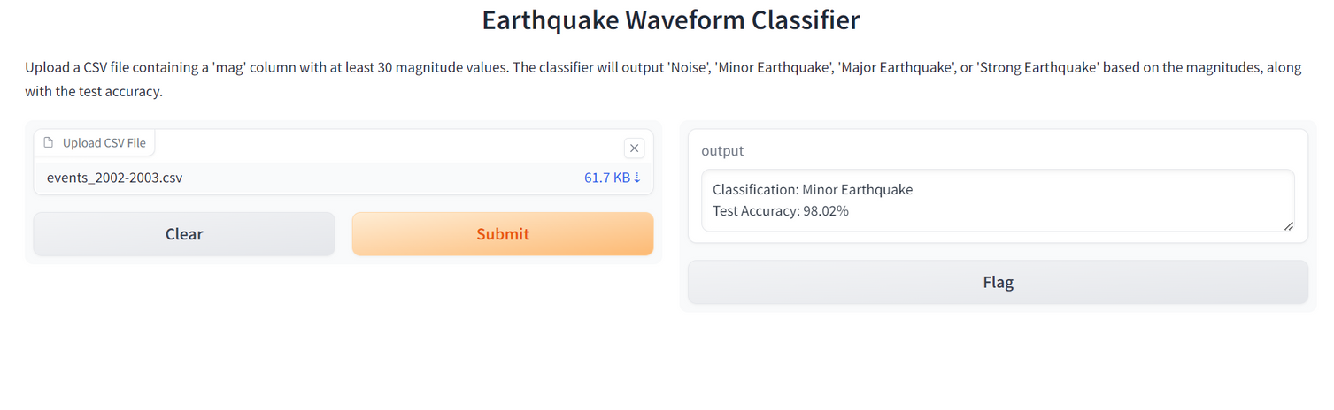
TEST RESULTS:
The output is presented in two forms:
Classification result: "Significant Earthquake" or "Non-significant Event."
Accuracy score: A percentage reflecting the model's performance in correctly identifying significant earthquakes.
The model can also be integrated with an interface (e.g., Gradio) for users to upload CSV files containing seismic data and receive real-time classification results, along with the test accuracy score.

Slide 25
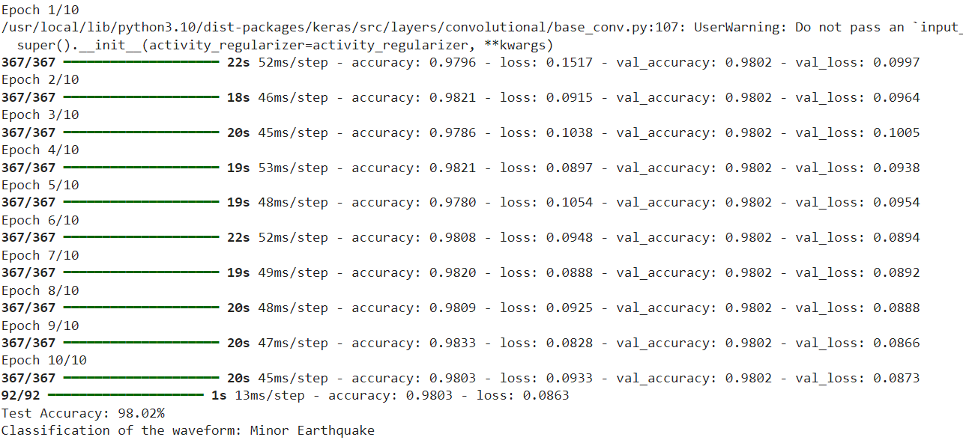
Accuracy:

Slide 26
CONCLUSION:
An earthquake is the sudden shaking of the ground caused by the rapid release of energy in the Earth's lithosphere.
This energy release occurs due to the movement of tectonic plates at fault lines.
Earthquake magnitude is measured using the Richter or moment magnitude scale.
Modern detection involves seismometers, which are sensitive instruments that record ground vibrations.
Seismographs convert these vibrations into visual data for analysis.
By analyzing seismic waves, scientists can determine an earthquake’s location, depth, and magnitude.
Advanced technologies and networks of seismometers enable real-time monitoring.
Early warning systems are developed using this real-time monitoring data.
These systems help in disaster preparedness and reducing potential damage and loss of life.
DEPARTMENT OF CSE-AIML & IoT

Slide 27
THANK YOU.
DEPARTMENT OF CSE-AIML & IoT

