Slide 1
BCA Final Year Project (Review III) DROWSINESS DETECTION
Submitted to the Presidency University, Bengaluru in partial fulfillment for the award of the degree of Bachelor of Computer Applications(BCA)
Project Team No : 40
Under the supervision of
Mr. Sakthi S Assistant Professor,
PSOCSE(Presidency School of Computer Science and Engineering)
Name | Roll Number
Y. Gnana Pavani | 20221BCA0060
Velpula Usha | 20221BCA0185
M. Yasaswini Sai | 20221BCA0044
E. Kushal | 20221BCA0053

Slide 2
Content
Problem Statement
Literature Survey
Tools and Technologies to be used
Timeline of the Project
GitHub Link
References

Slide 3
Problem Statement
Drowsy Driving Issue:
Leading cause of road accidents, often resulting in severe injuries or fatalities.
Example: Long-haul truck drivers on night shifts experience fatigue, causing delayed reactions and crashes.
Limitations of Existing Solutions:
Physical sensors: Expensive and intrusive.
Vision-based methods: Inaccurate under varying lighting conditions.
Research Goal:
Develop a Python-based deep learning system.
Analyze facial features to detect drowsiness in real-time.
Provide timely alerts to improve road safety and reduce accidents.

Slide 4
Literature Survey
Authors | Year | Dataset | Algorithms | Methodologies | Challenges | Advantages | Disadvantages
1. Eryl Nanda Pratama, Wikky Fawwaz Al Maki | 2024 | Not specified | Deep Neural Network, Haar Cascade | Combines Haar Cascade for face detection and DNN for drowsiness detection | Detecting drowsiness with face masks | Works with masked faces | Limited dataset details
2. Mandapati Ankitha, Sandeep Vemuri, Suraneni Lowkya Gayathri, Jarabala Sindhu Bhargavi | 2023 | Open/closed eye images | Convolutional Neural Network (CNN) | Uses CNN to analyze eye states and alert the driver | Variability in facial features | Real-time monitoring with alerts | May struggle with variations in lighting

Slide 5
Authors | Year | Dataset | Algorithms | Methodologies | Challenges | Advantages | Disadvantages
3. R Syed Ali Fathima, Kovi Venkata Keerthi, Kovuri Naga Bhuvanesh, Kota Naga Jyothi, Kotikalapudi Sravya, Patnana Vijay Kumar | 2025 | Not specified | OpenCV, Keras-based Neural Networks | Uses OpenCV for real-time image capture and Keras for processing | Balancing processing speed with accuracy | Efficient processing using OpenCV | Lack of dataset details
4. Parth P. Patel, Chirag L. Pavesha, Santoshi S. Sabat, Shraddha S. | 2022 | Not specified | Deep Learning techniques | Applies deep learning models to analyze facial features | Implementation in real-time scenarios | Potential for high accuracy | Dataset and methodology details not provided

Slide 6
Authors | Year | Dataset | Algorithms | Methodologies | Challenges | Advantages | Disadvantages
5. Kanwarpartap Singh Gill, Vatsala Anand, Rahul Chauhan, Siddhant Thapliyal, Rupesh Gupta | 2023 | Not specified | Convolutional Neural Network (CNN) | Utilizes CNN to determine eye states (open/closed) | Performance in different lighting conditions | Real-time eye state identification | Dataset details not provided
6. S Spandana, M. Srividhya, Yedavalli Venkata Raghava Rao, P. Devika, V. Srikanth, S Parvathi | 2024 | Not specified | Deep Learning models | Uses deep learning to analyze visual cues | Handling occlusions and lighting variations | No need for physical sensors | Specific dataset and algorithm details not provided

Slide 7
Authors | Year | Dataset | Algorithms | Methodologies | Challenges | Advantages | Disadvantages
7. Dakshnakumar G S, J. Anitha | 2023 | Not specified | Deep Learning approaches | Compares different deep learning models | Choosing the best model for real-time detection | Comprehensive study of various techniques | Lacks specific dataset and implementation details

Slide 8
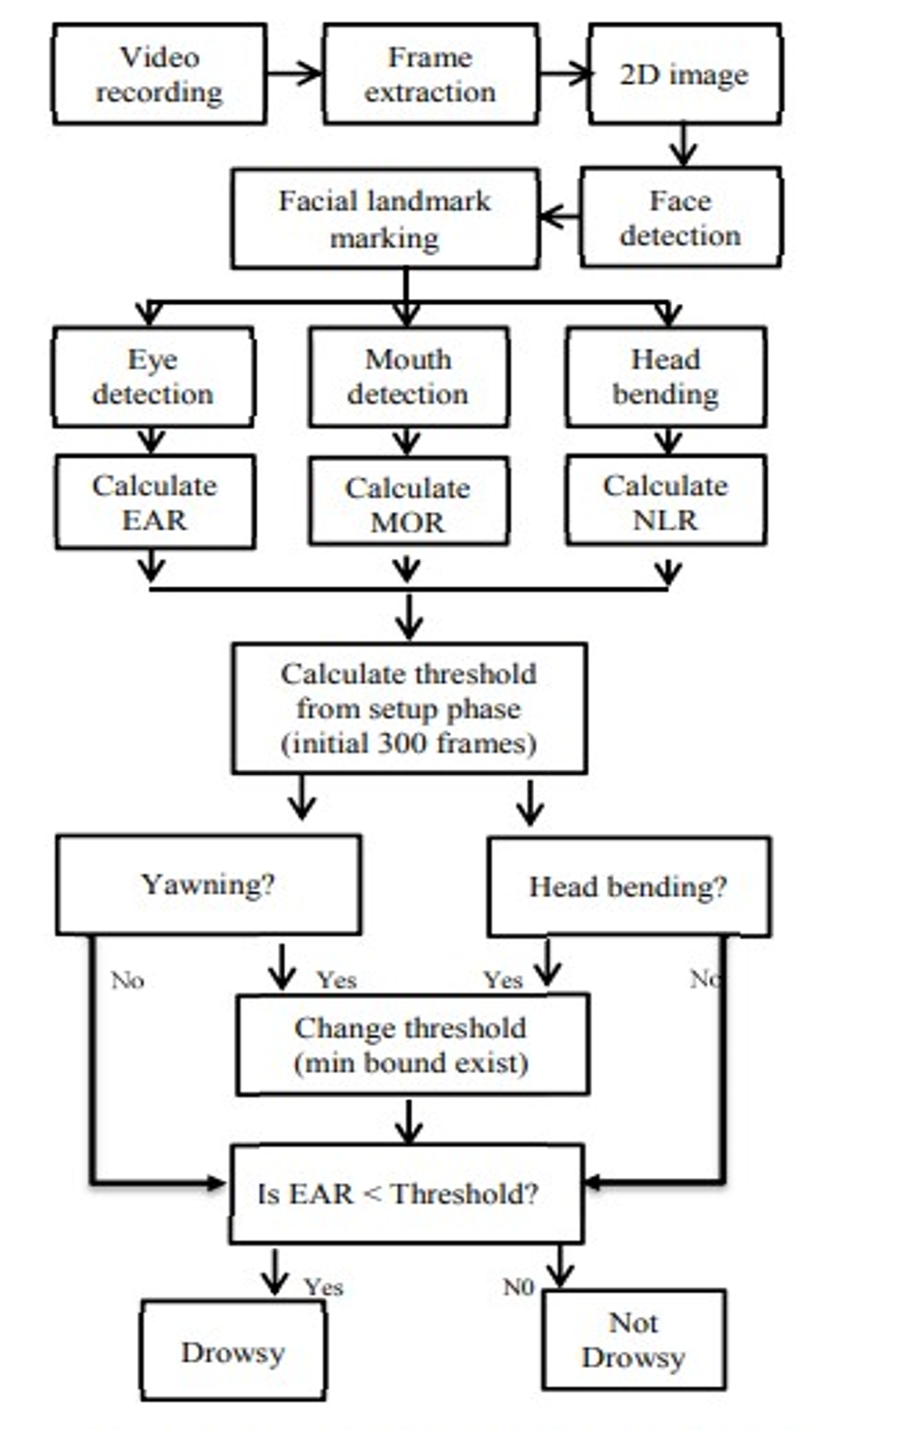
Architecture
Fig-1: The block diagram of proposed system

Slide 9
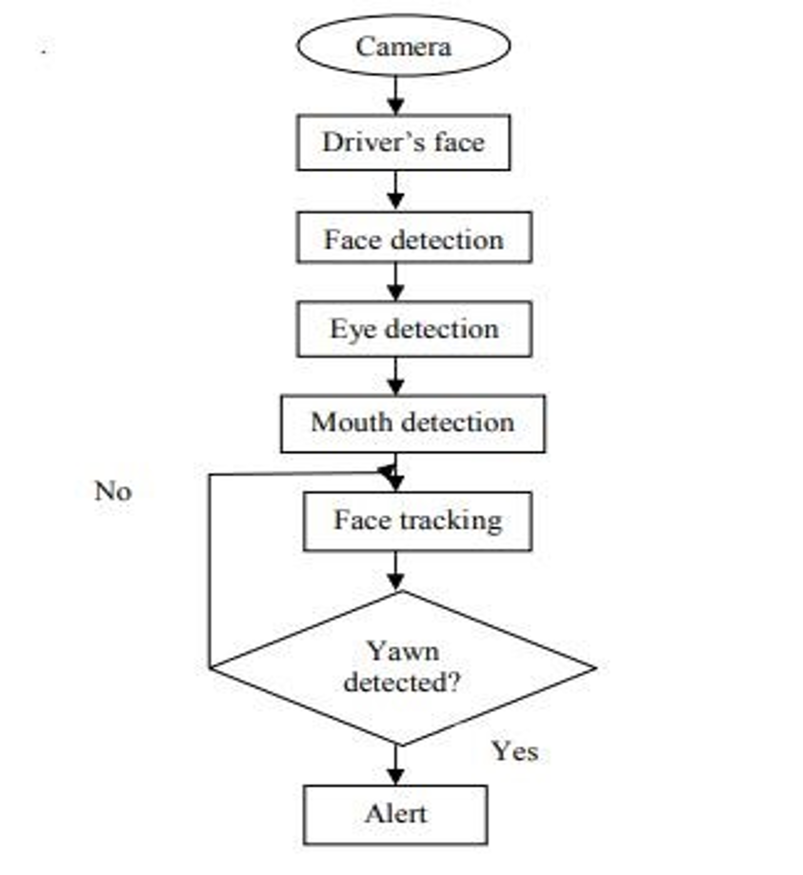
Architecture
Fig-2:Flow diagram of drowsiness detection

Slide 10
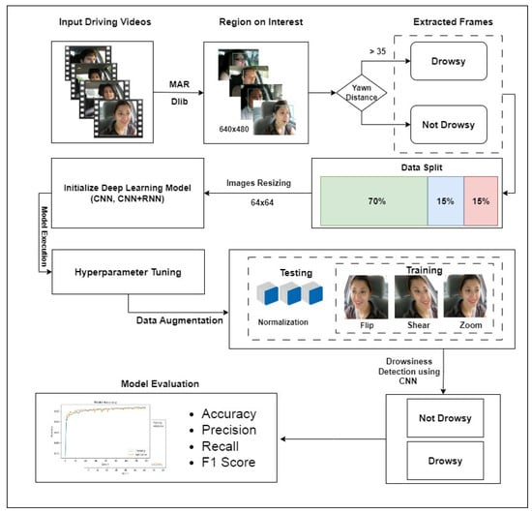
Module Design

Slide 11
Modules
Input Driving Videos (Data Collection)
Feature Extraction & Classification
Data Preprocessing & Augmentation
Model Execution
Model Evaluation

Slide 12
Module 1 Input Driving Videos (Data Collection)
The process begins with the collection of real-time driving videos from a dashboard camera or in-car monitoring system.
Face Detection:
Uses Dlib’s Facial Landmark Detector and Mouth Aspect Ratio (MAR) to locate the driver’s face.
Extracts key facial features like eyes, mouth, and head position for analysis.
Yawning Detection:
The distance between the lips is measured.
If Yawn Distance > 35, the driver is classified as Drowsy; otherwise, they are Not Drowsy.
Frame Extraction:
Frames are extracted from the video at regular intervals for further processing.

Slide 13
Module-1
Input Driving Videos(Data Collection):
📌 Libraries Used:
✅ cv2 – OpenCV (for video capture and processing)
✅ imutils.video.VideoStream – Efficient video streaming
✅ time – Adds delays for initialization

Slide 14
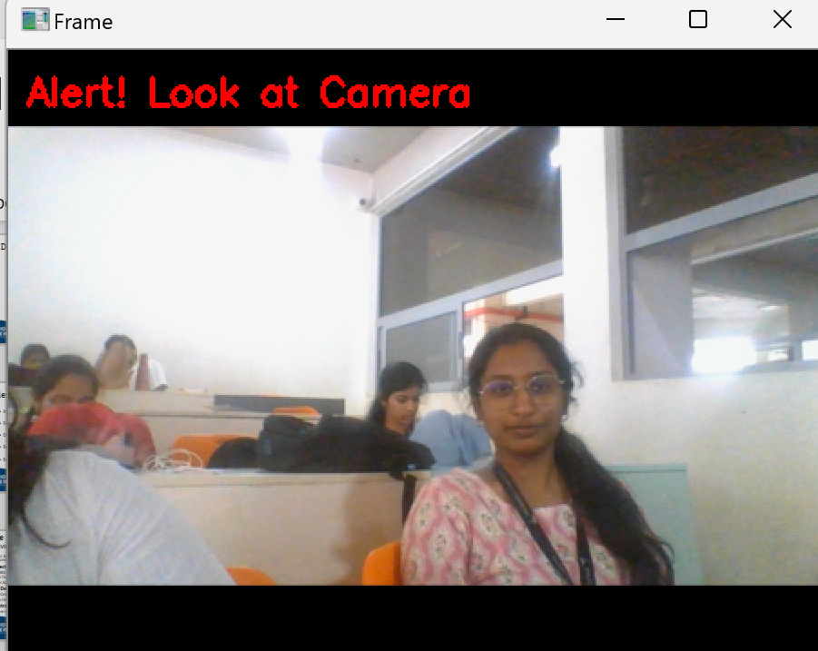

Slide 15
Module 2 Feature Extraction & Classification
This step involves identifying critical indicators of drowsiness, such as eye closure, yawning, and head tilt.
Eye Closure Detection:
Uses the Eye Aspect Ratio (EAR) method.
If EAR falls below a threshold for a sustained duration, the driver is flagged as Drowsy.
Mouth Aspect Ratio (MAR):
Measures how wide the mouth is open.
A higher MAR value indicates yawning, a sign of fatigue.
Head Pose Estimation:
Detects excessive head movements using Optical Flow tracking (Lucas-Kanade method).
A tilted head indicates possible drowsiness.

Slide 16
Module-2
Feature Extraction & Classification:
📌 Libraries Used:
✅ dlib – Face detection and landmark extraction
✅ cv2 – Image processing
✅ numpy – Numerical operations
✅ scipy.spatial.distance – Euclidean distance calculations
✅ playsound – Plays alarm sound

Slide 17
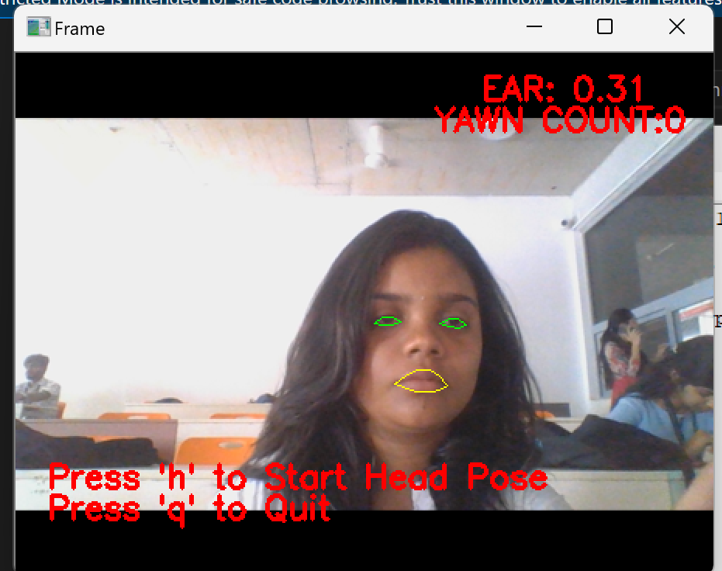

Slide 18
Module 3 Data Preprocessing & Augmentation
Since deep learning models require high-quality training data, preprocessing and augmentation steps are applied:
Image Resizing: Standardizes all input images to 64×64 pixels for efficient processing.
Data Splitting: The dataset is divided into:
70% Training Data – Used to train the deep learning model.
15% Validation Data – Used to fine-tune model hyperparameters.
15% Testing Data – Used to evaluate model accuracy.
Data Augmentation: To improve generalization and prevent overfitting, images are augmented using:
Flip
Shear
Zoom

Slide 19
Module-3
Data Preprocessing And Augmentation:
📌 Libraries Used:
✅ cv2 – Resizing, grayscale conversion
✅ numpy – Normalization
✅ albumentations – Image augmentation

Slide 20
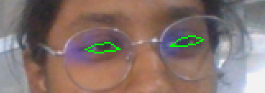

Slide 21
Module 4 Model Execution
The extracted facial features are processed using a deep learning model to classify driver drowsiness.
Model Used:
CNN (Convolutional Neural Network) – Extracts spatial features from images.
CNN + RNN (Recurrent Neural Network) – Detects sequential patterns in facial movements over time.
Hyperparameter Tuning:
Optimizes learning rate, batch size, dropout rate, and number of layers for better performance.
Training Process:
The model learns from training data to distinguish between Drowsy and Not Drowsy states.

Slide 22
Module-4
Model Execution And Evaluation:
📌 Libraries Used:
✅ cv2 – Model execution and displaying results
✅ playsound – Alert sound for model evaluation

Slide 23
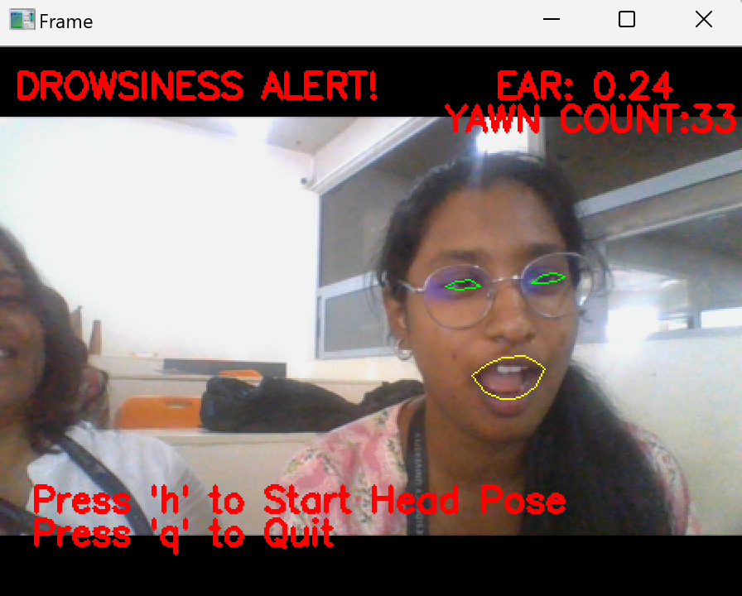

Slide 24
Module 5 Model Evaluation
After training, the model’s performance is assessed using key evaluation metrics:
Accuracy: Measures overall correctness of predictions.
Precision: Determines the proportion of detected drowsy states that are actually drowsy.
Recall: Measures how well the system detects actual drowsy states.
F1 Score: Balances precision and recall for a comprehensive evaluation.

Slide 25
Tools And Technologies To Be Used
Programming Languages:
Python – Popular for its extensive libraries like OpenCV, NumPy, and SciPy, used for image processing, computer vision, and machine learning.
Computer Vision Libraries:
OpenCV – A comprehensive library for computer vision tasks, including:
Face detection
Eye detection
Image processing
Video analysis

Slide 26
Tools And Technologies To Be Used
Machine Learning & Deep Learning Frameworks:
TensorFlow – Used for building deep learning models like CNN and RNN.
Keras – High-level neural network API running on TensorFlow, simplifies model training.
PyTorch – Flexible deep learning framework for real-time analysis.
Dlib – Provides pre-trained facial landmark detection models.

Slide 27
Tools And Technologies To Be Used
Deep Learning Models for Drowsiness Detection
Convolutional Neural Networks (CNNs)
A Convolutional Neural Network (CNN) is a deep learning model specifically designed for processing and analyzing visual data, such as images and videos. It is widely used in computer vision tasks like image classification, object detection, and facial recognition.
Used for image-based drowsiness detection.
Efficiently extracts features from images such as eye state (open/closed) and facial expressions.
Works well with static image inputs from a webcam or dashboard camera.

Slide 28
Github Link
The Github link provided should have public access permission.
GitHub Link :
https://github.com/pavani2406
GitHub Repository:
https://github.com/pavani2406/DrowzinessDetectionSystem

Slide 29
Timeline of the Project (Gantt Chart)
S. No. | Review(Offline) | Dates
1. | Review-0 | 07-02-2025
2. | Review-1 | 15-02-2025
3. | Review-2 | 05-03-2025
4. | Review-3 | 07-04-2025
5. | Review-4 | 26-05-2025

Slide 30
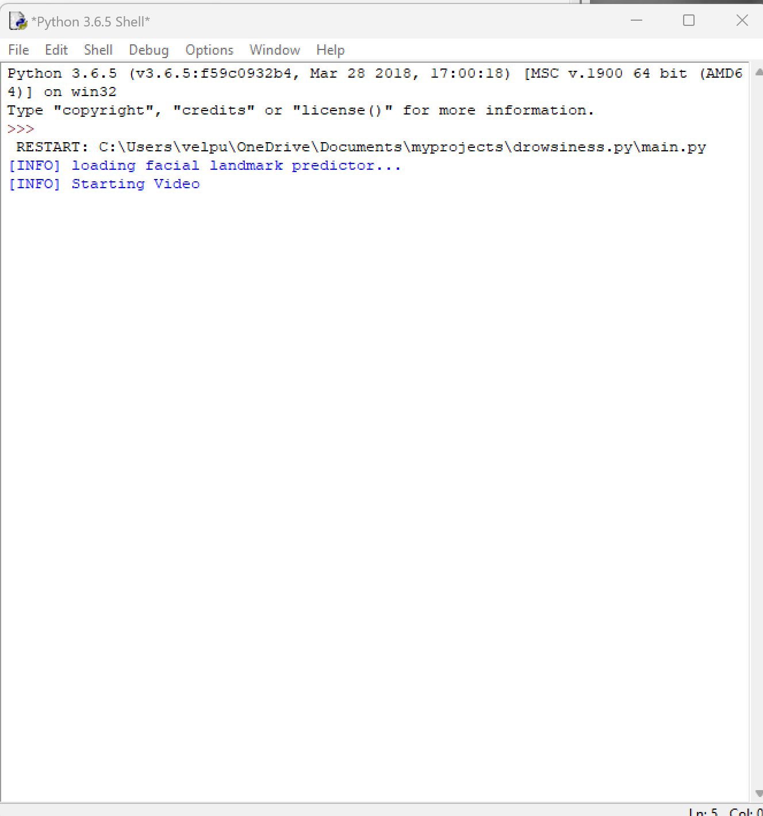
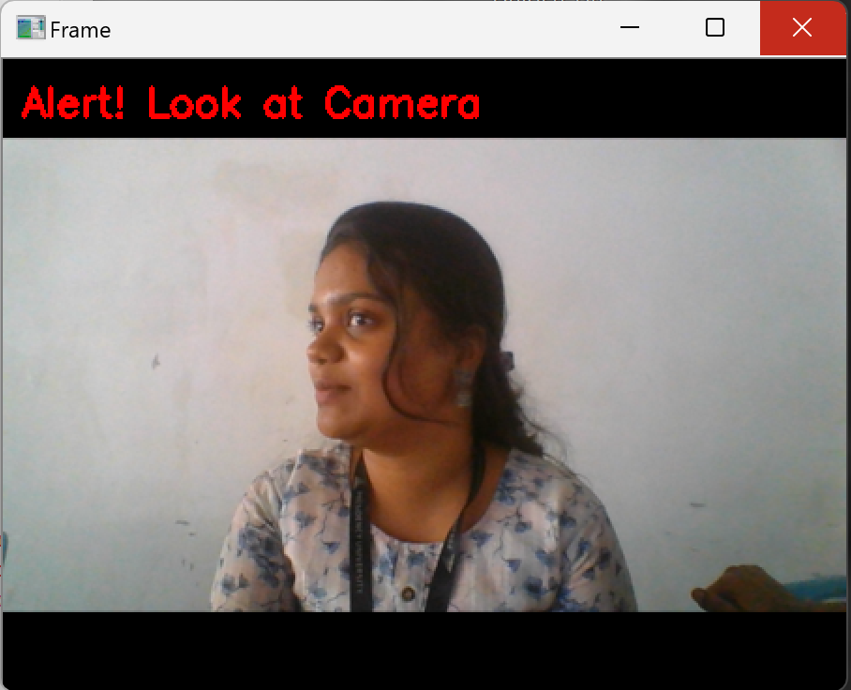
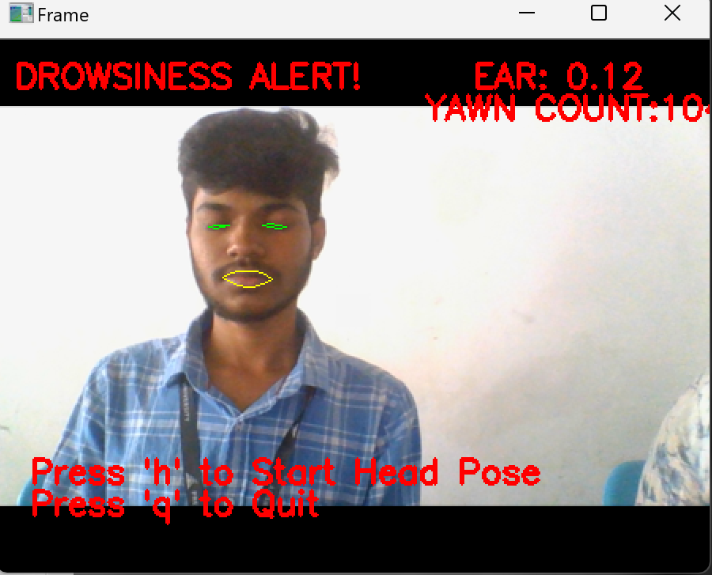
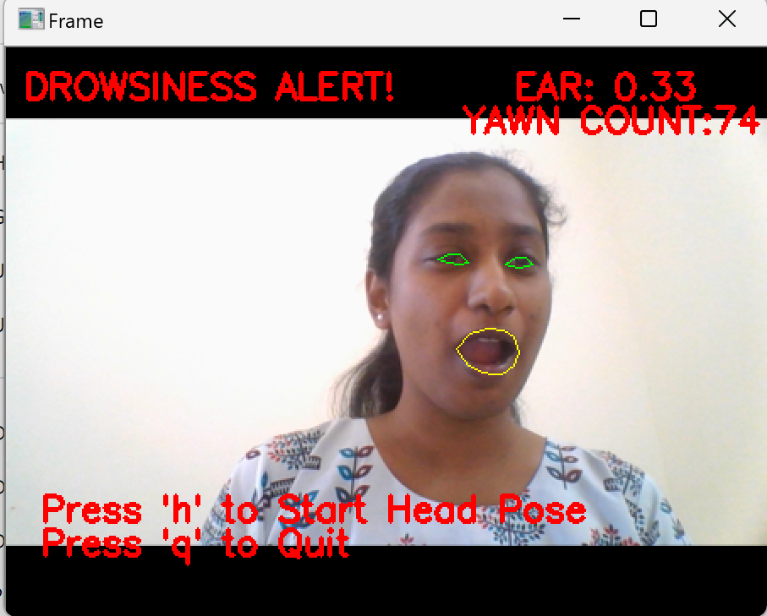
Final Output

Slide 31
References (IEEE Paper format)
1. Dakshnakumar G S; J. Anitha Investigation on Driver Drowsiness Detection using Deep Learning Approaches https://doi.org/10.1109/iccpct58313.2023.10245868
2. Eryl Nanda Pratama , Wikky Fawwaz Al Maki, Drowsiness Detection System for Masked Face Based on Deep Neural Network and Haar Cascade https://ieeexplore.ieee.org/document/10029948/authors#authors

Slide 32
References (IEEE Paper format)
3. Kanwarpartap Singh Gill; Vatsala Anand; Rahul Chauhan; Siddhant Thapliyal; Rupesh Gupta, A Convolutional Neural Network-Based Method for Real- Time Eye State Identification in Driver Drowsiness Detection https://ieeexplore.ieee.org/document/10442238
4. Mandapati Ankitha; Sandeep Vemuri; Suraneni Lowkya Gayathri; Jarabala Sindhu Bhargavi , Enhanced Driver’s Drowsiness Detection System using CNN model
https://ieeexplore.ieee.org/document/10353308

Slide 33
References (IEEE Paper format)
5. Parth P. Patel; Chirag L. Pavesha; Santoshi S. Sabat; Shraddha S. Deep Learning based Driver Drowsiness Detection , https://ieeexplore.ieee.org/document/9793253
6. R Syed Ali Fathima; Kovi Venkata Keerthi; Kovuri Naga Bhuvanesh; Kota Naga Jyothi; Kotikalapudi Sravya; Patnana Vijay Kumar, Driver Drowsiness Detection System with OpenCV and Keras https://ieeexplore.ieee.org/document/10823233

Slide 34
References (IEEE Paper format)
7. S Spandana; M. Srividhya; Yedavalli Venkata Raghava Rao; P. Devika; V. Srikanth; S Parvathi Vision based Driver Drowsiness Detection using Deep Learning https://doi.org/10.1109/assic60049.2024.10507905

Slide 35


