Slide 1
We are kindly welcome you to
“LEARNING WEBSITE ”
Here we are providing a tech courses for who are eagerly waiting enter into software ﬁeld..

Slide 2





ABSTRAT
We are developing an online LEARNING WEBSITE platform. The main motto of this platform is everyone can learn the software courses free of cost.
The main advantage of this website is anyone can access for free docments/pdf’s and cidro lecturers.
Particularly this website contains only software related courses like Development, Designing, Testing, Debugging and some of the math concepts like Aptitude,Reasoning etc...

Slide 3


TABLE OF CONTENTS
₀₄ Sneak Peek
The most important section of this project is courses. Because we are providing unlimited crash courses.
About the Project
We are providing software courses for free of codt to everyone. As well as some mathematical relations also.
01
Major Requirements
Here both software and hardware requirements are required. Some of those are HTML, CSS, JAVASCRIPT, BOOTSTRAP, RAM, OS ETC..
Project Goals
The main concept of this project is to provide software courses are free of cost.
05
Project Stages
This is development stage of this project.
02
Developed by
03
06
S.Pavani

Slide 4
OUR COMPANY
AI TECH SOLUTIONS PVT.LTD is a professional software company. We also deals software courses, for free of cost. And we are kindly helps to who are eagerly entering to software field.
Our company is all about creating innovate solutions and pushing the boundaries of technology. We developing software applications, websites, and even mobiles apps.
AI TECH SOLUTIONS PVT.LTD

Slide 5
WHAT WE ARE WORKIN ON
WEB DEVELOPMENT
Web development is the building and maintenance of websites; it’s the work that happens behind the scenes to make a website look great, work fast and perform well with a seamless user experience.
APP DEVELOPMENT
Mobile application development is the process of creating software applications that run on a mobile device, and a typical mobile application utilizes a network connection to work with remote computing resources.
TESTING
Testing is the process of evaluating a system or
its component(s) with the intent to find whether it satisfies the specified requirements or not. In simple words, testing is executing a system in order to identify any gaps, errors, or missing requirements

Slide 6
TECHNOLOGIES USED
HTML
For structuring the content of the website
JS
For adding interactive and dynamic features to the websites.
CSS
For styling and visually enhancing the presentation of the HTMLcontent.
BS
For responsive design and streamlined development

Slide 7
OUR PLACEMENT PARTNERS
GOOGLE
AMAZON
MICROSOFT

Slide 8
NOW
POOR DESIGN
PROGRAMMING FAILURES
LACK OF ADAPTABILITY

Slide 9
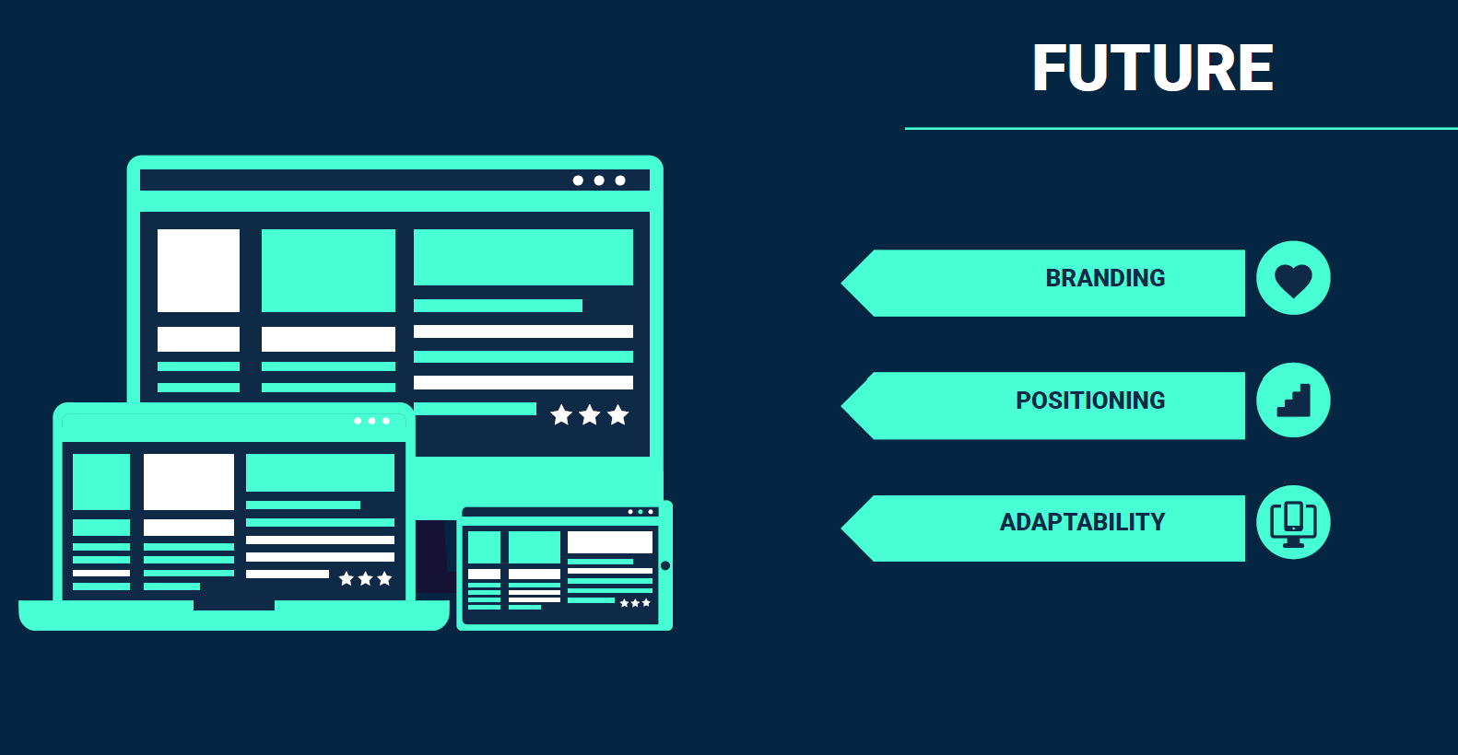

Slide 10
