Slide 1
Educational Quality Analysis Through Student Feedback
BATCH NUMBER: 14
Presented by:
25B21AI054 - A. Pavani - AIML
25B21AI066 - P. Satya - AIML
25B21AI061 - B. P. Pavani Ganga - AIML
25B31AI001 - M. S. U. Chandrika - AIML
Under esteemed guidance of:
Mrs. Pravallika
M.Tech, Assistant Professor (AIML)

Slide 2
OUTLINE
Problem formulation
Problem Definition
Literature review
Dataset Information
Objectives
Methodology
Technological requirements
Expected outcome
Conclusion

Slide 3
PROBLEM FORMULATION
Educational institutions collect large amounts of student feedback to evaluate teaching quality, course effectiveness, and overall learning experience. This feedback is typically collected through rating-based questionnaires and surveys. However, the analysis of this data is often done manually or through simple averaging techniques.
Manual analysis presents several challenges:
It is time-consuming.
It does not reveal hidden patterns or relationships.
It cannot efficiently handle large datasets.
There is a need for an automated, data-driven approach that can systematically analyze student
feedback using data mining techniques.

Slide 4
PROBLEM DEFINITION
Traditional methods of analyzing student feedback rely on manual evaluation or simple statistical techniques. These approaches are time-consuming, subjective, and inefficient when handling large volumes of survey data
. The problem is to design and implement a data mining system that can:
Accept large-scale student feedback data
Preprocess and clean the data
Identify significant attributes affecting student satisfaction
Classify students into satisfaction levels (Highly Satisfied, Satisfied, Dissatisfied)
Generate meaningful visualizations for interpretation
While ensuring:
High classification accuracy
Efficient processing
Objective and practical usability for academic decision-making

Slide 5
LITERATURE REVIEW
Paper Title | Journal Details & Authors | Methodology | Limitations
Machine Learning for Student Satisfaction Prediction | IJERT, 2021 – Singh et al. | Uses classification algorithms to predict student satisfaction based on feedback data and academic factors. | Accuracy depends on dataset size and quality
student Feedback Analysis using Data Mining | IEEE, 2021 – Kumar et al. | Uses Decision Tree, Naïve Bayes, and Random Forest to analyze student feedback and predict satisfaction levels. | Depends on quality of collected feedback data.
Educational Data Mining for Quality Analysis | Springer, 2020 – Sharma et al. | Applies data mining techniques to extract patterns and evaluate teaching effectiveness from student data. | Limited handling of unstructured feedback.
Impact of Data Preprocessing in Student Analysis | IJCA, 2019 – Reddy et al. | Focuses on preprocessing steps like handling missing values and transforming categorical data. | Improper preprocessing affects accuracy.
Visualization Techniques for Feedback Analysis | IEEE, 2022 – Patel et al. | Uses tools like Matplotlib and Seaborn to present feedback results through graphs and charts. | Visualization depends on correct data interpretation.

Slide 6
DATASET INFORMATION
Dataset Name: Student Feedback Dataset Total Records: 1024 rows Columns: 9
Key Attributes:
Student Name
Roll No
Department
Section
Q1_Teaching effectiveness
Q2_Content Quality
Q3_Classroom interaction
Q4_Resource used
Q5_Overall Experience

Slide 7
OBJECTIVES
The main objectives of this project are:
To collect and preprocess student feedback data.
To clean and transform the dataset using Python libraries such as Pandas and NumPy.
To apply feature engineering techniques to identify important attributes influencing satisfaction.
To implement classification algorithms to categorize students into satisfaction levels.
To visualize trends and patterns using Matplotlib.
To provide actionable insights to improve teaching effectiveness and academic quality.

Slide 8
CHALLENGES AND RISKS
Difficulty in collecting honest and unbiased student feedback
Handling missing and inconsistent data in datasets
Ensuring high accuracy in machine learning models
Data privacy issues while managing student information
Risk of wrong decisions due to incorrect analysis
Challenges and Risks

Slide 9
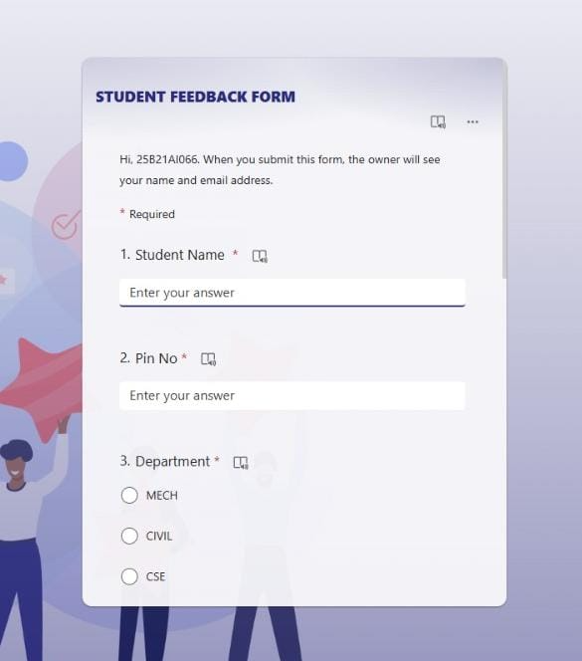
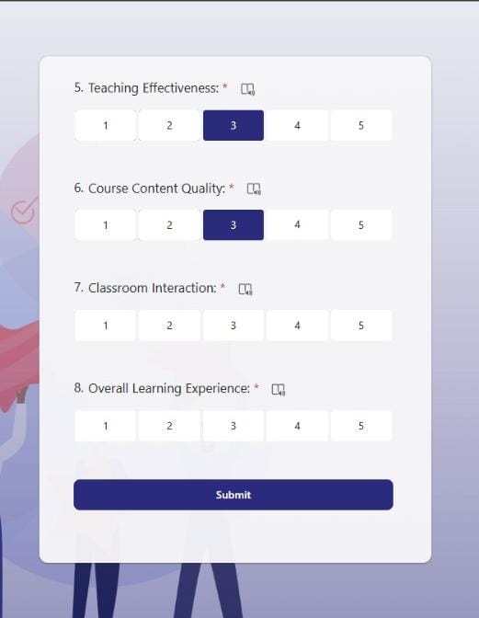
STUDENT FEEDBACK COLLECTION USING FORMS

Slide 10
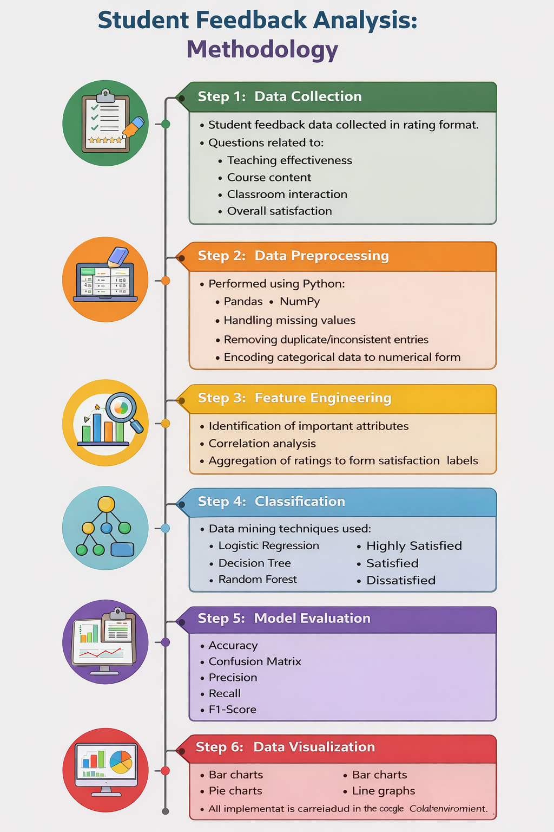
METHODOLOGY
This project follows a step-by-step process to analyze student feedback.
First, feedback is collected from students in the form of ratings.
Then, the data is cleaned by removing missing and incorrect values.
After that, important features are selected to understand student satisfaction.
Machine learning algorithms like Decision Tree and Random Forest are used to classify the feedback into different levels.
The model is then tested to check its accuracy.
Finally, the results are shown using simple charts like bar graphs and pie charts for easy understanding.

Slide 11
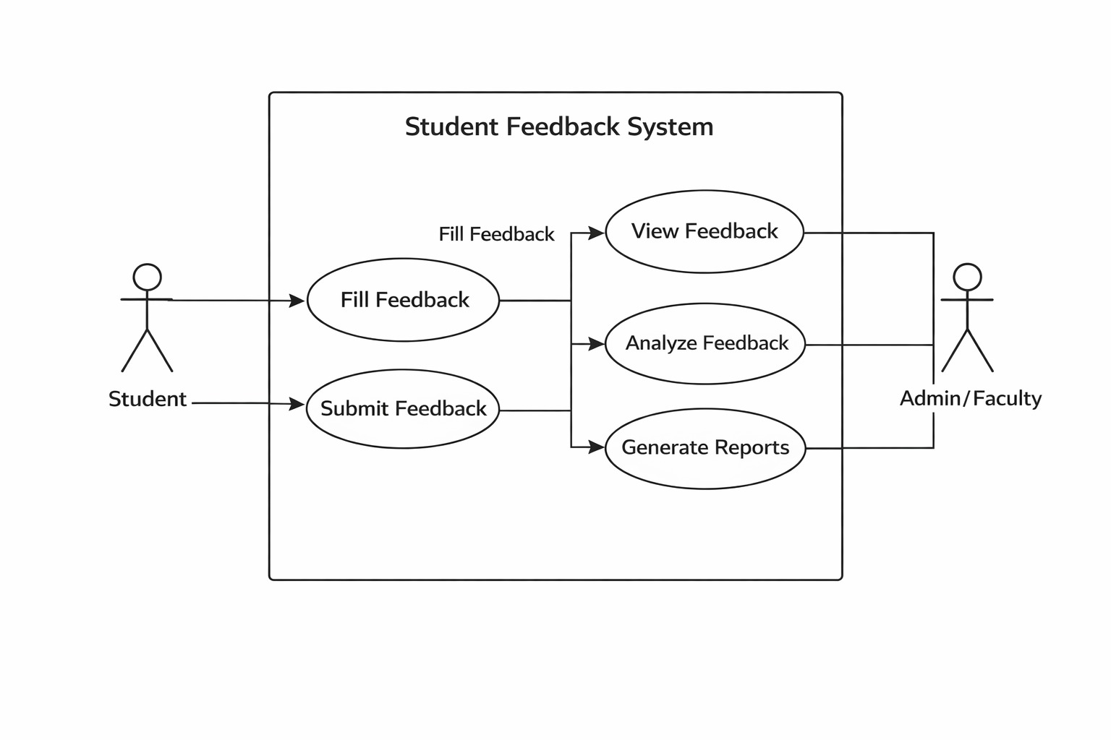
USE CASE DIAGRAM
Student gives feedback through system
System collects and stores feedback data
Data is cleaned and preprocessed
Feedback is analyzed using ML algorithms
System classifies satisfaction levels
Admin views reports and results
System provides visual reports using charts and graphs
Helps in improving teaching quality and decision making

Slide 12
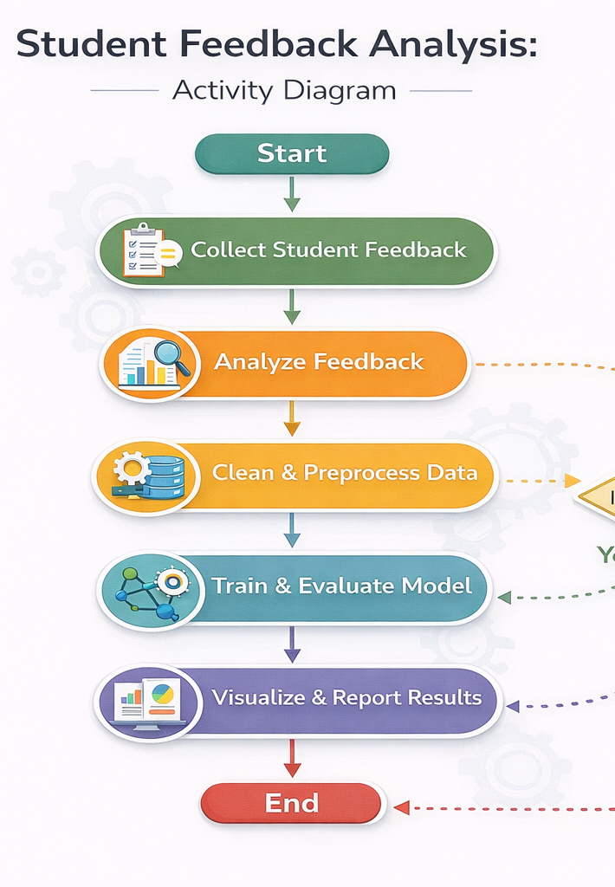
ACTIVITY DIAGRAM
The process starts with student giving feedback
System collects the feedback data
Data is checked and preprocessed
Cleaned data is sent for analysis
System performs classification of satisfaction levels

Slide 13
TECHNOLOGY REQUIREMENTS
Software Requirements
Operating System: Windows / Linux / MacOS
Python (Version 3.x)
Required Libraries: Pandas, NumPy, Matplotlib, Scikit-learn, Seaborn (optional)
Google Colab
Hardware Requirements
Processor: Intel i3 or higher
RAM: Minimum 4 GB (more than 4GB)
Storage: 10 GB free space

Slide 14
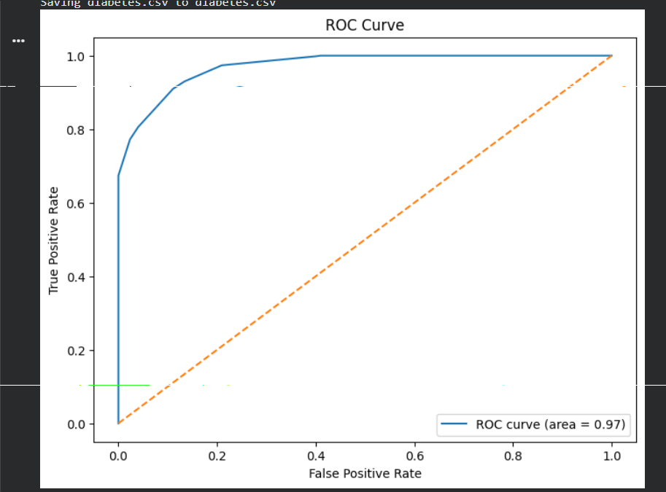
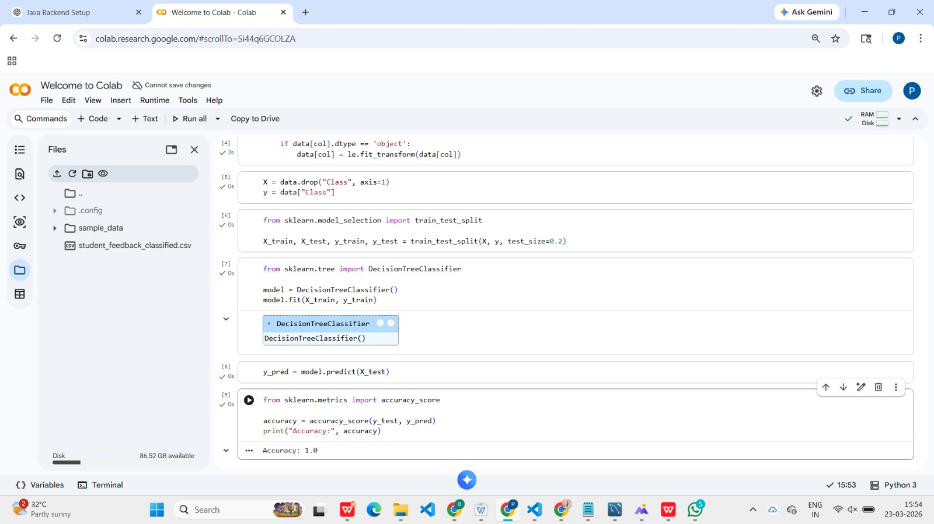
FINAL RESULT

Slide 15
CONCLUSION
This project demonstrates the effective application of data mining techniques to analyze student feedback systematically. By using Python-based tools and classification algorithms, large volumes of feedback data can be processed efficiently and objectively.
The automated analysis provides deeper insights into student satisfaction patterns, highlights areas needing improvement, and enables institutions to make informed academic decisions.
Ultimately, this approach enhances teaching effectiveness, promotes continuous quality improvement, and contributes to a better educational experience for students.

Slide 16
THANK YOU

