Slide 1
Process Scheduling
Interrupts
Pavani G

Slide 2
Contents
        CPU Scheduler
        Preemptive and Non preemptive
        Dispatcher
        Scheduling criteria
        Scheduling Algorithms
        Examples
        Interrupts
        Interrupt Service Routine

Slide 3
CPU Scheduler

Slide 4
Non Preemptive
once the CPU has been allocated to a process, the process keeps the CPU until it releases the CPU either by terminating or by switching to the waiting state.

Slide 5
Preemptive
The scheduling which takes place when a process switches from running state to ready state or from waiting state to ready state is called Preemptive Scheduling.

Slide 6
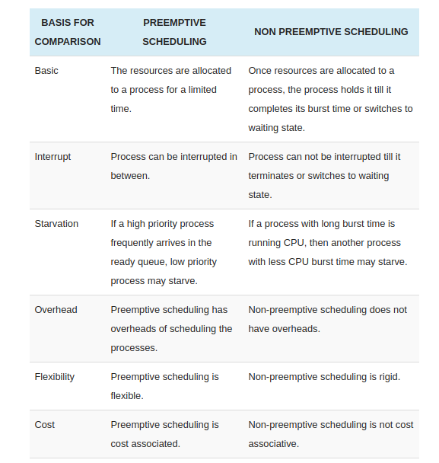
Comparision

