Slide 1
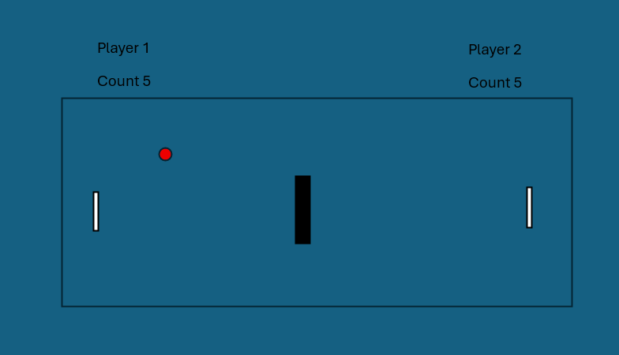
Mini Table Tennis Game
Team Pixel Warriors
Group
Members.
M. L. Wiksura - 2024/ICTS/021
A. P. U. Jayasiri - 2024/ICTS/024
A. A. L. N. Bandara - 2024/ICTS/101
K. P. C. S. Jayakodi - 2024/ICTS/036
ball
What
Does it Do ?
This is a two-player mini table tennis game where players use keys to control paddles and hit the ball.
The goal is to keep the ball in play and score points by successfully hitting it.
The game becomes faster over time, and it ends when one player misses the ball.
paddles
Programming
Concepts it demonstrates.
Variables: Positioning and speed (float/int).
Conditionals: if statements for collision and boundary checks.
Functions: Modular code structure (moveball(), paddleball(), etc.).
Coordinate System: Using X and Y axis for movement in a 2D space.

Slide 3
The Code
Key Section
of Code(Example):
Collision Logic:
if (x <= 20 + paddlew && y >= paddle2y && y <= paddle2y + paddleh)
Brief
Explanation.
This logic checks if the ball’s X-position has reached the paddle and if its Y – position is written the top and bottom edges of the paddle to trigger a bounce.
Interesting design decisions.
Randomization: Using random(2, 4) for ball speed so the game starts differently every time.
Input Handling: Using both character keys (“W”,”S”) and keycode (UP, DOWN) to allow two players on one keyboard.
Challenges
Encountered and solved.
Challenge: The ball getting “stuck” inside the paddle.
Solution: Manually resetting the ball’s X position (x = 20 + paddlew) immediately after a hit to ensure it stays outside the paddle area.

Slide 4
References & Reflection
All Sources.
Processing.org(Reference Documentation).
The Coding Train (YouTube Tutorials).
AI Tools (Debugging and logic optimization).
What each
team member learned:
Understanding how real-time loops (draw()) work in programming.
Handling user input efficiently to create a smooth gaming experience.
What you would
improve with more time:
Sound Effects: Adding “beep” sounds for paddle hits and “game over” sounds.
AI Opponent: Creating an automated paddle for single-player mode.
Visuals: Adding a “Start Menu” and different difficulty levels.
One Sentence from each member:
“Building this game helped me see how math and physics are used in coding.”
“Solving the collision logic was the most rewarding part of the project.”

