Slide 1

Introduction to Artificial Intelligence and Machine Learning
Prof.Aruna Ranganath

Slide 2
Today’s Agenda
Introduction to Machine Learning
Difference between programming and Machine Learning
Data set
Types of learning
Linear Regression and its cost function

Slide 3
What is Machine Learning?
“Learning is any process by which a system improves performance from experience.” - Herbert Simon
Definition by Tom Mitchell (1998):
Machine Learning is the study of algorithms that
improve their performance P
at some task T
with experience E
A well-defined learning task is given by <P,T,E>.

Slide 4
Traditional Programming Vs Learning
Traditional Programming
Data
Computer
Output
Program
Machine Learning
Data
Computer
Program
Output

Slide 5
Exercise-1
Finding the list of patient admitted between 1st Feb 2020 till 20th Feb 2020. Is this a data science problem? TRUE/FALSE

Slide 6
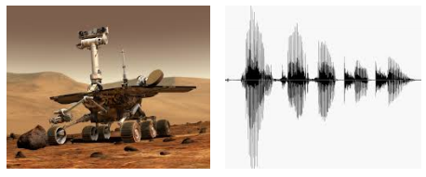
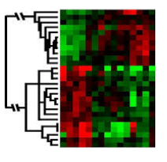
When Do We Use Machine Learning?
Human expertise does not exist (navigating on Mars)
Humans can’t explain their expertise (speech recognition)
Models are based on huge amounts of data (genomics)

Slide 7
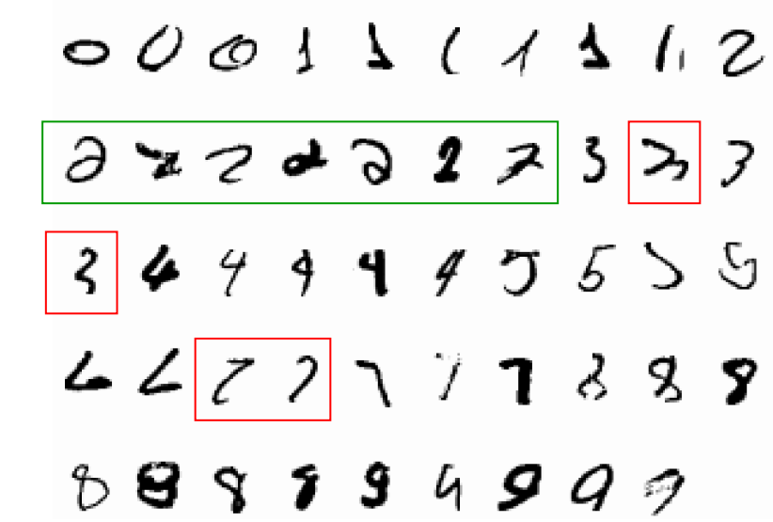
Handwritten Character recognition
A classic example of a task that requires machine learning: It is very hard to say what makes a 2

Slide 8
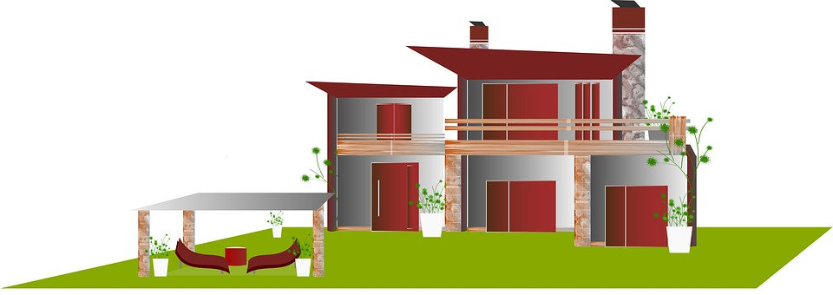
Data Set
Data is a collection of objects described using its attributes or features.
Building Area | Common Area | Type of Flooring | DistanceFrom BusDepot | Sale Price per square feet
11345 | 350 | Marble | 16503.22 | 6,715
2000 | 1334 | Vitrified Tiles | 16321.19 | 3,230
2544 | 924 | Wood Vitrified Tiles | 15619.92 | 6,588

Slide 9
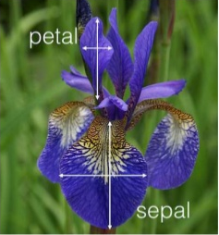
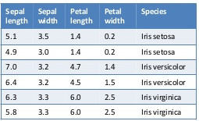
Exercise-2
Given the following data set how many samples do we have and what are the number of dimensions?

Slide 10
Different types of features
Nominal
Categorical
(qualitative)
Ordinal
Data
Interval
Numerical
(quantitative)
Ratio

Slide 11
Exercise-2
Given the data about the type of medal (Gold, Silver, Bronze) won by participants in Olympics. What type of variable does this data represent?
a. Nominal
b. Ordinal
C. Interval
D. Ratio

Slide 12
Types of Learning
Learning
Supervised
Learning
Unsupervised
Learning
Classification
Regression
Clustering

Slide 13
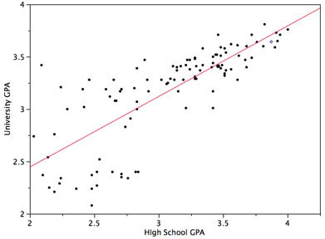
Supervised Learning: Regression
Given (x₁, y₁), (x₂, y₂), ..., (x_{n}, y_{n})
Learn a function f(x) to predict y given x where y is Continuous/real-valued.

Slide 14
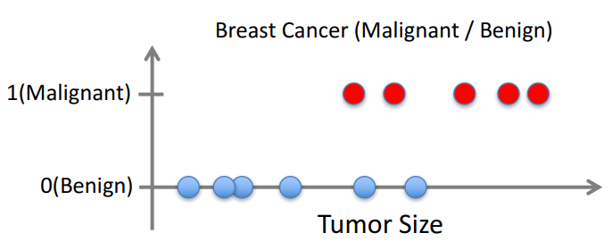
Supervised Learning: Classification
Given (x₁, y₁), (x₂, y₂), ..., (x_{n}, y_{n})
Learn a function f(x) to predict y given x where y is Categorical

Slide 15
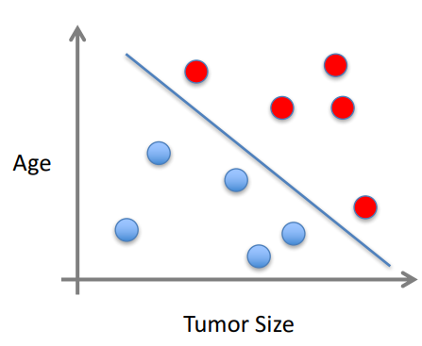
Supervised Learning: Classification
x can be multi-dimensional
Each dimension corresponds to an attribute
Clump Thickness
Uniformity of Cell Size
Uniformity of Cell Shape
…

Slide 16
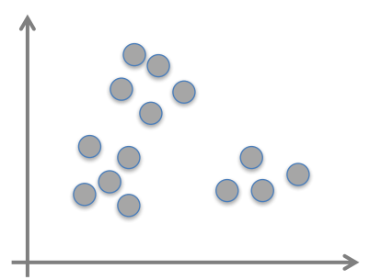
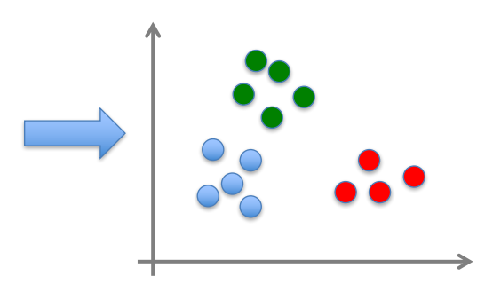
Unsupervised Learning
Given x₁, x₂, ..., x_{n} (without labels)
Output hidden structure behind the x’s
E.g., clustering

Slide 17
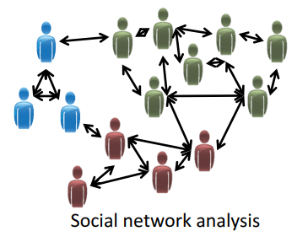
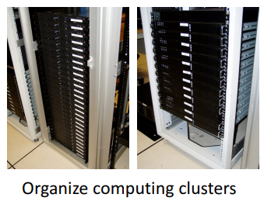
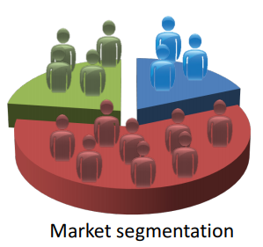
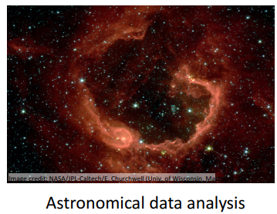
Unsupervised Learning Applications

Slide 18
What We’ll Cover in this Course
Supervised learning - Regression
Simple Linear Regression
Multiple Regression
Unsupervised learning
K Means clustering
Hierarchical clustering
Supervised learning - Classification
K-nearest neighbors
Logistic regression
Support Vector Machines
Naive Bayes
Decision Tree
Random Forest
Building search Engines
Building Recommender Systems

Slide 19
Exercise-3
A badminton coach wondered whether the time allotted for practice per week has any effect on the points scored in a game. What type of learning is suitable?
A. Linear Regression
B. Classification
C. Clustering
D. Not a learning

Slide 20
Exercise-4
You are designing a robot for a pet shop which must learn to discriminate Dogs from Cats. What type of learning is suitable?
A. Linear Regression
B. Classification
C. Clustering
D. Not a learning

Slide 21
Exercise-5
You are want to identify how many types of flowers are three in the data based on petal width and length. What type of learning is suitable?
A. Linear Regression
B. Classification
C. Clustering
D. Not a learning

Slide 22
Linear Regression
Regression problems are supervised learning problems where target / response is a continuous variable (or equivalently can take any real number).
Given input data set D the goal is to find a best line that can fit the data.
Model is of the form Y=W₀+W₁X
Where W0 is the intercept and W₁ is the slope

Slide 23
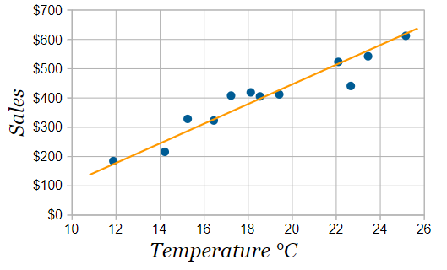
Example
Mohan has two variables Temperature and how many ice creams were sold at the shop from Monday to Friday.
X Temperature | Y Ice Creams Sold
2 | 4
3 | 5
5 | 7
7 | 10
9 | 15

Slide 24
Ordinary Least Squares

Slide 25
Example
Step 1: For each (x,y) calculate x² and xy:
x | y | x² | xy
2 | 4 | 4 | 8
3 | 5 | 9 | 15
5 | 7 | 25 | 35
7 | 10 | 49 | 70
9 | 15 | 81 | 135

Slide 26
Example
Step 2: Sum x, y, x² and xy (gives us Σx, Σy, Σx² and Σxy):
x | y | x² | xy
2 | 4 | 4 | 8
3 | 5 | 9 | 15
5 | 7 | 25 | 35
7 | 10 | 49 | 70
9 | 15 | 81 | 135
Σx: 26 | Σy: 41 | Σx²: 168 | Σxy: 263
N (number of data values) = 5

Slide 27
Example
Step 3: Calculate Slope m:
Step 4: Calculate Intercept b:
m = (N Σ(xy) − Σx Σy) / (N Σ(x²) − (Σx)²)
m= (5 x 263 − 26 x 41) / (5 x 168 − 26²)
= 1.5183
b = (Σy − m Σx) / N
b = (41 − 1.5183 x 26) / 5 = 0.3049

Slide 28
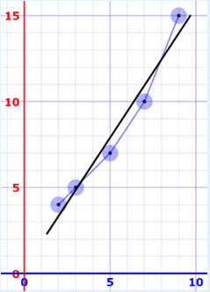
Example
Step 5: Assemble the equation of a line: y = mx + b
y = 1.518x + 0.305
x | y | y = 1.518x + 0.305 | error
2 | 4 | 3.34 | −0.66
3 | 5 | 4.86 | −0.14
5 | 7 | 7.89 | 0.89
7 | 10 | 10.93 | 0.93
9 | 15 | 13.97 | −1.03
x | y | y = 1.518x + 0.305 | error

Slide 29
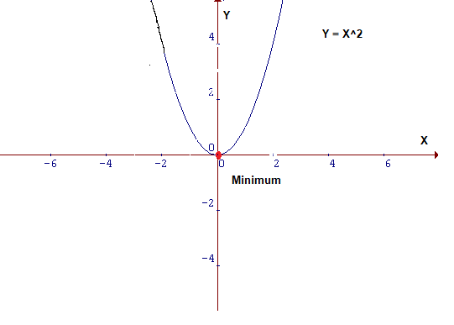

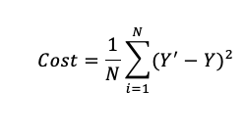
Cost Function

Slide 30
Summary
Definitions of Machine Learning
Difference between programming and Machine Learning
Data set
Types of learning
Linear Regression using Ordinary Least Squares method

