Slide 1

Feature Engineering
Prof.Aruna Ranganath

Slide 2
Today’s Agenda
Data preparation
Feature engineering
Feature scaling
Datasets
Dimensionality reduction

Slide 3
Data preparation
Missing values
Temporal Variables
Categorical Variables
Standardization

Slide 4
Data Preprocessing
GOAL: Engineer the data suitable for building faster and simple models
CLEAN
FORMAT
Select appropriate features
Data Transformation

Slide 5

Data cleaning
Data Quality issues
Missing values
Duplicate data
Inconsistent / Invalid data
Noise
Outliers

Slide 6
Missing values
Customer Name | Age | Income
Rahul | 35 | 12,00,000
Shravya | -- | 8,00,000
Mehul | 40 | 22,00,000
Vaishali | 25 | --
Shiva | 65 | --

Slide 7
Duplicate Data
Duplicate data occurs when your data set has redundant data objects
Customer Name | Address
Shravya | Flat no 450, Street no – 2 Celebrity homes,Mumbai
Shravya | Flat no 304, Street no – 215, Lave view homes, Bangalore
Mehul | Plot no 80, APARNA SAROVAR ZENITH, Nallagandla, Gachibowli
Shiva | Plot no 80, APARNA SAROVAR ZENITH, Nallagandla, Gachibowli

Slide 8
Inconsistent / Invalid data
Impossible value for a feature
Ex: age -10
7 letter Income -10000
zip code in India
Primarily occur due to data entry error

Slide 9
Noise
It is meaningless or distorted data.
Customer Name | Address
Shravya | Flat no 450, Street no – 2 Celebrity homes,Mumbai
Shravya | Flat no ϱђЂѭҖ, Street no – 215, Lave view homes, Bangalore
Mehul | Plot no 80, APARNA SAROVAR ZENITH, Nallagandla, Gachibowli
Shivă | Plot no 80, APARNA SAROVAR ZENITH, Nallagandla, Gachibowli

Slide 10
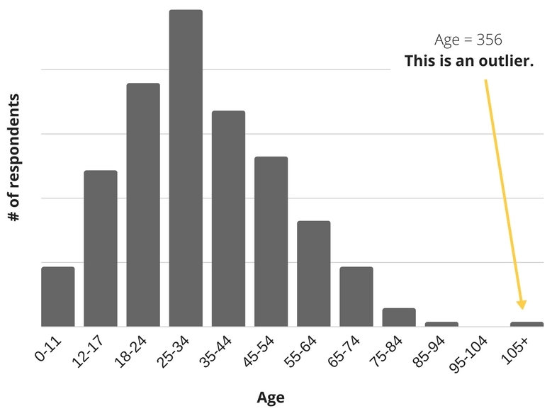
Outliers
A data object that is considerable different from others general behavior of the data.

Slide 11
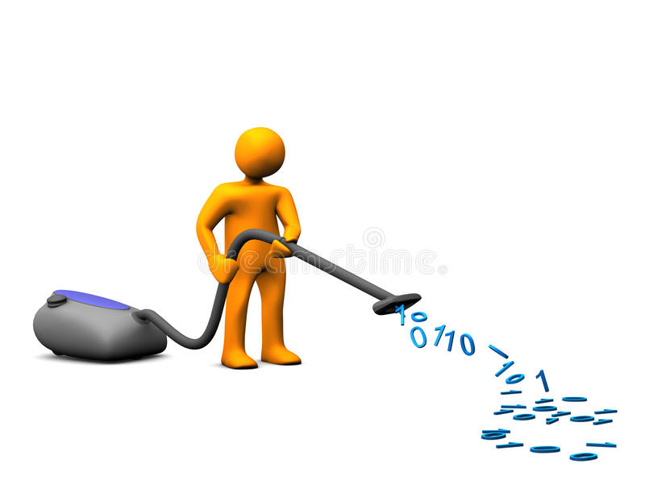
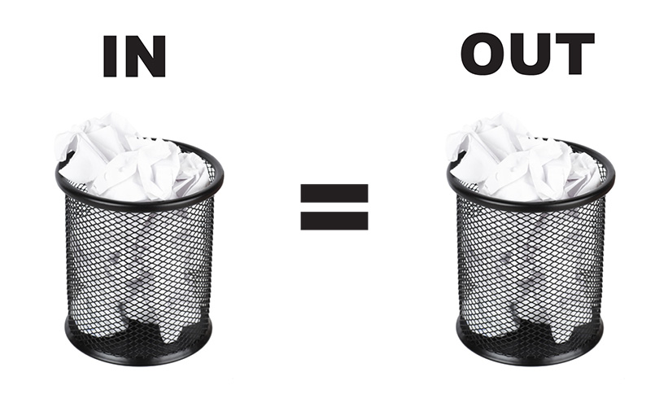
Data Preprocessing techniques
Feature selection
Adding or removing features
Feature Transformation
Scaling
Dimension reduction
Data Preprocessing is a very important
and tedious process

Slide 12

Major issue with real word data sets
Real world data is often dirty

Slide 13
Imputation Techniques for Numeric values
Gender | Age
Male | 42
Male | NA
Male | 24
Male | NA
Male | 36
Male | 57
Female | 32
Female | NA
Female | NA
Female | 18
Female | NA
Female | 23
Mean age = 33.14
Median age = 32

Slide 14
Adding a new variable to indicate missingness
Gender | Age | Age Missing?
Male | 42 | 0
Male | NA | 1
Male | 24 | 0
Male | NA | 1
Male | 36 | 0
Male | 57 | 0
Female | 32 | 0
Female | NA | 1
Female | NA | 1
Female | 18 | 1
Female | NA | 0
Female | 23 | 1

Slide 15
Imputation by most frequent category for categorical values
Gender | Age
Male | 42
Male | 43
Male | 24
NA | 63
Male | 36
Male | 57
Female | 32
NA | 33
Female | 45
Female | 18
NA | 55
Female | 23

Slide 16
Normalization
Types of common scaling operations or Normalization methods
Min-max normalization
z-score normalization
Normalization by decimal scaling

Slide 17

Min-Max Scaling
Min-max scaling squeezes (or stretches) all feature values to be within the range of [0, 1].
x
x - feature value
min(x) - minimum value of feature x
max(x) - maximum value of feature x
0
1

Slide 18

Exercise - 2
Let income range $12,000 to $98,000 be normalized to [0.0, 1.0].
Then $73,000 is mapped to ?

Slide 19
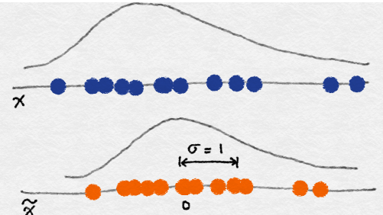

z-score normalization
In z-score normalization (or zero-mean normalization)
The values for an attribute, x, are normalized based on the mean (x) and standard deviation (σ_{x} ) of x.
The resulting scaled feature has a mean of 0 and a variance of 1.

Slide 20
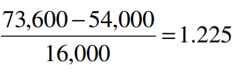
Exercise - 3
Let μ_{x}= 54,000, σ_{x} = 16,000, for the attribute income
With z-score normalization, a value of $73,600 for income is transformed to:
Z=score normalization can change the original data quite a bit.

Slide 21
Exercise - 3
Which of the following data standardization ensures that the mean is 0 and standard deviation is 1?
a. Min-Max Normalization
b. Z- Score Normalization
c. Decimal Scaling
d. None

Slide 22
Exercise - 4
Which of the following data standardization can be used to change the range of the data from old to new?
a. Min-Max Normalization
b. Z- Score Normalization
c. Decimal Scaling
d. None

Slide 23
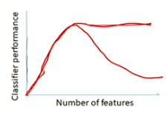
Curse of Dimensionality
As dimensionality increases the number of data points required for a classification model also increase exponentially.
Hughes Phenomenon: For a fixed number of training samples(N) in the data set the performance of the models decreases as dimensionality increase.
Reasons for this phenomenon:
Redundant Features – Carry same data in some other form
Correlation between features – the presence of one feature influence the other.
Irrelevant Features - those that are simply unnecessary

Slide 25
Feature Selection
Given: A set of predictors (“features”) F={f₁,f₂,f₃…f_{D}} and target class label T.
Find: Minimum subset F’={f₁’,f₂’,f₃’…f_{M}’} that achieves maximum classification performance where F’ ⊆ F.
Feature subset selection
Given D initial set of features
There are 2^{D} possible subsets.
Need a criteria to decide which subset is the best:
Classifier based on these m features has the lowest probability of error of all such classifiers.
Evaluating 2^{D} possible subsets is time consuming and expensive.
Use heuristics to reduce the search space.

Slide 26
Feature Selection approaches
Three approaches to evaluate 2^{D} possible subsets
Unsupervised (Filter Methods)
Use only features/predictor variables
Select the features that have the most information
Supervised: Wrapper Methods
Train using the selected subset
Estimate error on the validation set
Embedded Methods
Feature selection is done while training the model

Slide 27
Steps in Feature Selection
Feature selection is an optimization problem having the following steps:
Step1: Search the space of all possible features
Step2: Pick the optimal subset using an objective function
Training data
Complete feature
Subset
Feature Subset Selection
Search
Feature
subset
Goodness
Objective Function
Final feature Subset
Machine Learning Algorithm

Slide 28
Filter Methods
The Predictive power of individual feature is evaluated.
Rank each feature according to some univariate metric and select the highest ranking features.
The score should reflect the discriminative power of each feature.
Input: large feature set Ω
1 Identify candidate subset S ⊆ Ω
2 While !stop criterion()
Evaluate utility function J using S.
Adapt S
3 Return S.
Pros: fast, provides generically useful feature set
Cons: cause higher error than wrappers

Slide 29
Types of Filters
Univariate filters evaluate each feature independently with respect to the target variable.
Correlation
Fisher Score
Mutual Information (Information Gain)
Gini index
Gain Ratio
Chi-Squared test
Multivariate filters evaluate features in context of others.

Slide 30
Types of Filters
Correlation-based
Pearson product-moment correlation
Spearman rank correlation
Kendall concordance
Information-theoretic metrics
Mutual Information (Information Gain)
Gain Ratio
Statistical/probabilistic independence metrics
Chi-square statistic
F-statistic
Welch's statistic
Others
Fisher score
Gini index
Cramer's V

Slide 31
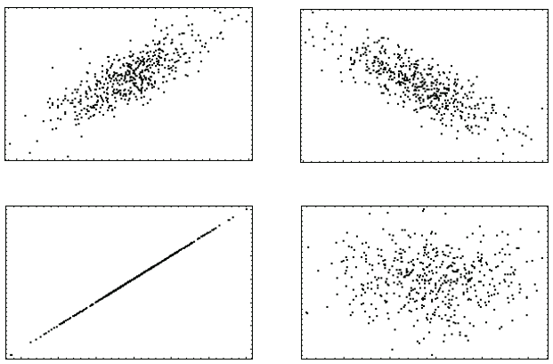
How “useful” is a single feature? : Univariate filters
Trying to predict someone’s ML exam grade from various possible indicators (a.k.a. features):
1) Statistics grade,
2) Biology grade,
3) Linear Algebra grade, or
4) Height ...
Which one would you pick?

Slide 32
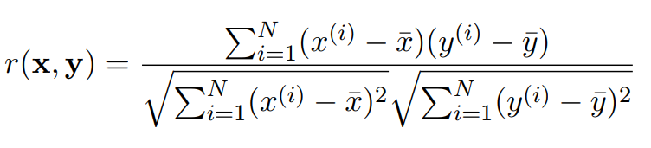
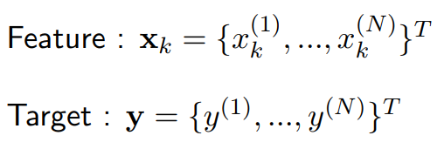
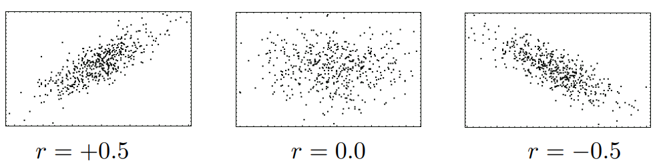
Pearson’s Correlation Coefficient
Used to measure the strength of association between two continuous random variables.
Both positive and negative correlation is useful!

Slide 33
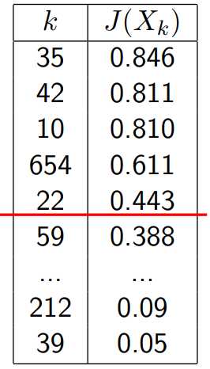
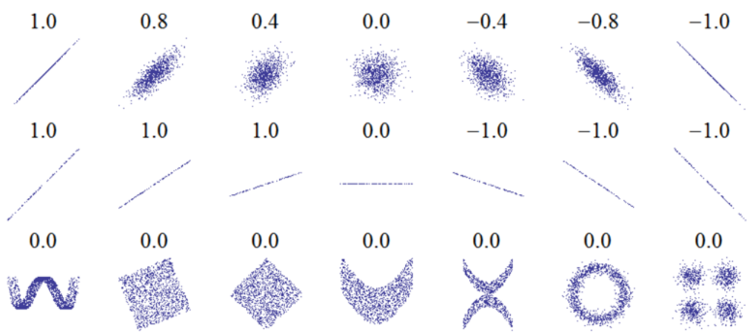
Ranking with Filter Criteria
Rank features X_{i} , ∀i by their values of J(X_{k}).
Retain the highest ranked features, discard the lowest ranked.
Cut-off point decided by user, e.g. |S| = 5,
S = {35, 42, 10, 654, 22}.
Limitation: Pearson assumes all features are INDEPENDENT ! and... only identifies LINEAR correlations.

Slide 34
There are LOTS of ranking criteria...
Pearson, Fisher, Mutual Info, Jeffreys-Matsusita, Gini Index, AUC, F-measure, Kolmogorov distance, Chi-squared, CFS, Alpha-divergence, Symmetrical Uncertainty,.... etc, etc
How do I pick the right filter ? Unfortunately, quite complex.... depends on:
type of variables/targets (continuous, discrete, categorical).
class distribution
degree of nonlinearity/feature interaction
The “No Free Lunch” theorem states that there is no universal model that works best for every problem.

Slide 35
Exercise-5
Which of the following represent the curse of dimensionality?
a. For fixed number of features as number of samples increase the classifier performance decreases or remains constant.
b. For fixed number of samples as number of features increase the classifier performance decreases or remains constant.
C. For fixed number of samples and features the classifier performance decreases or remains constant.
d. None of the above

Slide 36
Wrapper Based Methods
Greedy Based algorithms
Agnostic to the machine learning models chosen.
Sequential feature selection algorithm add or remove one feature at a time based on the classifier performance until a desired criterion is met.

Slide 37
Algorithm for Wrapper based method
Input: large feature set Ω
Identify candidate subset S ⊆ Ω
While !stop_criterion()
Evaluate error of a classifier using S.
Adapt subset S.
Return S.
Training data
Complete feature
Subset
Wrapper Feature Subset Selection
Search
Feature
subset
Predictive
accuracy
Machine Learning Algorithm
Commonly used Stop criterions
Increase / Decrease in Predictive accuracy
Predefined number of features is reached
Final feature Subset
Machine Learning Algorithm

Slide 38
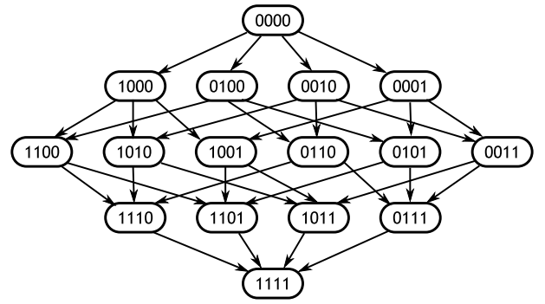
Sequential forward selection(SFS)
1. Start with the empty set 𝑌₀ = {∅}
2. Select the next best feature 𝑥⁺ = arg max 𝐽(𝑌_{𝑘} + 𝑥)
3. Update 𝑌_{𝑘+1} = 𝑌_{𝑘} + 𝑥⁺ ; 𝑘 = 𝑘 + 1
4. Go to 2

Slide 39
Sequential Backward selection(SBS)
1. Start with the full set 𝑌₀ = {X}
2. Remove the worst feature 𝑥⁻ = arg max 𝐽(𝑌_{𝑘} - 𝑥)
3. Update 𝑌_{𝑘+1} = 𝑌_{𝑘} - 𝑥⁻ ; 𝑘 = 𝑘 + 1
4. Go to 2
𝑥∈𝑌_{k}
Backwards selection is frequently used with random forest models

Slide 40
Dimensionality Reduction using Principal Component Analysis
Goal is to find a projection that captures the largest amount of variation in data
x₂
e
x₁

Slide 41
Summary
Simple linear regression using Gradient Descent
Defined Bias and Variance
Modeled Ridge Regression
Modeled Lasso Regression

