Slide 1

Classification using Logistic Regression,K-nearest neighbors and SVM
Prof.Aruna Ranganath

Slide 2
Today’s Agenda
Classification
Logistic regression
K-Nearest Neighbor
Support Vector Machines

Slide 3
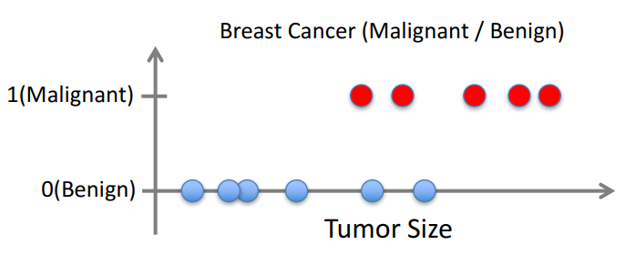
Classification
Given (x₁, y₁), (x₂, y₂), ..., (x_{n}, y_{n})
Learn a function f(x) to predict y given x where y is Categorical
Binary Classification
Multiclass Classification

Slide 4
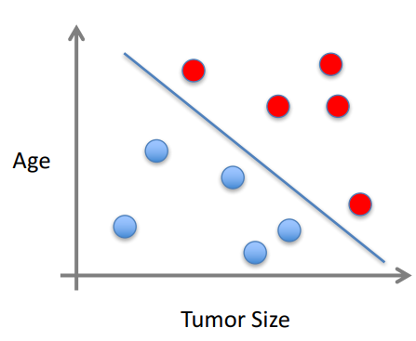
Classification
x can be multi-dimensional
Each dimension corresponds to an attribute
Clump Thickness
Uniformity of Cell Size
Uniformity of Cell Shape
…

Slide 5
Logistic Regression
1
Cancer
0
Tumor size

Slide 6
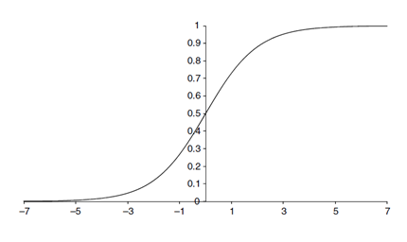
Logistic Regression

Slide 7
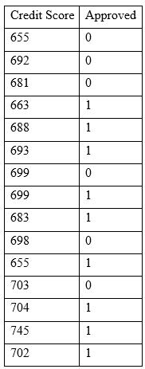
Exercise-1
On running a Linear regression, the weights were as follows:
Y= -9.346+0.014634 X
You want to now estimate for a test instance X₁=720 whether the loan would have approved or not.
P’⁼ e^{β0+β1x1} / (1+ e^{β0+β1x1})
Where e is a constant value 2.718
P’= e^{-9.346+0.014634 (720)} / (1+ e^{-9.346+0.014634 (720)})
P’=3.289/1+3.289
P’=0.7668 since P’ is >0.5 the loan will be classified as approved.

Slide 8
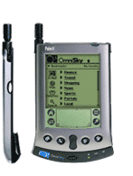

Instance-based Learning
Its very similar to a
Desktop!!
The KNN classifier is also a non parametric and instance-based learning algorithm.

Slide 9
k Nearest Neighbor
Requires 3 things:
The set of stored records
Distance metric to compute distance between records
The value of k, the number of nearest neighbors to retrieve
To classify an unknown record:
Compute distance to other training records
Identify k nearest neighbors
Use class labels of nearest neighbors to determine the class label of unknown record (e.g., by taking majority vote)
?

Slide 10
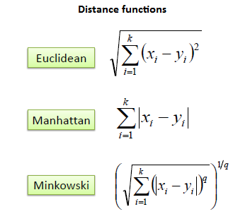
k Nearest Neighbor
Compute the distance between two points:
Determine the class from nearest neighbor list
Take the majority vote of class labels among the k-nearest neighbors
Weighted factor
w = 1/d²

Slide 11
k Nearest Neighbor
k = 1:
Belongs to square class
k = 3:
Belongs to triangle class
?
k = 7:
Belongs to square class
Choosing the value of k:
If k is too small, sensitive to noise points
If k is too large, neighborhood may include points from other classes
Choose an odd value for k, to eliminate ties

Slide 12
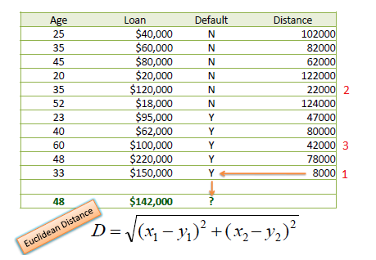
Example
Consider the following data concerning credit default. Age and Loan are two numerical variables (predictors) and Default is the target.
Standardize features

Slide 13
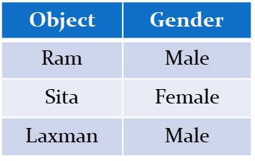
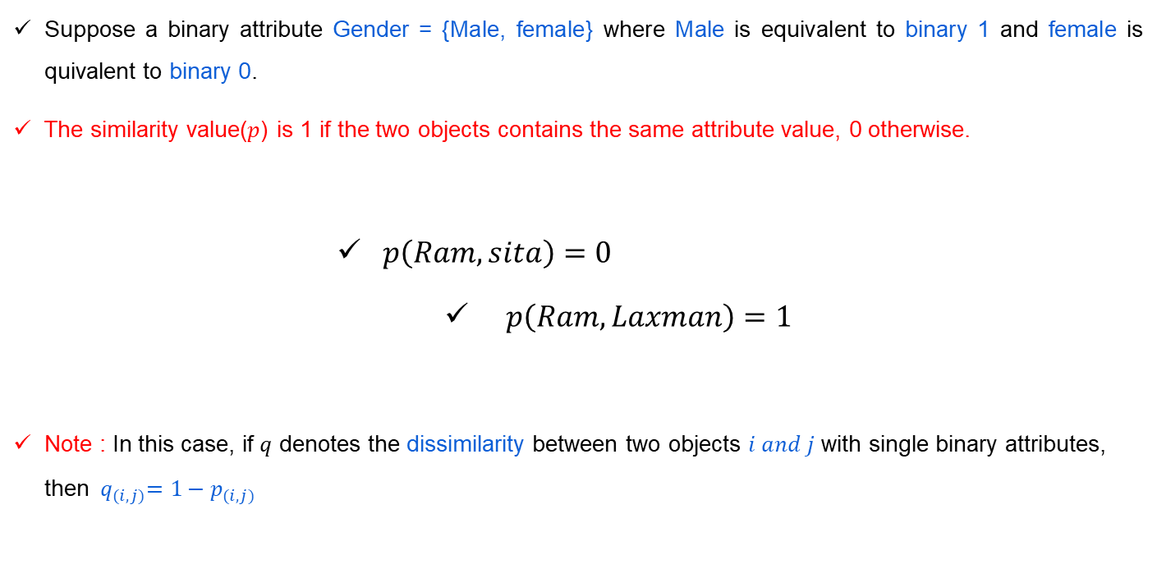
Proximity Measures for Single Nominal attribute
Suppose a binary attribute Gender = {Male, female} where Male is equivalent to binary 1 and female is quivalent to binary 0.
The similarity value($p$) is 1 if the two objects contains the same attribute value, 0 otherwise.
$p\left(Ram, sita\right)=0$
$p\left(Ram, Laxman\right)=1$
Note : In this case, if $q$ denotes the dissimilarity between two objects $i and j$ with single binary attributes, then ${{ q}_{(i,j)}=1−p}_{(i,j)}$

Slide 14
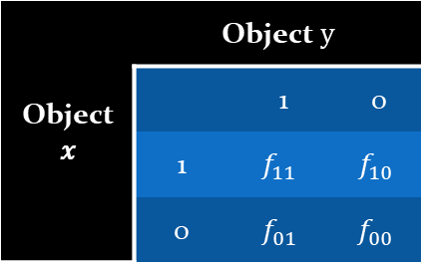
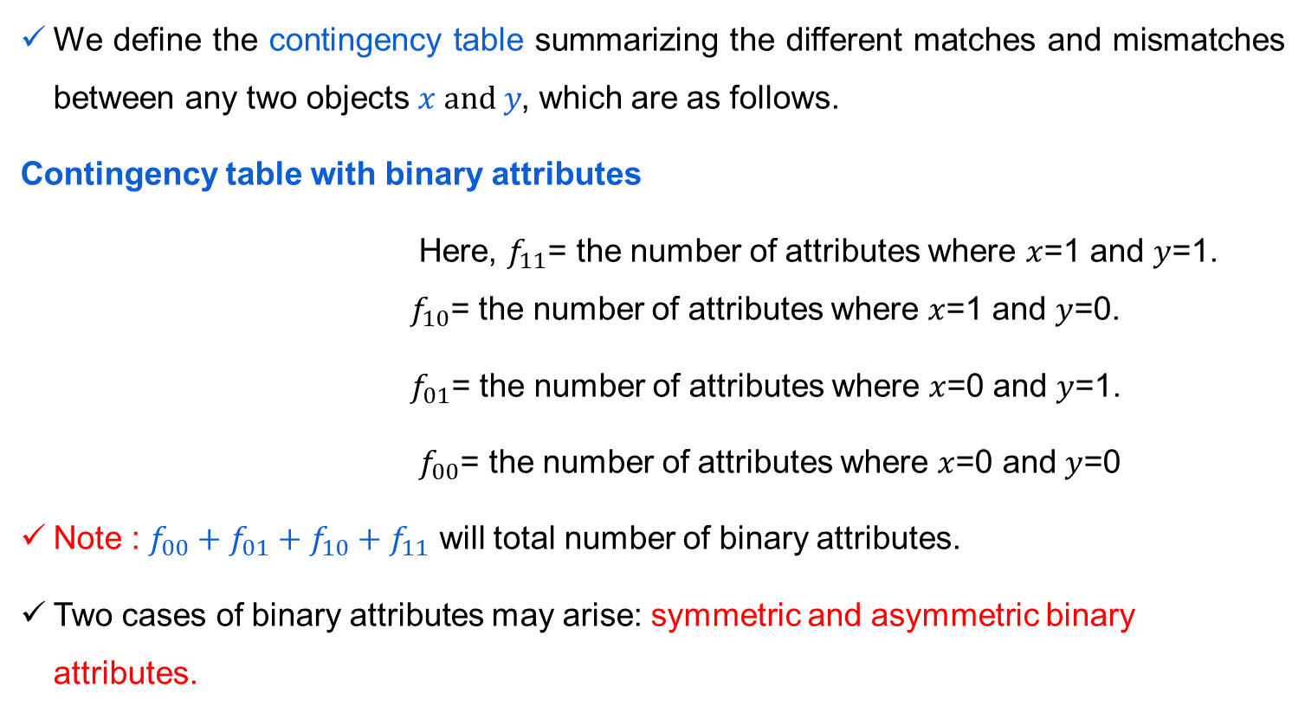
Proximity Measures for Two or more Nominal attribute
Proximity Measures for Multiple Nominal attributes
We define the contingency table summarizing the different matches and mismatches between any two objects $x and y$, which are as follows.
Contingency table with binary attributes
Here, $f_{11}$= the number of attributes where $x$=1 and $y$=1. $f_{10}$= the number of attributes where $x$=1 and $y$=0.
$f_{01}$= the number of attributes where $x$=0 and $y$=1.
$f_{00}$= the number of attributes where $x$=0 and $y$=0
Note : $f_{00}+f_{01}+f_{10}+f_{11}$ will total number of binary attributes.
Two cases of binary attributes may arise: symmetric and asymmetric binary attributes.

Slide 15
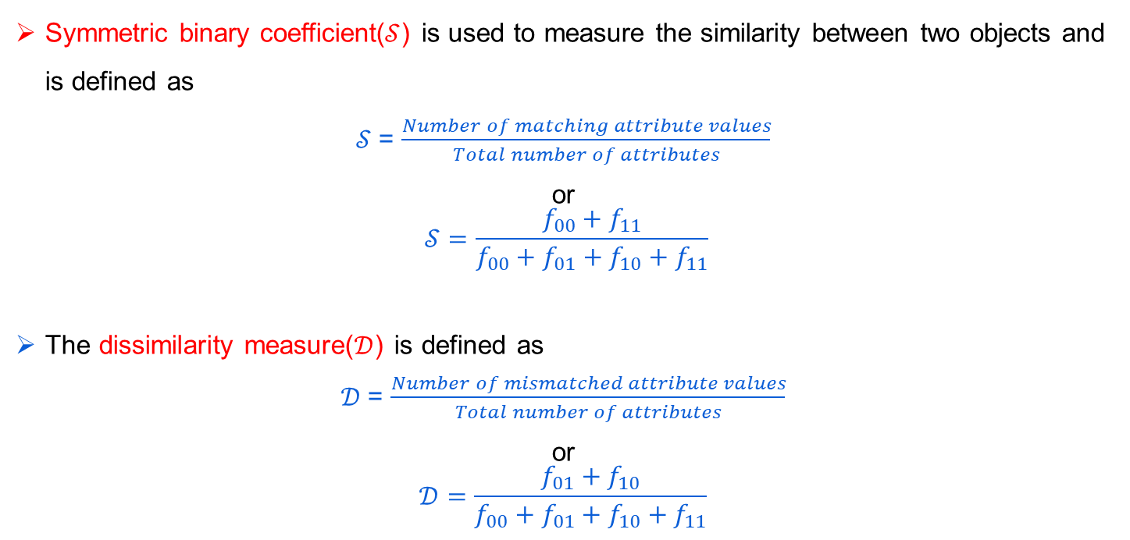
Similarity Measure for Symmetric Binary attribute
Symmetric binary coefficient($𝒮$) is used to measure the similarity between two objects and is defined as
$𝒮$= $\frac{Number of matching attribute values}{Total number of attributes}$
or
$$𝒮=\frac{f_{00}+f_{11}}{f_{00}+f_{01}+f_{10}+f_{11}}$$
The dissimilarity measure($𝒟$) is defined as
$𝒟$= $\frac{Number of mismatched attribute values}{Total number of attributes}$
or
$$𝒟=\frac{f_{01}+f_{10}}{f_{00}+f_{01}+f_{10}+f_{11}}$$
Notes:
Note that, $𝒟=1−$ $𝒮$

Slide 16
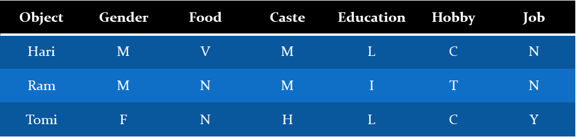
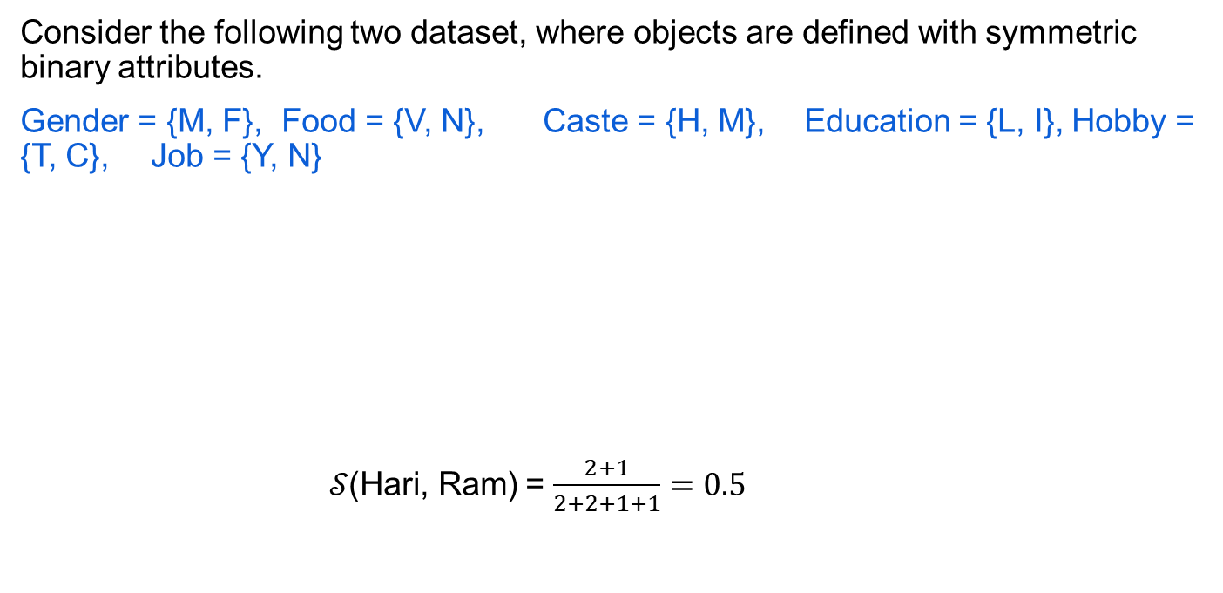
Similarity Measure with Symmetric Binary
Consider the following two dataset, where objects are defined with symmetric binary attributes.
Gender = {M, F}, Food = {V, N}, Caste = {H, M}, Education = {L, I}, Hobby = {T, C}, Job = {Y, N}
$𝒮\text{(}\text{Hari}\text{, }\text{Ram}\text{)}$ = $\frac{2+1}{2+2+1+1}=0.5$
 | 1 | 0
1 | 1 | 1
0 | 2 | 2

Slide 17
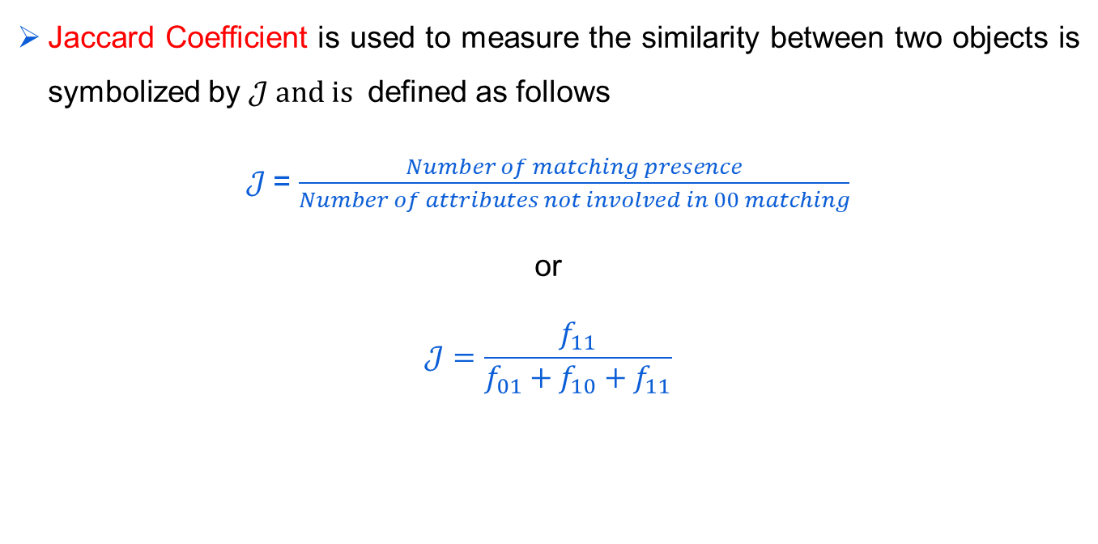
Proximity Measure with Asymmetric Binary
Jaccard Coefficient is used to measure the similarity between two objects is symbolized by $𝒥 and is$ defined as follows
$𝒥$= $\frac{Number of matching presence}{Number of attributes not involved in 00 matching}$
or
$$𝒥=\frac{f_{11}}{f_{01}+f_{10}+f_{11}}$$

Slide 18
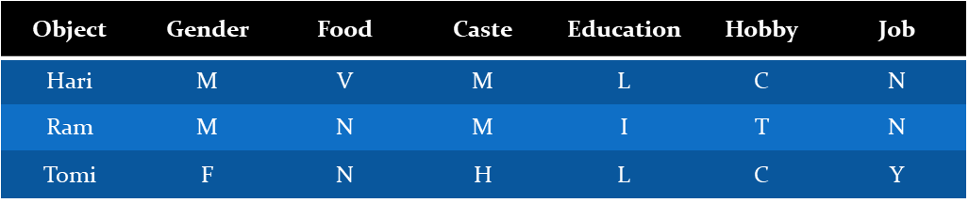
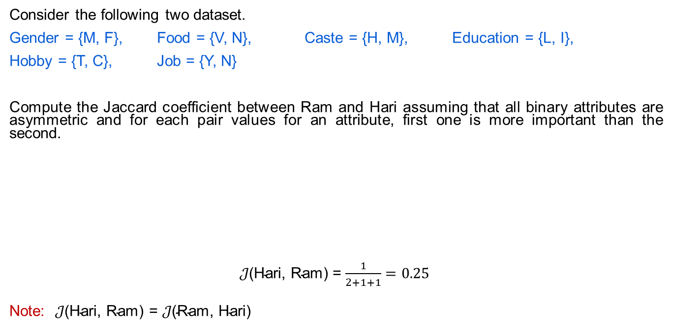
Proximity Measure with Asymmetric Binary
Consider the following two dataset.
Gender = {M, F}, Food = {V, N}, Caste = {H, M}, Education = {L, I},
Hobby = {T, C}, Job = {Y, N}
Compute the Jaccard coefficient between Ram and Hari assuming that all binary attributes are asymmetric and for each pair values for an attribute, first one is more important than the second.
$𝒥\text{(}\text{Hari}\text{, }\text{Ram}\text{)}$ = $\frac{1}{2+1+1}=0.25$
Note:$𝒥\text{(}\text{Hari}\text{, }\text{Ram}\text{)}$ = $𝒥\text{(}\text{Ram}\text{, }\text{Hari}\text{)}$
 | 1 | 0
1 | 1 | 1
0 | 2 | 2

Slide 19
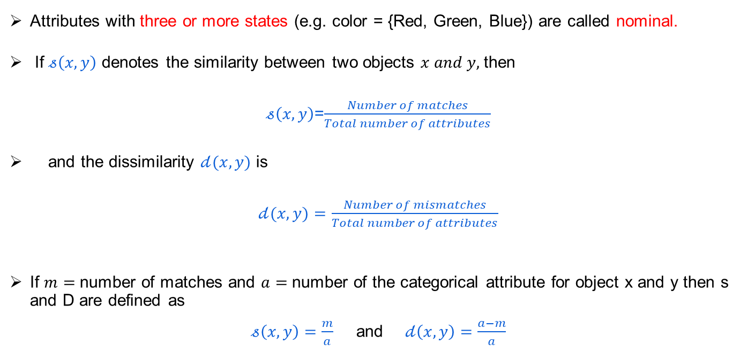
Proximity Measures for Categorical Attribute
Attributes with three or more states (e.g. color = {Red, Green, Blue}) are called nominal.
If $𝓈\left(x,y\right)$ denotes the similarity between two objects $x and y,$ then
$𝓈\left(x,y\right)$=$\frac{Number of matches}{Total number of attributes}$
and the dissimilarity $𝒹(x,y)$ is
$𝒹(x,y)$ $=\frac{Number of mismatches}{Total number of attributes}$
If $m=$ number of matches and $a=$ number of the categorical attribute for object x and y then s and D are defined as
$𝓈\left(x,y\right)=\frac{m}{a}$ and$𝒹\left(x,y\right)=\frac{a−m}{a}$
Notes:
Binary attribute is a special kind of nominal attribute where the attribute has values with two states only.

Slide 20
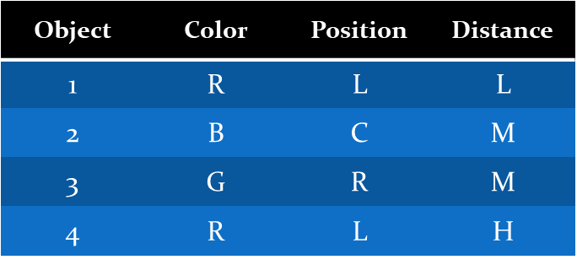
Proximity Measures for Categorical Attribute

Slide 21
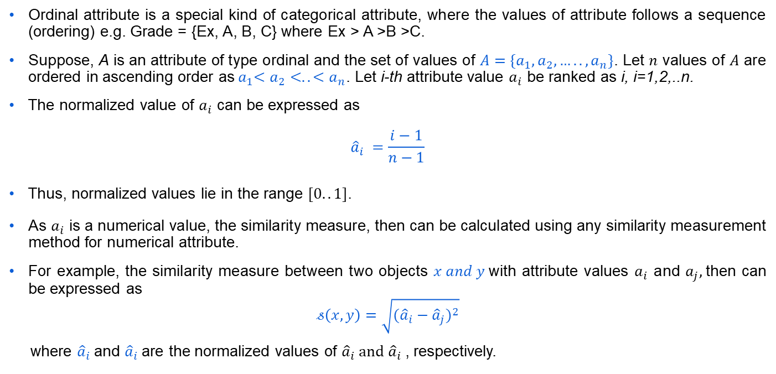
Proximity Measure for Ordinal Attribute
Ordinal attribute is a special kind of categorical attribute, where the values of attribute follows a sequence (ordering) e.g. Grade = {Ex, A, B, C} where Ex > A >B >C.
Suppose, A is an attribute of type ordinal and the set of values of ${A=\{a}_{1},a_{2},…..,a_{n}\}$. Let $n$ values of $A$ are ordered in ascending order as${ a}_{1}<a_{2}<..<a_{n}$. Let i-th attribute value $a_{i}$ be ranked as i, i=1,2,..n.
The normalized value of $a_{i}$ can be expressed as
$${\hat{a}}_{i} =\frac{i−1}{n−1}$$
Thus, normalized values lie in the range $[0..1]$.
As $a_{i}$ is a numerical value, the similarity measure, then can be calculated using any similarity measurement method for numerical attribute.
For example, the similarity measure between two objects $x and y$with attribute values $a_{i}$ and $a_{j},$then can be expressed as
$$𝓈\left(x,y\right)=\sqrt{({{\hat{a}}_{i}−{\hat{a}}_{j})}^{2}}$$
where ${\hat{a}}_{i}$and ${\hat{a}}_{i}$are the normalized values of ${\hat{a}}_{i} and$ ${\hat{a}}_{i}$, respectively.

Slide 22
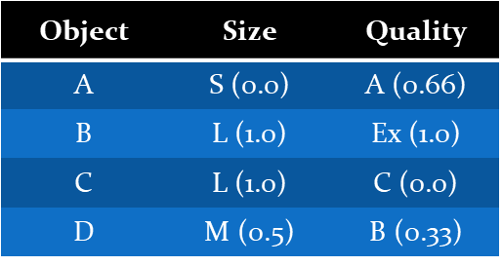
Proximity Measure for Ordinal Attribute
Consider the following set of records, where each record is defined by two ordinal attributes size={S, M, L} and Quality = {Ex, A, B, C} such that S<M<L and Ex>A>B>C.
Find the dissimilarity matrix, when each object is defined by only one ordinal attribute say size (or quality).

Slide 23
Properties of distance measures
Distance d (p, q) between two points p and q is a dissimilarity measure if it satisfies:
1. Positive definiteness:
d (p, q) ≥ 0 for all p and q and
d (p, q) = 0 only if p = q.
2. Symmetry: d (p, q) = d (q, p) for all p and q.
3. Triangle Inequality:
d (p, r) ≤ d (p, q) + d (q, r) for all points p, q, and r.
Notes:
Examples:
Euclidean distance
Minkowski distance
Mahalanobis distance

Slide 24
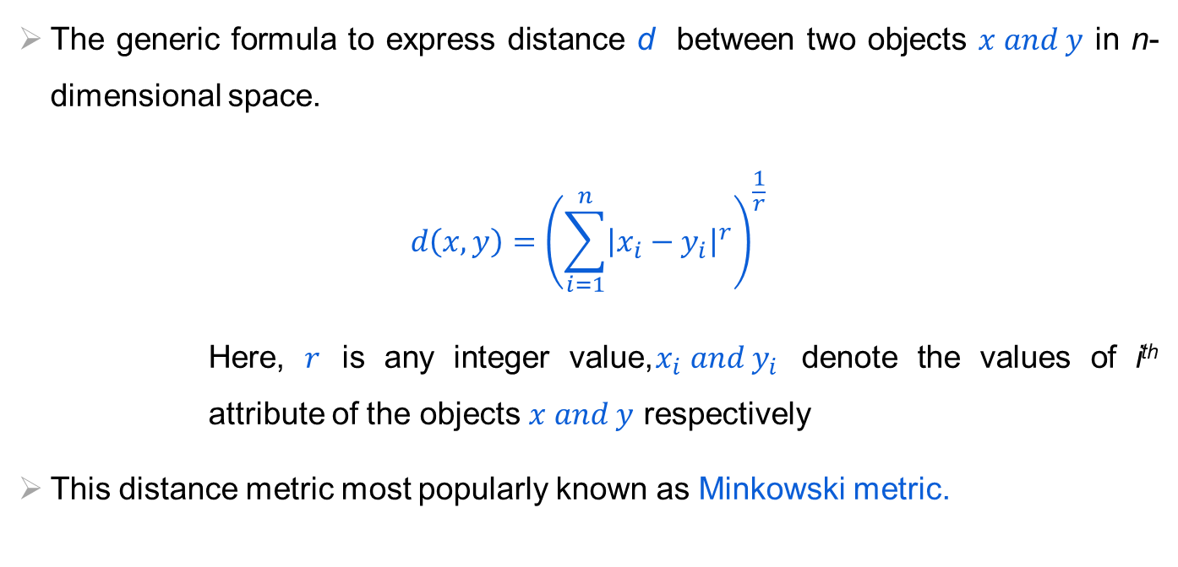
Proximity Measure with Interval Scale
The generic formula to express distance d between two objects $x and y$ in n-dimensional space.
$$d\left(x,y\right)={\left(\sum_{i=1}^{n}{{\left|x_{i}−y_{i}\right|}^{r}}\right)}^{\frac{1}{r}}$$
Here, $r$ is any integer value,$x_{i} and y_{i}$ denote the values of i^{th} attribute of the objects $x and y$ respectively
This distance metric most popularly known as Minkowski metric.
Notes:
Suppose, $x_{i} and y_{i}$ denote the values of i^{th} attribute of the objects $x and y$ respectively.

Slide 25
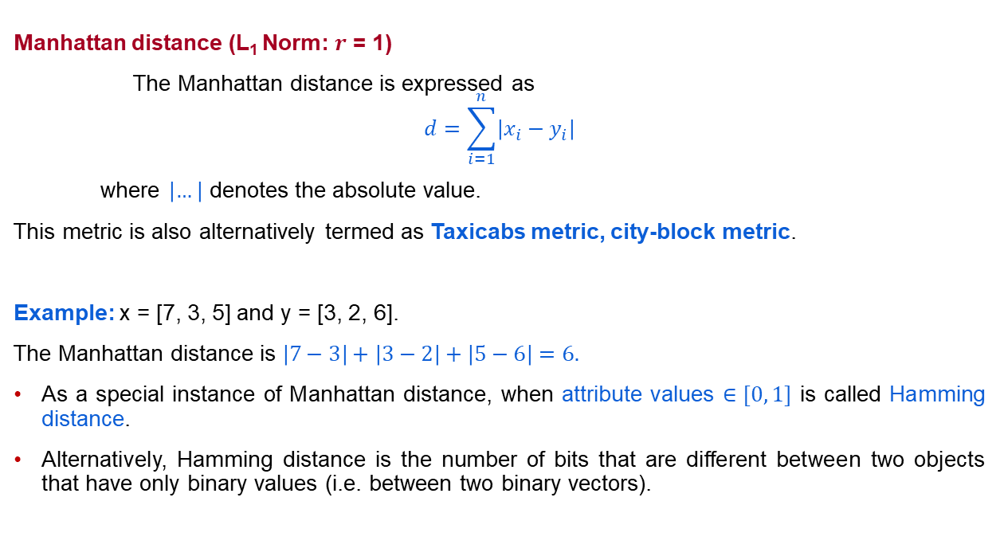
Proximity Measure with Interval Scale
Manhattan distance (L₁ Norm: $r$ = 1)
The Manhattan distance is expressed as
$$d=\sum_{i=1}^{n}{\left|x_{i}−y_{i}\right|}$$
where $\left|…\right|$ denotes the absolute value.
This metric is also alternatively termed as Taxicabs metric, city-block metric.
Example: x = [7, 3, 5] and y = [3, 2, 6].
The Manhattan distance is $\left|7−3\right|+\left|3−2\right|+\left|5−6\right|=6.$
As a special instance of Manhattan distance, when attribute values $∈[0, 1]$ is called Hamming distance.
Alternatively, Hamming distance is the number of bits that are different between two objects that have only binary values (i.e. between two binary vectors).
Notes:
Depending on the value of $r$, the distance measure is renamed accordingly.

Slide 26
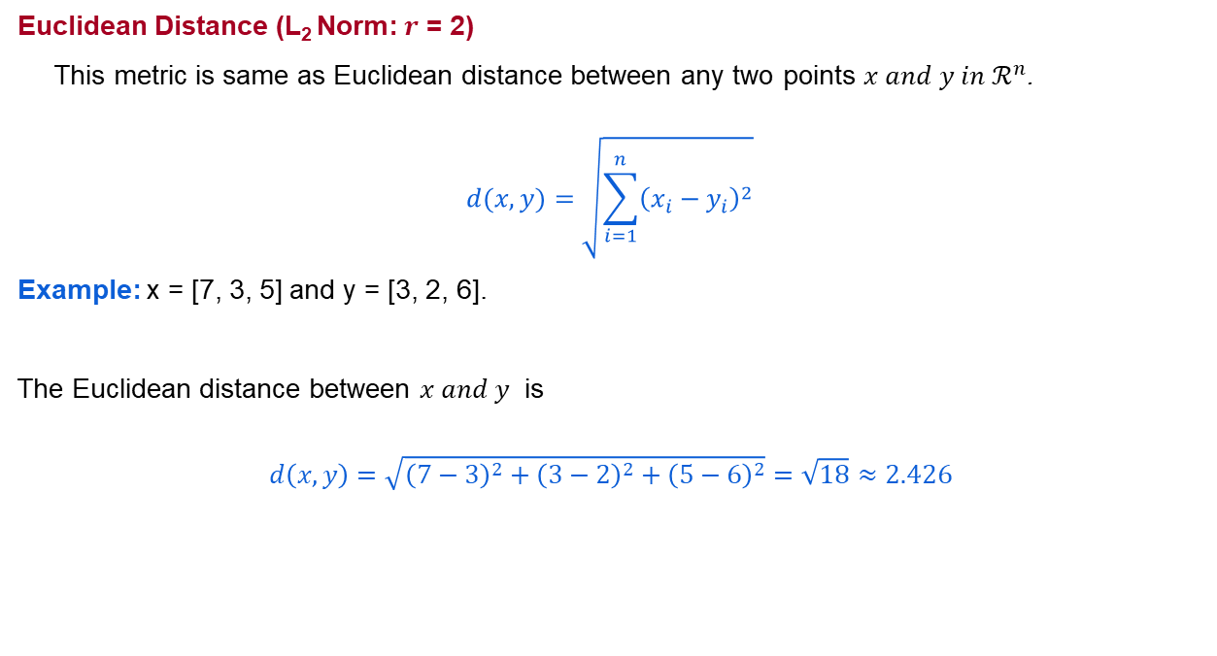
Proximity Measure with Interval Scale
Euclidean Distance (L₂ Norm: $r$ = 2)
This metric is same as Euclidean distance between any two points $x and y in ℛ^{n}$.
$$d(x,y)=\sqrt{\sum_{i=1}^{n}{{\left(x_{i}−y_{i}\right)}^{2}}}$$
Example: x = [7, 3, 5] and y = [3, 2, 6].
The Euclidean distance between $x and y$ is
$$d\left(x,y\right)=\sqrt{{\left(7−3\right)}^{2}+{\left(3−2\right)}^{2}+{\left(5−6\right)}^{2}}=\sqrt{18}≈2.426$$

Slide 27
Proximity Measure for Mixed Attributes
The previous metrics on similarity measures assume that all the attributes were of the same type. Thus, a general approach is needed when the attributes are of different types.
One straightforward approach is to compute the similarity between each attribute separately and then combine these attribute using a method that results in a similarity between 0 and 1.
Typically, the overall similarity is defined as the average of all the individual attribute similarities.

Slide 28
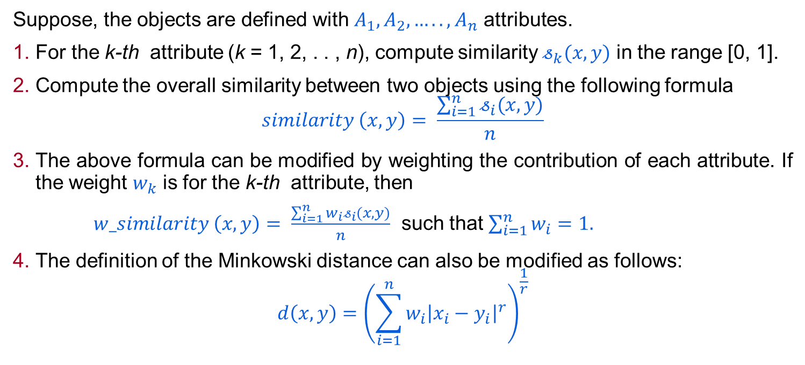
Proximity Measure with Vector Objects
Suppose, the objects are defined with $A_{1},A_{2},…..,A_{n}$ attributes.
For the k-th attribute (k = 1, 2, . . , n), compute similarity $𝓈_{k}(x,y)$ in the range [0, 1].
Compute the overall similarity between two objects using the following formula
$$similarity \left(x,y\right)= \frac{\sum_{i=1}^{n}{𝓈_{i}(x,y)}}{n}$$
The above formula can be modified by weighting the contribution of each attribute. If the weight $w_{k}$ is for the k-th attribute, then
$w_similarity \left(x,y\right)= \frac{\sum_{i=1}^{n}{{w_{i}𝓈}_{i}(x,y)}}{n}$ such that $\sum_{i=1}^{n}{w_{i}}=1.$
The definition of the Minkowski distance can also be modified as follows:
$$d\left(x,y\right)={\left(\sum_{i=1}^{n}{{w_{i}\left|x_{i}−y_{i}\right|}^{r}}\right)}^{\frac{1}{r}}$$

Slide 29
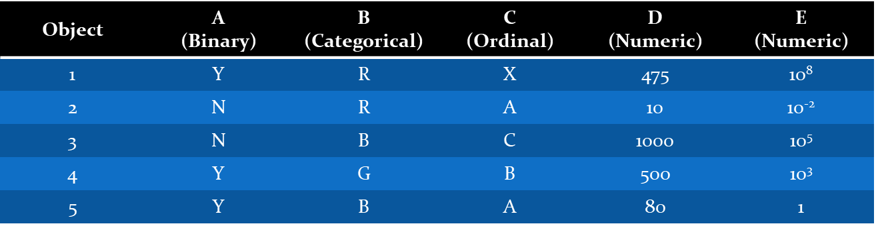
Proximity Measure with Mixed Attributes
Consider the following set of objects.

Slide 30
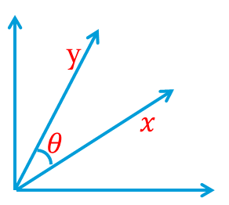
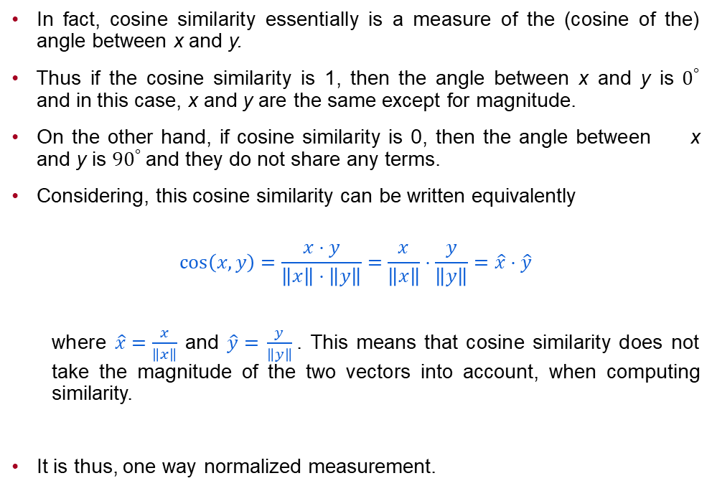
Cosine Similarity
In fact, cosine similarity essentially is a measure of the (cosine of the) angle between x and y.
Thus if the cosine similarity is 1, then the angle between x and y is $0^{°}$ and in this case, x and y are the same except for magnitude.
On the other hand, if cosine similarity is 0, then the angle between x and y is ${90}^{°}$ and they do not share any terms.
Considering, this cosine similarity can be written equivalently
$$\cos\left(x,y\right)=\frac{x⋅y}{\left\|x\right\|⋅\left\|y\right\|}=\frac{x}{\left\|x\right\|}⋅\frac{y}{\left\|y\right\|}=\hat{x}⋅\hat{y}$$
where $\hat{x}=\frac{x}{\left\|x\right\|}$ and $\hat{y}=$ $\frac{y}{\left\|y\right\|}$. This means that cosine similarity does not take the magnitude of the two vectors into account, when computing similarity.
It is thus, one way normalized measurement.

Slide 31
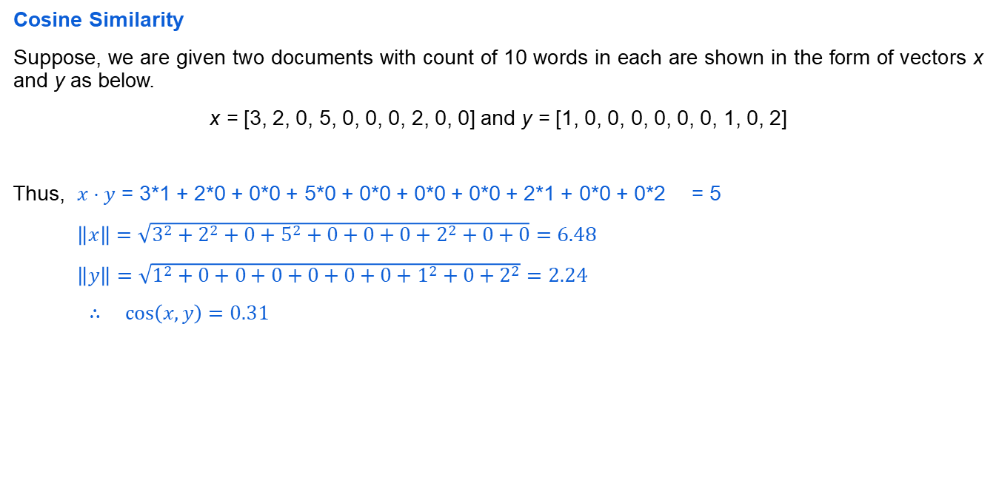
Non-Metric Similarity
Cosine Similarity
Suppose, we are given two documents with count of 10 words in each are shown in the form of vectors x and y as below.
x = [3, 2, 0, 5, 0, 0, 0, 2, 0, 0] and y = [1, 0, 0, 0, 0, 0, 0, 1, 0, 2]
Thus, $x⋅y$ = 3*1 + 2*0 + 0*0 + 5*0 + 0*0 + 0*0 + 0*0 + 2*1 + 0*0 + 0*2 = 5
$\left\|x\right\|=\sqrt{3^{2}+2^{2}+0+5^{2}+0+0+0+2^{2}+0+0}=6.48$
$\left\|y\right\|=\sqrt{1^{2}+0+0+0+0+0+0+1^{2}+0+2^{2}}=2.24$
$∴\cos\left(x,y\right)=0.31$

Slide 32
Summary
Logistic regression
K-Nearest Neighbor
Proximity measures

