Slide 1
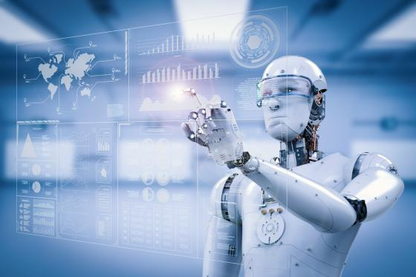
Classification using Support Vector Machines
Prof.Aruna Ranganath

Slide 2
Today’s Agenda
Support Vector Machines

Slide 3
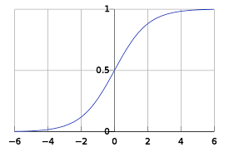
SUPPORT VECTOR MACHINES
SVM’s have a cleaver way of preventing overfitting and work with large feature without too much of computation.
Logistic regression gives us a linear decision surface.

Slide 5
Linear Models for classification
For a binary classification
Input: <(x₁,y₁) (x₂,y₂) (x₃,y₃) …. (x_{n},y_{n}) >
Goal: find vector w=<w1,w2,w3….,wd>
+1 if w₁x₁+w₂x₂+…+w_{d}x_{d} >= θ
f(x) =
-1 otherwise
If W^{T}X >= θ then red balls
Blue Triangles otherwise
How to find the weight vector W
that represent the line that
separates the classes?

Slide 6
Linear Models for classification
Assume that if each feature has a weight associated with it as wi
Prediction can be represented as weighted sum
If f(x) is Positive then red balls
If f(x) is Negative then blue triangles
f(x) = Σ w^{i}x^{i}
= w^{T} . x

Slide 7
Decision Surface
Which is the best line that separates the two classes?

Slide 8
Largest Margin
a
c
The confidence in our classification is the distance of the point to the separating hyperplane.
Hence we would like to find a hyperplane that has largest margin.
Find a line that separates the classes the most.

Slide 9
Decision Surface and Margin
Margin ᵧ: Distance of the closest example form the decision boundary.
Assumption: The positive and negative points are linearly separable.

Slide 10
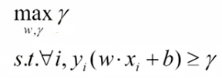
Largest Margin
Prediction = sign (w.x+b)
Confidence of prediction:
=(w.x+b) y
For i^{th} data point:
ᵧ_{i}= (w.x_{i}+b)y
Can be rewritten as
a
w
ᵧ
c
ᵧ
ᵧ
w.x+b=0

Slide 11
Support Vectors
w.x+b=0
Points that are closest to the decision surface are called Support vectors.
A data set must have a minimum of two support vectors but there can be more than two.
Support vectors determine the equation of the line.

Slide 12
Advantages and disadvantages of SVM
Effective in high dimensional spaces.
Can also be used when the number of dimensions are greater than the samples.
Stores only the Support vectors in RAM hence memory efficient.
Cannot perform well when we have large data set because the required training time is higher.
Cannot handle noise in the data.

Slide 13
Summary
Support Vector Machines and its mathematical intution

