Slide 1

Classification using Naïve Bayes Theorm
Prof.Aruna Ranganath

Slide 2
Today’s Agenda
Conditional Probability
Bayes Theorem
Naïve Bayes classifier

Slide 3
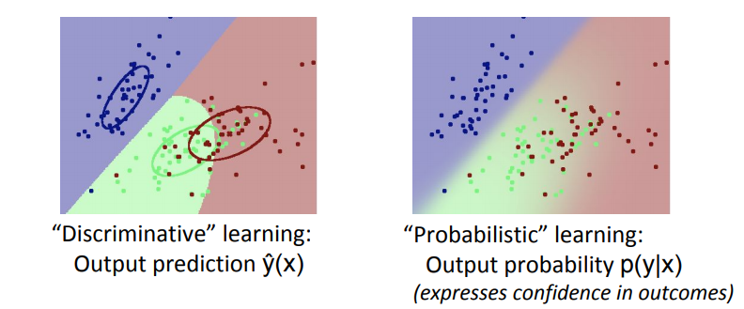
Probabilistic vs. Discriminative learning
Probabilistic” learning
Conditional models just explain y: p(y|x)
Generative models also explain x: p(x,y)
Often a component of unsupervised or semi-supervised learning
Bayes and Naïve Bayes classifiers are generative models

Slide 4
Conditional Probability and Naïve Bayes

Slide 6
Three flavors of Naïve Bayes
Bernoulli naive bayes: Assumes that each feature is a binary random variable.
Multinomial naive bayes: Assumes each feature is a random variable having discrete count.
Gaussian naive bayes: Assumes each feature is a random variable having continuous value.

Slide 7
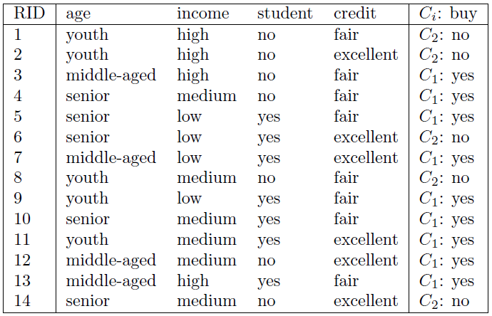
X = (age = youth, income = medium, student = yes, credit = fair)

Slide 8
Example
We need to maximize P(X|Ci)P(Ci), for i = 1, 2. P(Ci), the a priori probability of each class, can be estimated based on the training samples:
P(buy = yes) = 9 / 14
P(buy = no) = 5 / 14
To compute P(X|Ci), for i = 1, 2, we compute the following conditional probabilities:
P(age = youth|buy = yes) = 2/9
P(age = youth|buy = no) = 3/ 5
P(income = medium|buy = yes) = 4 / 9
P(income = medium|buy = no) = 2 / 5
P(student = yes|buy = yes) = 6 / 9
P(student = yes|buy = no) = 1 / 5
P(credit = fair|buy = yes) = 6 / 9
P(credit = fair|buy = no) = 2 / 5

Slide 9
Example (contd..)
Using the probabilities from previous slide, we obtain
P(X|buy = yes) = P(age = youth|buy = yes)
=P(income = medium|buy = yes)
=P(student = yes|buy = yes)
=P(credit = fair|buy = yes)
= 2 / 9 * 4 / 9 * 6 / 9 * 6 / 9
= 0.044.

Slide 10
Example (contd..)
Similarly,
P(X|buy = no) = 3/5 * 2 /5 * 1 / 5 * 2 / 5
= 0.019
To find the class that maximizes P(X|Ci)P(Ci), we compute
P(X|buy = yes)P(buy = yes) = 0.028
P(X|buy = no)P(buy = no) = 0.007
Thus the naive Bayesian classifier predicts buy = yes for sample X.

Slide 11
Sentiment Analysis using Naïve Bayes classifier
“(1) I bought an iPhone a few days ago. (2) It was such a nice phone. (3) The touch screen was really cool. (4) The voice quality was clear too. (5) Although the battery life was not long, that is ok for me. (6) However, my mother was mad with me as I did not tell her before I bought it. (7) She also thought the phone was too expensive, and wanted me to return it to the shop. … ”

Slide 12
Modelling Sentiment Analysis problem
The solution to the Sentiment Analysis problem depends on the granularity of the sentiment
Positive / Negative or 1 to 5 stars : (Binary Classification / Multiclass classification)
Naïve Bayes, and support vector machines (SVM),Logistic regression and Maximum Entropy etc..
Regression if the Sentiment is a continuous value between 1 to 5

Slide 13
The Multinomial Naive Bayes’ Classifier

Slide 14
The Multinomial Naive Bayes’ Classifier

Slide 15
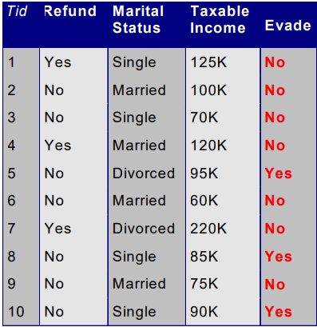
Gaussian naive bayes
P(X|Class=No) = P(Refund=No|Class=No) X P(Married| Class=No) X P(Income=120K| Class=No) = 4/7 X 4/7 X 0.0072 = 0.0024 X
P(X|Class=Yes) = P(Refund=No| Class=Yes) X P(Married| Class=Yes) X P(Income=120K| Class=Yes) = 1 X 0 X 1.2 X 10-9 = 0
X = (Refund = No, Married, Income =120K)

Slide 16
Naïve Bayes
Robust to noise points.
Handle missing values by ignoring the instance during probability estimate calculations.
Independence assumption may not hold for some attributes in that case we need to work with Bayesian Belief Networks.

Slide 17
Prediction
Actual = [1, 0, 1, 1, 0, 1, 0, 0]
Prediction = [1, 0, 0, 1, 0, 1, 1, 1]

Slide 18
Accuracy Measure
Actual = [1, 0, 1, 1, 0, 1, 0, 0]
Prediction = [1, 0, 0, 1, 0, 1, 1, 1]
Accuracy = proportion of correctly predicted examples (0 and 1 both)

Slide 19
Accuracy Measure
Actual = [1, 0, 1, 1, 0, 1, 0, 0]
Prediction = [1, 0, 0, 1, 0, 1, 1, 1]
Accuracy = ?

Slide 20
Accuracy Measure
Actual = [1, 0, 1, 1, 0, 1, 0, 0]
Prediction = [1, 0, 0, 1, 0, 1, 1, 1]
Accuracy = 5/8
= 0.625

Slide 21
Problem with Accuracy Measure
99 0’s
Actual = [1, 0, 0, 0, 0, 0, 0, 0, …,0 ]
Prediction = [0, 0, 0, 0, 0, 0, 0, 0,…, 0]
Dumb classifier
Accuracy = ?

Slide 22
Problem with Accuracy Measure
99 0’s
Actual = [1, 0, 0, 0, 0, 0, 0, 0, …,0 ]
Prediction = [0, 0, 0, 0, 0, 0, 0, 0,…, 0]
Dumb classifier
Accuracy = 99/100
= 0.99

Slide 23
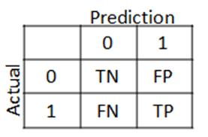
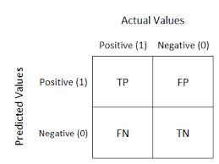
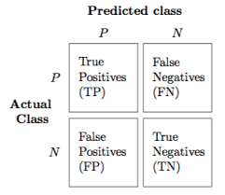
Towards a Better Measure
True Positive (TP) False Positive (FP) True Negative (TN)
False Negative (FP)
Multiple ways to draw the confusion matrix

Slide 24
Towards a Better Measure
True Positive (TP) False Positive (FP) True Negative (TN)
False Negative (FP)
Actual = [1, 0, 1, 1, 0, 1, 0, 0]
Prediction = [1, 0, 0, 1, 0, 1, 1, 1]

Slide 25
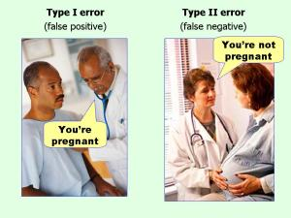
Towards a Better Measure
True Positive (TP) False Positive (FP) True Negative (TN)
False Negative (FP)
Actual = [1, 0, 1, 1, 0, 1, 0, 0]
Prediction = [1, 0, 0, 1, 0, 1, 1, 1]

Slide 26
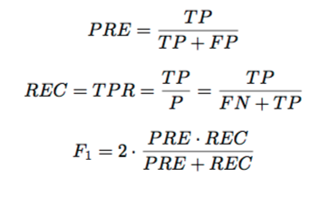
Metrics to Evaluate a Classifier
Accuracy
Precision
Recall
F1-score
Actual = [1, 0, 1, 1, 0, 1, 0, 0]
Prediction = [1, 0, 0, 0, 0, 1, 1, 1]

Slide 27
Metrics to Evaluate a Classifier
Accuracy
Precision
Recall
F1-score
Actual = [1, 0, 1, 1, 0, 1, 0, 0]
Prediction = [1, 0, 0, 0, 0, 1, 1, 1]

Slide 28
Summary
Conditional Probability
Bayes rule
Naïve Bayes classifier
Classification Metrics

