Slide 1

Classification using Decision Trees and Ensemble Methods
Prof.Aruna Ranganath

Slide 2
Today’s agenda
The Algorithm
Attribute Selection Measures
Tree Pruning
Scalability and Decision Tree Induction

Slide 3
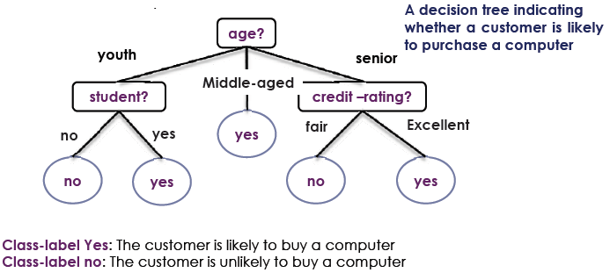
Decision Tree Induction
Decision tree induction is the learning of decision trees from class labeled training tuples
A decision tree is a flowchart-like tree structure
Internal nodes (non leaf node) denotes a test on an attribute
Branches represent outcomes of tests
Leaf nodes (terminal nodes) hold class labels
Root node is the topmost node

Slide 4
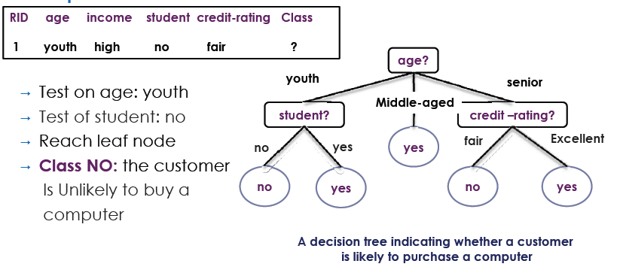
Decision Tree Induction
How are decision trees used for classification?
The attributes of a tuple are tested against the decision tree
A path is traced from the root to a leaf node which holds the prediction for that tuple

Slide 5
Decision Tree Induction
Why decision trees classifiers so popular?
The construction of a decision tree does not require any domain knowledge or parameter setting
They can handle high dimensional data
Intuitive representation that is easily understood by humans
Learning and classification are simple and fast
They have a good accuracy
Applications
Medicine, astronomy
financial analysis, manufacturing
And many other applications

Slide 6
The Algorithm
Principle
Basic algorithm (adopted by ID3, C4.5 and CART): a greedy algorithm
Tree is constructed in a top-down recursive divide-and-conquer manner
Iterations
At start, all the training tuples are at the root
Tuples are partitioned recursively based on selected attributes
Test attributes are selected on the basis of a heuristic or statistical measure (e.g., information gain)
Stopping conditions
All samples for a given node belong to the same class
There are no remaining attributes for further partitioning .– majority voting is employed for classifying the leaf
There are no samples left

Slide 7
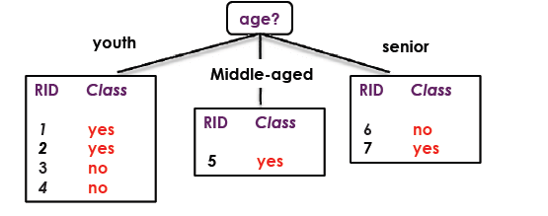
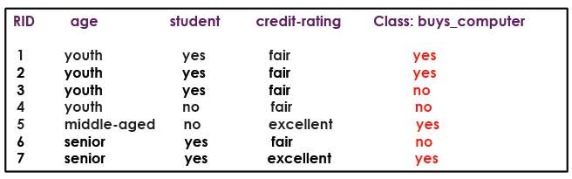
Example

Slide 8
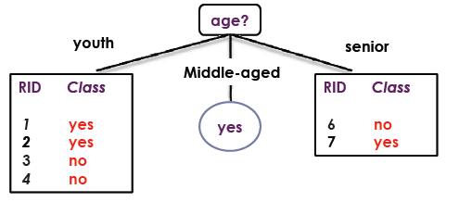
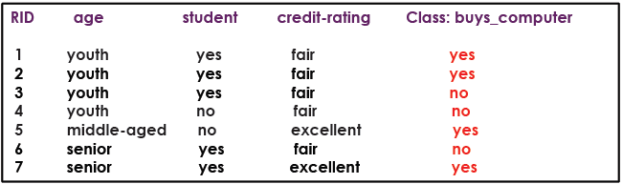
Example

Slide 9
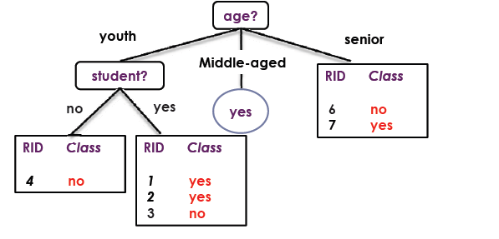
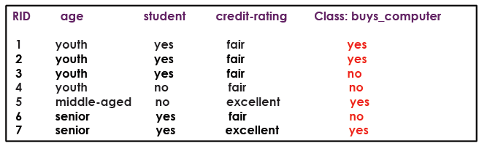
Example

Slide 10
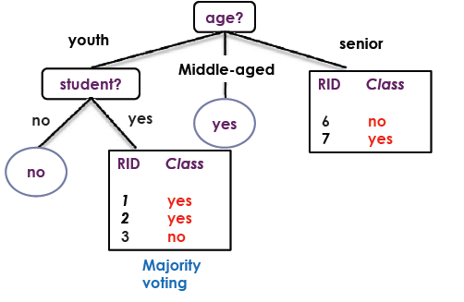
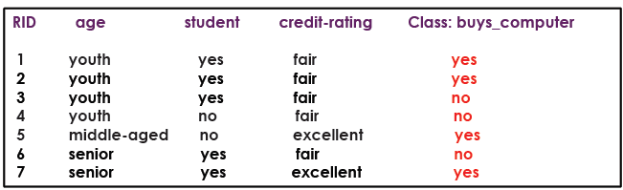
Example

Slide 11
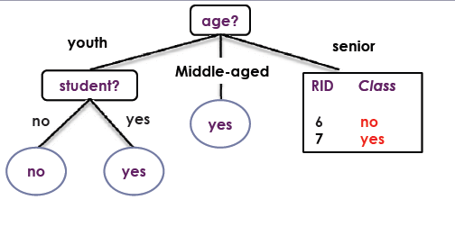
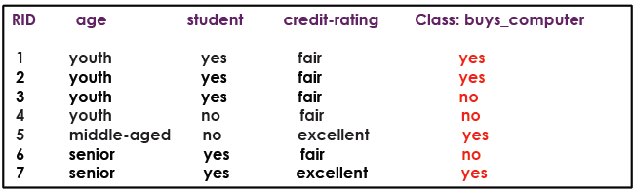
Example

Slide 12
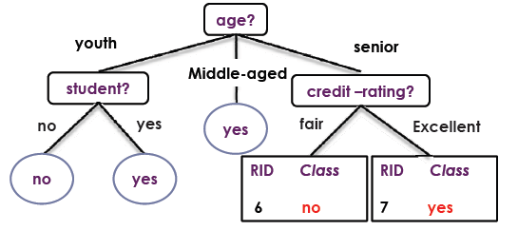
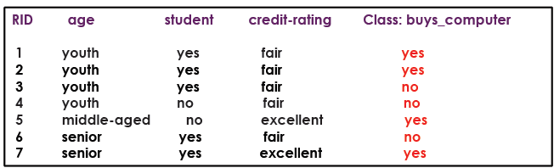
Example

Slide 13
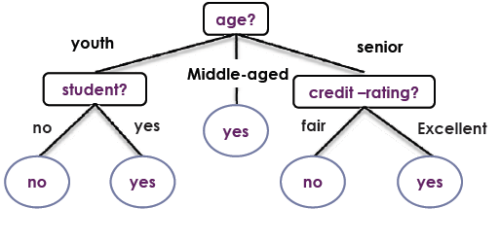
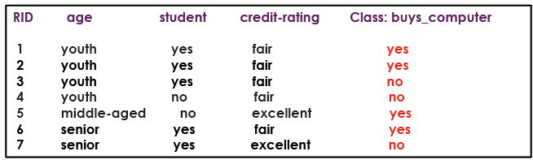
Example

Slide 14
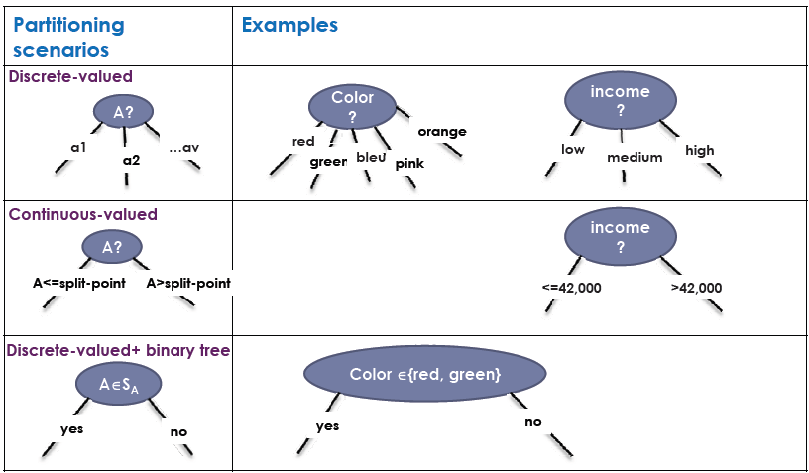
Three Possible Partition Scenarios

Slide 15
Attribute Selection Measures
An attribute selection measure is a heuristic for selecting the splitting criterion that .“best.” separates a given data partition D Ideally
Each resulting partition would be pure
A pure partition is a partition contain tuples that all belong to the same class
Attribute selection measures (splitting rules)
Determine how the tuples at a given node are to be split
Provide ranking for each attribute describing the tuples
The attribute with highest score is chosen
Determine a split point or a splitting subset
Methods
Information gain
Gain ratio
Gini Index

Slide 16
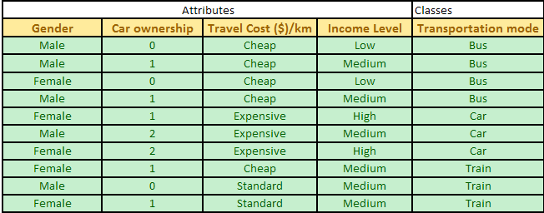
Example

Slide 17
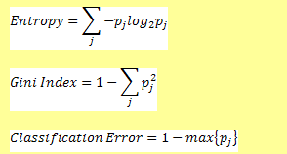
Example
All above formulas contain values of probability of a class j.
In our example, the classes of Transportation mode below consist of three groups of Bus, Car and Train. In this case, we have 4 buses, 3 cars and 3 trains (in short we write as 4B, 3C, 3T). The total data is 10 rows.

Slide 18
Example
Based on these data, we can compute probability of
each class. Since probability is equal to frequency
relative, we have
Prob (Bus) = 4 / 10 = 0.4
Prob (Car) = 3 / 10 = 0.3
Prob (Train) = 3 / 10 = 0.3
Example: Given that Prob (Bus) = 0.4, Prob (Car) = 0.3 and
Prob (Train) = 0.3,
we can now compute entropy as
Entropy = – 0.4 log₂ (0.4) – 0.3 log₂ (0.3) – 0.3 log₂ (0.3) = 1.571

Slide 19
Gini Index
Given that Prob (Bus) = 0.4, Prob (Car) = 0.3 and Prob (Train) = 0.3, we can now compute Gini index as
Gini Index = 1 – (0.4^2 + 0.3^2 + 0.3^2) = 0.660
Gini index of a pure table (consist of single class) is zero because the probability is 1 and 1-(1)^2 = 0.

Slide 20
Classification error
Example: Given that Prob (Bus) = 0.4, Prob (Car) = 0.3 and Prob (Train) = 0.3, index of classification error is given as
Classification Error Index = 1 – Max{0.4, 0.3, 0.3} = 1 - 0.4 = 0.60
Similar to Entropy and Gini Index, Classification error index of a pure table (consist of single class) is zero because the probability is 1 and 1-max(1) = 0.

Slide 21
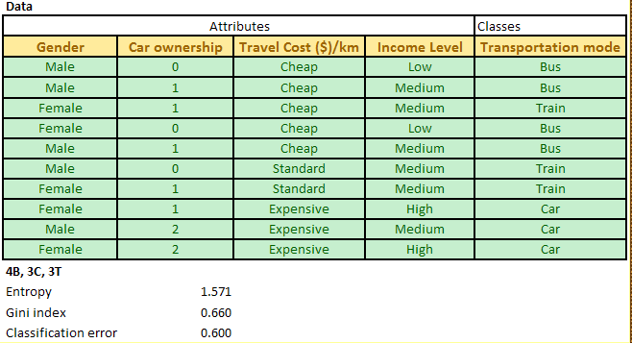

Slide 22
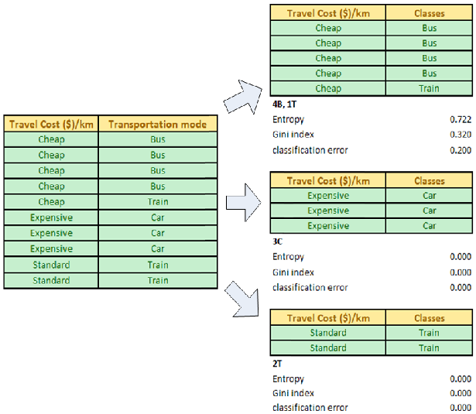

Slide 23
Information gain
Information gain (i) = Entropy of parent table D – Sum (n k /n * Entropy of each value k of subset table Si )
For example, our data table D has classes of 4B, 3C, 3T which produce entropy of 1.571. Now we try the attribute Travel cost per km which we split into three: Cheap that has classes of 4B, 1T (thus entropy of 0.722), Standard that has classes of 2T (thus entropy = 0 because pure single class) and Expensive with single class of 3C (thus entropy also zero).
The information gain of attribute Travel cost per km is computed as 1.571 – (5/10 * 0.722 +2/10* 0+3/10 *0) = 1.210

Slide 24


Slide 25
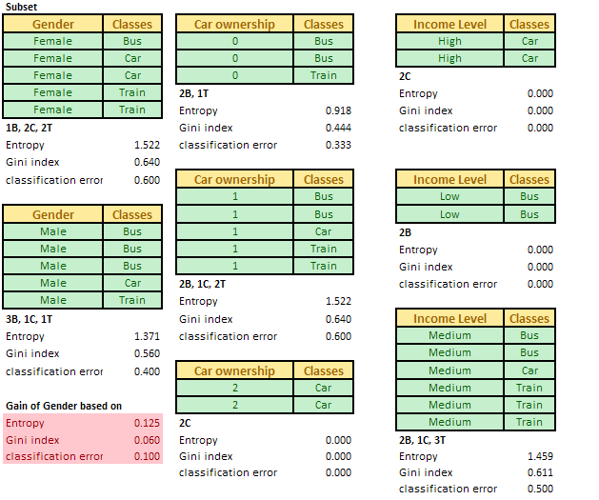


Slide 26
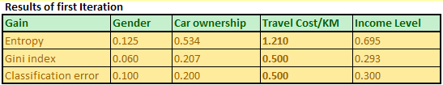

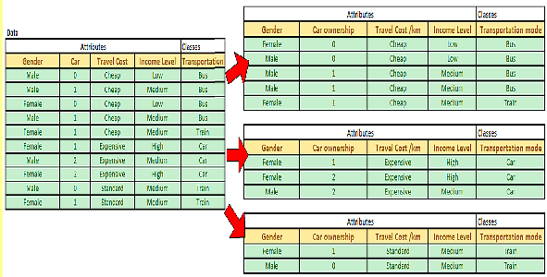

Slide 27
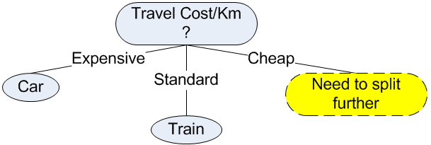

Slide 28
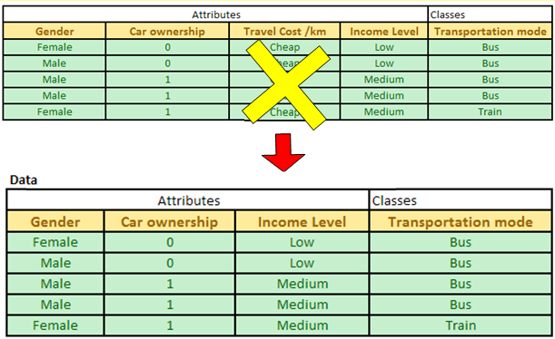
Second Iteration
Now we have only three attributes: Gender, car ownership and Income level.
Notes:
In the second iteration, we need to update our data table. Since Expensive and Standard Travel cost/km have been associated with pure class, we do not need these data any longer. For second iteration, our data table D is only come from the Cheap Travel cost/km. We remove attribute travel cost/km from the data because they are equal and redundant.

Slide 29
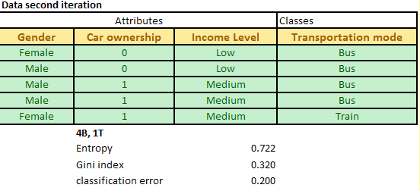
Then, we repeat the procedure of computing degree of impurity and information gain for the three attributes.

Slide 30
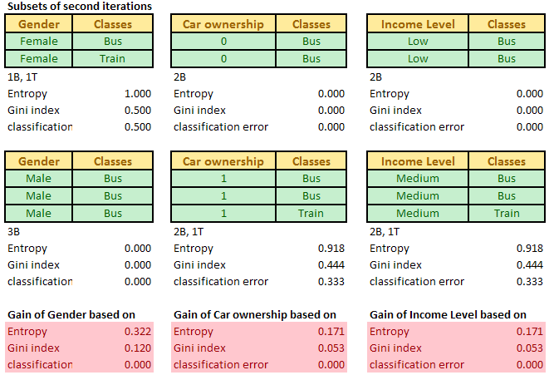
Notes:
The maximum gain is obtained for the optimum attribute Gender. Once we obtain the optimum attribute, the data table is split according to that optimum attribute. In our case, Male Gender is only associated with pure class Bus, while Female still need further split of attribute.

Slide 31
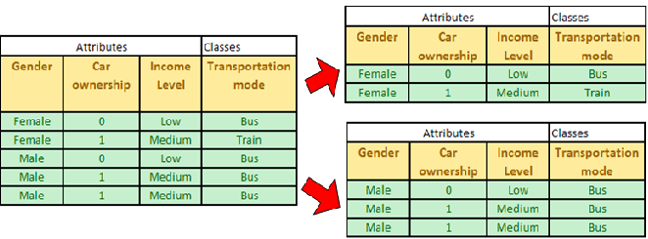
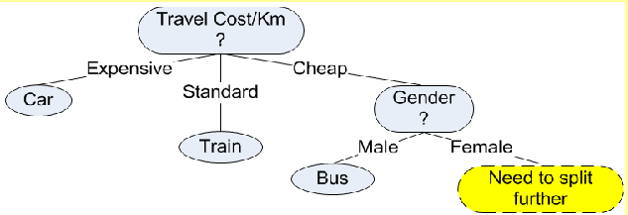
Notes:
Next Iteration of Decision Tree Algorithm
By Kardi Teknomo, PhD.
< Previous | Next | Content>
Second Iteration
In the second iteration, we need to update our data table. Since Expensive and Standard Travel cost/km have been associated with pure class, we do not need these data any longer. For second iteration, our data table D is only come from the Cheap Travel cost/km. We remove attribute travel cost/km from the data because they are equal and redundant.
Now we have only three attributes: Gender, car ownership and Income level. The degree of impurity of the data table D is shown in the picture below.
Then, we repeat the procedure of computing degree of impurity and information gain for the three attributes. The results of computation are exhibited below.
The maximum gain is obtained for the optimum attribute Gender. Once we obtain the optimum attribute, the data table is split according to that optimum attribute. In our case, Male Gender is only associated with pure class Bus, while Female still need further split of attribute.
Using this information, we can now update our decision tree. We can add node Gender which has two values of male and female. The pure class is related to leaf node, thus Male gender has leaf node of Bus. For Female gender, we need to split further the attributes in the next iteration.

Slide 32
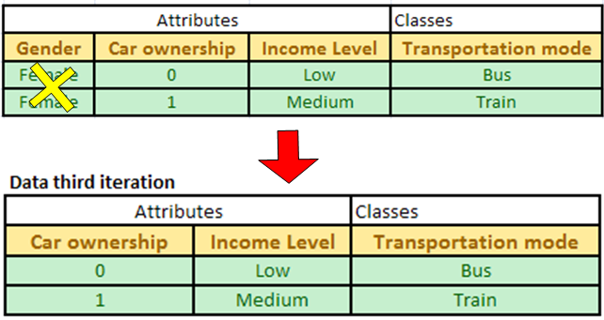
Third Iteration
Notes:
Data table of the third iteration comes only from part of the data table of the second iteration with male gender removed (thus only female part). Since attribute Gender has been used in the decision tree, we can remove the attribute and focus only on the remaining two attributes: Car ownership and Income level.
If you observed the data table of the third iteration, it consists only two rows. Each row has distinct values. If we use attribute car ownership, we will get pure class for each of its value. Similarly, attribute income level will also give pure class for each value. Therefore, we can use either one of the two attributes. Suppose we select attribute car ownership, we can update our decision tree into the final version

Slide 33
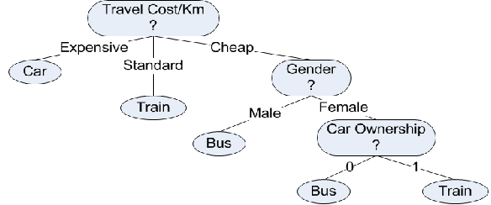

Slide 34
Ensemble Methods
Bagging (Bootstrap Aggregator)
Boosting

Slide 35
Random Forest
Base Learners are Decision Trees
DT1
Decision Trees generally has
Low Bias
High Variance
Which can be overcome by building multiple decision Trees
DT2
Data Set is split into multiple subsets using Random Sampling with replacement
DT3
DT4
Aggregator
Bootstapping
DT5

Slide 36
Summary
Conditional Probability
Bayes rule
Naïve Bayes classifier
Classification Metrics

